Slide 1
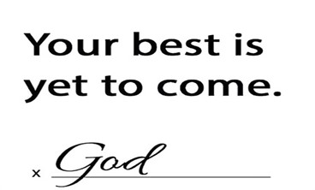
2024

Slide 2
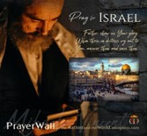

Psalm 17:7-9 -Complete Jewish Bible
⁷ Show how wonderful is your grace, savior of those who seek at your right hand refuge from their foes. ⁸ Protect them like the pupil of your eye, hide them in the shadow of your wings ⁹ from the wicked, who are assailing them, from their deadly enemies, who are all around them.
And All of the Innocent Victims
on Both Sides

Slide 3
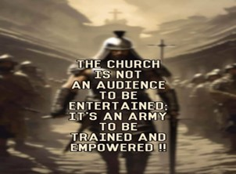
Repeat
These are the 2 Most Important Hours of My Week – Help Me to Cherish Them
I Am Here Today to Worship
Not to Be Entertained
I Am Singing to An Audience of One
Accept My Worship Oh Lord!

Slide 4
Repeat
I Lift My Offering to You
Let It Please You Oh Lord
This is My Seed
Although It Leaves My Hand
It will Never Leave My Life
You Will Multiply It!
Accept My Seed Oh Lord!

Slide 5
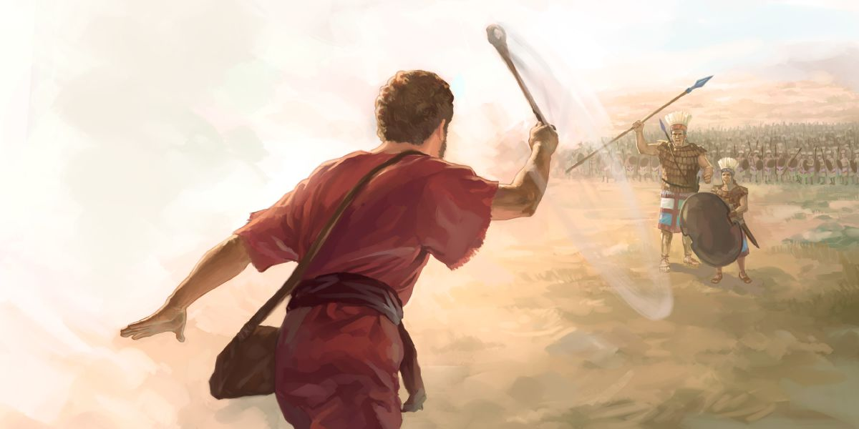
Lessons learned from a “Rock Fight”
April 7, 2024
I Sam 17
Edward Christian Church

Slide 6
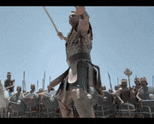
David and Goliath
Many Sermons Preached…
Most from David's Viewpoint.
Today- from Goliath's Viewpoint

Slide 7
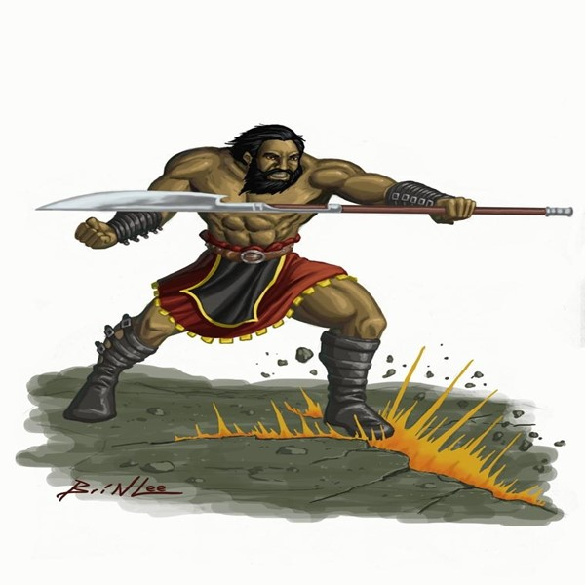

Goliath
This was Another Day at the Office for Goliath
Goliath= Beheader
Champion= Gap-stander
Challenger= 40 days unanswered
Beheaded Israel w-out a fight
Typical Warfare for Goliath
Then He Met a Little Shepherd Boy…
...Goliath's Perspective Was About To Change

Slide 8
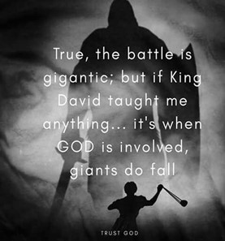
There are Five Things that Goliath Did to Bring
...His Defeat by David the Shepherd Boy
…Five Misconceptions
He is Still Using These Five Things…
…to Bring Us Down
We Must Never Allow these Things…
…on the Spiritual Battlefields of Life
This Should Bring Hope to Us in Our Battles...

Slide 9
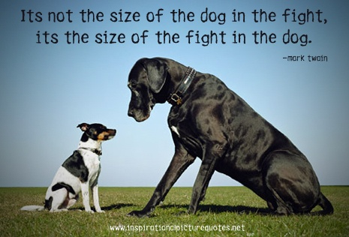
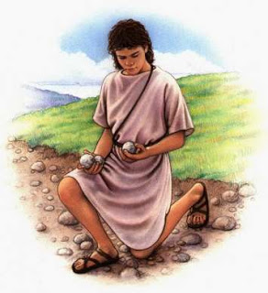
He Judged the Outcome by the… “Size of His Opponent”
(42) ".he disdained him; for he was only a youth"
Goliath was Insulted
Boy was Sent
Not Mighty Experienced Warrior
He Laughed and Mocked
He Had Already Determined Winner
An Easy..Quick Victory
Big Mistake!

Slide 10
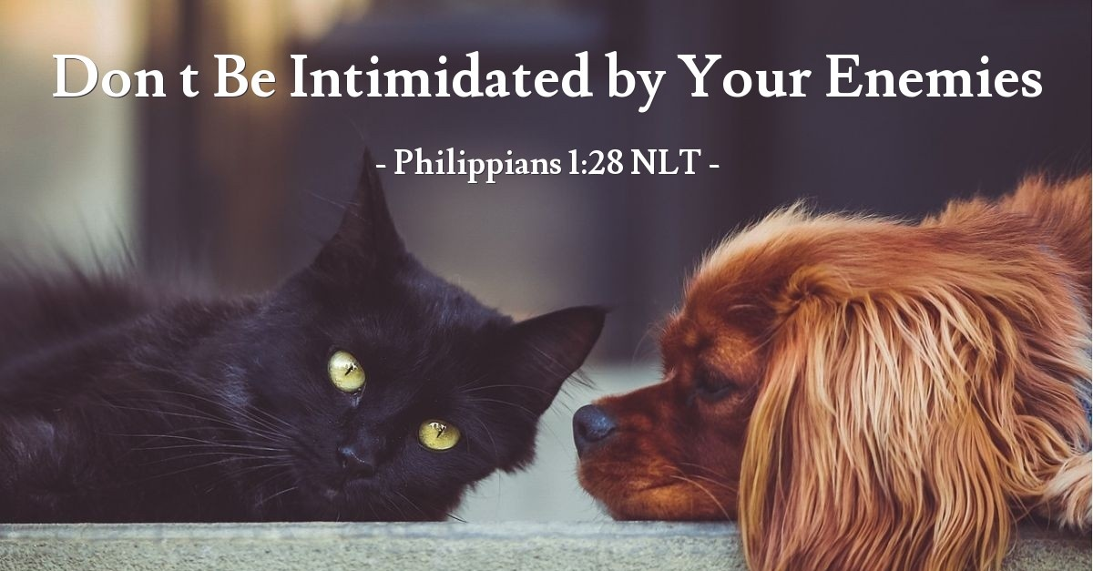
Satan Works Through Intimidation
1 Pet 5:8, “Be sober, be vigilant; because your adversary the devil, as a roaring lion, walketh about, seeking whom he may devour:
Phil 1:28, “in nothing terrified by your adversaries:
which is to them an evident token of perdition, but
to you of salvation, and that of God”
1 Tim 4:12, "Let no man despise thy youth;
but be thou an example of the believers...”

Slide 11
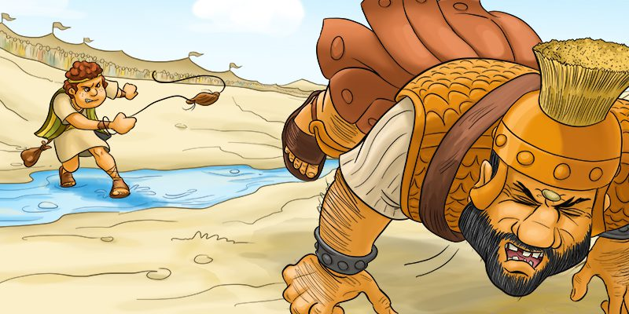
He Judged the Outcome by the… “Size of His Opponent”
Mightiest Things Wrapped in Tiny Packages
Tiny Atom has Ability of Massive Destruction
Small Rattlesnake as Deadly as Large One.
the Midians Overthrown by Gideon's 300.
Elijah / his Servant Stopped the Syrians.

Slide 12

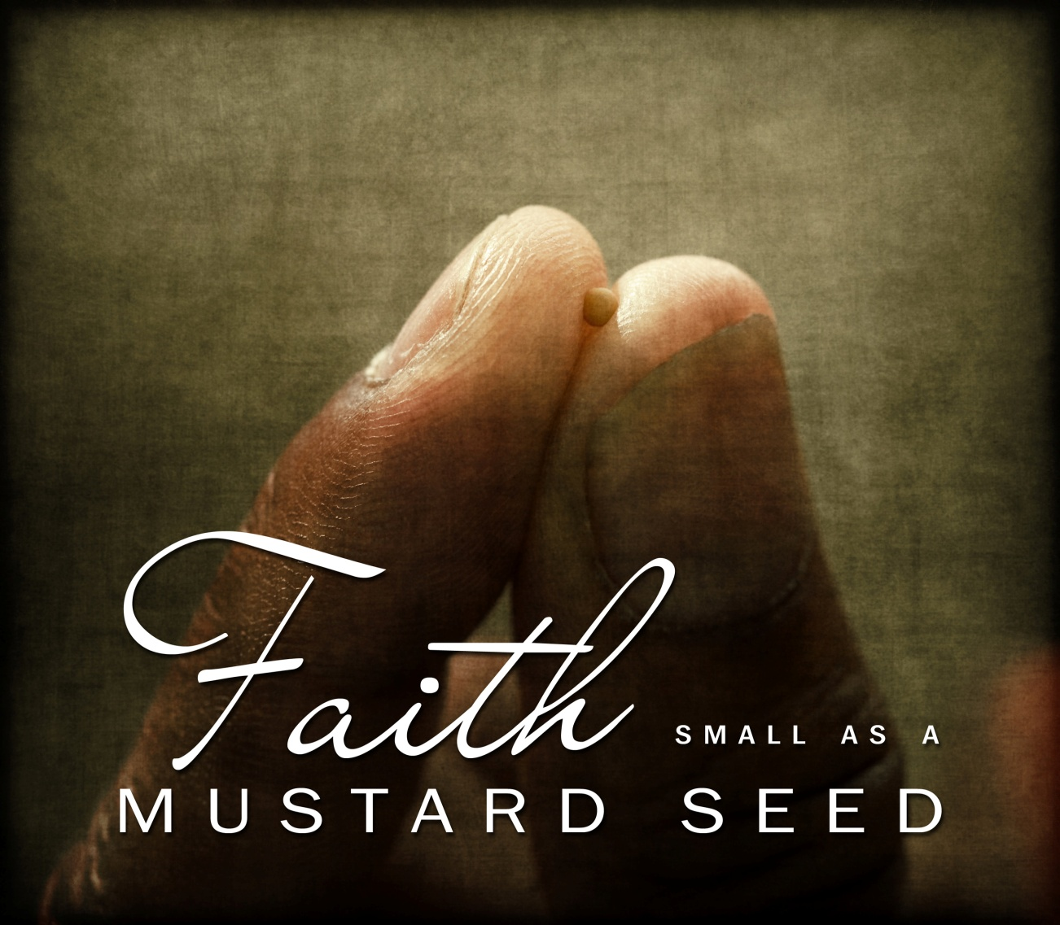
He Judged the Outcome by the… “Size of His Opponent”
The Power of “Mustard Seed Faith”
Smallest Seed
Powerful Results
Matt 17:20, “Jesus said unto them, Because of your
unbelief: for verily I say unto you, If ye have faith as a
grain of mustard seed, ye shall say unto this mountain,
Remove hence to yonder place; and it shall remove;
and nothing shall be impossible unto you”

Slide 13
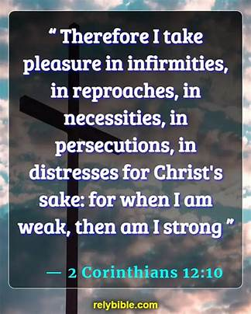
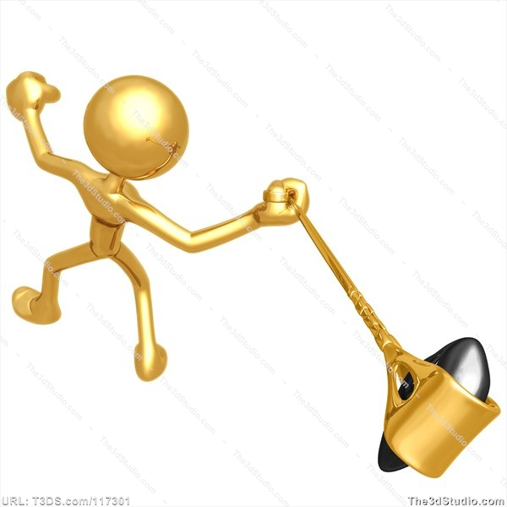
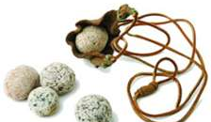
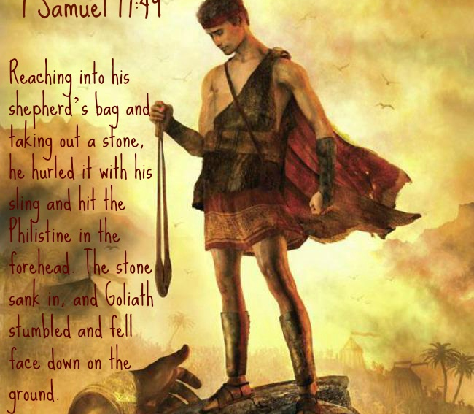
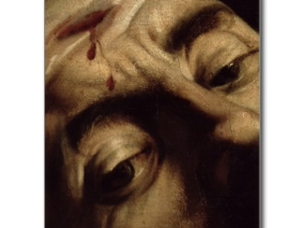
2 Corinthians 12:10 Amplified
¹⁰ So I am well pleased with weaknesses, with insults, with distresses, with persecutions, and with difficulties, for the sake of Christ; for when I am weak [in human strength], then I am strong [truly able, truly powerful, truly drawing from God’s strength].

Slide 15
A severe rash prompted a man from a rural area to come to town to be examined by one of my colleagues. After the usual history-taking followed by a series of test, the physician advised the patient that he would have to get rid of the dog that was evidently causing the allergic reaction. As the man was preparing to leave the office, my colleague asked him out of curiosity if he planned to sell the animal or give it away. "Neither one," the patient replied. "I’m going to get me one of them second opinions I been reading about. It’s a lot easier to find a doctor than a good bird dog."

