Slide 1
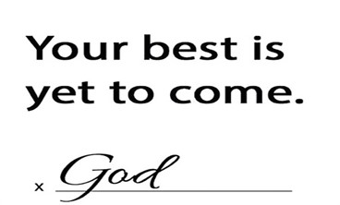
2024

Slide 2


Psalm 17:7-9 -Complete Jewish Bible
⁷ Show how wonderful is your grace,
savior of those who seek at your right hand
refuge from their foes.
⁸ Protect them like the pupil of your eye,
hide them in the shadow of your wings
⁹ from the wicked, who are assailing them,
from their deadly enemies, who are all around them.
And All of the Innocent Victims
on Both Sides

Slide 3
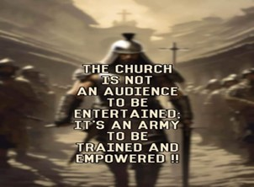
Repeat
These are the 2 Most Important Hours of My Week – Help Me to Cherish Them
I Am Here Today to Worship
Not to Be Entertained
I Am Singing to An Audience of One
Accept My Worship Oh Lord!

Slide 4
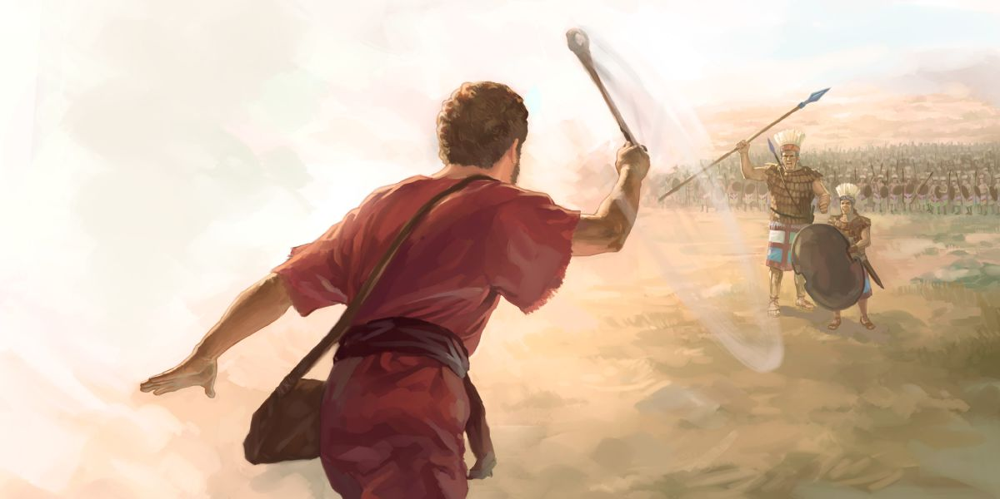
Lessons learned from a
“Rock Fight”
Pt 2
April 14, 2024
I Sam 17
Edward Christian Church

Slide 5
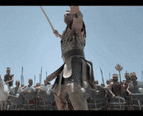
David and Goliath
Many Sermons Preached…
Most from David's Viewpoint.
Today- from Goliath's Viewpoint

Slide 6
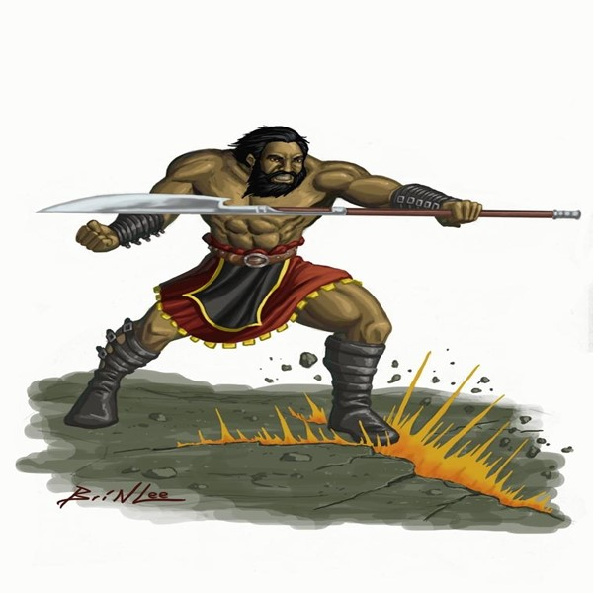

Goliath
This was Another Day at the Office for Goliath
Goliath= Beheader
Champion= Gap-stander
Challenger= 40 days unanswered
Beheaded Israel w-out a fight
Typical Warfare for Goliath
Then He Met a Little Shepherd Boy…
...Goliath's Perspective Was About To Change

Slide 7
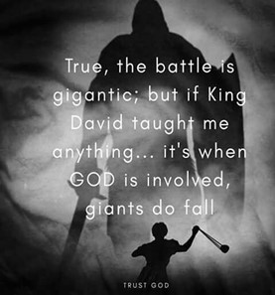
There are Five Things that Goliath Did to Bring
...His Defeat by David the Shepherd Boy
…Five Misconceptions
He is Still Using These Five Things…
…to Bring Us Down
We Must Never Allow these Things…
…on the Spiritual Battlefields of Life
This Should Bring Hope to Us in Our Battles...

Slide 8
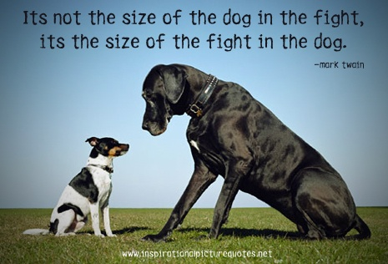
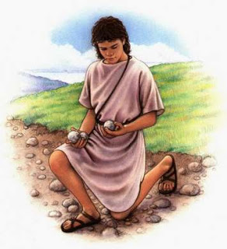
He Judged the Outcome by the…
“Size of His Opponent”
(42) ".he disdained him; for he was only a youth"
Goliath was Insulted
  Boy was Sent
  Not Mighty Experienced Warrior
He Laughed and Mocked
  He Had Already Determined Winner
  An Easy..Quick Victory
  Big Mistake!

Slide 9
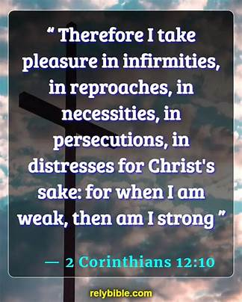
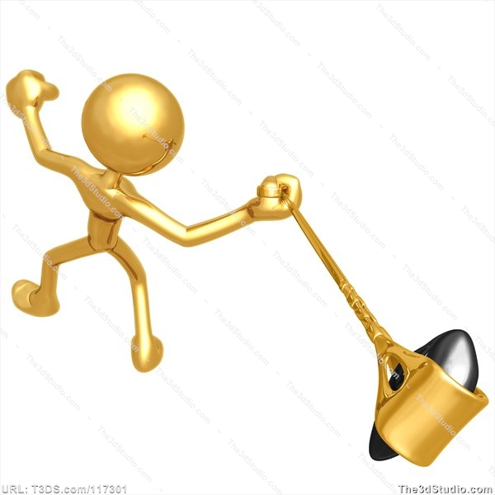
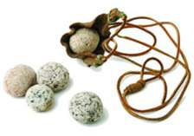
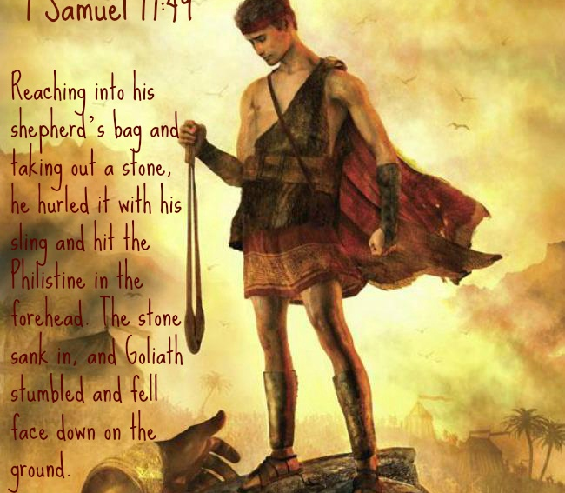
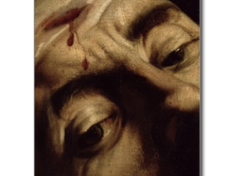
2 Corinthians 12:10 Amplified
¹⁰ So I am well pleased with weaknesses, with insults, with distresses, with persecutions, and with difficulties, for the sake of Christ; for when I am weak [in human strength], then I am strong [truly able, truly powerful, truly drawing from God’s strength].

Slide 10

He Did Not Respect His…
…“Opponent's Weapon” (43)
Goliath Saw the Sling as an Insult - not worth time
  Sling looked Primitive and Harmless.
  Goliath had No Respect for It
  that was His Downfall
  David was a Master at Sling
"Put on the whole armor of God,
that you may be able to stand against
the wiles of the devil.” Ephesians 6:11

Slide 11
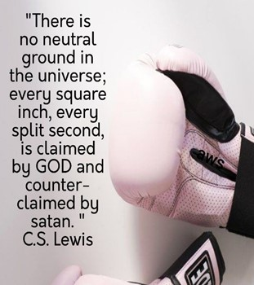
One of Our Biggest Dangers is…
When We Look At His Weapons Without..
    Respect
      Ineffective
      Out of Date
    Regard
      Do Not Use
      Don’t Think You Are Able

Slide 12
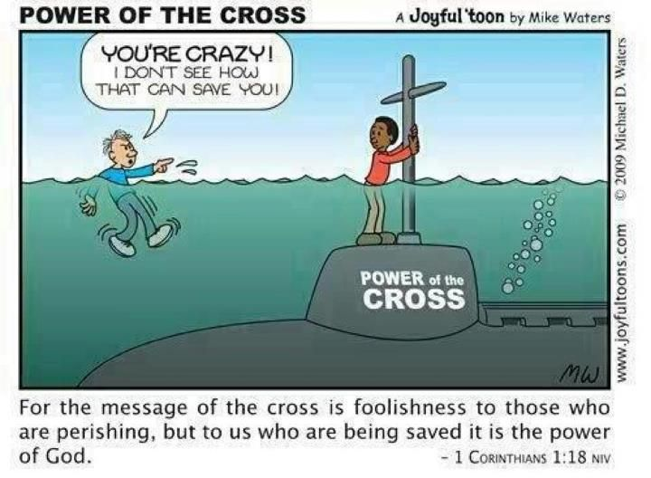
He Did Not Respect His…
… “Opponent's Weapon”
1 Cor 1:27, "But God hath chosen the foolish things of the world to confound the wise; and God hath chosen the weak things of the world to confound the things which are mighty”
Foolish- absurd / dull (moron)
Wise- skilled / learned (wisdom)
Weak-w-out strength-feeble
Mighty- powerful /strong in body / mind

Slide 13
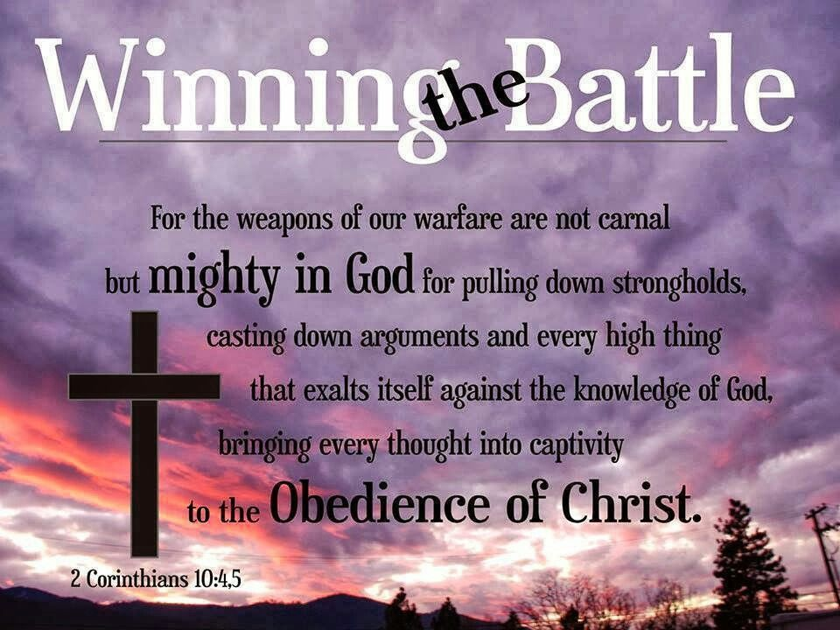
He Did Not Respect His…
… “Opponent's Weapon”
“For the weapons of our warfare are not carnal, but mighty through God to the pulling down of strong holds” - 2 Cor 10:4
  Weapons = Sword / Shield / Armor
  Warfare = Strategy
  Carnal = Pertaining to the Flesh/ Appetites
  Pulling Down = Demolish / Tear Down
  Strongholds = Fortress / Fortify / Build Against

Slide 14
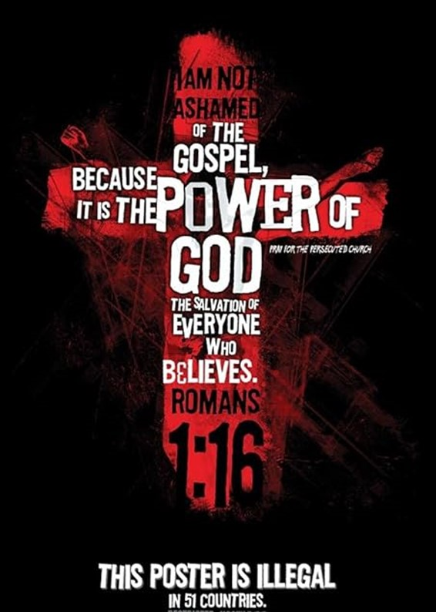
There’s a Reason for This…
But God has selected [for His purpose] the foolish things of the world to shame the wise [revealing their ignorance], and God has selected [for His purpose] the weak things of the world to shame the things which are strong [revealing their frailty]. 1 Cor 1:27 Amp
Tell Yourself Multiple Times a Day…
God Desires to Use Me…
…Esp with ALL of My Faults!!!
God Wants to Use Your Weakness
…to Shame the Wise

Slide 15
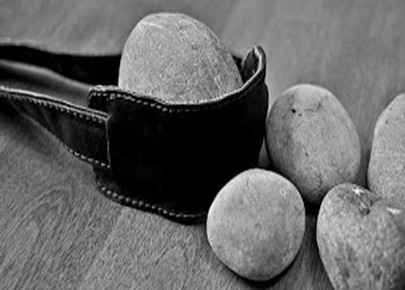
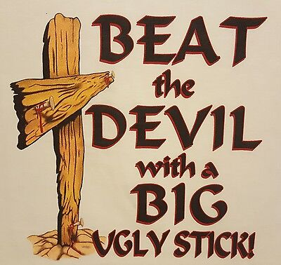

Slide 16
End Pt 2

Slide 17
Why don’t eggs tell jokes? They’d crack each other up.
I’m reading a book on anti-gravity. It’s impossible to put down!
I would tell you a construction joke, but I’m still working on it.
I used to play piano by ear, but now I use my hands.
What do you get when you cross a snowman and a vampire? Frostbite.
I’m so good at sleeping, I can do it with my eyes closed.

