Slide 1
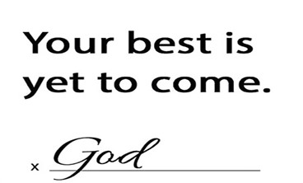
2024

Slide 2
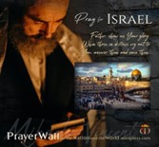

Psalm 17:7-9 -Complete Jewish Bible
⁷ Show how wonderful is your grace, savior of those who seek at your right hand refuge from their foes. ⁸ Protect them like the pupil of your eye, hide them in the shadow of your wings ⁹ from the wicked, who are assailing them, from their deadly enemies, who are all around them.
And All of the Innocent Victims
on Both Sides

Slide 3
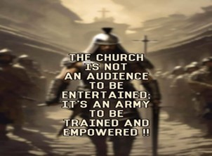
Repeat
These are the 2 Most Important Hours of My Week – Help Me to Cherish Them
I Am Here Today to Worship
Not to Be Entertained
I Am Singing to An Audience of One
Accept My Worship Oh Lord!

Slide 4
Repeat
I Lift My Offering to You
Let It Please You Oh Lord
This is My Seed
Although It Leaves My Hand
It will Never Leave My Life
You Will Multiply It!
Accept My Seed Oh Lord!

Slide 5
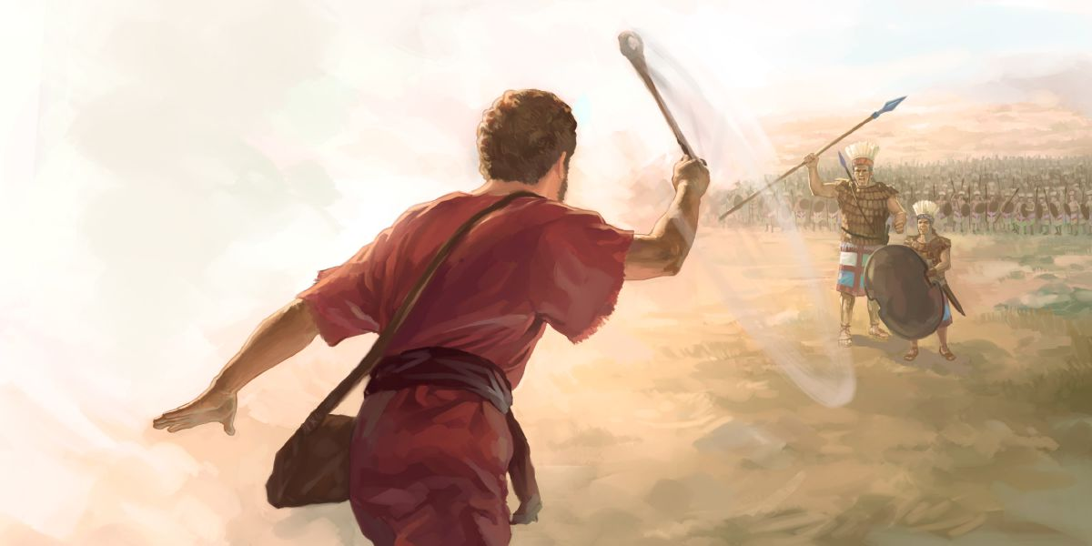
Lessons learned from a “Rock Fight” Pt 3
April 21, 2024
I Sam 17
Edward Christian Church

Slide 6
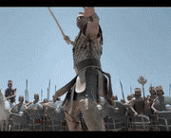
David and Goliath
Many Sermons Preached…
Most from David's Viewpoint.
Today- from Goliath's Viewpoint

Slide 7
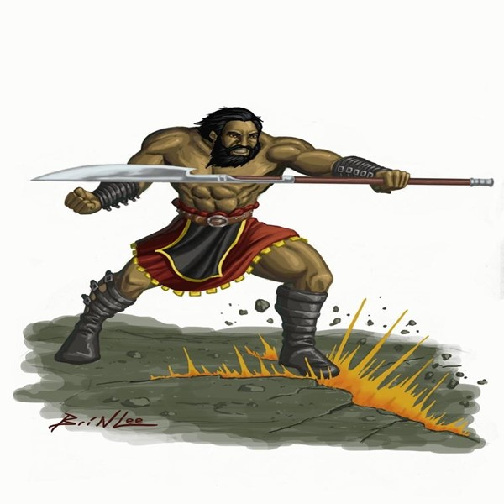

Goliath
This was Another Day at the Office for Goliath
Goliath= Beheader
Champion= Gap-stander
Challenger= 40 days unanswered
Beheaded Israel w-out a fight
Typical Warfare for Goliath
Then He Met a Little Shepherd Boy…
...Goliath's Perspective Was About To Change

Slide 8
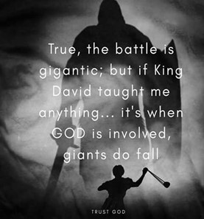
There are Five Things that Goliath Did to Bring
...His Defeat by David the Shepherd Boy
…Five Misconceptions
He is Still Using These Five Things…
…to Bring Us Down
We Must Never Allow these Things…
…on the Spiritual Battlefields of Life
This Should Bring Hope to Us in Our Battles...

Slide 9
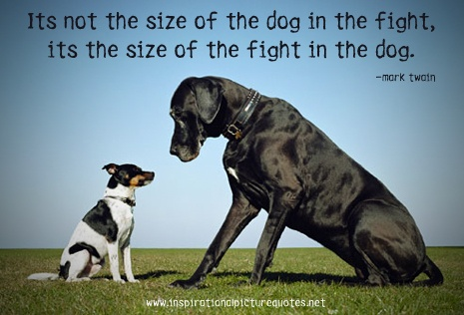
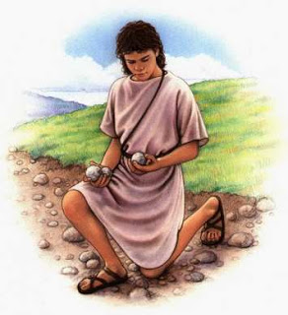
He Judged the Outcome by the… “Size of His Opponent”
(42) ".he disdained him; for he was only a youth"
Goliath was Insulted
Boy was Sent
Not Mighty Experienced Warrior
He Laughed and Mocked
He Had Already Determined Winner
An Easy..Quick Victory
Big Mistake!

Slide 10
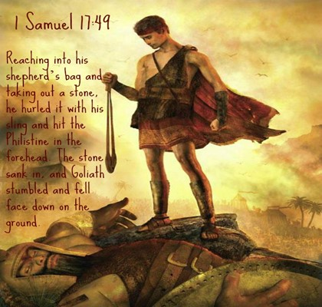
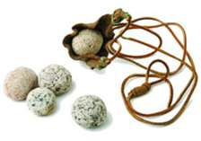
He Did Not Respect His… …“Opponent's Weapon” (43)
Goliath Saw the Sling as an Insult - not worth time
Sling looked Primitive and Harmless.
Goliath had No Respect for It
that was His Downfall
David was a Master at Sling
"Put on the whole armor of God,
that you may be able to stand against
the wiles of the devil.” Ephesians 6:11

Slide 11
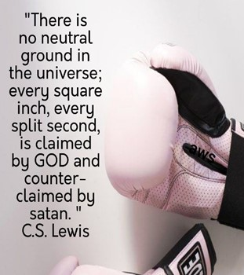
One of Our Biggest Dangers is…
When We Look At His Weapons Without..
Respect
Ineffective
Out of Date
Regard
Do Not Use
Don’t Think You Are Able

Slide 12
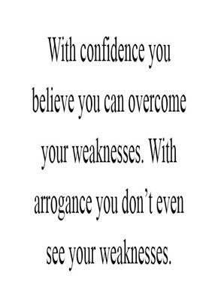
He was Overconfident (43)
It Never Once Entered His Mind that He Might Lose
Goliath asked, "Am I a dog?"
40 days...Nothing
Thought Nothing Would Change
Satan is Propelled by Pride..
….Isa 14:12-19

Slide 13
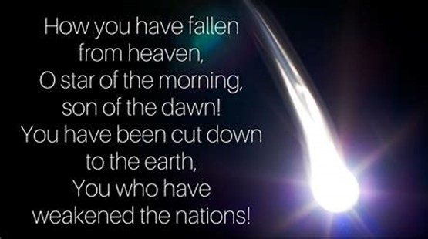
Satan Knows He's Defeated..
…His Pride Won’t Let Him Accept It

Slide 14
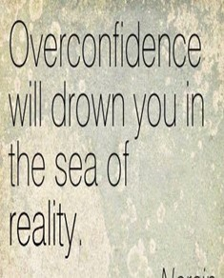
He was Overconfident
1 Cor 10:12 , “Wherefore let him that thinketh
he standeth take heed lest he fall”
It is possible to become Too Confident in your Strengths and Neglect Your Weaknesses.
Abraham was a Man of Faith.
Abe Lost His Faith Going Down to Egypt

Slide 15
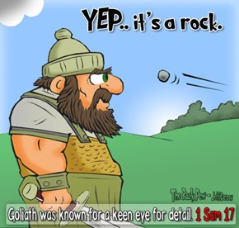
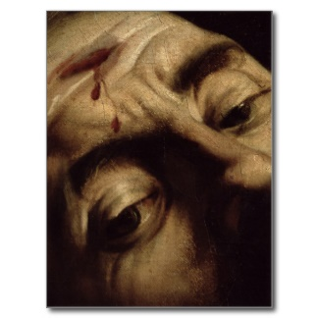
He Left a “Place of Vulnerability” Uncovered (49)
Who Would Have Thought It?
Out Of All Of His Body,
The One Open Place Small Opening On His Head
Satan Doesn't Play Fair
He Will Find the Uncovered Place…
…Play On It Until He Brings You Down.
…a Place of Broken Focus
Take No Chances
Cover Everything With the Blood

Slide 16
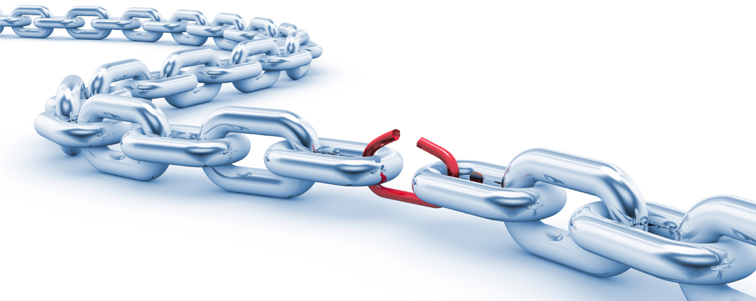
He Left a“Place of Vulnerability” Uncovered (49)
Satan is a Powerful Foe..
…But He Is Still Vulnerable
“Lest Satan should get an advantage of us: for we are not ignorant of his devices” -2 Cor 2:11
Devices= Plans, Strategy
The Beheader Lost His Head...
His Plans – Strategies Destroyed !

Slide 17
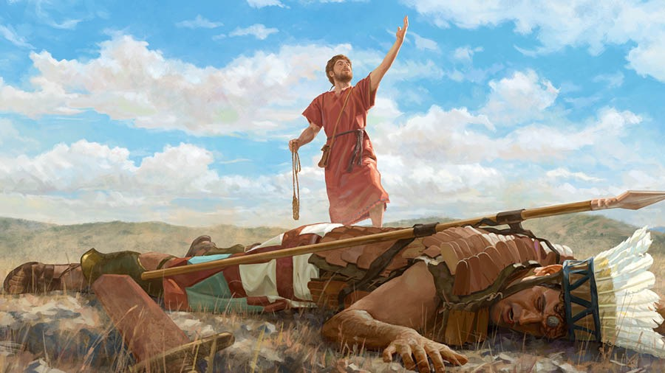
He Risked His Life on a Lost Cause
Goliath was on the Losing Side
Set Themselves Against God
God Will Always Win
Rev 20:3. ... 1k yrs Bottomless Pit..
….When Released He Still Attacks
2 Thes 2:8“then shall that Wicked be revealed, whom
The Lord shall consume with the spirit of his mouth/ Shall Destroy with the brightness of his coming”
All Jesus Has To Do Is Show Up!

Slide 18
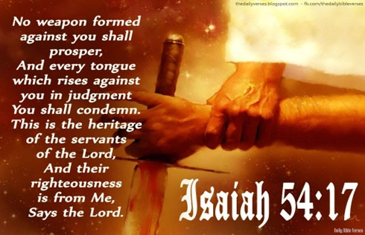
Remember Three Things in Our Daily Walk
The Battle is…
Not Imagined –Real
Eph 6:12 For our struggle is not against flesh and blood, but against the rulers, against the powers, against the world forces of this darkness, against the spiritual forces of wickedness in the heavenly places.
Not Ours –But His
2 Chro 20:15 And he said, Hearken ye, all Judah, and ye inhabitants of Jerusalem, and thou king Jehoshaphat, Thus saith the Lord unto you, Be not afraid nor dismayed by reason of this great multitude; for the battle is not yours, but God's.

Slide 19
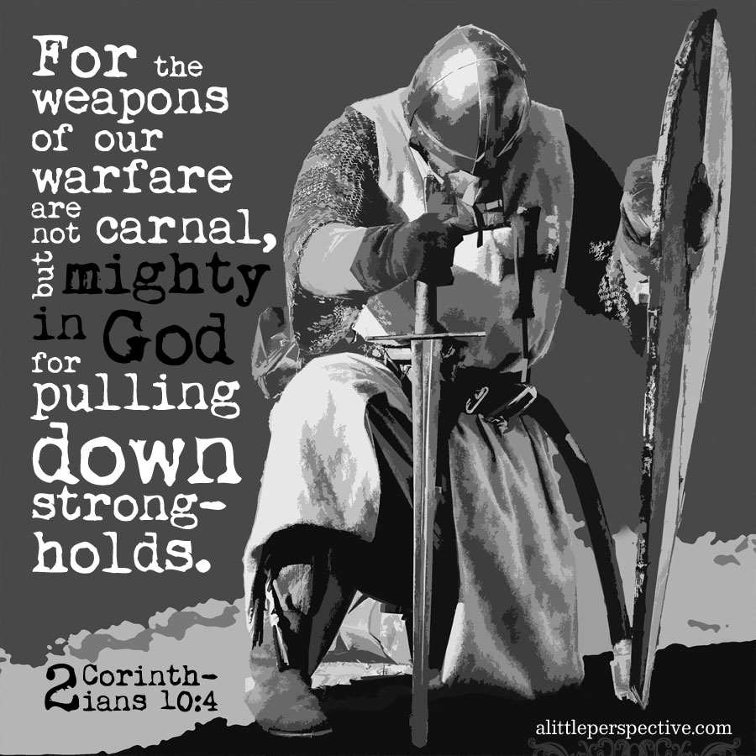
Remember Three Things in Our Daily Walk
The Battle is…
Not Imagined –Real
Not Ours –But His
Not Fought in Flesh –Mighty
⁴ We fight with weapons that are different from those the world uses. Our weapons have power from God that can destroy the enemy’s strong places. We destroy people’s arguments ⁵ and every proud thing that raises itself against the knowledge of God. We capture every thought and make it give up and obey Christ. 2 Cor 10:4-5 NCV

Slide 20
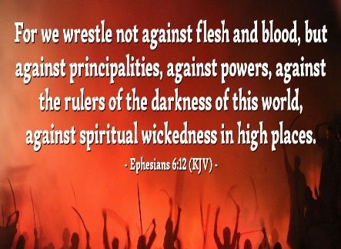


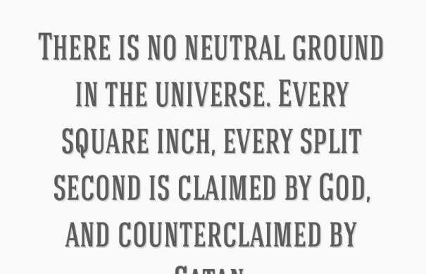
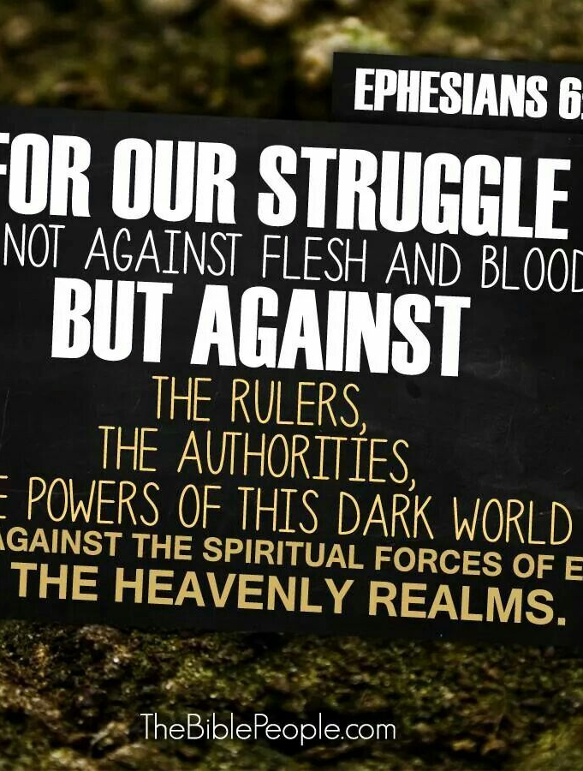
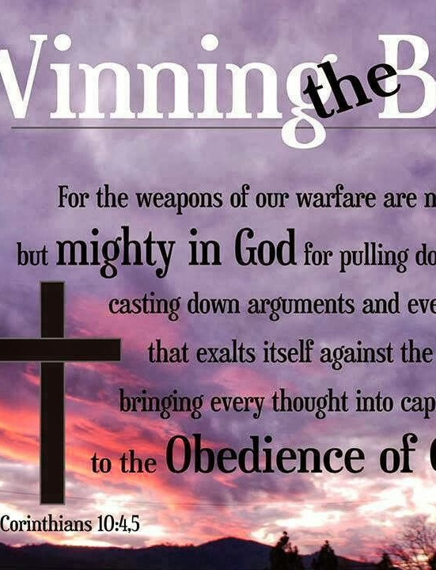
This Week
Keep This Thought
This is a Battleground not a Playground
Keep This Task
Develop a Warrior Mindset
Start Taking Back Lost Ground

Slide 21
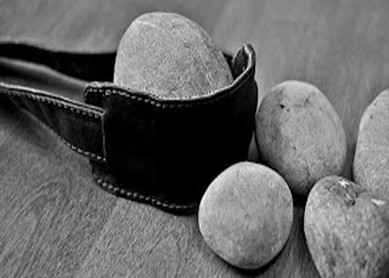
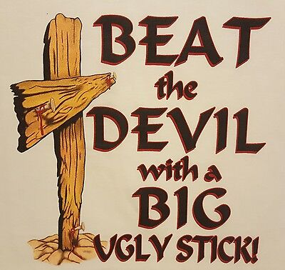

Slide 23
HUMOROUS HOSPITAL CHARTS
• The patient refused autopsy.
• Note: Patient recovering from forehead cut. Patient became very angry when given an enema by mistake.
• Patient has chest pain if she lies on her left side for over a year.
• On the second day, the knee was better, and on the third day it disappeared.
• She is numb from her toes down.
• Patient was alert and unresponsive.
• Skin: Somewhat pale but present.
• Patient has two teenage children, but no other abnormalities.

