Slide 2
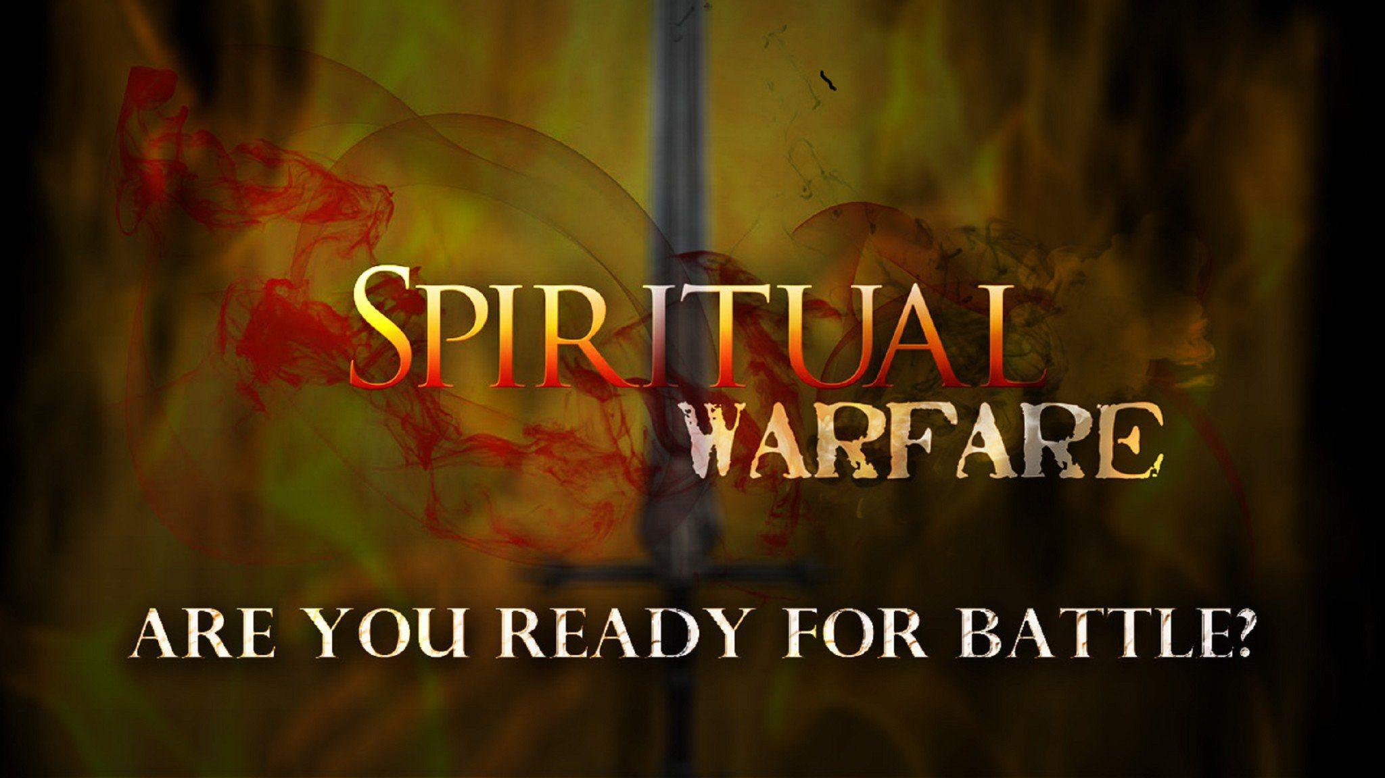
Edward Christian Church
Spiritual
Warfare
Pt 1
The Battle
Ephesians 6:10-12
April 28, 2024

Slide 3
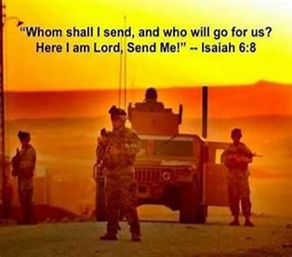
Occupy Til I Come
Occupy
-Does Not Mean-
  Take Up Space
      -It Does Mean–
        Take a Stance
        Be Productive
        Take Back Lost …
        …Ground / Property

Slide 4
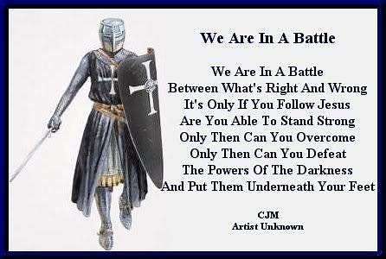
This Means War!!!
There is a War Waging…
It’s a Terrible War of Eternal Proportions
    We Can Reject It
    We Can Rename It
    We Can Resist It
    We Can Recognize it…
  …and Refuse to Do Nothing!!

Slide 5
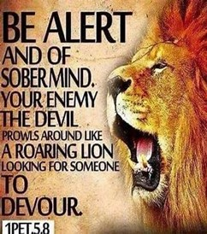
This Means War!!!
This is More Than a War…
Over Absolute Power over the World,
…but for Spiritual Domination of the World
It’s More Than a War…
Over Land Disputes or Material Gain,
…but for the Souls of Mankind
It’s More Than a War…
…against the Taliban or Extreme Muslim Radicals
…but Against the Rulers of Darkness and
Spiritual Wickedness

Slide 6
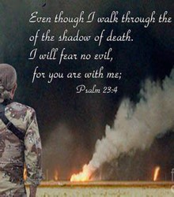
Recognize the Battle
Wrestle
  Hand to Hand Struggle
  House of Combatic Sports
3 Types:
    Boxers
    Wrestlers
    Pankratists
      Shows Intensity
      Shows Seriousness

Slide 7
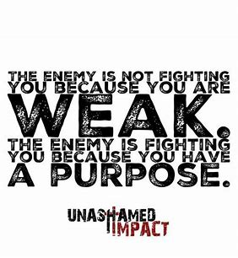
Recognize the Battle
Against
  Forward position
  Face to face encounter
  Shows…
    Engagement
    Involvement
    No Neutral Ground
Luke 11:23 (KJV)
²³ He that is not with me is against me: and he that gathereth not with me scattereth.

Slide 8
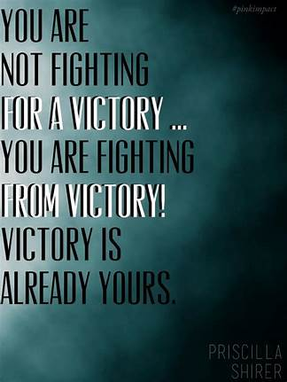
Recognize the Battle
Warning
  Be (now-constant)
  Strong (infused w- inner ability)
  In the Lord (found one place)
  Power (overwhelming – irresistible)
  Might (strong arm)

Slide 9
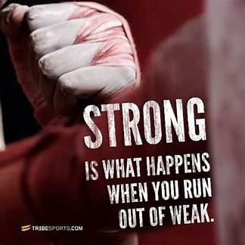
Recognize the Opponent
Not against flesh and blood
Transfer of Authority
Adam > Satan > Christ
4 Categories…
Principalities (ancient –chief)
Powers (delegated authority)
Rulers (order/ arrangement –raw power)
Spirit. Wickedness (vile, vicious, malignant)

Slide 10
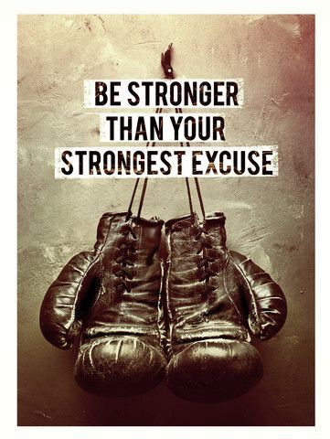
Recognize the Battleground
Mind (your thought process)
Matter (what matters)
    Family
    Church
    Friends
    Workplace
Use Them as a Target for an Attack
Use Them as the Attacker & One of the Above…
…is the Target !
(usually w-out their knowledge or permission)

Slide 11
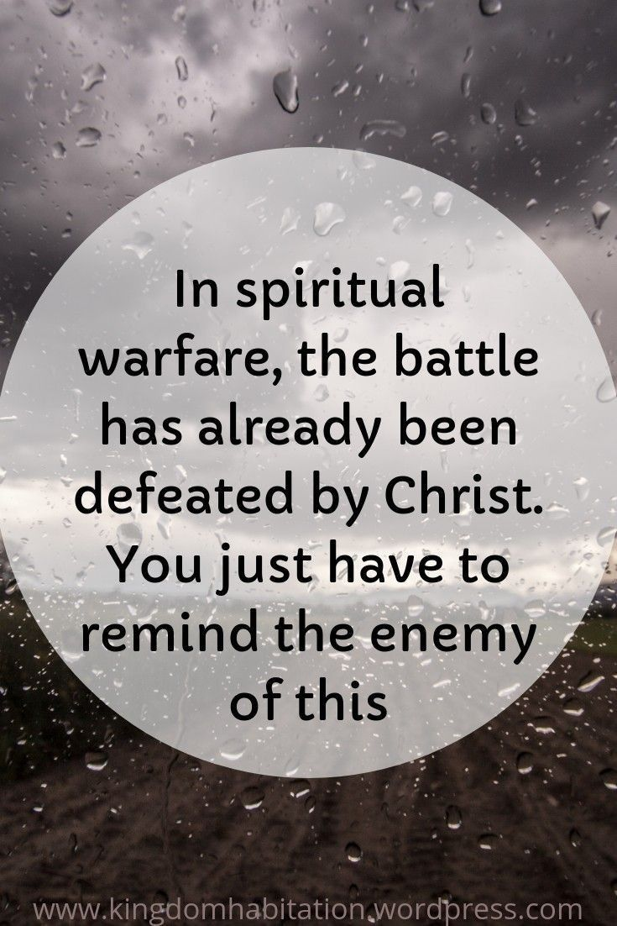
  Remember That We Win!
  There Are Two Ways to Fight …
      “To God” -Fighting for Victory
      “Through God” -Fighting From Victory
      “To God” Requires More of You
      “Through God” Requires Less of You
      You Choose

Slide 13
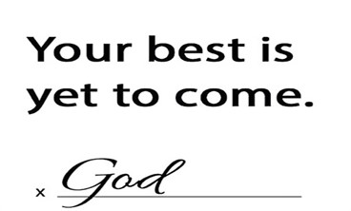
2024

Slide 14
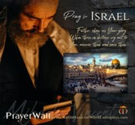

Psalm 17:7-9 -Complete Jewish Bible
⁷ Show how wonderful is your grace,
savior of those who seek at your right hand
refuge from their foes.
⁸ Protect them like the pupil of your eye,
hide them in the shadow of your wings
⁹ from the wicked, who are assailing them,
from their deadly enemies, who are all around them.
And All of the Innocent Victims
on Both Sides

Slide 15
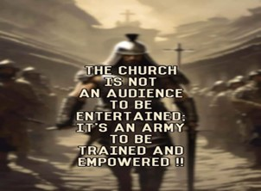
Repeat
These are the 2 Most Important Hours of My Week – Help Me to Cherish Them
I Am Here Today to Worship
Not to Be Entertained
I Am Singing to An Audience of One
Accept My Worship Oh Lord!

Slide 16
Repeat
I Lift My Offering to You
Let It Please You Oh Lord
This is My Seed
Although It Leaves My Hand
It will Never Leave My Life
You Will Multiply It!
Accept My Seed Oh Lord!

Slide 17
Pastor went to his church office on Monday morning and discovered a dead mule in the church yard. He telephoned the police. Since there did not appear to be any foul play, the police referred the Pastor to the Health Department.
They explained, "Since there was no health threat you'll need to call the Sanitation Department."
When the pastor called the Sanitation Department, the Manager of the Sanitation Department said, "I can't pick up that dead mule without authorization from the mayor."
The Pastor was not at all too eager to call the mayor, who possessed a very bad temper and was always extremely unpleasant and hard to deal with, but, eventually, the Pastor called the mayor anyway.
The mayor did not disappoint the Pastor. The mayor immediately began to rant and rave. After his continued rant at the pastor, the mayor finally said, "Why did you call me any way? Isn't your job to bury the dead?"
The pastor paused for a brief prayer, and asked the Lord to direct his response. The lord led the pastor to the words he was seeking, "Yes, Mayor, it IS my job to bury the dead, BUT I always like to notify the next of kin first!"

