Slide 1

2 Chron 20:1-24
Spiritual Warfare
“Worship and Warfare”
Pt 1
May 5, 2024
Edward Christian Church

Slide 2
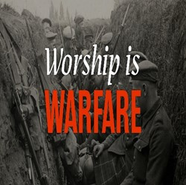
Worship is an Act of War
It is a Spiritual Battle Against…
…the Principalities of Darkness
Worship Creates a Wall of Fire…
…Around the Soul in Warfare
In the Old Test, the people of God learned that worship and warfare went hand in hand
When they repented and truly worshipped God, He always gave them victory

Slide 3
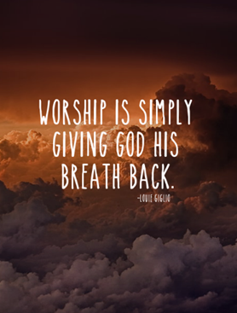
Power in Praises
When we lift our voices in song, pour out our hearts in worship, there's a shift that happens.
The atmosphere changes.
The walls that surround us,
…burdens that weigh us down,
…battles that we face,
…fade into background.
We're transported to a place where…
…it's just us and God.
It's a Place of Peace,
…a Place of Joy,
…a Place of Strength.

Slide 4
Maybe You Noticed Today …
No Music
No Singing
No CDs
No A Capello
No Praise
No Worship
Very Little Being Sent Up
Very Little Being Sent Down

Slide 5
If Satan Had His Way…
This Is How Every Service…
…In Every Church
…Would Be Every Week
Before I Address the Question “Why?”
Let Me Challenge Your “No Way!”

Slide 6
Who Would of Thought Removal of…
Morning Prayer/ Devotions in School
National Anthem/ Pledge of Allegiance…
…In Schools and Sporting Events
Prayer at School/ Sporting Events
Manger Scenes –Public / Private
Crosses –Public / Private
Ten Commandments Court Room/ Public

Slide 7
Now “Why”….
All of the Above Mentioned
…Powerful
….Connects Us to God
Praise and Worship
…Connects God to Us
Invites His Presence

Slide 8
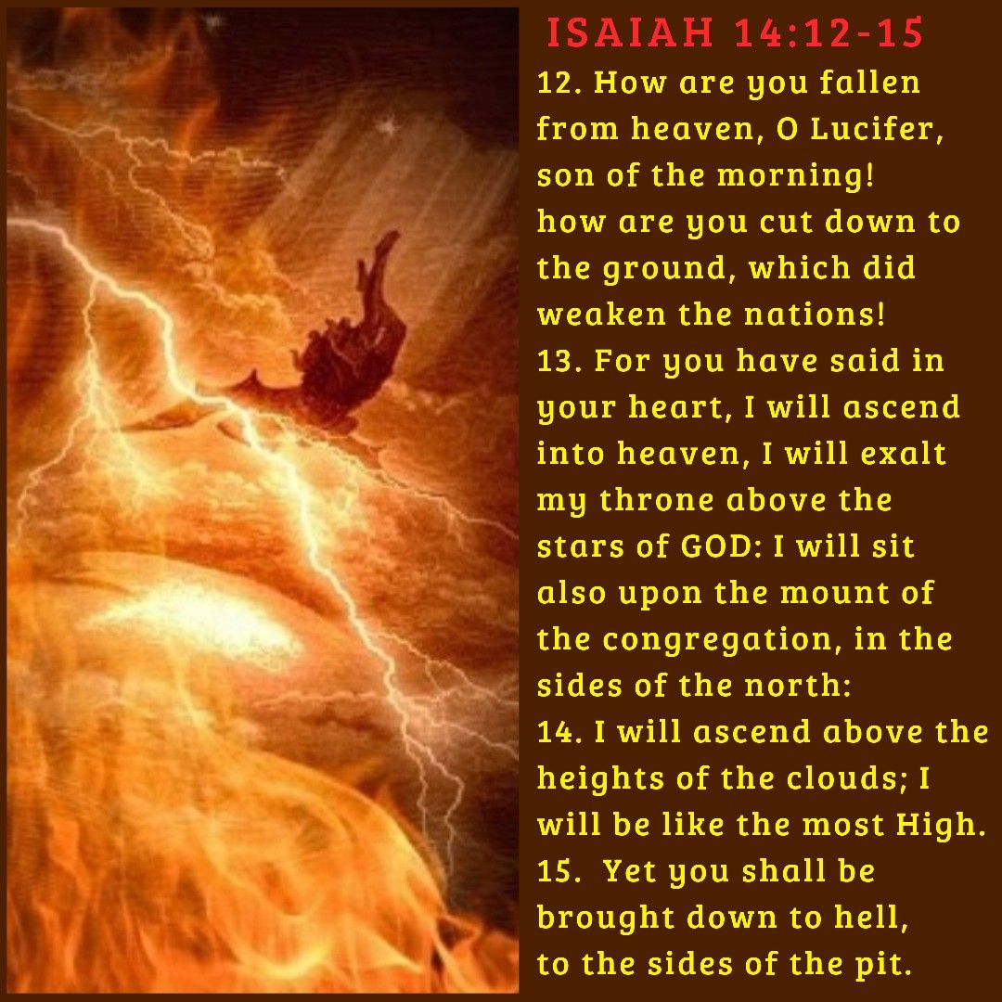
Isaiah 14
Opens Our Eyes to…
Why He Tries to Stop Our Worship
He wants to be Praised and Worshipped
Not Only Instead Of God
But As God

Slide 9
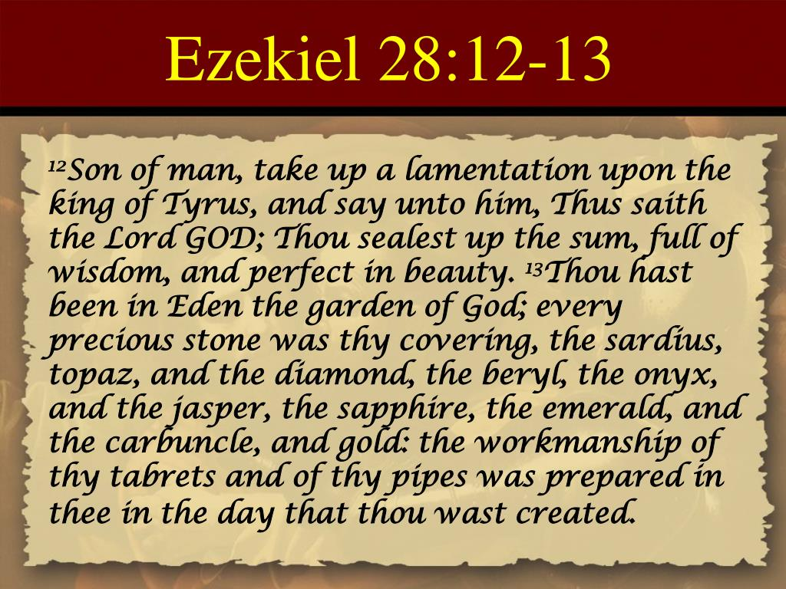
Ezekiel 28
    Opens Our Eyes to…
    Satan’s Connection to
        Praise
        Worship
        Music
Satan Understands It’s Power
            Connect
            Control

Slide 10
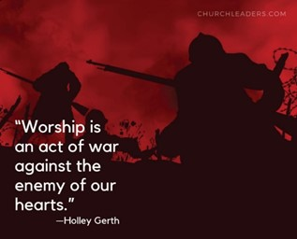
  Praise Needs to Lead in Battle
  Why?
  Conditions Our Heart
  Conditions Enemy's Mind
When Our Praise Is Silent…
…So Is God’s Response
When You Go Into Battle Remember…
Your Praise Is A Battle Cry

Slide 11
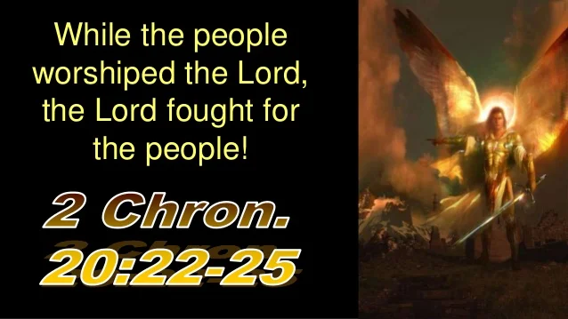
2 Chron 20:22
The Power of Praise in Battle
Places God in Front of Our Battles (21)
Prepares for God to Move (22)
Pushes Back the Darkness that Surrounds
Perplexes Satan and His Plan (23)
Propels Us to Victory (24)
Praises Can Become
A Powerful Weapon In Our Battles!

Slide 12
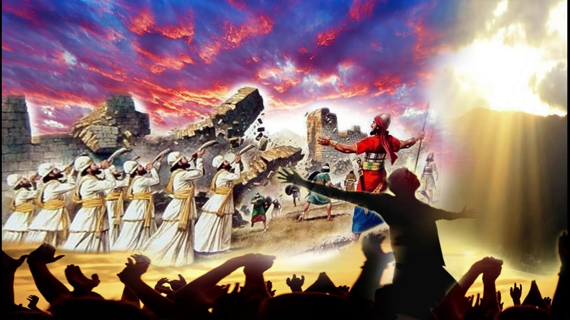
1st: Our Praises Invite God's Presence.
Psa 22:3, God inhabits our praises
We create a space where God can move…
…manifest His power.
Our praises are like a welcome mat…
…inviting God into our situations,
When God is present, anything is possible.
2nd: Our Praises Shift Our Focus.
It's easy to stay focused on the obstacle
Shifts focus from problem to problem-solver

Slide 13
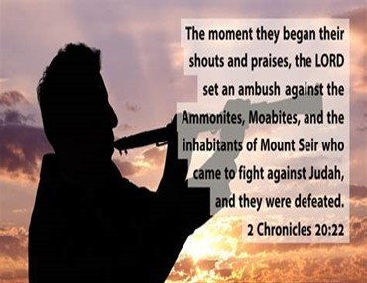
3rd: Our Praises Release Our Faith.
Its not just singing songs, making declarations
Its declaring God is good, faithful, / able
….no matter what we're going through
4th: Our Praises Disarm The Enemy.
it wasn't their Weapons that Defeated Them...
…it was their Worship.
It Confused the Enemy…
…Caused Chaos in the Enemy's Camp
It dismantled the Enemy's Strategies.
Praise is a weapon that is Mighty in God…
…for the Pulling Down of Strongholds.

Slide 14

If Satan Can't Stop Our Praise / Worship
He Hinders It…
…When We Forget that PW Is Not About
Pleasing Me
But
Pleasing God
When We Refuse to Worship or Complain About Worship….
This is What God Hears

Slide 16
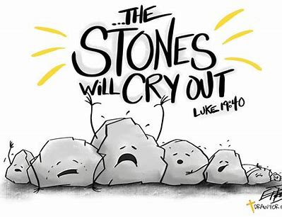


Slide 17
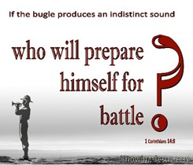
Praise and Worship
Similar but Different
Both Point to God
Worship is “Inside Job”
Bow Down
Praise is “Outward Job”
Raise Up
In Life’s Battles….
…Its Our War Cry!!!

Slide 18
