Slide 1

Welcome to Service
in God’s House Honoring Mothers

Slide 2
Repeat
These are the 2 Most Important Hours of My Week – Help Me to Cherish Them
I Am Here Today to Worship
Not to Be Entertained
I Am Singing to An Audience of One
Accept My Worship Oh Lord!

Slide 3
Repeat
I Lift My Offering to You
Let It Please You Oh Lord
This is My Seed
Although It Leaves My Hand
It will Never Leave My Life
You Will Multiply It!
Accept My Seed Oh Lord!

Slide 5
A Mother's Dictionary
Bottle Feeding:
An opportunity for Daddy to get up at 2 a.m. too.
Defense:
What you'd better have around de yard if you're going to let the children play outside.
Drooling:
How teething babies wash their chins.
Dumbwaiter:
One who asks if the kids would care to order dessert

Slide 6
A Mother's Dictionary
Feedback:
The inevitable result when the baby doesn't appreciate the strained carrots.
Full Name:
What you call your child when you're mad at him.
Grandparents:
The people who think your children are wonderful
even though they're sure you're not raising them right.
Hearsay:
What toddlers do when anyone mutters a dirty word.

Slide 7
A Mother's Dictionary
Look Out:
What it's too late for your child to do by the time you scream it.
Prenatal:
When your life was still somewhat your own.
Prepared Childbirth:
A contradiction in terms.
Puddle:
A small body of water that draws other small bodies wearing dry shoes into it.

Slide 8
A Mother's Dictionary
Sterilize:
What you do to your first baby's pacifier by boiling it and to your last baby's pacifier by blowing on it.
Temper Tantrums:
What you should keep to a minimum so as to not upset the children.
Two-Minute Warning:
When the baby's face turns red and she begins to make those familiar grunting noises.
Whodunit:
None of the kids that live in your house.

Slide 9

Good Morning Mothers (by birth or adoption)
Ever Felt Insufficient?
That What You Do Doesn’t Count?
Let’s Talk!
As a Mother, Everything You Do Counts
Through Christ You Are More than Sufficient
From the Cradle to the Grave Your Influence Will Always Be in Your Family’s Heart

Slide 10

But It Goes Much Deeper …
Whether You Know It or Not
You Play a Vital Role in Spiritual Warfare
It Is Exemplified Through What the World Considers the Least Likely…
A Canaanite Woman
Her Actions in Crisis Points to
Mothers First Steps in Spiritual Warfare

Slide 11
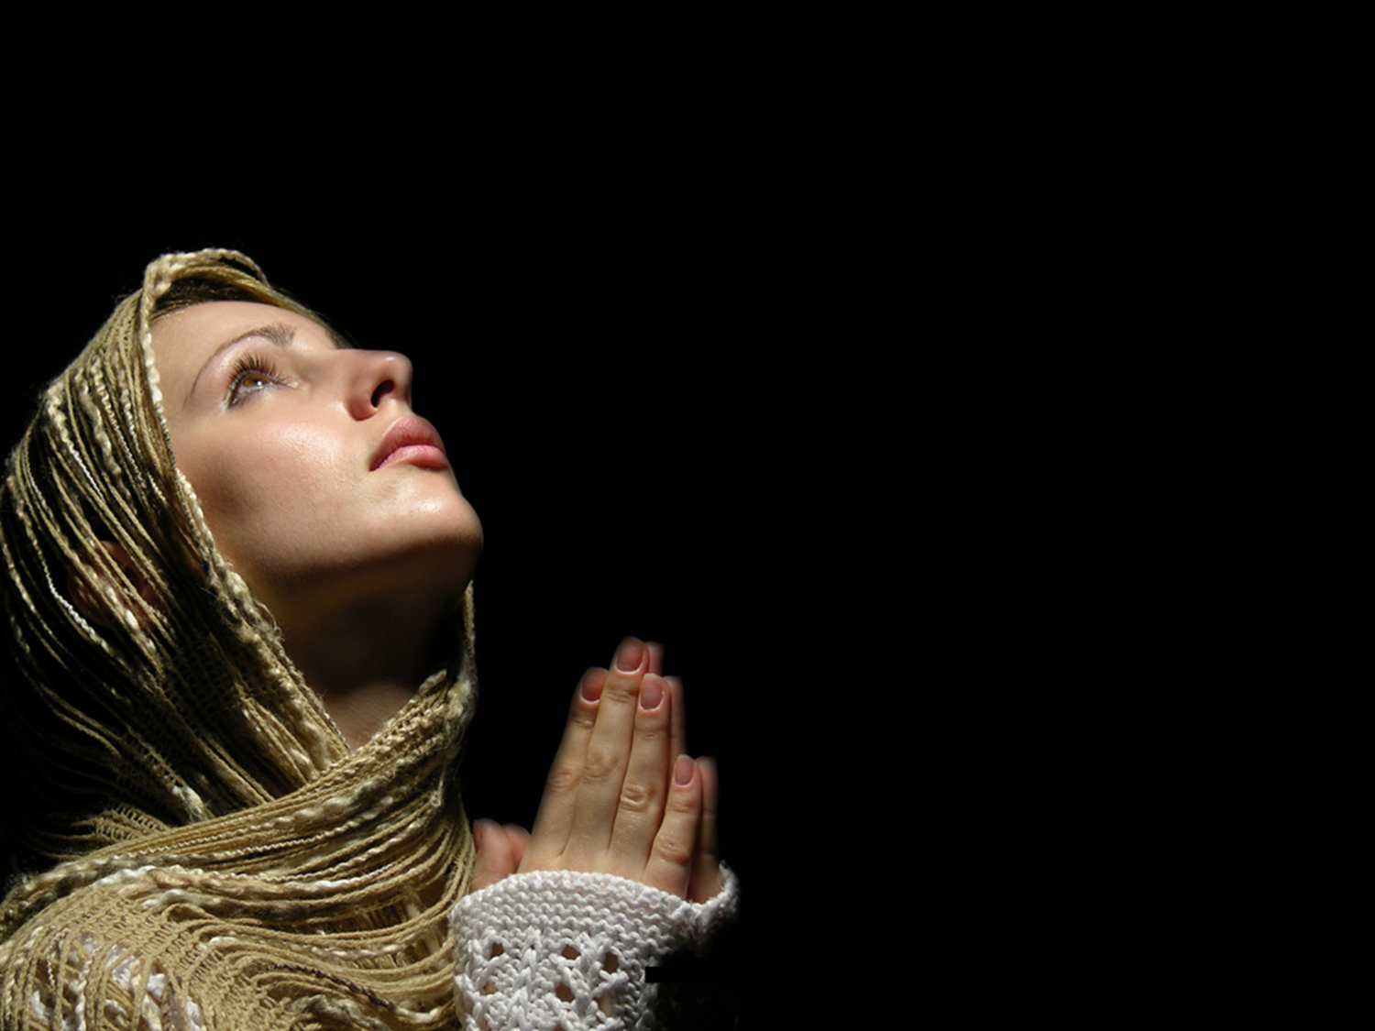
Edward Christian Church
May 12, 2024
Mothers and
Spiritual Warfare
Matthew 15:21
Mother’s Day 2024

Slide 12
Sayings about Mother
A Spanish proverb says: An Ounce of Mother is Worth a Pound of Clergy
Abraham Lincoln said: No One is Poor who has a Godly Mother
A Jewish Proverb may say it Best: A Child without a Mother is like a Door without a Knob
“The hand that rocks the cradle is the hand that rules the world.” -W.R. Wallace

Slide 13
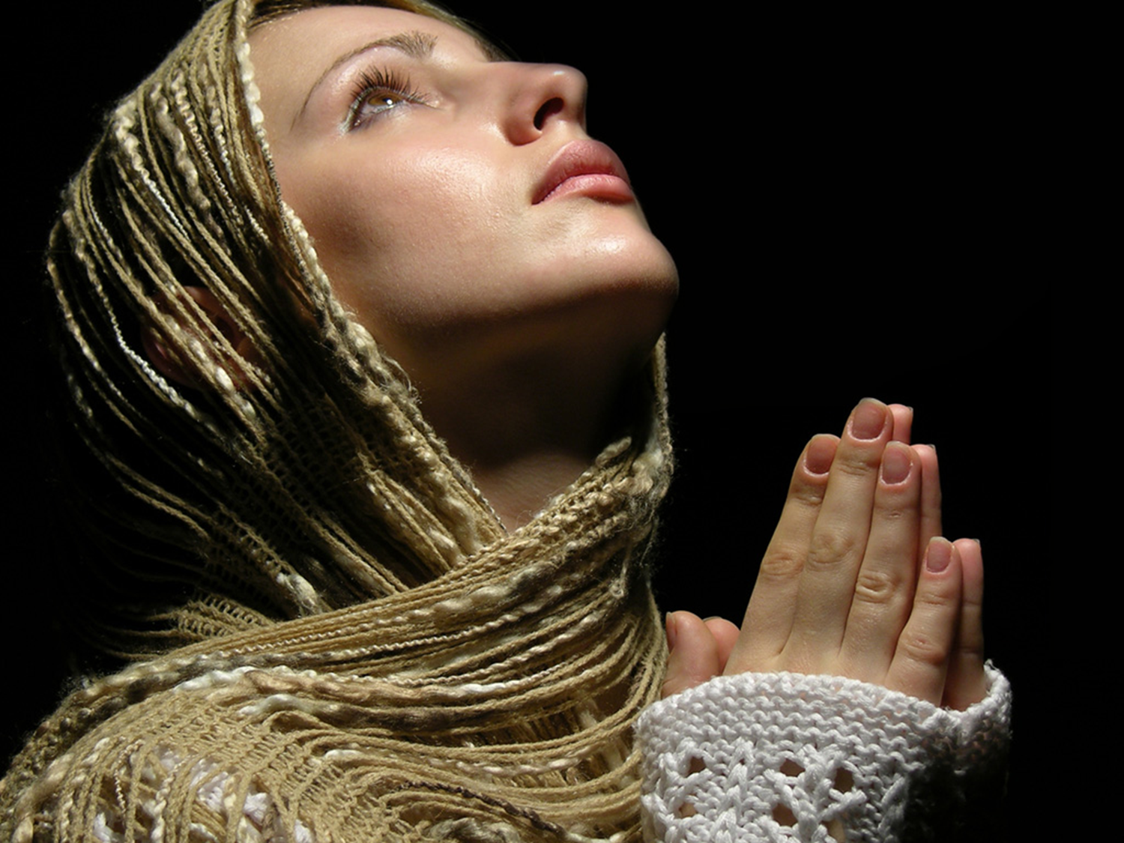
Don’t Need to Be… …a Great Somebody …Just Get to a Great God
We Wrestle Not with Flesh And Blood
Eph 6:12
She Was a…
Poor Woman –Husband Never Mentioned
Outcast:
Birth –Canaanite/ Gentile
Situation –Daughter/ devil
No Name
But Elevated by God
One of Only 2 Jesus said had “Great Faith”
What Did She Do to Catch Jesus’ Attention?

Slide 14
Overcome Great Excuses
We Wrestle Not with Flesh And Blood
Eph 6:12
Mark 7:26
She Stepped Beyond Own Crisis’…
Identity (Nobody –Unnamed)
Inferiority (Woman)
Prejudice (Gentile / Canaanite)

Slide 15

Empowered By Great Love
1 Cor 16:13-14 NKJV
Watch, stand fast in the faith, be brave, be strong. Let all be done with love
Her Love was Powerful than Her…
Fear
Shame
Hardship and Sacrifice
1 Peter 4:8, “…love covers a multitude of sins”
1 John 4:18, “ There is no fear in love; but perfect love casteth out fear: because fear hath torment. He that feareth is not made perfect in love”

Slide 16

Armed With Great Determination
She Conquered the Test of…
Patience in Divine Silence (22-23)
…Jesus did not answer
Doubt /Discouragement (23)
…send her away
Rejection (24)
…I was sent only to...Israel
Humility (25-27)
…It is not right.... to dogs
James 1:3-4 Amp
³ Be assured and understand that the trial and proving of your faith bring out endurance and steadfastness and patience.
⁴ But let endurance and steadfastness and patience have full play and do a thorough work, so that you may be [people] perfectly and fully developed [with no defects], lacking in nothing.

Slide 17

Knew Power of Great Prayer
Ephesians 6:18 Amp
¹⁸ Pray at all times (on every occasion, in every season) in the Spirit, with all [manner of] prayer and entreaty. To that end keep alert and watch with strong purpose and perseverance, interceding in behalf of all the saints (God’s consecrated people).
She Acknowledged…
His Divinity…
…Worship
His Control…
…Lord
She Can’t Manage Her Life…
…Without His Help

Slide 18
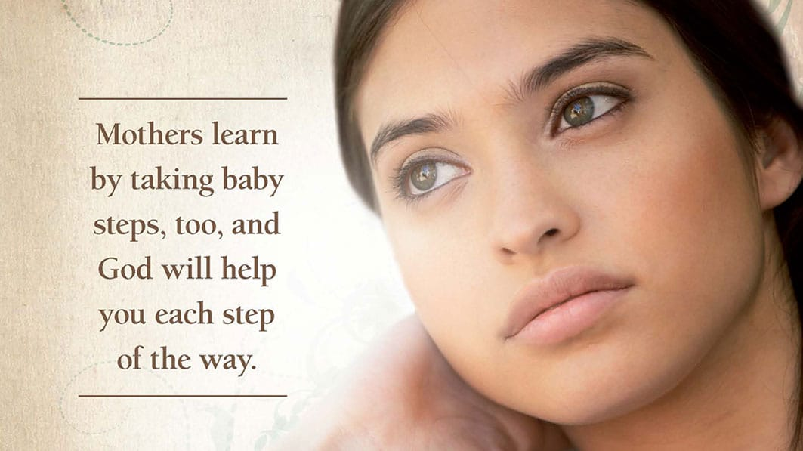
Kept by Great Persistent
James 1:3 Amp
³ Be assured that the testing of your faith [through experience] produces endurance [leading to spiritual maturity, and inner peace].
This Woman’s Faith was Tested
in Three Ways:
She Kept After Jesus Inspite of...
His Silence
Disciples Lack Of
Being Undeserving
…She Kept Coming!

Slide 19


Crumbs
Less than Leftovers…
Disposable - Napkins
Discarded - Thrown on Floor
Dogs - Would Clean the Floor
Not Even Considered Part of the Meal
But It wasn’t “What She Got”…
…but “Who She Got it From”!

Slide 20

She Stood Til Triumphed
She Received Great;
Commendation
…You have a great faith
Approval
…Your request is granted
Miracle
…Her daughter was healed

Slide 21
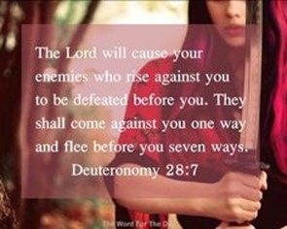
She Stood Til Triumphed
Don’t Give Up!
Yes
You Are In Spiritual Warfare
No
You Don’t Have to Be Perfect…
…to Go to Battle !!

Slide 22
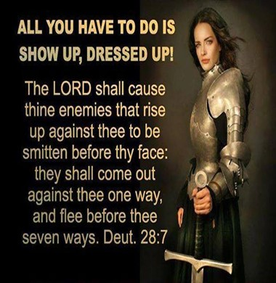

Slide 24
When I die and they lay me to rest Gonna go to the place that's the best When I lay me down to die Goin' up to the spirit in the sky

Slide 25
Goin' up to the spirit in the sky (spirit in the sky) That's where I'm gonna go when I die (when I die) When I die and they lay me to rest I'm gonna go to the place that's the best

Slide 26
Prepare yourself you know it's a must Gotta have a friend in Jesus So you know that when you die He's gonna recommend you To the spirit in the sky (spirit in the sky)

Slide 27
Goin' up to the spirit in the sky (spirit in the sky) That's where I'm gonna go when I die (when I die) When I die and they lay me to rest I'm gonna go to the place that's the best

Slide 28
Never been a sinner, I never sinned I got a friend in Jesus So you know that when I die He's gonna set me up with the spirit in the sky

Slide 29
He’ll set up to the spirit in the sky (spirit in the sky) That's where I'm gonna go when I die (when I die) When I die and they lay me to rest I'm gonna go to the place that's the best

Slide 30

Some Kind of Wonderful

Slide 31
I don't need a whole lots of money I don't need a big fine car I've got everything that a man could want And I got more than I could ask for

Slide 32
I don't have to run around I don't have to stay out all night 'Cause I've got a sweet, a sweet, lovin' savior And He knows how to treat me right

Slide 33
Now my Jesus, He's alright Well, my savior's clean outta sight Don't you see that He's Some kind of wonderful? You know He is, He's Some kind of wonderful Yes, He is, He's Some kind of wonderful Yeah, yeah, yeah, yeah

Slide 34
Oh, when He holds me in His arms You know it sets my soul on fire Ooh, when my savior's huggin' me My ol' heart becomes filled with desire

Slide 35
And when He wraps His lovin' arms around me It 'bout drives me out of my mind Yeah, when my savior's liftin' me The chills run up and down my spine

Slide 36
Now my Jesus, He's alright Well, my savior's clean outta sight Don't you see that He's Some kind of wonderful? You know He is, He's Some kind of wonderful Yes, He is, He's Some kind of wonderful Yeah, yeah, yeah, yeah

Slide 37
Now is there anybody, yeah Got a sweet lovin' savior like mine? There's got to be somebody, yeah Got, got a sweet lovin' savior like mine, yeah

Slide 38
Now, can I get a witness? Can I get a witness? One more time, people Can I get a witness? Yeah, yeah, yeah, yeah, yeah Can I get a witness? Whoa-whoa-oh-oh Can I get a witness? You know I need somebody Can I get a witness? Yeah, yeah, yeah, yeah

Slide 39
Some kind of wonderful? You know He is, He's Some kind of wonderful Yes, He is, He's Some kind of wonderful Yeah, yeah, yeah, yeah

Slide 40


Slide 41
It is time that we give you honor This is the day to give you All the praise that you deserve Yes, it's time to give you honor This is the day to give you All the praise that you deserve

Slide 42
A Holy King, of everything Inhabit the praises of Your people A Holy King, of everything Inhabit the praises of Your people

Slide 43
Have we waited far too long to surrender Forgive us Oh God the years We failed to seek your face Oh Lord, your mercy turns us into Grateful people We can't seem to find the words So take our lives that there might be enough To tell you how grateful Lord, we are grateful

Slide 44
It is time that we give you honor This is the day to give you All the praise that you deserve Yes, it's time to give you honor This is the day to give you All the praise that you deserve

Slide 45
A Holy King, of everything Inhabit the praises of Your people A Holy King, of everything Inhabit the praises of Your people

Slide 46
Have we waited far too long to surrender Forgive us Oh God the years We failed to seek your face Oh Lord, your mercy turns us into Grateful people We can't seem to find the words So take our lives that there might be enough To tell you how grateful Lord, we are grateful

Slide 47
Bless the lord oh, my soul and all that it within me bless his holy name

Slide 48


Slide 49
Draw me close to You Never let me go I lay it all down again To hear You say that I'm Your friend

Slide 50
You are my desire No one else will do 'Cause nothing else can take Your place To feel the warmth of Your embrace Help me find the way, bring me back to You

Slide 51
You're all I want You're all I've ever needed You're all I want Help me know You are near

Slide 52
Draw me close to You Never let me go I lay it all down again To hear You say that I'm Your friend

Slide 53
You are my desire No one else will do 'Cause nothing else can take Your place To feel the warmth of Your embrace Help me find the way, bring me back to You

Slide 54
You're all I want You're all I've ever needed You're all I want Help me know You are near

Slide 55
You're all I want You're all I've ever needed You're all I want Help me know You are near

