Slide 2

Edward Christian Church
Spiritual
Warfare
Pt 2
Our Adversary
Ephesians 6:10-12
May 19, 2024

Slide 3
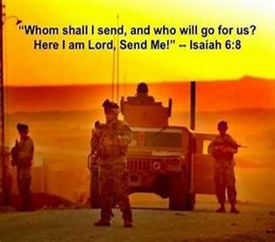
Occupy Til I Come
Occupy
-Does Not Mean
Take Up Space
-It Does Mean –
Take a Stance
Be Productive
Take Back Lost …
…Ground / Property

Slide 4
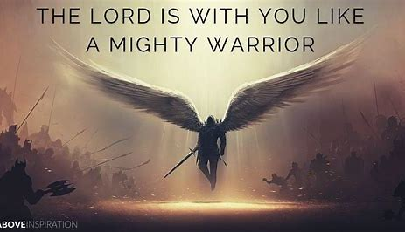
This Means War!!!
There is a War Waging Even Now
It’s a Terrible War of Eternal Proportions
We Can Reject It
We Can Rename It
We Can Resist It
We Can Recognize it…
…and Refuse to Do Nothing!!

Slide 5
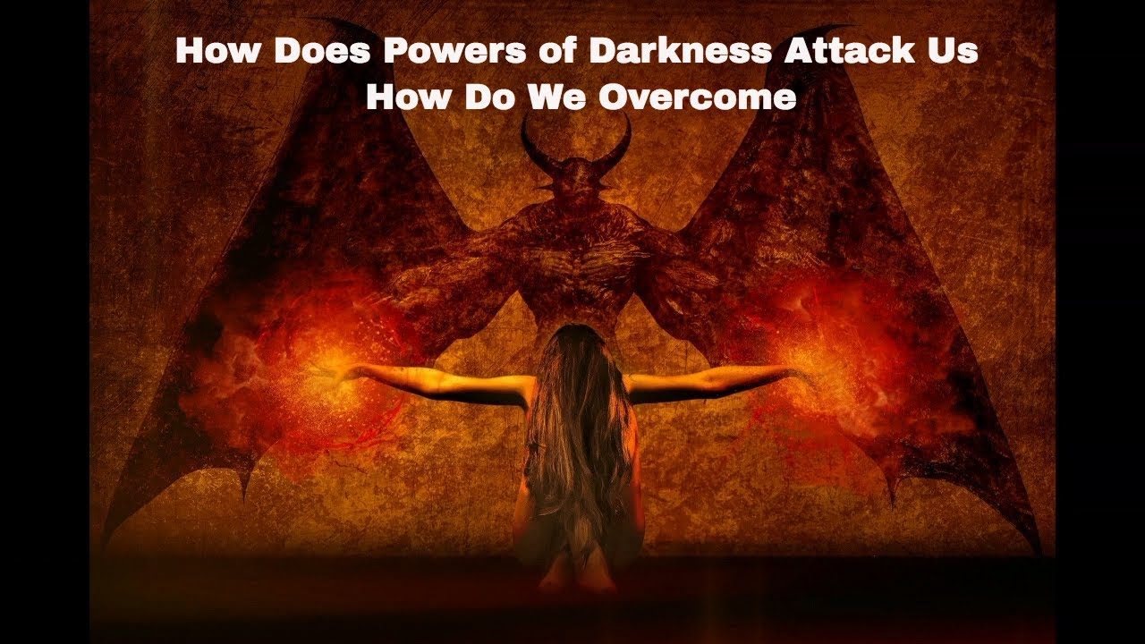
Recognize the Opponent
Desires to:
Deceive
Divide
Destroy
Dominate

Slide 6
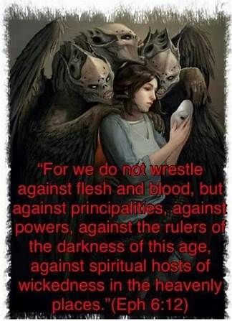
“”Desire to Manipulate Mind
Adversary 2 Words
Anti (against –person on edge of insanity)
Dikos (rt for righteousness) refers to justice
Roaring Lion -denotes hunger / dread
Walks about (on the hunt)
Seek (implies not all will fall)
Devour (gulp entire –drown)
Angel of Light
Minister of truth

Slide 7
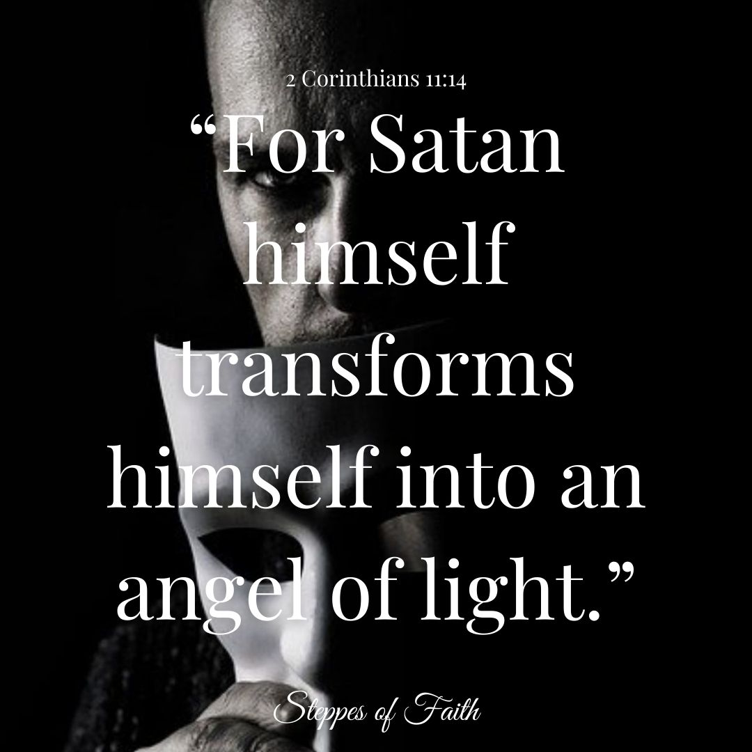
“ “Manipulate Mind
2 Corinthians 11:14 (KJV) And no marvel; for Satan himself is transformed into an angel of light.
Marvel Not
don’t be surprised
Satan
the accuser
Transformed
transfigure or disguise
Angel of Light
Minister of Truth

Slide 8
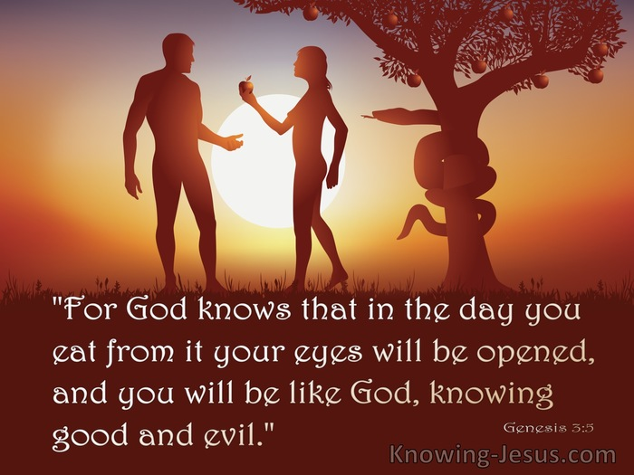
Conditioning Process
Satan Knows Most of Us…
…Will Not Fall for an Outright Lie
He Works a 3 Step…
…Conditioning Process
#1- Start with Truth…
#2- Then Truth Mixed with a Lie
Eventually…
#3- Then Outright Lie Mixed with Truth

Slide 9

“”Desire to Manipulate Mind
Adversary
Roaring Lion
Angel of Light
Devil =diablos
Dia (thru-penetrate) Ballo (I Throw)
To Keep Throwing til Penetrate
40 times used in New Test
Satan / Accuser
Shantana (to hate/ to accuse)
50 times in OT / NT

Slide 10
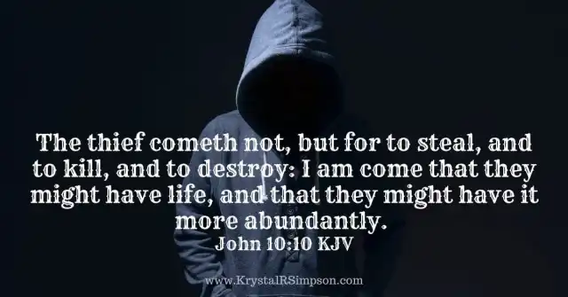
Satan’s Destructive Bent
Abaddon - Heb –Destruction
Apollyon - Gk -Destroyer
Both Names found in Rev 9:11
Angel of Bottomless Pit
Matt 13:18-33
I Tim 4:1-6
John 10:10

Slide 11
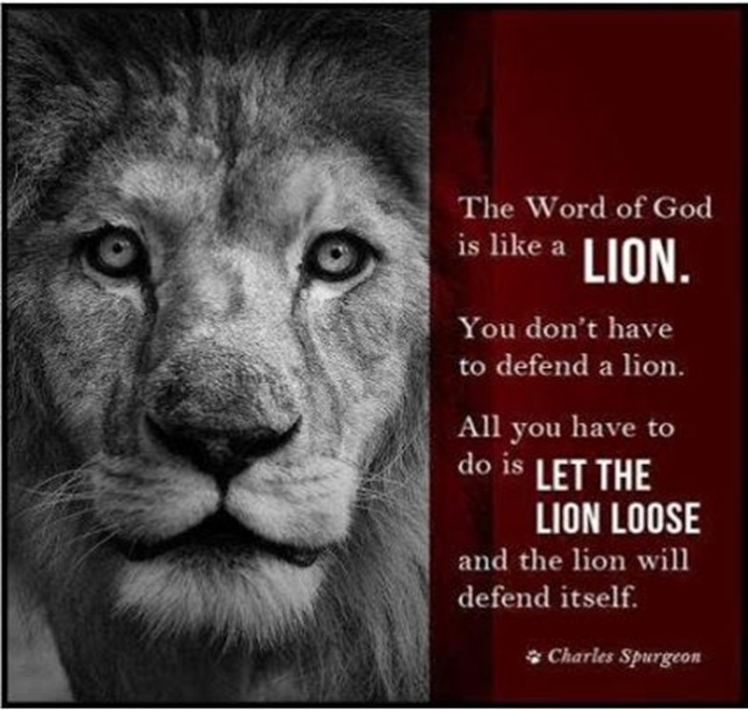
Message of Salvation = Story of 2 Adams
"For as by the one man's disobedience many were made sinners, so by the one man's obedience the many will be made righteous" -Rom. 5:19
What the 1st Adam Lost…
When Confronted by / his lies
…He Got in Alignment with the satan’s lies
…Not God’s Word
….We Lost
…the 2nd Adam Reclaims
When Confronted by satan / his lies
…He Got in Alignment with God’s Word …
…Not satan’s lies
…We Won

Slide 12
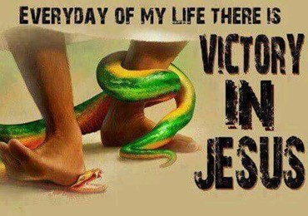
Genesis 3:15 NKJV
¹⁵ And I will put enmity Between you / the woman, between your seed /her Seed; He shall bruise your head, And you shall bruise His heel.”
Luke 10:19 NKJV
Behold, I give you the authority to trample on serpents / scorpions, / over all the power of the enemy, nothing shall by any means hurt you.
This Week
Instead of Aligning with satan’s lies
Align with God’s Truth
Walk in Jesus’ Victory (attitude)
Stand on His Word (attention)

Slide 13
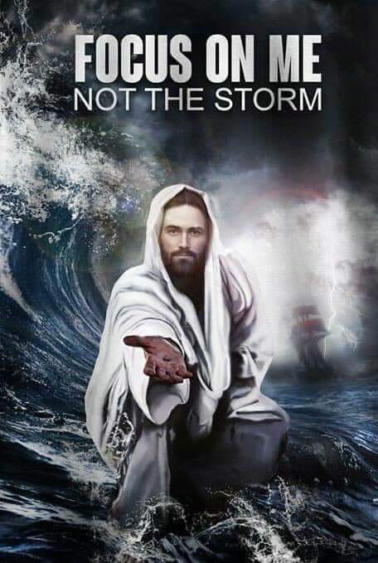
2024

Slide 14
This Week
Instead of Aligning with satan’s lies
Align with God’s Truth
Walk in Jesus’ Victory
(attitude)
Stand on His Word (attention)

Slide 15
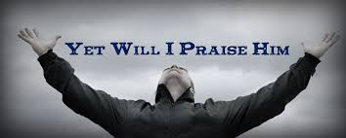
Edward Christian Church
5/19/2024

Slide 17
Two first graders were overheard as they left Sunday school class, "Do you really believe all that stuff about the devil?" "No, I think it’s like Santa Claus. It’s really your dad."

Slide 18
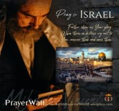

Psalm 17:7-9 -Complete Jewish Bible
⁷ Show how wonderful is your grace, savior of those who seek at your right hand refuge from their foes. ⁸ Protect them like the pupil of your eye, hide them in the shadow of your wings ⁹ from the wicked, who are assailing them, from their deadly enemies, who are all around them.
And All of the Innocent Victims
on Both Sides

Slide 19
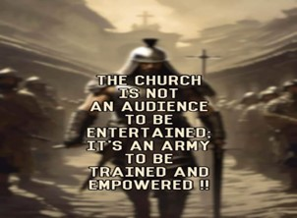
Repeat
These are the 2 Most Important Hours of My Week – Help Me to Cherish Them
I Am Here Today to Worship
Not to Be Entertained
I Am Singing to An Audience of One
Accept My Worship Oh Lord!

