Slide 1
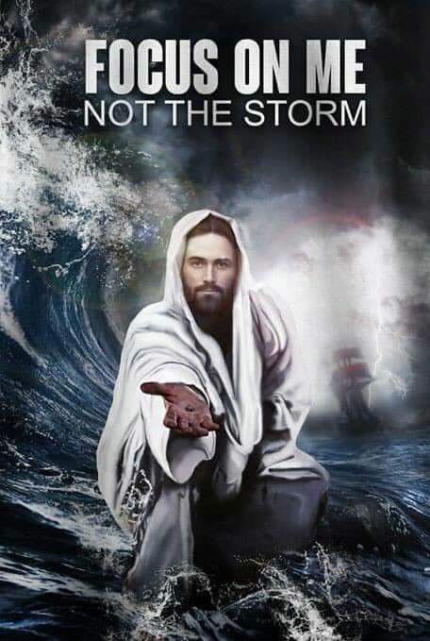
2024

Slide 2
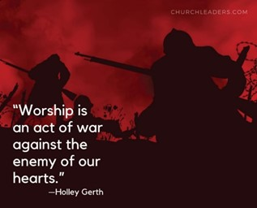

Slide 3
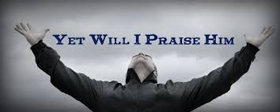
Edward Christian Church
5/26/2024

Slide 4
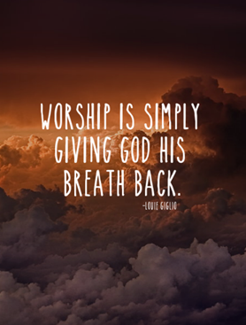

Slide 6

Edward Christian Church
Spiritual
Warfare
Pt 3
Our Adversary
Ephesians 6:10-12
May 26, 2024

Slide 7
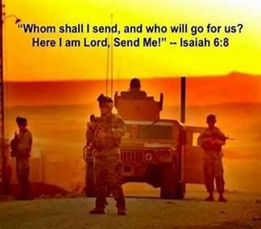
Occupy Til I Come
Occupy
-Does Not Mean
Take Up Space
-It Does Mean –
Take a Stance
Be Productive
Take Back Lost …
…Ground / Property

Slide 8
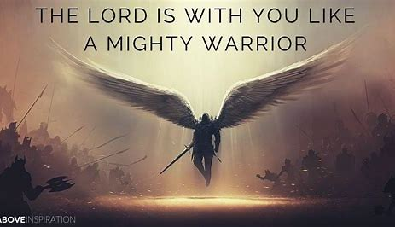
This Means War!!!
There is a War Waging Even Now
It’s a Terrible War of Eternal Proportions
We Can Reject It
We Can Rename It
We Can Resist It
We Can Recognize it…
…and Refuse to Do Nothing!!

Slide 9
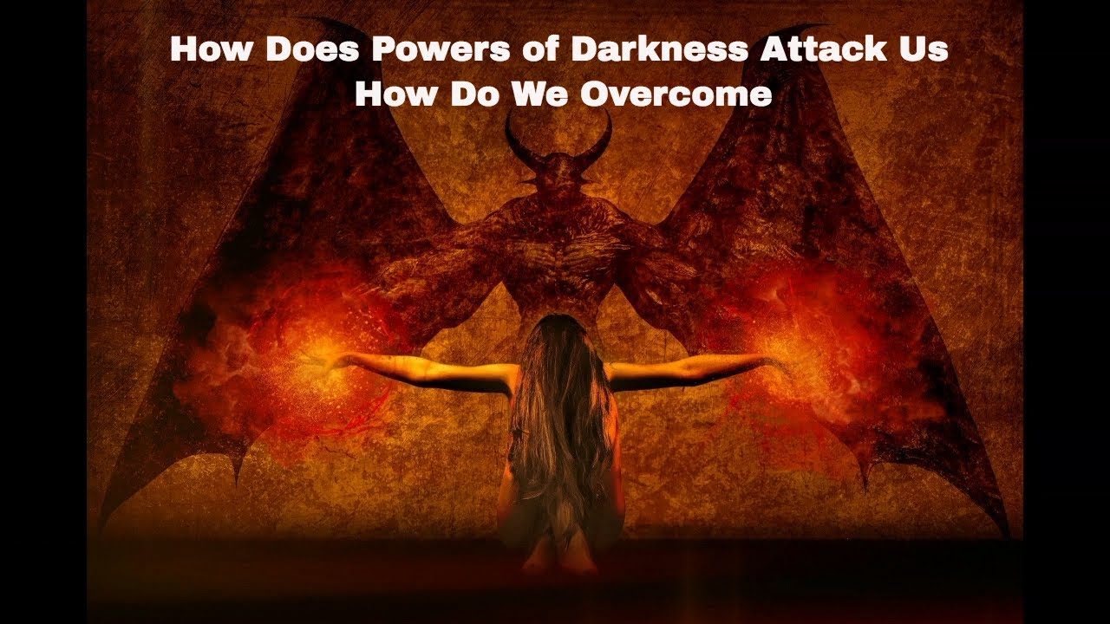
Recognize the Opponent
Desires to:
Deceive
Divide
Destroy
Dominate

Slide 10


Slide 11

“”Desire to Manipulate Mind
Adversary
Roaring Lion
Angel of Light
Devil =diablos
Dia (thru-penetrate) Ballo (I Throw)
To Keep Throwing til Penetrate
40 times used in New Test
Satan / Accuser
Shantana (to hate/ to accuse)
50 times in OT / NT

Slide 12
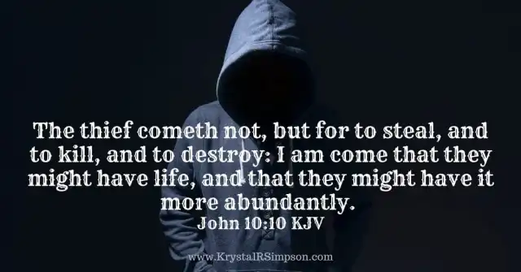
Satan’s Destructive Bent
Abaddon - Heb –Destruction
Apollyon - Gk -Destroyer
Both Names found in Rev 9:11
Angel of Bottomless Pit
John 10:10
Satan Desires to…
Steal= klepto
Kill= sacrifice by fire
Destroy= Apollyon

Slide 13
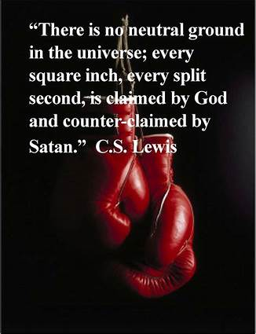
Satan’s Preverted Nature
Beelzebulb -int used by Philistines
Baalzebub (Lord of the Flies)
Beelzebulb (Lord of the Dunghill, manure)
2 Powerful Images
Lord of Demon Spirits (ID)
He / his Spirits Attracted to Filth (MO)
Belial –Worthless
I Sam 2:12 –Eli’s sons “sons of Belial”
Dragon/ Serpent –craftiness
Genesis 3:1- subtile (make a bare)
Deadly, poisonous, ready to strike - kill

Slide 14
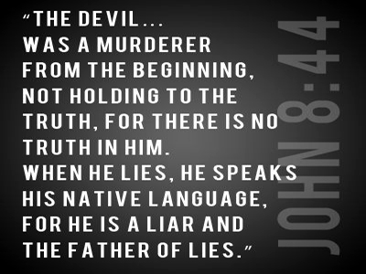
Satan’s Preverted Nature
Beelzebulb
Belial –Worthless
Dragon/ Serpent –interchangeable
Evil One - Matt 6:13 gk
No one more familiar than Jesus
Satan is the Master Deceiver
Murderer –
John 8:44
Gen 4:8

Slide 15
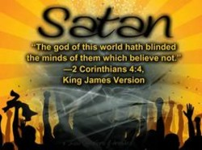
Satan’s Desire to Control
God of this World -II Cor 4:4
God (Diety – magistrate)
World (age, course)
Prince of this World -John 16:11
Prince (one who holds 1st place)
Prince of Demons -Mk 3:22
Prince of the Power of the Air -Eph 2:2
Power (exousia –authority)
Air / Demons –rep (disembodied spirits)

Slide 16
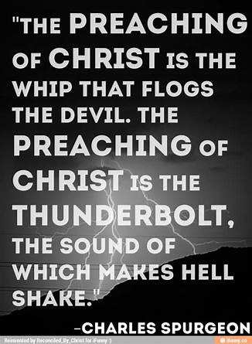
We Do Have…
More Authority Than Satan Wants Us to Know
More Power Than Satan Wants Us to Know
Because the Greater One Living In Us
The Church Of Jesus Christ Is Loaded With Heaps And Heaps Of Raw Power.
But that Power Can Be…
Disruppted, Disconnected and Disjointed
When We Lack…
Discipline, Organization, And Commitment!

Slide 17
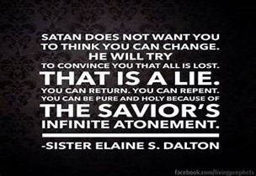
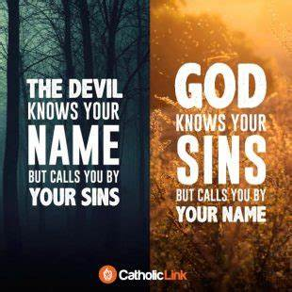

Slide 18
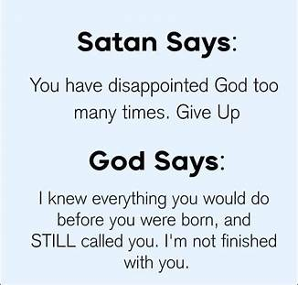
You Don’t Have to …
Listen the Lies of Satan
Lay Down and Hope for the Best
You Are Not…
Helpless or Hopeless
Without Weapons
Without Power
Without Victory
The Cross Provides ALL We NEED!!!

Slide 20
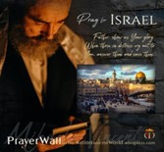

Psalm 17:7-9 -Complete Jewish Bible
⁷ Show how wonderful is your grace, savior of those who seek at your right hand refuge from their foes. ⁸ Protect them like the pupil of your eye, hide them in the shadow of your wings ⁹ from the wicked, who are assailing them, from their deadly enemies, who are all around them.
And All of the Innocent Victims
on Both Sides

Slide 21

Repeat
These are the 2 Most Important Hours of My Week – Help Me to Cherish Them
I Am Here Today to Worship
Not to Be Entertained
I Am Singing to An Audience of One
Accept My Worship Oh Lord!

Slide 22
John and Nancy, married for 40 years, planned a second wedding to renew their vows.
Nancy described to her friend the dress she would wear.
Nancy's friend asked, "What color shoes?"
Nancy replied, "Silver."
John chimed in: "Yep, silver ... to match her hair."
With a pointed look at John's bald spot, Nancy's friend said: "So, John, I guess you'll go barefoot."

