Slide 1
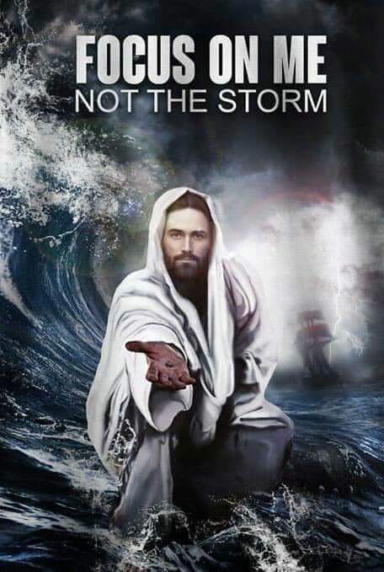
2024

Slide 2


Psalm 17:7-9 -Complete Jewish Bible
⁷ Show how wonderful is your grace,
savior of those who seek at your right hand
refuge from their foes.
⁸ Protect them like the pupil of your eye,
hide them in the shadow of your wings
⁹ from the wicked, who are assailing them,
from their deadly enemies, who are all around them.
And All of the Innocent Victims
on Both Sides

Slide 3
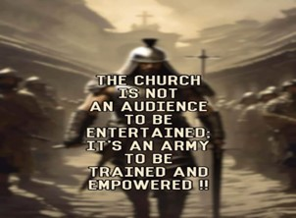
Repeat
These are the 2 Most Important Hours of My Week – Help Me to Cherish Them
I Am Here Today to Worship
Not to Be Entertained
I Am Singing to An Audience of One
Accept My Worship Oh Lord!

Slide 4
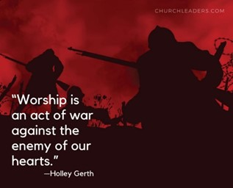

Slide 5

ECC PRAISE 6/2/2024

Slide 7

Edward Christian Church
Spiritual
Warfare
Pt 4
Our Adversary
Ephesians 6:10-12
June 2, 2024

Slide 8
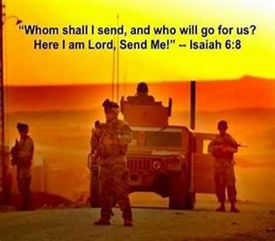
Occupy Til I Come
Occupy
-Does Not Mean
  Take Up Space
-It Does Mean –
  Take a Stance
  Be Productive
  Take Back Lost …
  …Ground / Property

Slide 9
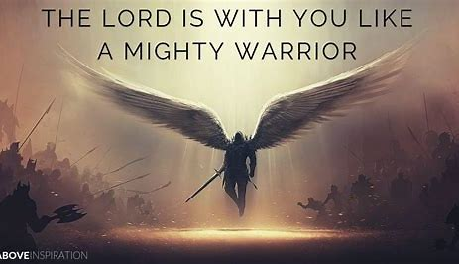
This Means War!!!
There is a War Waging Even Now
It’s a Terrible War of Eternal Proportions
  We Can Reject It
  We Can Rename It
  We Can Resist It
  We Can Recognize it…
  …and Refuse to Do Nothing!!

Slide 10
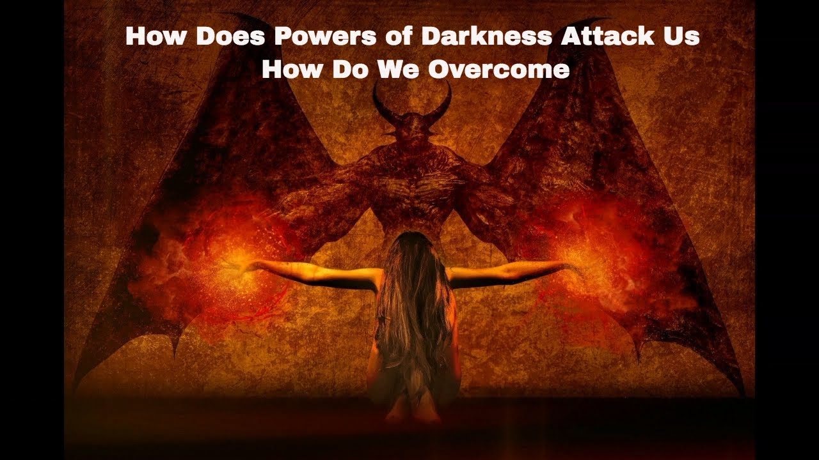
Recognize the Opponent
Desires to:
  Deceive
  Divide
  Destroy
  Dominate

Slide 11

Recognize the Battle
Warning
  Be (now-constant)
  Strong (infused w- inner ability)
  In the Lord (found one place)
  Power (overwhelming – irresistible)
  Might (strong arm)

Slide 12
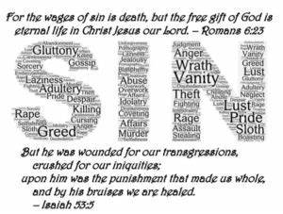
Redemption
Very Powerful…
Our Redemption Provides…
            Restoration
            Rest
            Refreshment

Slide 13
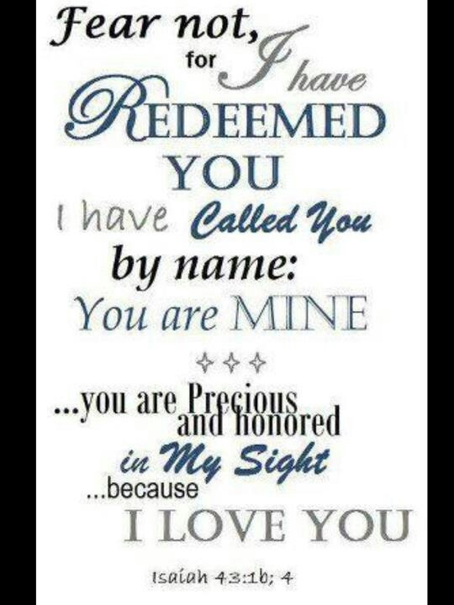
Redemption
Four Words in New Testament…
…Are Used to Describe
Redemption
Each One Helps Us Better Understand…
…Spiritual Warfare

Slide 14
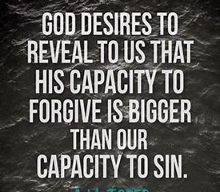
Satan’s Slave Market
“a- go- rid- zo” =marketplace, slave market
…to buy in the marketplace."
Purchase Right Off the Auction Block.
Jesus did this when He died on the cross.
He paid the full price that we might go free from the penalty of sin.

Slide 15

“a- go- rid- zo” =marketplace, slave market
…Rescue from Loss
Rom 7:14 – sold under sin
  Sold = Transfer of Property
  Picture of Satan’s Ownership before Salvation
Rom 6:17, 20 -servants
  One whose will is completely swallowed up in
  the Will of Another
I Cor 6:20 – bought w- a Price
  Jesus came to us and Purchased us!
  Take away Satan’s Legal Authority

Slide 16
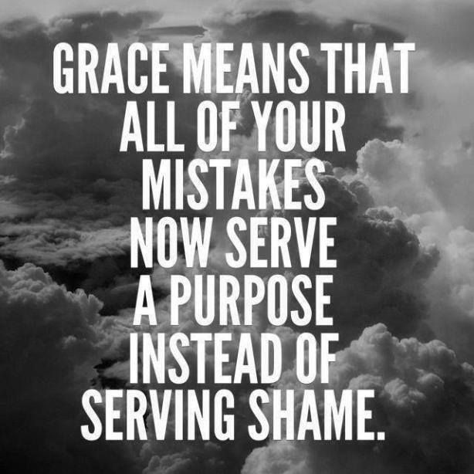
Purchased Out of Slavery
“ex- a- go- rid- zo” =market + out…
…to take off the market."
Jesus paid the price for us and…
…we are No Longer Up For Sale!
He Bought Us / Intends to Keep Us

Slide 17

“ex- a- go- rid- zo” =market + out
Gal 3:13 –redeemed from the Curse
  to Take Off the Block …
  …to Never Be On Block Again
  Removal
Gal 4:4-5
  Fulness of Time ..Sent Forth Son… Redeem…Adoption of Sons
  Paid Price =
  …Not Cheap but Complete

Slide 18
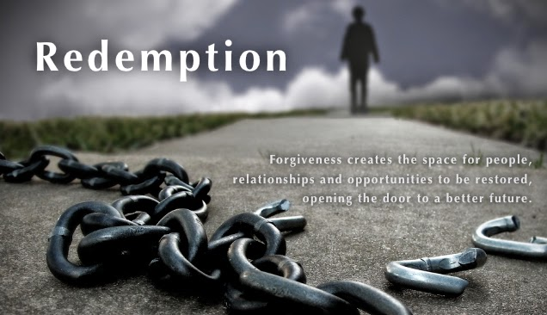

Slide 20
World's Shortest Fairy Tale
Once upon a time, a guy asked a girl "Will you marry me?"
The girl said "No."
And the guy lived happily ever after, went fishing, hunting and golfing and stuff - a lot.

