Slide 1

2024

Slide 2


Slide 3

Repeat
I Lift My Offering to You
Let It Please You Oh Lord
This is My Seed
Although It Leaves My Hand
It will Never Leave My Life
You Will Multiply It!
Accept My Seed Oh Lord!

Slide 4


Slide 5


Slide 6
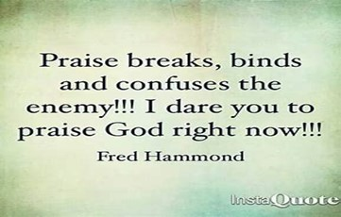

Slide 8

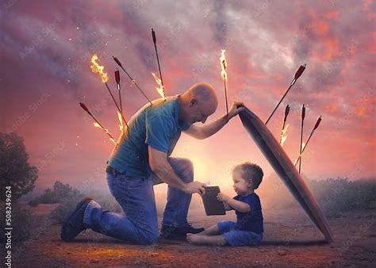
June 16, 2024
Edward Christian Church
“Fathers”
Spiritual Warfare
The Difference Makers
Father’s Day 2024

Slide 9

Front Lines
Fathers
Did You Know We Are the
Front Line of Spiritual Warfare?
Wife
Children
Families
Church

Slide 10

Ezekiel 22:30
"I looked for someone among you
who could build walls or stand in front
of me by the gaps in the walls to
defend the land and keep it from being
destroyed. But I couldn't find anyone

Slide 11
The Problem
There’s a
G a p
in our Nation, Schools, Families, Homes
Separation between God and His People

Slide 12

God’s Plan / Pursuit - “I sought for a MAN..”
Not a
Committee
Neighbor
Someone Else
Better Time
But a Man!
Man= Heb
Husband/ Dad, Steward …
…Champion, Foot-man,
…Mighty Man

Slide 13
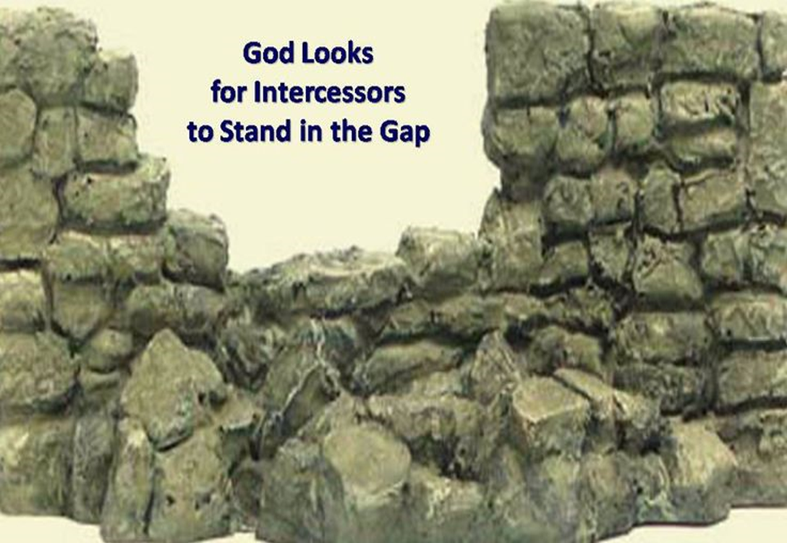
God’s Plan / Pursuit - “I sought for a MAN..”
God's Choice- "From among them..."
Able to Relate –Close to Heart
God’s Representative - “…before Me…”
God's Burden- “..for The Land…”
Our World, Community, Homes, Schools, Neighborhood, Employment.

Slide 14

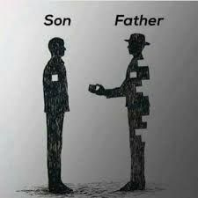
God’s Path - “..stand in the gap”
Gap – breach/ broken wall
Gaps That Only You Can Fill
Faith
Family
Found in the Land

Slide 15

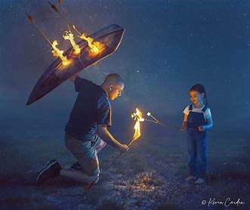
God’s Path - “..stand in the gap”
Stand –appointed to arise…
…and remain firm
Time to Get…
Beyond Ourselves
Into the Fight
Stay in the Fight

Slide 16

God’s Power – “to make up the hedge”
Make Up the Hedge
Repair the Breach - close off- build a wall
Nehemiah- Trowel /Sword
David- Israel /Philistines
Jesus- Cross made up the Hedge
Bridged the Gap
Jesus + Dads Make Up the Hedge for our wives, children, families, churches

Slide 17
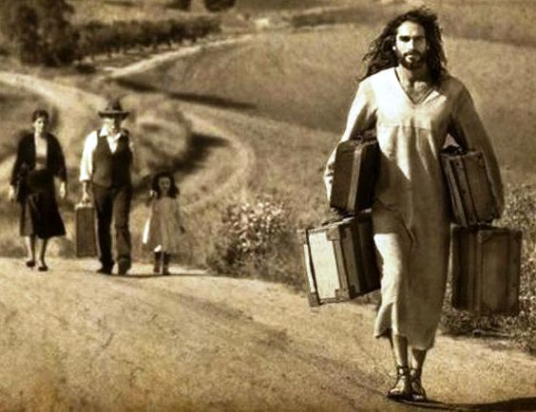
God’s POWER “to make up the hedge”
You DON’T Stand alone.
Jesus Stands With You And Helps Carry Your Load!
Matthew 11:28-30 Jesus said:
“Take my yolk upon you and LEARN from me… you will find REST… my yoke is EASY… burden is light.”

Slide 18

God’s Purpose – “…that I should not destroy it…”
Destroy - decay, ruin, corrupt, destroy , lose, perish, spill
Make up the Hedge – Repair the Breach
Stand - to stand, abide (behind), arise, remain, repair, + serve, stand fast/ firm
In the Gap - a breach, a break

Slide 19
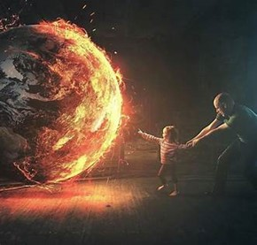
God’s Purpose – “…that I should not destroy it…”
Destroy - decay, ruin, corrupt, destroy, lose, perish, spill
Deliverance…
Doesn’t Come from an Army…
…But a Man (husband/ dad)
Noah- Ark
Moses- Ark

Slide 20
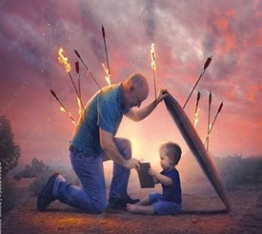
God’s Purpose “…that I should not destroy it…”
Ezekiel 22:30-31The Message (MSG)
“I looked for someone to stand up for me against all this, to repair the defenses of the city, to take a stand for me and stand in the gap to protect this land so I wouldn’t have to destroy it. I couldn’t find anyone. Not one.”
Ezekiel 22:30-31 DLV
“I looked for a dad to stand up for me against all this, to repair the defenses of the family, / to take a stand for me and stand in the gap to protect this country so I wouldn’t have to destroy it. I couldn’t find anyone. Not one.”

Slide 21

Gap Standers
The Bible is Full of Gap Standers
i.e. “Difference Makers”
Common Factors
Sent
God Called
Selfless
It’s Never About Them
Service
It’s About Helping Others

Slide 22
Gap Standers
The Bible is Full of Gap Standers
i.e. “Difference Makers”
FATHERS who stood in the gap:
Noah: Righteous; obediently put his family in the ark to save them
Jacob: Provided for his family; learned to sew (made a coat for Joseph)
Jairus: Prayed (went to Jesus) for his daughter’s healing

Slide 23
Gap Standers
The Bible is Full of Gap Standers
i.e. “Difference Makers”
STEP-Fathers Who Stood in the Gap:
Mordecai: Raised Esther; continued to advise her once she was grown and out of the house
Joseph: Protected and defended Jesus’ mother, Mary; Raised Jesus as his own and taught him his profession

Slide 24

Fathers Remember…
We Are the
Front Line of Spiritual Warfare
Wife
Children
Families
Church
They Are Depending on It!!!

Slide 25

Be Encouraged Men…
We are the Priests of Our Homes
Not by Accident but Design
We Have Heavenly Power When We…
Pray
Proclaim the Word
Protect/ Provide for Our Family
When We Stand Up to Our Challenge…
…God Stands With Us!!!

Slide 27
OILY HAIR
Trying to control my dry hair, I treated my scalp
with olive oil before washing it.
Worried that the oil might leave an odor,
I washed my hair several times.
That night when I went to bed,
I leaned over to my husband and asked,
"Do I smell like olive oil?"
"No," he said, sniffing me.
"Do I smell like Popeye?"

