Slide 1
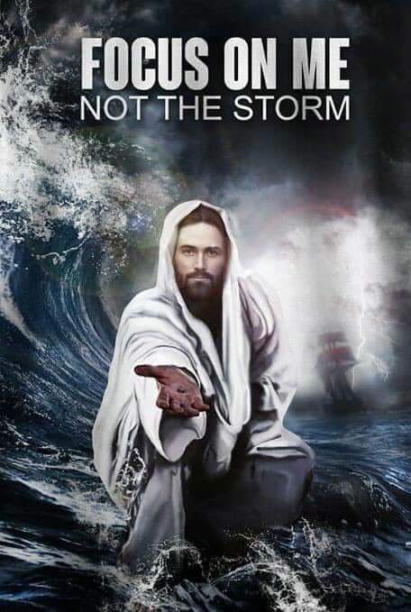
2024

Slide 2
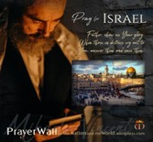

Psalm 17:7-9 -Complete Jewish Bible
⁷ Show how wonderful is your grace,
savior of those who seek at your right hand
refuge from their foes.
⁸ Protect them like the pupil of your eye,
hide them in the shadow of your wings
⁹ from the wicked, who are assailing them,
from their deadly enemies, who are all around them.
And All of the Innocent Victims
on Both Sides

Slide 3
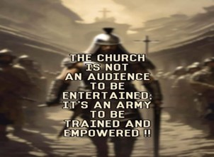
Repeat
These are the 2 Most Important Hours of My Week – Help Me to Cherish Them
I Am Here Today to Worship
Not to Be Entertained
I Am Singing to An Audience of One
Accept My Worship Oh Lord!

Slide 4
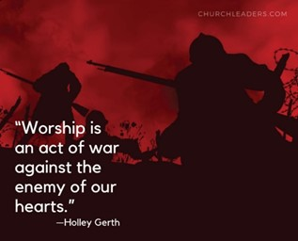

Slide 5
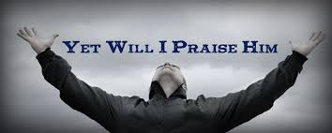
Edward Christian Church
6/21/2024

Slide 6

Repeat
I Lift My Offering to You
Let It Please You Oh Lord
This is My Seed
Although It Leaves My Hand
It will Never Leave My Life
You Will Multiply It!
Accept My Seed Oh Lord!

Slide 7
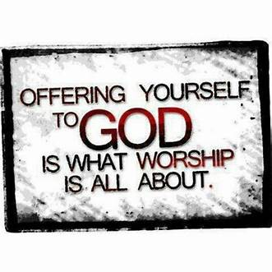

Slide 8


Slide 9
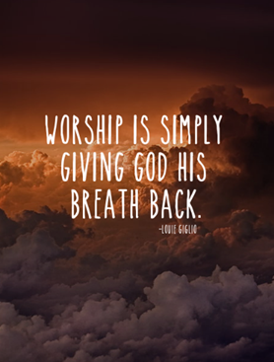

Slide 10
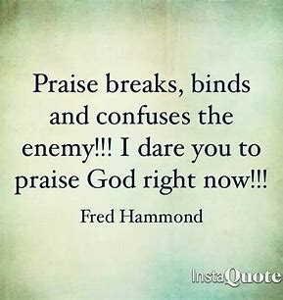

Slide 12

Edward Christian Church
Spiritual
Warfare
Pt 6
Our Adversary
Ephesians 6:10-12
June 23, 2024

Slide 13
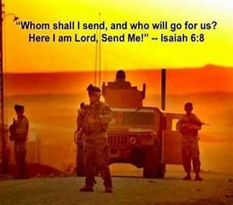
Occupy Til I Come
Occupy
-Does Not Mean
  Take Up Space
-It Does Mean –
  Take a Stance
  Be Productive
  Take Back Lost …
  …Ground / Property

Slide 14
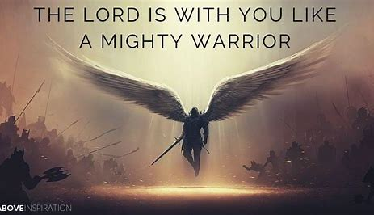
This Means War!!!
There is a War Waging Even Now
It’s a Terrible War of Eternal Proportions
  We Can Reject It
  We Can Rename It
  We Can Resist It
  We Can Recognize it…
  …and Refuse to Do Nothing!!

Slide 15
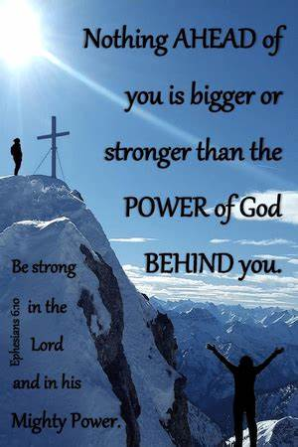
Recognize the Battle
Warning
  Be (now-constant)
  Strong (infused w- inner ability)
  In the Lord (found one place)
  Power (overwhelming – irresistible)
  Might (strong arm)

Slide 16


Slide 17
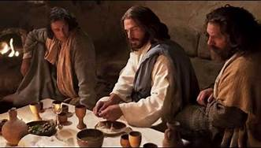
Last Supper
14 Present
Jesus and His Disciples and…
..Satan
He was Looking for a Way to Get to Jesus
A Doorway = an Entry Point in His Life…
…to Affect His Life
He Found None –John 14:30
Hereafter I will not talk much w- you: for the prince of this world cometh, and hath nothing in me.
Every Door was Shut!

Slide 18
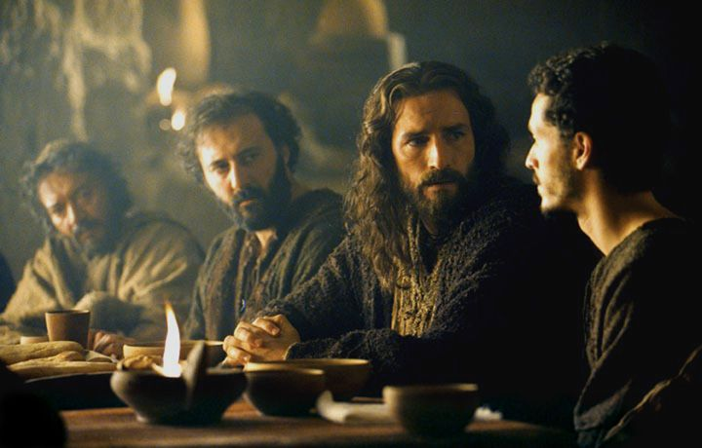
Last Supper
Jesus Lived a Life that Kept the Door Closed
So Satan looked for Someone Close…
…to Get to Him
                “Disciples”
There was a Dispute…
                Among them
                Within them
These Disputes…
…Produced Doors
…Entry Points for Satanic Activity

Slide 19
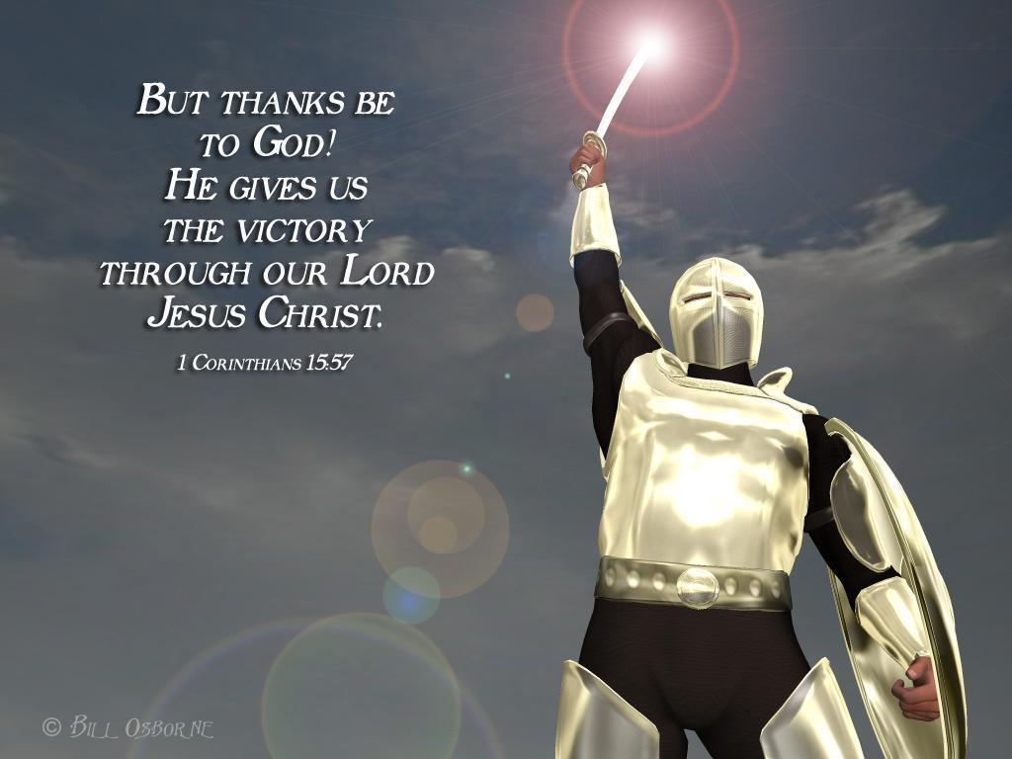
Victory
Jesus Never Meant for Us to Live
…Defeated
…Depressed
…Unproductive Lives
But Satan Constantly Looks for Doors…
…to Expose These to Us
…to Bring these into Our Lives

Slide 20
A Child of God CANNOT be Possessed
God and Satan Cannot Co-Exist
God…
…is Never Limited
All Places @ Once
He is Omnipresent
All Powerful
He is Omnipotent
All Knowing
He is Omniscient
Satan…
…is Limited
One Place @ Time
He is Not
Limited Power
He is Not
Limited Knowledge
He is Not

Slide 21
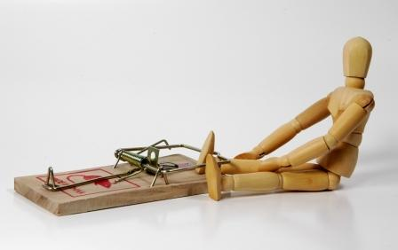
Child of God CANNOT Be Possessed
But He Can Be…
  Oppressed
  Suppressed
  Bruised
  Used
That’s Why God Warns…
Eph 4:27 -No Place for Devil…(open door)
These Doors Are…

Slide 22


Slide 23
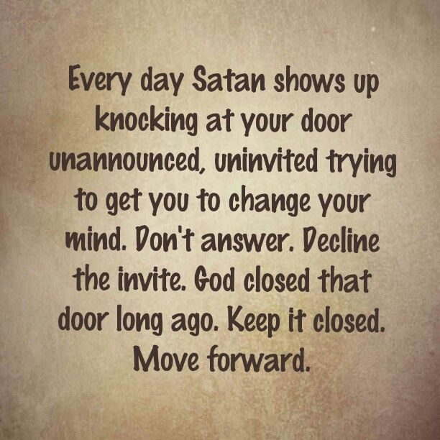
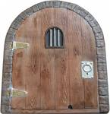
Eph 4:27 –no place for Devil (No Door)
Door = Opportunity
There are 5 Doors
#1- Fear

Slide 24

What Do You Fear?
During his 1933 Inaugural Address, President Franklin Roosevelt sought to calm a troubled America in the throes of depression by saying…
"There is Nothing to Fear but Fear Itself"
Fear is a Feeling of Dread, Alarm, Panic and Anxiety
Fear Ranges from Mild Anxiety to Panic Attacks
The Psychiatric Association has categorized a variety of phobias, such as acrophobia, claustrophobia, agoraphobia

Slide 25


What Do You Fear?
We Are Born With Only Two Fears
  Fear of Falling and the Fear of Loud Noises
  All other Fears are Learned Responses
Fear Takes On Many Forms
  fear of success, failure, rejection, disease, future, life after death
  Jesus described last days-times of intense, worldwide fear -Luke 21:26
Fear Produces Negative Effects
  Fear paralyzes decision making, immobilizes action,
  hinders prayer, limits faith, stifles joy, damages health
  restricts relationships, lowers productivity

Slide 26

Because of Fear...
Adam /Eve hid from God in Garden -Gen 3:8-10
Israel forfeited Canaan -Num 14:20-25
Ephraim turned back in the day of battle -Psa 78:9
Saul's army fled from Goliath -1 Sam 17:8-10
Elijah suffered depression -1 Kings 19:3-5
Jonah ran from the call of God -Jonah 1:3
Man w- one talent buried it in the ground -Matt 25:24
Disciples-"Master..care that we perish?" -Mark 4:38
Christ's disciples deserted Him at cross -Matt 26:56

Slide 27
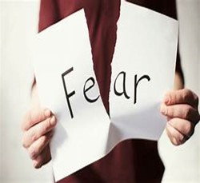
What Do You Fear?
In a World of Fear, God Speaks:
“Fear not; only believe!"
This was Christ's Message to Jairus…
"Fear not; only believe!” -Luke 8:50
It's been said that…
“Fear Is The Distance Between A Man And God”

Slide 28
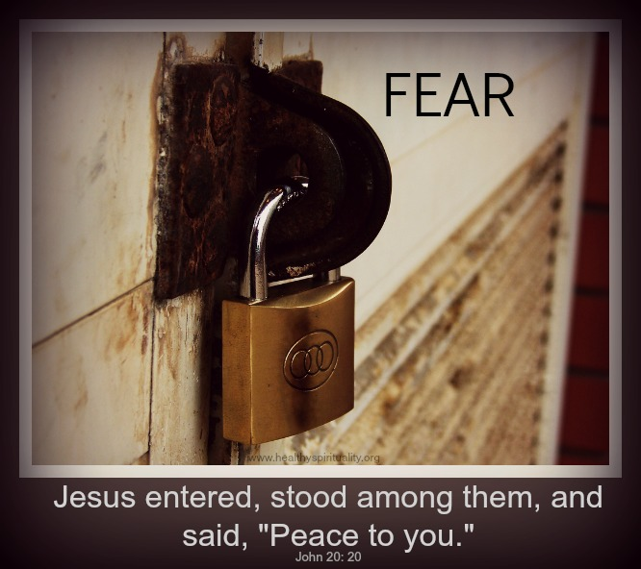
Door #1- Fear
Most Common Commandment
  365 times
Rational Fear
  Protects
  Prioritizes
Irrational Fear
  Paralyzes
  Prevents

Slide 29

Door #1- Fear
II Tim 1:7
Not Given Spirit of…
…Fear (timidity –spt inferiority)
But…
  Power
  Love
  Sound Mind
Fear is the Opposite
  Weak
  Self-centered
  Confused

Slide 30

Door #1- Fear
How Do I Close the Door?
      Realize…
      Fear is From Satan
      Fear is a Choice
      I DO NOT have to Accept IT!
Choose…
Faith in God /
His Ability to Handle…
my Past, Present, Future
my Problems, my Giants

Slide 31
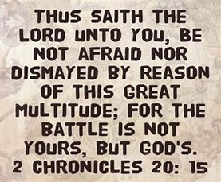
I Refuse to Live By…
Fear-
2 Timothy 1:7 (KJV)⁷ For God hath not given us the spirit of fear; but of power, and of love, and of a sound mind.
Anxiety-
Philippians 4:6-7 (NLT)⁶ Don’t worry about anything; instead, pray about everything. Tell God what you need, and thank him for all he has done. ⁷ Then you will experience God’s peace, which exceeds anything we can understand. His peace will guard your hearts and minds as you live in Christ Jesus
Paranoia-
Jeremiah 17:9-10 (MSG) “The heart is hopelessly dark / deceitful, a puzzle that no one can figure out. But I, God, search the heart/ examine the mind.
Isaiah 26:3 (NLT) You will keep in perfect peace all who trust in you, all whose thoughts are fixed on you!

Slide 33
humorous story of a guy who prayed this prayer every morning: "Lord, if you want me to witness to someone today, please give me a sign to show me who it is." One day he found himself on a bus when a big, burly man sat next to him. The bus was nearly empty but this guy sat next to our praying friend. The timid Christian anxiously waited for his stop so he could exit the bus. But before he could get very nervous about the man next to him, the big guy burst into tears and began to weep. He then cried out with a loud voice, "I need to be saved. I’m a lost sinner and I need the Lord. Won’t somebody tell me how to be saved?" He turned to the Christian and pleaded, "Can you show me how to be saved?" The believer immediately bowed his head and prayed, "Lord, is this a sign?"

Slide 34
A fog covering seven city blocks is composed of 1 glass of water
According to the Bureau of Standards in Washington, a dense fog covering seven city blocks to a depth of 100 feet is composed of less than one glass of water. That amount of water is divided into about 60 billion tiny droplets. Yet when those minute particles settle over a city or the countryside, they can almost blot out everything from sight.

Slide 35
Black Bart and the Power of Fear
He was a professional thief.
His name stirred fear as the desert wind stirs tumbleweeds.
He terrorized the Wells Fargo stage line for thirteen years, roaring like a tornado in and out of the Sierra Nevada’s,
spooking the most rugged frontiersmen.
In journals from San Francisco to New York,
his name became synonymous with the danger of the frontier.
During his reign of terror between 1875 and 1883, he is credited with
stealing the bags / the breath away from 29 different stagecoach crews.
And he did it all without firing a shot.
His weapon was his reputation. His ammunition was intimidation.
A hood hid his face. No victim ever saw him.
No artist ever sketched his features.
No sheriff could ever track his trail.
He never fired a shot or took a hostage.
He didn’t have to. His presence was enough to paralyze.
Black Bart.
A hooded bandit armed with a deadly weapon.
What was his deadly weapon? One word, it was FEAR!

