Slide 1

Repeat
I Lift My Offering to You
Let It Please You Oh Lord
This is My Seed
Although It Leaves My Hand
It will Never Leave My Life
You Will Multiply It!
Accept My Seed Oh Lord!

Slide 2
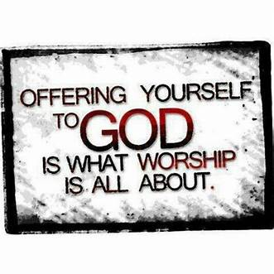

Slide 3


Slide 4
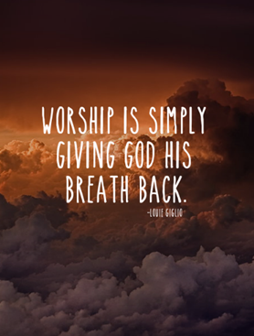

Slide 5
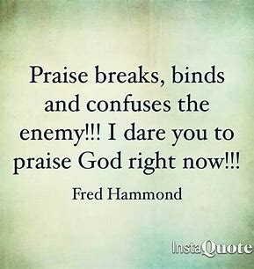

Slide 6
My wife beamed at me with pride and said, "WOW! I never thought our son would go that far!"
I said, "This catapult is amazing!
Go get our daughter."

Slide 8

Edward Christian Church
Spiritual
Warfare
Pt 7
Our Adversary
Ephesians 6:10-12
June 30, 2024

Slide 9
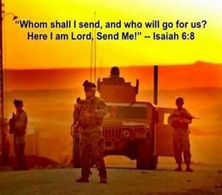
Occupy Til I Come
Occupy
-Does Not Mean
Take Up Space
-It Does Mean –
Take a Stance
Be Productive
Take Back Lost …
…Ground / Property

Slide 10
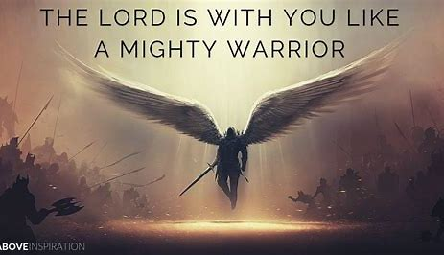
This Means War!!!
There is a War Waging Even Now
It’s a Terrible War of Eternal Proportions
We Can Reject It
We Can Rename It
We Can Resist It
We Can Recognize it…
…and Refuse to Do Nothing!!

Slide 11
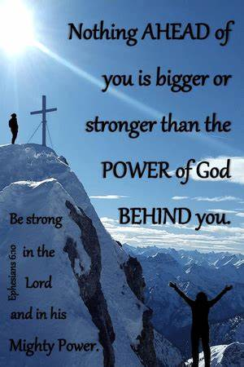
Recognize the Battle
Warning
Be (now-constant)
Strong (infused w- inner ability)
In the Lord (found one place)
Power (overwhelming – irresistible)
Might (strong arm)

Slide 12


Slide 13
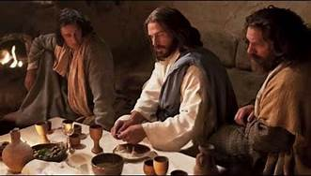
Last Supper
14 Present
Jesus and His Disciples and…
..Satan
He was Looking for a Way to Get to Jesus
A Doorway = an Entry Point in His Life…
…to Affect His Life
He Found None –John 14:30 Hereafter I will not talk much w- you: for the prince of this world cometh, and hath nothing in me.
Every Door was Shut!

Slide 14
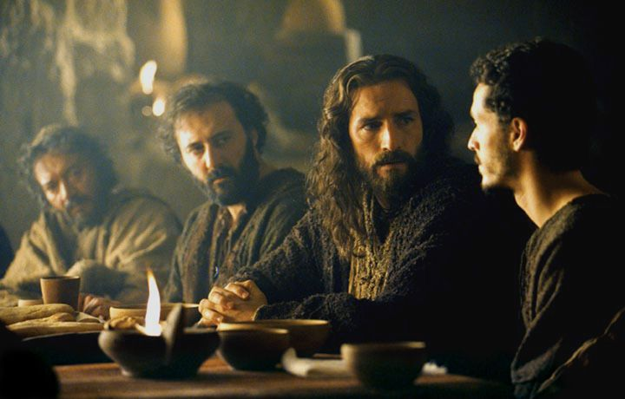
Last Supper
Jesus Lived a Life that Kept the Door Closed
So Satan looked for Someone Close…
…to Get to Him
“Disciples”
There was a Dispute…
Among them
Within them
These Disputes…
…Produced Doors
…Entry Points for Satanic Activity

Slide 15


Slide 16
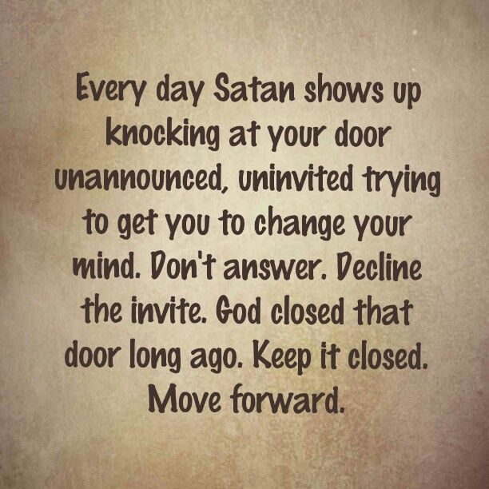
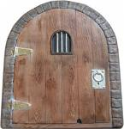
Eph 4:27 –no place for Devil (No Door)
Door = Opportunity
There are 5 Doors
#1- Fear

Slide 17

Door #1- Fear
II Tim 1:7
Not Given Spirit of…
…Fear (timidity –spt inferiority)
But…
Power
Love
Sound Mind
Fear is the Opposite
Weak
Self-centered
Confused

Slide 18
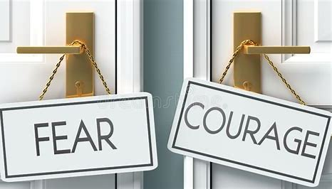
Door #1- Fear
How Do I Close the Door?
Realize…
Fear is From Satan
Fear is a Choice
I DO NOT have to Accept IT!
Choose…
Faith in God /
His Ability to Handle…
my Past, Present, Future
my Problems, my Giants

Slide 19

Eph 4:27 –no place for Devil (No Door)
Door = Opportunity
There are 5 Doors
#1- Fear
#2- Pride
“Inflated Self-Interest”

Slide 20


Slide 21
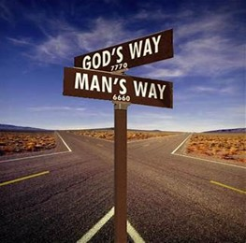
Types of Pride
Healthy Pride
Leads to Sense of…
…Accomplishment
Unhealthy Pride
Non-Aggressive
Aggressive
Reverse
Leads to Sense of…
…Arrogance (Ego)

Slide 22
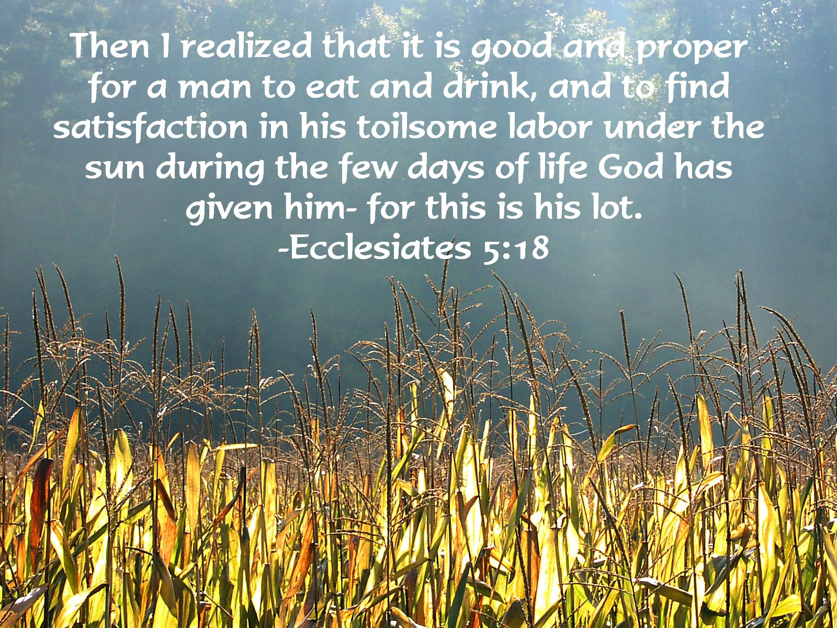
Healthy Pride
Sense of Accomplishment
Ecc 5:18-19
It's a Gift from God…
to be Able to Work Hard and…
…see the Results of Our Efforts.
take Pleasure in Our Achievements…
…or Achievements of those Around Us
Always Keep Them in Perspective
Always Thank God for Them

Slide 23
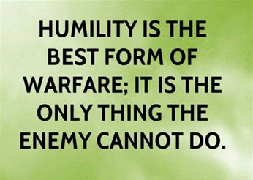
UnHealthy Pride
(Arrogance)
Inflated Self Interest
Non-Aggressive
Peter -Luke 22
My Way…
…Best Way
Characteristics:
Refuse Most Help
Refuse Most Advice
Favorite Saying…
…I Know What I’m Doing !

Slide 24

UnHealthy Pride
Tendency to Lose Perspective
Forget to Give Thanks to God
How to Overcome ?
Regain Perspective
I am Human
…He Is God
I am Prone to Fail
…He Never Fails
Remember
My Way Not Always the Best Way!
Regain Thanks to God

Slide 25
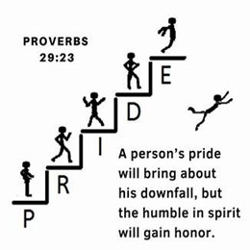
UnHealthy Pride
Aggressive
Uzziah (II Chron 26:19-21)
My Way…
…Only Way
Characteristics:
Sabotage Most Help
Down Play Most Advice
Favorite Saying…
…We are Going to Do It My Way!

Slide 26
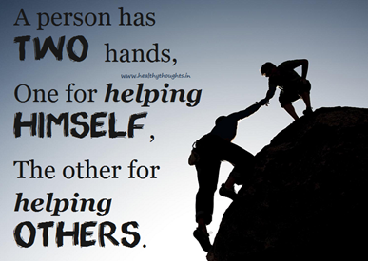
UnHealthy Pride
Reverse
Timothy -I Tim 1:7
My Way…
…Never the Way
Characteristics:
Afraid to Help
Afraid to Give Advice
Favorite Saying…
…They Never Do It My Way!

Slide 27
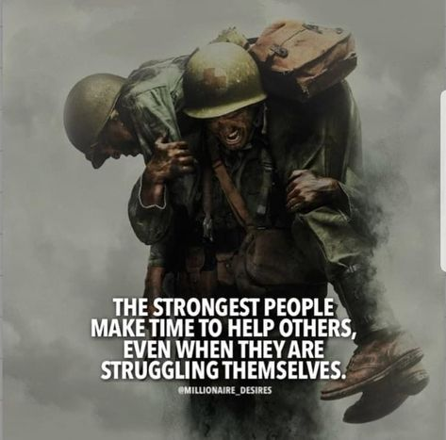
Four Key Questions
Am I in Competition w- Others
Can I listen to opinion to others ?
With out attacking them?
Believing my opinion is the only one?
Do I Feel Self-Sufficient
Do I Struggle w- Self Image
Do I Choose Friends for..
Appearance
Position
Performance

Slide 28
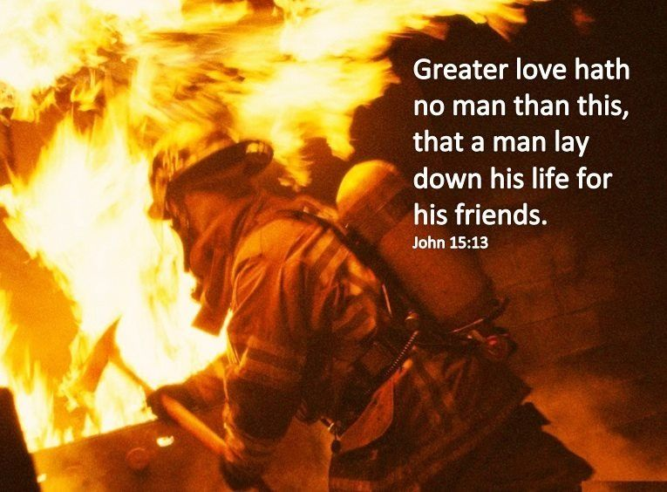
Prescription for “I” Strain
How Do I Close the Door?
…True Biblical Humility
Biblical Humility…
…Does Not Mean
We Operate…
…Out of Weakness
…Does Mean
We Operate…
…Out of Strength

Slide 29
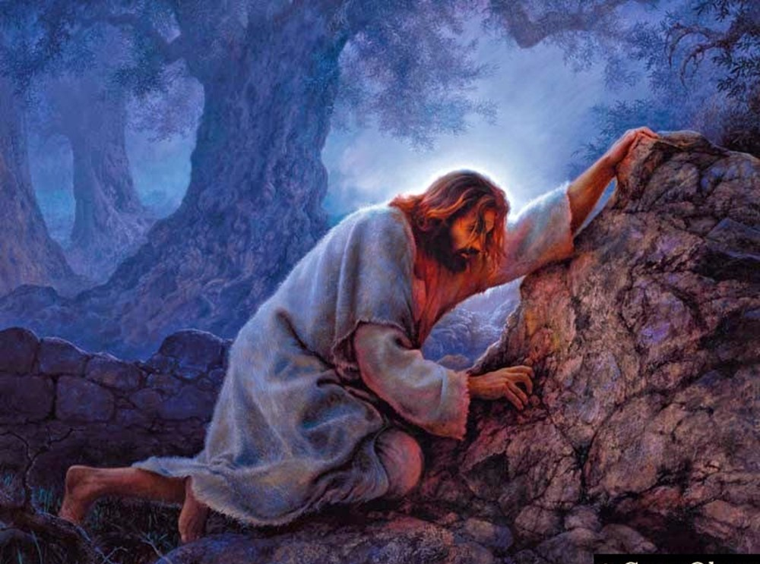
Closing the Door on Pride
Humility
Phil 2:6-8
Humility Defined…
Submission “ My Father! If it is possible, let this cup pass from me. Yet I want your will, not mine.” Matt 26:39
Die to Self

Slide 30

Closing the Door on Pride
Submission
Love
¹³ Greater love hath no man than this, that a man lay down his life for his friends. -John 15:13 (KJV)
Do Unto Others
Sacrifice “No one takes my life away from me. I give it up of my own free will.” John 10:18 Today’s Eng Vers
Do Unto Others First

Slide 31
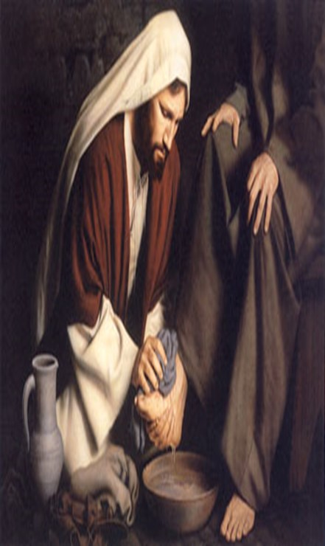

Closing the Door on Pride
Submission
Love
Sacrifice
James 4:6-7 (KJV) ⁶But he giveth more grace. Wherefore he saith, God resisteth the proud, but giveth grace unto the humble. ⁷ Submit yourselves therefore to God. Resist the devil, and he will flee from you.
You Will Close the Door!!!

Slide 32

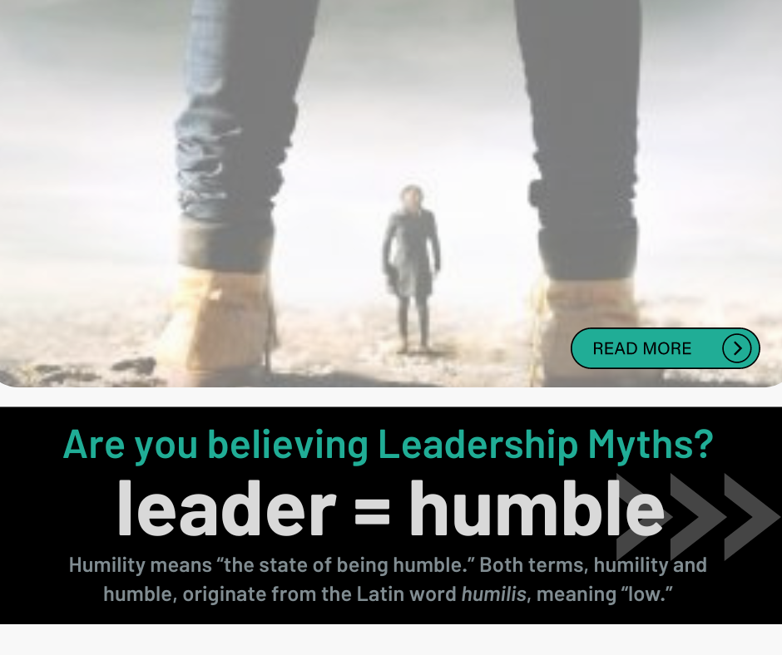
Myth #1:
Humble people are losers, not as capable as others
Truth:
The humble are lifted up by the Lord -James 4:10
Myth #2:
Humble people end up as failures/ unimportant
Truth:
The humble will one day be exalted -Matt 23:12
Myth #3:
Humble people aren’t as smart as others
Truth:
The humble will grow in wisdom -Proverbs 11:2
Myth #4:
“” won’t be victorious or successful as others
Truth: The humble succeed in the end -Psalm 149:4

Slide 33
