Slide 1

Edward Christian Church
Spiritual
Warfare
Pt 8
Our Adversary
Ephesians 6:10-12
July 7, 2024

Slide 2
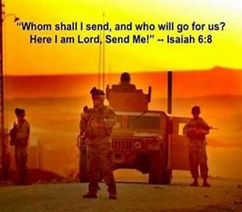
Occupy Til I Come
Occupy
-Does Not Mean
  Take Up Space
-It Does Mean –
  Take a Stance
  Be Productive
  Take Back Lost …
  …Ground / Property

Slide 3
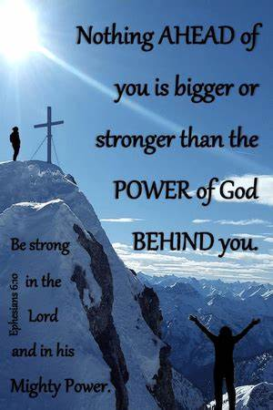
Recognize the Battle
Warning
  Be (now-constant)
  Strong (infused w- inner ability)
  In the Lord (found one place)
  Power (overwhelming – irresistible)
  Might (strong arm)

Slide 4


Slide 5
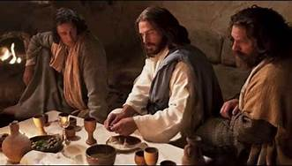
Last Supper
14 Present
Jesus and His Disciples and…
..Satan
He was Looking for a Way to Get to Jesus
A Doorway = an Entry Point in His Life…
…to Affect His Life
He Found None –John 14:30
Hereafter I will not talk much w- you: for the prince of this world cometh, and hath nothing in me.
Every Door was Shut!

Slide 6
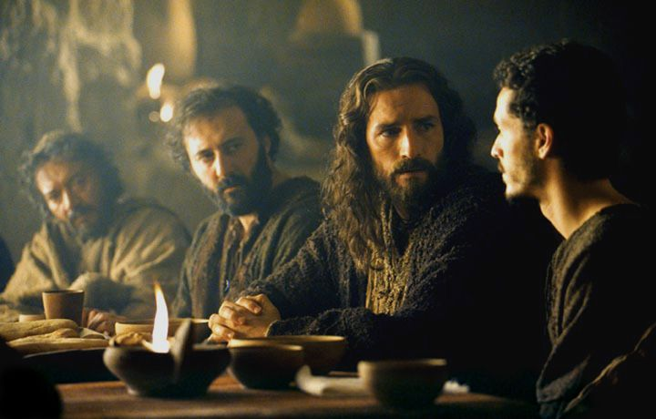
Last Supper
Jesus Lived a Life that Kept the Door Closed
So Satan looked for Someone Close…
…to Get to Him
                “Disciples”
There was a Dispute…
                Among them
                Within them
These Disputes…
…Produced Doors
…Entry Points for Satanic Activity

Slide 7
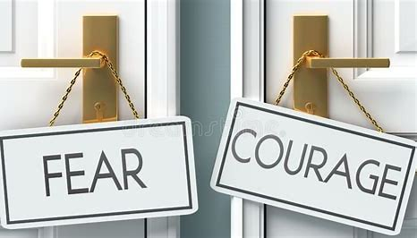
Door #1- Fear
How Do I Close the Door?
      Realize…
      Fear is From Satan
      Fear is a Choice
      I DO NOT have to Accept IT!
Choose…
Faith in God /
His Ability to Handle…
my Past, Present, Future
my Problems, my Giants

Slide 8

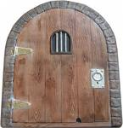
Eph 4:27 –No Place for Devil (No Door)
Door = Opportunity
There are 5 Doors
#1- Fear
#2- Pride
“Inflated Self-Interest”

Slide 9
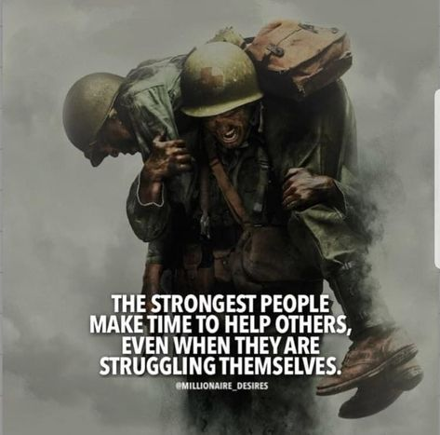
Four Key Questions
Am I in Competition w- Others
  Can I listen to opinion of others ?
  Without attacking them?
  Believing my opinion is the only one?
Do I Feel Self-Sufficient
Do I Struggle w- Self Image
Do I Choose Friends for..
      Appearance
      Position
      Performance

Slide 10

Eph 4:27 –no place for Devil (No Door)
Door = Opportunity
There are 5 Doors
#1- Fear
#2- Pride
#3- Forgiveness
“the Key that Sets So Many Free”

Slide 11
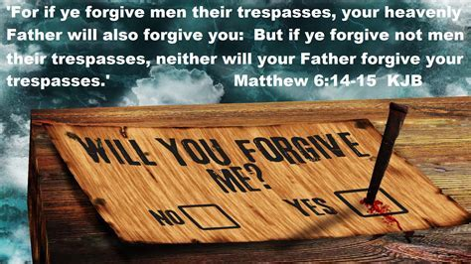
Door #3- Unforgiveness
One of the Most Effective Doors that
Satan Uses to Enter Our Lives is…
UnForgiveness
It Starts as Subtle as Whisper
Then it Explodes into Our Lives Like a…
Tidal Wave
It Locks us Down…
Knocks us Out of Spiritual Balance
Although it Starts with One…
…It Affects Every Relationship!!

Slide 12

Why Forgive?
Matthew 18:21-35
Unforgiveness Binds (22)
  Sin –Command –State of Spt Revolt
  Matt 6:12, “Forgive debts as we forgive”
Unforgiveness Blinds (31)
  Hinders our Relationship w- God / Others
  Matt 6:15, “if not forgive, he will not forgive”
Unforgiveness Grinds (34)
  Torment

Slide 13

What Forgiveness is Not
Not Denying the Offense
  It never really happened
Not Forgetting Offense
  I can just forget it happened
Not Excusing Offense
  Still hold others accountable for their actions or lack of actions.
Forgiveness Doesn't Mean Things Go
Back to the Way They Were Before
  It Doesn’t Always Lead to Reconciliation
  But It Does Open the Door For It

Slide 14
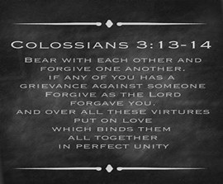
What Forgiveness Is
Closing the Door
To Forgive means to “Release”
"to forgive“ = "to let go" and
"to cancel a debt".
It is an Act of the Will
Forgiveness is a 2 Step Process
a- Immediate -decision
b- On-Going -process
It is Truly Modeling Christ
It Works Beyond Reconciliation

Slide 15

Forgiveness vs Reconciliation
Forgiveness Only Needs One Person
Reconciliation requires at least two persons
Forgiveness is Directed One-way
Reconciliation is Reciprocal... Two-ways
Forgiveness is Decision to Release Offender
Reconciliation is Effort to Rejoin the Offender
Forgiveness is Unconditional, Regardless of Lack of Repentance
Reconciliation is conditional based on…
…Repentance and Change of Behavior

Slide 16

SetBacks to Forgiveness
Fear
“What If”
They Do Not Acknowledge
They Do Not Change
Pride
“Why”
They Don’t Deserve Release
They Do Deserve Pain

Slide 17

Unforgiveness
Unforgiveness Leads to Anger…
…Unresolved Anger Leads to Bitterness
Ephesians 4:26-27 (KJV)
Be ye angry, /sin not: let not the sun go down upon your wrath: …give place to devil.
Battle –all become angry
Bottled –sun go down wrath(rage> bitterness)
Blown Out –Place to Devil(diablos-accuser)

Slide 18
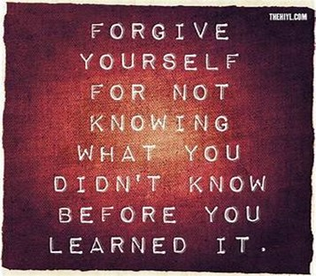
Unforgiveness
Unforgiveness leads to Anger…
…Unresolved Anger leads to Bitterness
Bitterness leads to Depression
Depression (Anger Turned Inward)
It Imprisons You!
Forgiveness = Release
It’s Not for the Offender- but for You
Not Based on their Actions…
…but Your Attitude
It Sets You Free!

Slide 19
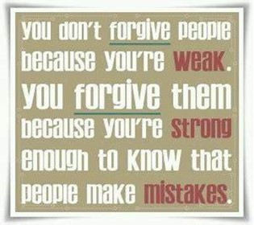
“Whoever opts for revenge should dig two graves.” (Chinese proverb)
“Not forgiving someone is like drinking rat poison and then waiting for the rat to die.”

Slide 20

Forgiveness
Unforgiveness Builds a Wall
Forgiveness Builds a Bridge
Changes Our Status from…
Victim to Victor
We Serve a Merciful and Gracious God
He Expects the Same from Us!

Slide 21
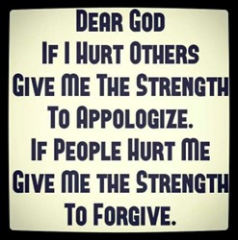
"Lord of Grace, If I hold in my heart the pain caused by others, and I’ll find it hard to forgive. Pour Your grace into my heart, and allow me to let go of bitterness. Help me to forgive as freely as You have forgiven me, knowing that in forgiveness lies the path to true peace."
"Lord, please help me to forgive those who have hurt me and have sinned against me. Through the power of your Holy Spirit, I can choose to live free of bitterness and anger over what others have done to me. Help me to release them into your hands, and heal the wounds of my heart."
Shut the Door!
It’s Cold Out There!
Forgive!!!

Slide 22

Repeat
I Lift My Offering to You
Let It Please You Oh Lord
This is My Seed
Although It Leaves My Hand
It will Never Leave My Life
You Will Multiply It!
Accept My Seed Oh Lord!

Slide 23
One day a mother was out and dad was looking after daughter. She was maybe 2 1/2 years old and had just recovered from a bad cold. Someone had given her a little tea set as a get-well gift and it was one of her favorite toys.
Dad was in the living room engrossed in the evening news when she brought Daddy a little cup of "tea," which was just water. After several cups of tea and lots of praise for such good tea, mom came home.
Dad made her wait in the living room to watch her bring him a cup of tea. ("It's just the cutest thing!") Mom waited and sure enough, She came down the hall with a cup of tea for Daddy. Mom watched him drink it, then said (as only a mother would)..."Did it ever occur to you that the only place she can reach to get water is from the toilet?"
If you get an email w- subject "Knock Knock," don't open it. It’s a Jehovah Witness working from home.

