Slide 1
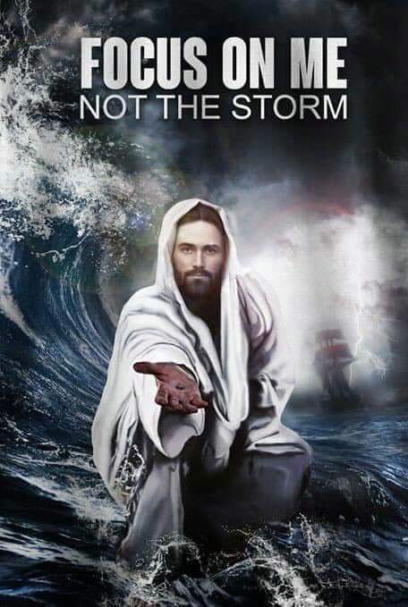
2024

Slide 2
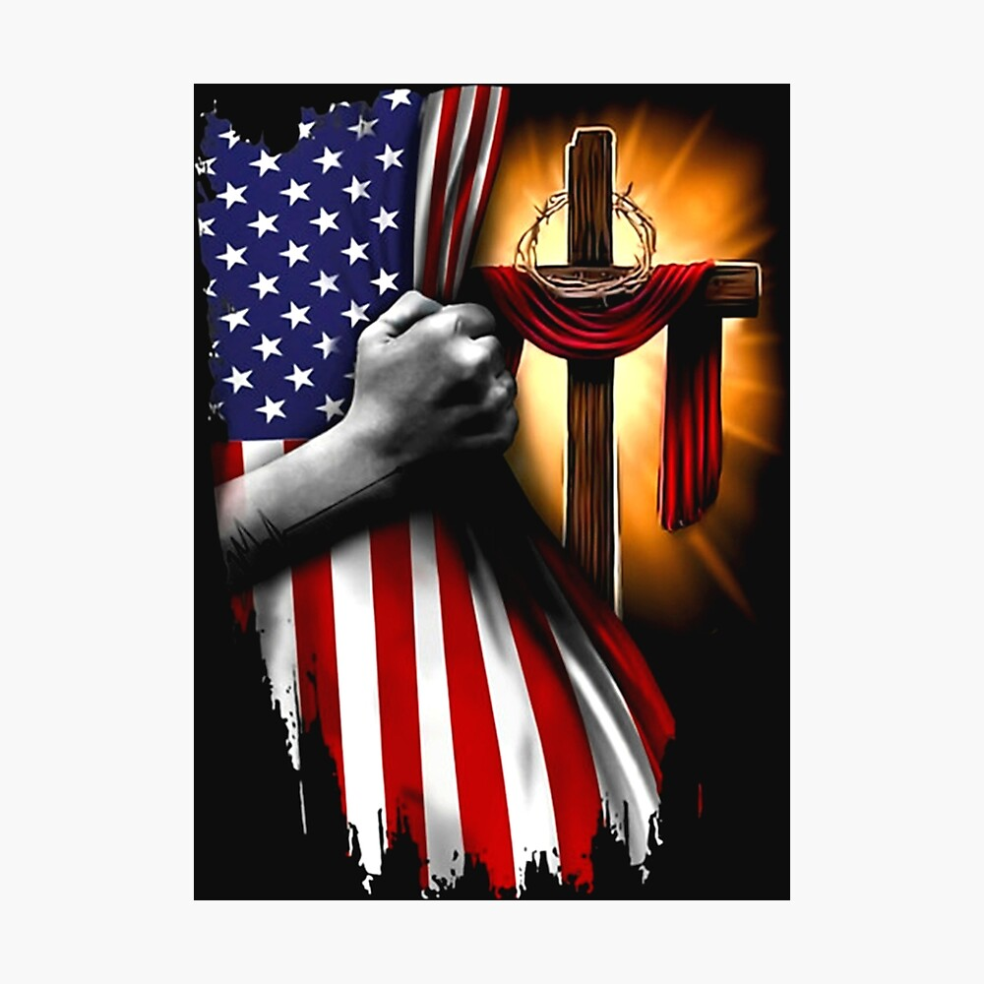
This is Much Bigger Than Politics
We Are In Crisis as a Nation
We Need God to Intervene
No Matter Our Political Viewpoint
Let Us Join Together
Seek God

Slide 3
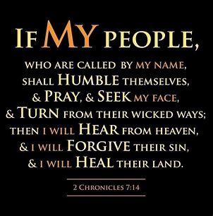

Slide 4
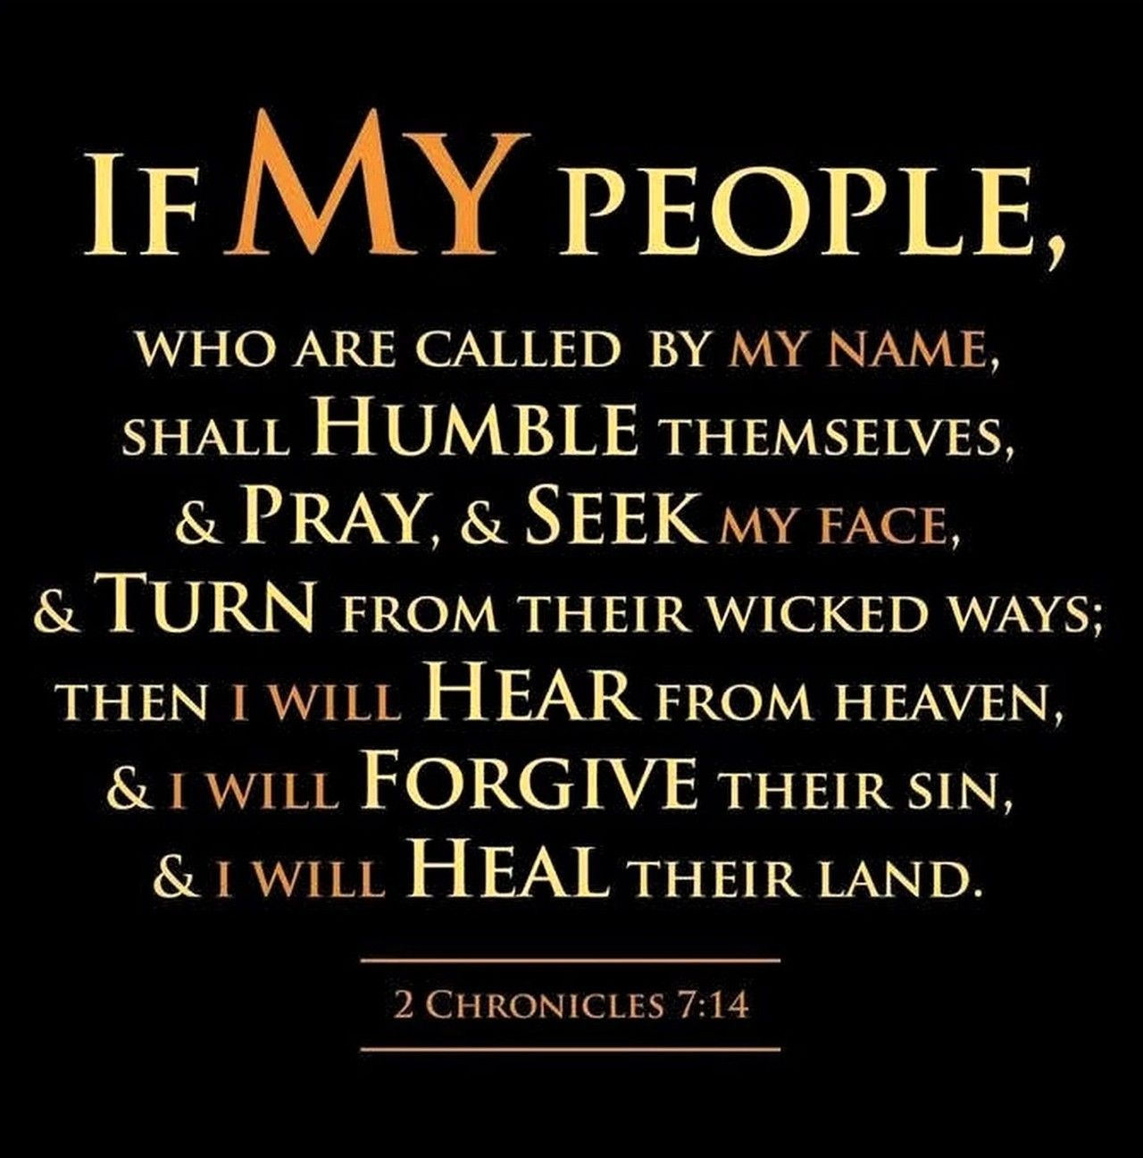
If My People –
Who Are Called By My Name
Shall Humble Themselves
Pray
Seek
Turn from Wicked Ways
Then I Will…
Hear
Forgive
Heal

Slide 5
