Slide 1
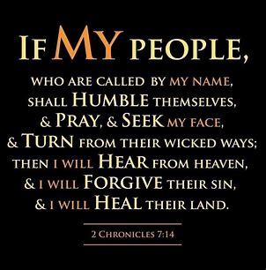

Slide 2

This is Much Bigger Than Politics
We Are In Crisis as a Nation
We Need God to Intervene
No Matter Our Political Viewpoint
Let Us Join Together
Seek God

Slide 3
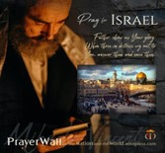

Psalm 17:7-9 -Complete Jewish Bible
⁷ Show how wonderful is your grace,
savior of those who seek at your right hand
refuge from their foes.
⁸ Protect them like the pupil of your eye,
hide them in the shadow of your wings
⁹ from the wicked, who are assailing them,
from their deadly enemies, who are all around them.
And All of the Innocent Victims
on Both Sides

Slide 4
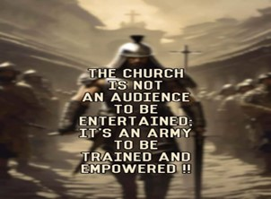
Repeat
These are the 2 Most Important Hours of My Week – Help Me to Cherish Them
I Am Here Today to Worship
Not to Be Entertained
I Am Singing to An Audience of One
Accept My Worship Oh Lord!

Slide 5
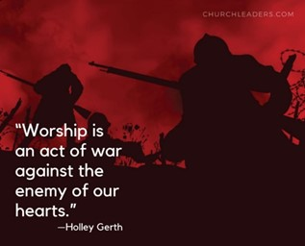

Slide 6
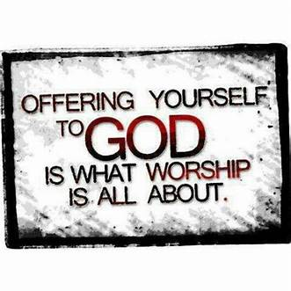

Slide 7
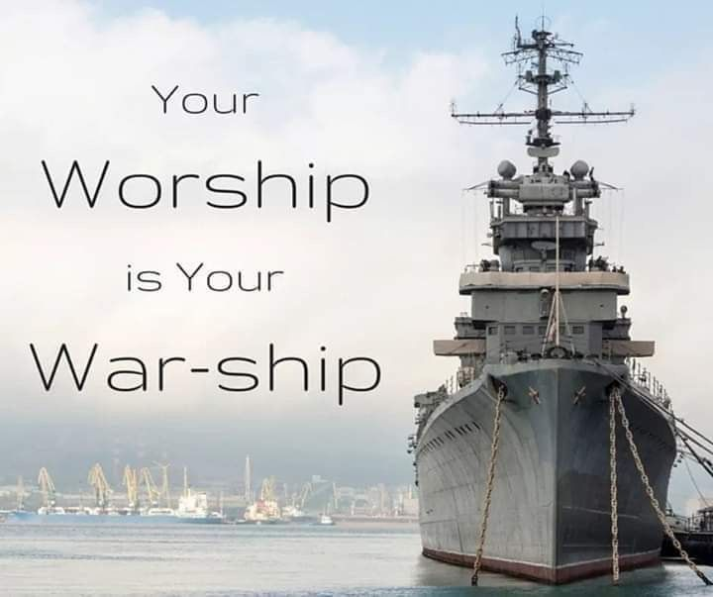

Slide 8

Repeat
I Lift My Offering to You
Let It Please You Oh Lord
This is My Seed
Although It Leaves My Hand
It will Never Leave My Life
You Will Multiply It!
Accept My Seed Oh Lord!

Slide 9
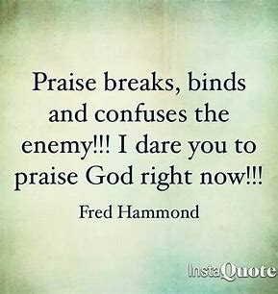

Slide 11

Edward Christian Church
Spiritual
Warfare
Pt 9a
Our Adversary
Ephesians 6:10-12
July 14, 2024

Slide 12
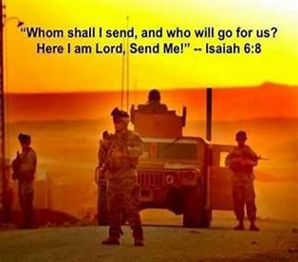
Occupy Til I Come
Occupy
-Does Not Mean
  Take Up Space
-It Does Mean –
  Take a Stance
  Be Productive
  Take Back Lost …
  …Ground / Property

Slide 13
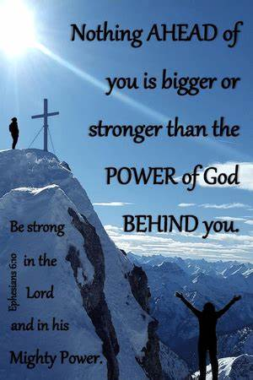
Recognize the Battle
Warning
  Be (now-constant)
  Strong (infused w- inner ability)
  In the Lord (found one place)
  Power (overwhelming – irresistible)
  Might (strong arm)

Slide 14


Slide 15
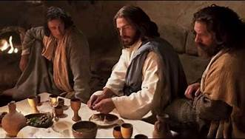
Last Supper
14 Present
Jesus and His Disciples and…
..Satan
He was Looking for a Way to Get to Jesus
A Doorway = an Entry Point in His Life…
…to Affect His Life
He Found None –John 14:30
Hereafter I will not talk much w- you: for the prince of this world cometh, and hath nothing in me.
Every Door was Shut!

Slide 16
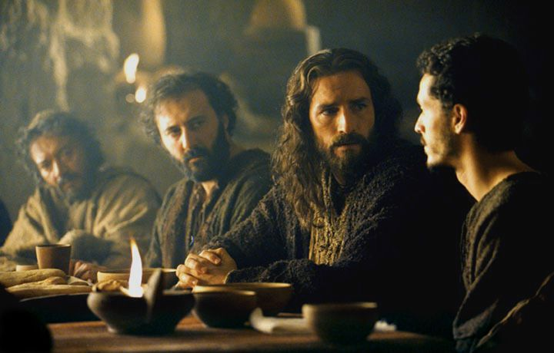
Last Supper
Jesus Lived a Life that Kept the Door Closed
So Satan looked for Someone Close…
…to Get to Him
                “Disciples”
There was a Dispute…
                Among them
                Within them
These Disputes…
…Produced Doors
…Entry Points for Satanic Activity

Slide 17


Slide 18

Door #1- Fear
How Do I Close the Door?
      Realize…
      Fear is From Satan
      Fear is a Choice
      I DO NOT have to Accept IT!
Choose…
Faith in God /
His Ability to Handle…
my Past, Present, Future
my Problems, my Giants

Slide 19

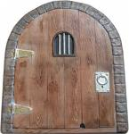
Eph 4:27 –No Place for Devil (No Door)
Door = Opportunity
There are 5 Doors
#1- Fear
#2- Pride
“Inflated Self-Interest”

Slide 20
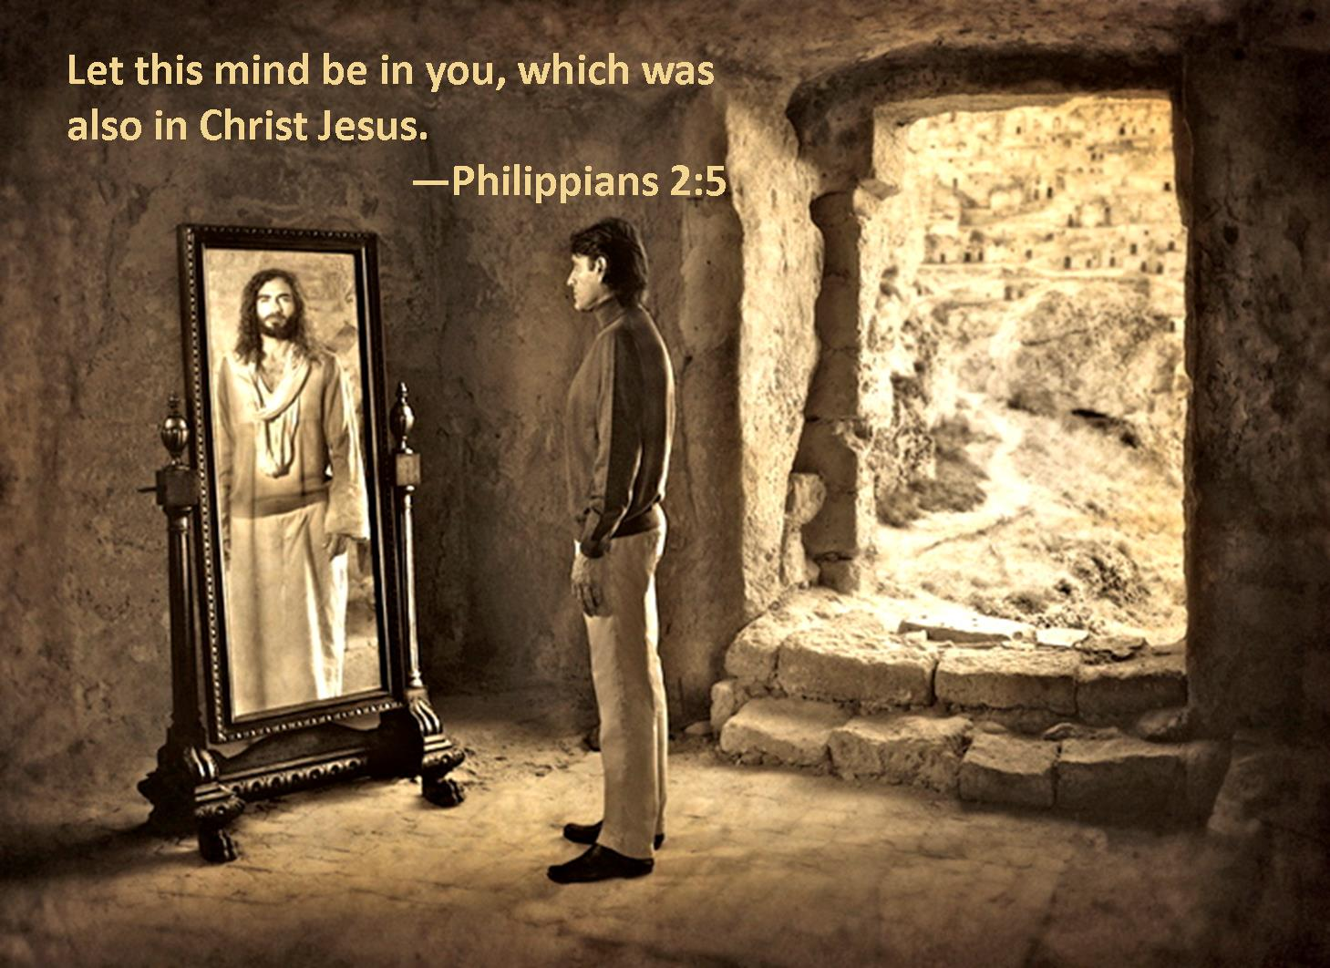
Four Key Questions
Am I in Competition w- Others
  Can I listen to opinion of others ?
  Without attacking them?
  Believing my opinion is the only one?
Do I Feel Self-Sufficient
Do I Struggle w- Self Image
Do I Choose Friends for..
      Appearance
      Position
      Performance
Refer to Phil 2:5

Slide 21

Eph 4:27 –no place for Devil (No Door)
Door = Opportunity
There are 5 Doors
#1- Fear
#2- Pride
#3- Forgiveness
“the Gift that Keeps on Giving”

Slide 22
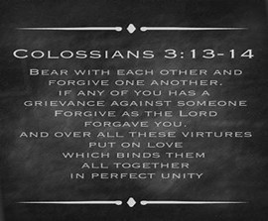
What Forgiveness Is
Closing the Door
To Forgive means to “Release”
"to forgive“ = "to let go" and
"to cancel a debt".
It is an Act of the Will
Forgiveness is a 2 Step Process
a- Immediate -decision
b- On-Going -process
It is Truly Modeling Christ
It Works Beyond Reconciliation

Slide 23

Eph 4:27
no place for Devil (No Door)
Door = Opportunity
There are 5 Doors
#1- Fear
#2- Pride
#3- Forgiveness
#4- Word Deficit
“Willful Ignorance”

Slide 24
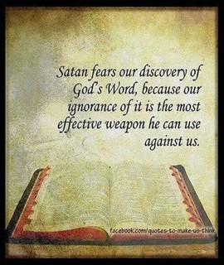
The Word of God is Our Greatest…
  Wonder
  Weapon
  Wisdom
That’s Why Satan is Trying So Hard…
  Prevent
  Destroy
  Twist

Slide 25
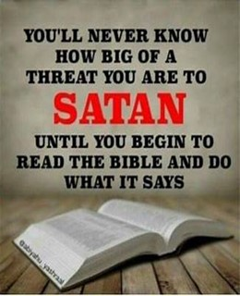
Divine Origin of God's Word:
"In the beginning was the Word,/ the Word was with God,/ the Word was God."
emphasizes the Eternal Nature of God's Word
its Intimate Connection to Very Being of God

Slide 26
Divine Origin of God's Word:
The Word is not merely a Collection of Teachings or Stories;
it is the Very Essence Of Who God Is.
As such, the Power of God's Word is Rooted in the Power of God Himself, which is Infinite, Eternal, and Unchanging.

Slide 27
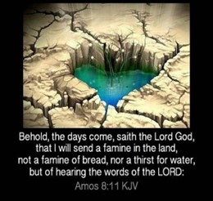
Famine in the Land –Amos 8:11-12 NLT
¹¹ “The time is surely coming,” says the Sovereign Lord, “when I will send a famine on the land—not a famine of bread or water but of hearing the words of the Lord. ¹² People will stagger from sea to sea / wander fr. border to border searching for the word of the Lord, but they will not find it.
¹¹ I, the Lord, also promise you a terrible shortage, but not of food and water. You will hunger and thirst to hear my message. ¹² You will search everywhere—from north to south, from east to west. You will go all over the earth, seeking a message from me, the Lord. But you won't find one. Amos 8:11-12 CEV
The Famine is Here!!!

Slide 28
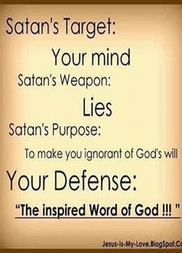

Slide 29
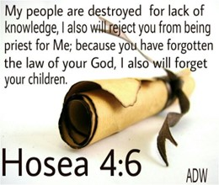
My people are destroyed for lack of knowledge is a verse from the Bible, in the book of Hosea 4:6
Hosea 4:6 NLT = My people are being destroyed
because they don’t know me
Our World is on a Collision Course with Evil
We Need to Get Back to the Word!!

Slide 30
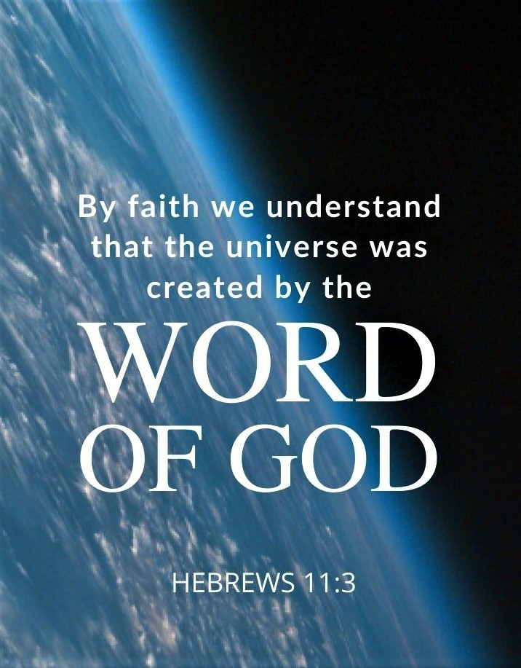
Fresh Breath of Air
All Scripture is given by inspiration of God, and is profitable for doctrine, for reproof, for correction, for instruction in righteousness
2 Timothy 3:16 NKJV
Every Scripture is God-breathed (given by His inspiration) and profitable for instruction, for reproof and conviction of sin, for correction of error and discipline in obedience, [and] for training in righteousness (in holy living, in conformity to God’s will in thought, purpose, and action)
2 Timothy 3:16 Amp

Slide 31
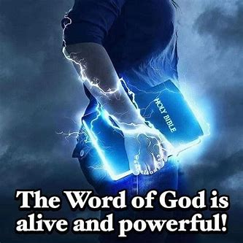
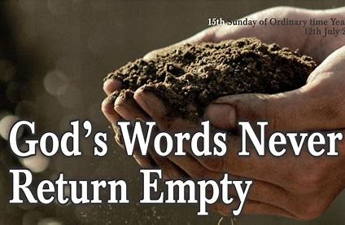
We Hear Gods Word is Outdated, Not Relevant
Really???
Quick -Living, Active, Life Giving
Powerful –gk=Energy, Eternal Energy
When We Speak God’s Word into Situation..
We Speak Fresh, Living, Energy into It…
Heal
Change
Empower
Isa 55:11 Assures This…

Slide 32
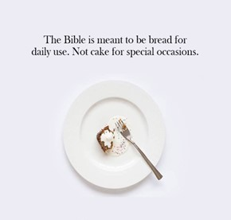
God’s Word is Bread
John 6:51, “I am the living bread that came down out of heaven; if anyone eats of this bread, he will live forever; and the bread also which I will give for the life of the world is My flesh.”
“People need more than bread for their life; the must feed on every word of God” -Matt 4:4
God’s Word Brings Life in a World Full of Death
Speak It!
Shout It!

Slide 33
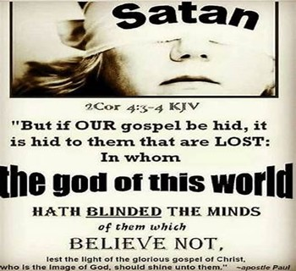
2 Corinthians 4:3-4 Amp
³ But even if our Gospel (the glad tidings) also be hidden (obscured and covered up with a veil that hinders the knowledge of God), it is hidden [only] to those who are perishing and obscured [only] to those who are spiritually dying and veiled [only] to those who are lost.
⁴ For the god of this world has blinded the unbelievers’ minds [that they should not discern the truth], preventing them from seeing the illuminating light of the Gospel of the glory of Christ (the Messiah), Who is the Image and Likeness of God.
We ARE the Light, a City on a Hill!
Shine, Shine, Shine

Slide 35
A young man drove his scooter in to a gas station and dismounted
"I'll need about a pint of gas," he said to the attendant, "and a few ounces of oil for the motor."
"Certainly, sir," the attendant said,
"And would you also like me to cough into your tires?
The secret to a clean kitchen is simple.
Don't cook.
Ever.

