Slide 1
Edward Christian Church
Spiritual
Warfare
Pt 10a
Our Adversary
Ephesians 6:10-12
July 28, 2024

Slide 2
Occupy Til I Come
Occupy
-Does Not Mean
  Take Up Space
-It Does Mean –
  Take a Stance
  Be Productive
  Take Back Lost …
  …Ground / Property

Slide 3
Recognize the Battle
Warning
  Be (now-constant)
  Strong (infused w- inner ability)
  In the Lord (found one place)
  Power (overwhelming – irresistible)
  Might (strong arm)

Slide 4


Slide 5
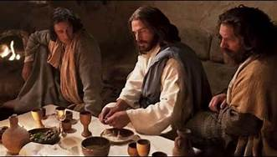
Last Supper
14 Present
Jesus and His Disciples and…
..Satan
He was Looking for a Way to Get to Jesus
A Doorway = an Entry Point in His Life…
…to Affect His Life
He Found None –John 14:30
Hereafter I will not talk much w- you: for the prince of this world cometh, and hath nothing in me.
Every Door was Shut!

Slide 6
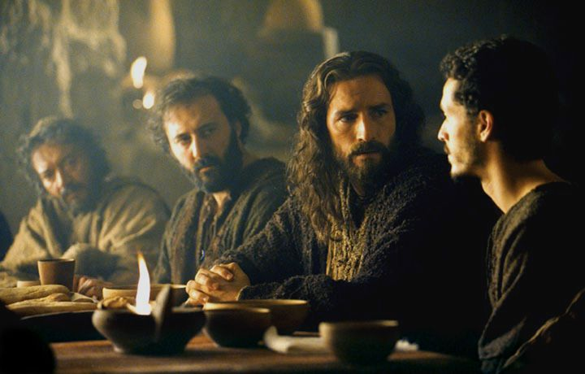
Last Supper
Jesus Lived a Life that Kept the Door Closed
So Satan looked for Someone Close…
…to Get to Him
                “Disciples”
There was a Dispute…
                Among them
                Within them
These Disputes…
…Produced Doors
…Entry Points for Satanic Activity

Slide 7


Slide 8
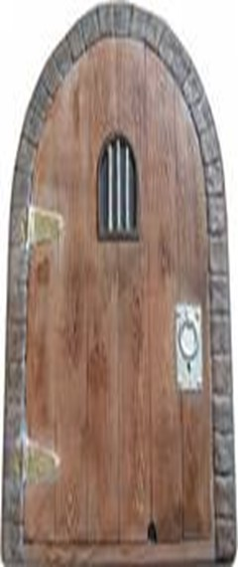
Eph 4:27
no place for Devil (No Door)
Door = Opportunity
There are 5 Doors
#1- Fear
#2- Pride
#3- Forgiveness
#4- Word Deficit
#5- Lack of Stewardship

Slide 9
“Whose Job Is It, Anyway?”
This is a little story about four people named Everybody, Somebody, Anybody, and Nobody.
There was an important job to be done and Everybody was sure that Somebody would do it.
Anybody could have done it, but Nobody did it.
Somebody got angry about that because it was Everybody's job.
Everybody thought that Anybody could do it, but Nobody realized that Everybody wouldn't do it.
It ended up that Everybody blamed Somebody when Nobody did what Anybody could have done
The story may be confusing, but the message is clear: no one took responsibility, so nothing got accomplished.

Slide 10

ABC’s
of
Stewardship
Attitude”
Luke 10:25-37

Slide 11

Stewardship
Using God Given Abilities to…
…Manage God Given Resources,
…to Accomplish God Given Results

Slide 12

Stewardship Areas
Time
Talent
Treasure
Testimony
Temple
  Acknowledgement
  Attitude
  Action

Slide 13
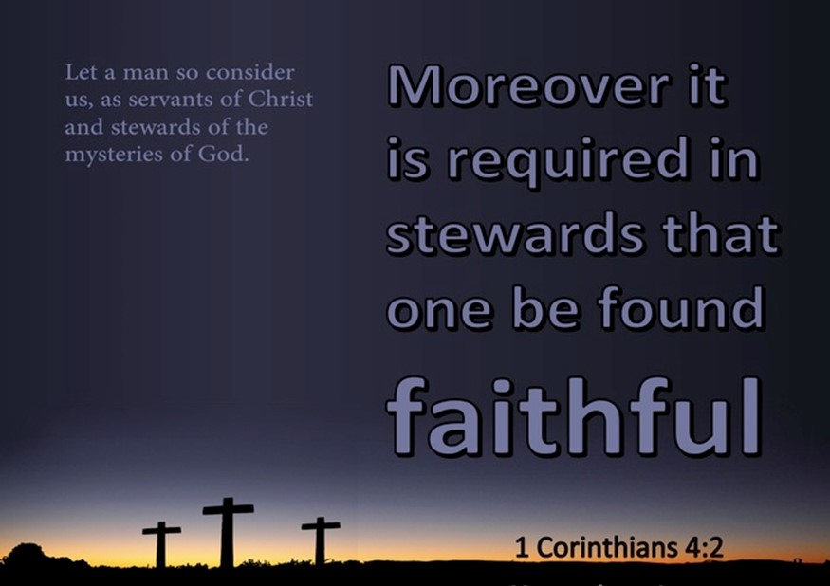
“Stewardship is Not”
Giving
(giving of my resources).
Doing
(giving of my abilities)
Giving Money to Church
Doing Ministry in Church
is Not Stewardship,
…it is Merely Part of It
But…
and you can’t be a Steward without These

Slide 14

“Stewardship is Not”
If Stewardship Is Not About
What I Can Give
What I Can Do…
So
What Is It About?

Slide 15

“Stewardship is…”
HEART OF STEWARDSHIP
“Attitude”
ATTITUDE Stands Behind Your….
Giving
Service
It’s Not in “What”
What You Give or Do For God,
It’s “WHY”

Slide 16
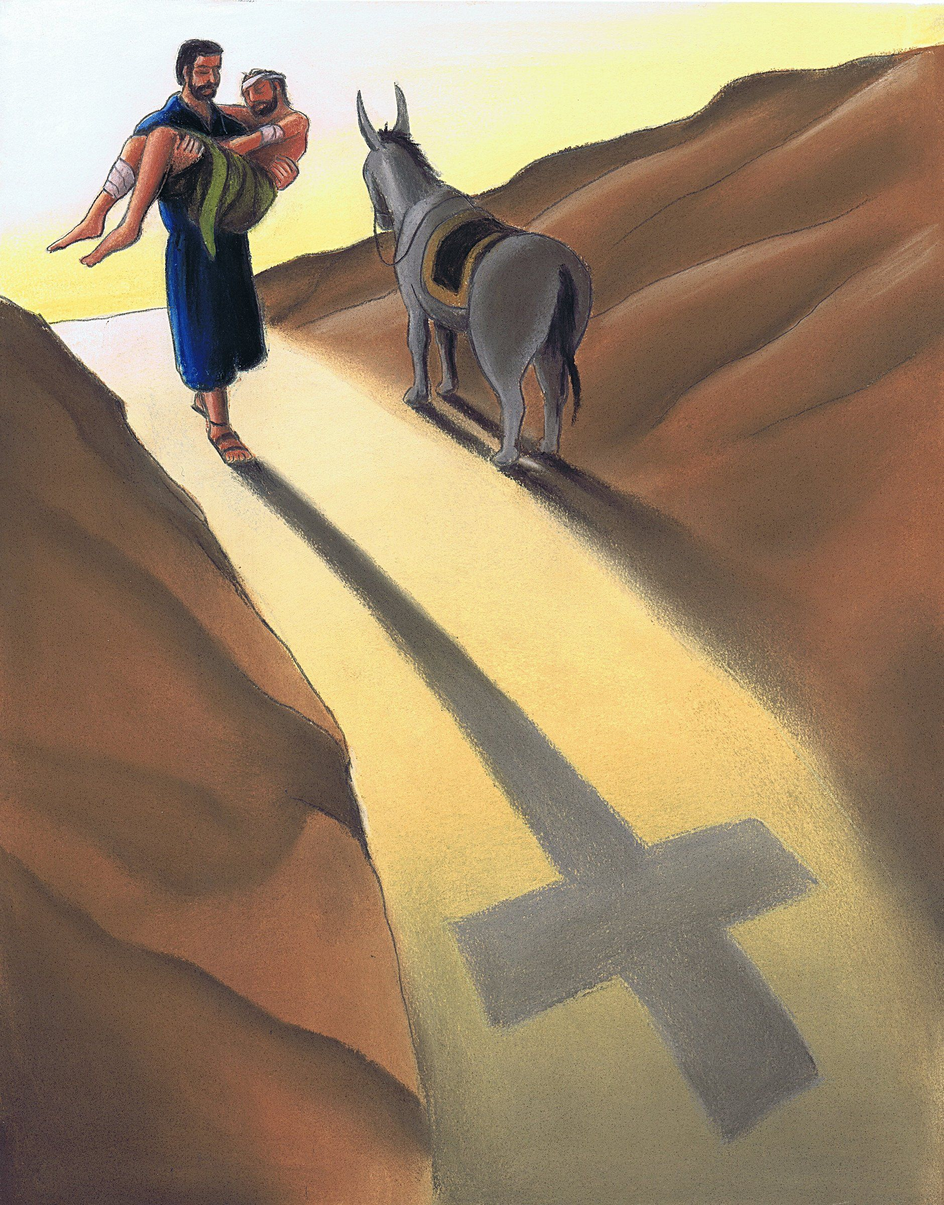
The Parable of the Good Samaritan
is a Parable About the
Attitude of Stewardship.
There Are Three Attitudes On Display Here
Which Shoe Fits Your Foot?

Slide 17

1st Attitude
What’s YOURS is MINE and I’m going to take it (30)
thieves on the road
That’s not an Attitude we’d approve of…
…even the world understands this is wrong
But…
Malachi 3:8-10 God speaks to Israel…
"Will a man rob God? Yet you rob me. "But you ask, ’How do we rob you?’ "In tithes and offerings. You are under a curse-- the whole nation of you-- because you are robbing me. Bring the whole tithe into the storehouse, that there may be food in my house. Test me in this," says the LORD Almighty, "and see if I will not throw open the floodgates of heaven and pour out so much blessing that you will not have room enough for it”

Slide 18
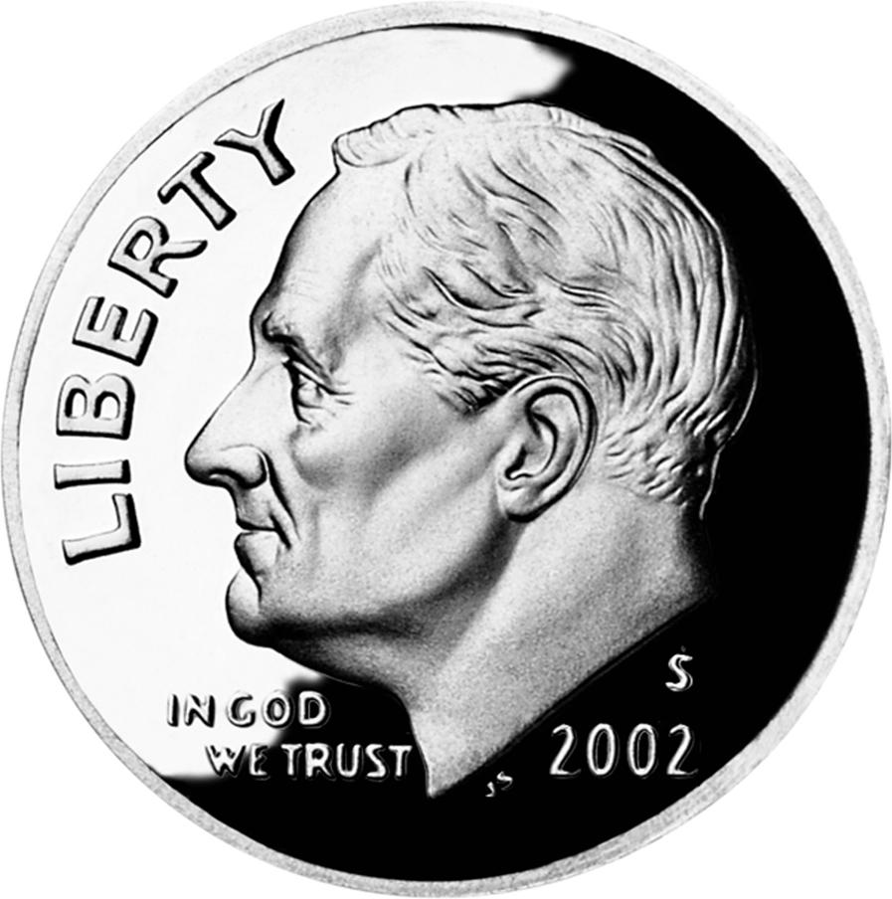
How Much Belongs to God?

Slide 19
How Much Belongs to God?
Can You Imagine What We Could Accomplish If We Applied This to
All the Stewardship Areas in Our Lives ?

Slide 20

The 2nd Attitude
What’s Mine is Mine and I’m Going to Keep It (31-32)
Who does Jesus say passed by this man in ditch?
(A Levite and a Pharisee).
These were men of ministry, religious leaders.
These were the DOERS in the congregation.
They were trained to serve God –
BUT not going to do anything for beaten man.
In Order for Them to Help this Man,
Have to Give Up Something Important to Them
Their Time, Resources, Personal Comfort.

Slide 21
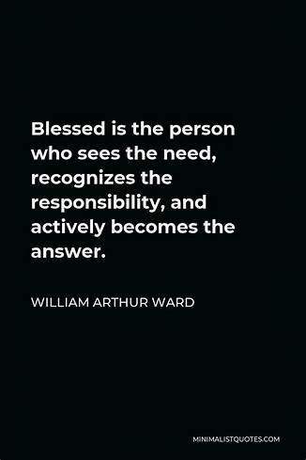
3rd Attitude
What’s Mine is Yours – I’ll Share It with You (33-37)
This Samaritan was not “trained in ministry.”
not any wealthier than the Levite or Pharisee.
probably had other things to do in his life.
he stopped when the others walked on by.
WHAT MADE THE DIFFERENCE? – His Attitude.
The Samaritan’s Attitude Helped Him
Overcome His Prejudice
Ignore The Inconvenience
Give Up His Possessions To Take Care Of Man

Slide 22

Right Attitude
It’s All About the Attitude of Ownership
If You’re A Steward…
…You Realize You Don’t Own Anything
…But Take Care Of Something
…For Someone Else
I Need To Make Up My Mind That I Don’t Own My…
Time
Talent
Treasure
Testimony
Temple

Slide 23
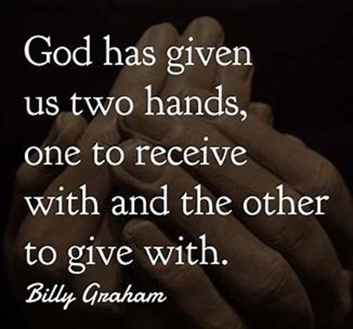
Practice Saying…
They’re All His
They Belong to Him
I Just Manage Them
If I Master This Attitude
I’m A Good Steward

