Slide 1
Mercy with the morning sun Hope when I am hanging by a thread Every time I look for it, I find Your faithfulness again

Slide 2
Water in the wilderness My Defender in the lion's den Every time I look for it, I find Your faithfulness again Here we go Yeah

Slide 3
Faithful then, faithful now You never run out of faithfulness, faithfulness Woah-oh-oh, oh Faithful then, faithful now You never run out of faithfulness, faithfulness

Slide 4
Oh, love that held Him to the cross 'Til He paid the price for all my sin A temporary tomb was sealed by stone But it couldn't keep Him in

Slide 5
Now that He has conquered death Oh, tell me, what's impossible for Him? 'Cause if the Lord, my God is on my side Then who can be against?

Slide 6
Faithful then, faithful now You never run out of faithfulness, faithfulness Woah-oh-oh, oh Faithful then, faithful now You never run out of faithfulness, faithfulness

Slide 7
You never run out You never run, never run out of it You never run out You never run, never run out of it You never run out You never run, never run out of it You never run out You never run, never run out of it

Slide 8
For the things You've done For the things to come For the breath in my lungs Oh, thank You, Jesus For the things You've done For the things to come For the breath in my lungs

Slide 9
Oh, thank You, Jesus For the things You've done For the things to come For the breath in my lungs Oh, thank You, Jesus For the things You've done For the things to come For the breath in my lungs Oh, thank You, Jesus

Slide 10
Faithful then, faithful now You never run out of faithfulness, faithfulness Woah-oh-oh, oh Faithful then, faithful now You never run out of faithfulness, faithfulness

Slide 11
You never run out You never run, never run out of it You never run out You never run, never run out of it You never run out You never run, never run out of it You never run out You never run, never run out of it

Slide 12
Look what the Lord has done Look what the Lord has done He healed my body He touched my mind He saved me just in time

Slide 13
Faithful then, faithful now You never run out of faithfulness Faithful then, faithful now You never run out of faithfulness

Slide 14
Faithfulness, faithfulness I know a little something about it Faithfulness, faithfulness I'll never stop singing about it Faithfulness, faithfulness I know a little something about (ooh) Faithfulness, faithfulness I'll never stop singing about

Slide 15
I heard an old, old story How a savior came from glory How He gave His life on Calvary To save a wretch like me I heard about His groaning And His precious blood's atoning Then I repented of my sins and won the victory

Slide 16
Faithfulness, faithfulness I know a little something about it Faithfulness, faithfulness I'll never stop singing about it Faithfulness, faithfulness I know a little something about (ooh) Faithfulness, faithfulness I'll never stop singing about

Slide 17
I got a feeling, everything gonna be alright I got a feeling, everything gonna be alright I got a feeling, everything gonna be alright Be alright, Be alright, Be alright

Slide 18
Faithfulness, faithfulness I know a little something about it Faithfulness, faithfulness I'll never stop singing about it Faithfulness, faithfulness I know a little something about (ooh) Faithfulness, faithfulness I'll never stop singing about

Slide 19
This is the day, This is the day That the Lord has made, That the Lord has made, I will rejoice, I will rejoice and be glad in it and be glad in it

Slide 20
This is the day That the Lord has made, I will rejoice and be glad in it

Slide 21
This is the day That the Lord has made, I will rejoice and be glad in it

Slide 22
This is the day, This is the day That the Lord has made,

Slide 23
Faithfulness, faithfulness I know a little something about it Faithfulness, faithfulness I'll never stop singing about it Faithfulness, faithfulness I know a little something about (ooh) Faithfulness, faithfulness I'll never stop singing about

Slide 24
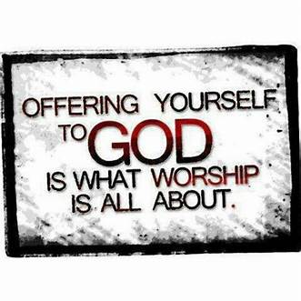

Slide 25

Repeat
I Lift My Offering to You
Let It Please You Oh Lord
This is My Seed
Although It Leaves My Hand
It will Never Leave My Life
You Will Multiply It!
Accept My Seed Oh Lord!

Slide 26
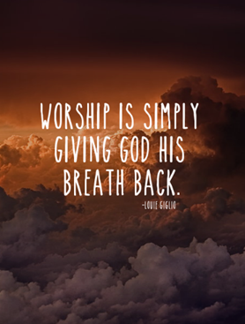

Slide 27
Raise a Hallelujah

Slide 28
I raise a hallelujah, in the presence of my enemies I raise a hallelujah, louder than the unbelief I raise a hallelujah, my weapon is a melody I raise a hallelujah, heaven comes to fight for me

Slide 29
I'm gonna sing, in the middle of the storm Louder and louder, you're gonna hear my praises roar Up from the ashes, hope will arise Death is defeated, the king is alive!

Slide 30
I raise a hallelujah, with everything inside of me I raise a hallelujah, I will watch the darkness flee I raise a hallelujah, in the middle of the mystery I raise a hallelujah, fear you lost your hold on me!

Slide 31
I'm gonna sing, in the middle of the storm Louder and louder, you're gonna hear my praises roar Up from the ashes, hope will arise Death is defeated, the king is alive!

Slide 32
Sing a little louder (in the presence of my enemies) Sing a little louder (louder than the unbelief) Sing a little louder (my weapon is a melody) Sing a little louder (heaven comes to fight for me) Sing a little louder (in the presence of my enemies)

Slide 33
Sing a little louder (louder than the unbelief) Sing a little louder (my weapon is a melody) Sing a little louder (heaven comes to fight for me) Sing a little louder

Slide 34
I'm gonna sing, in the middle of the storm Louder and louder, you're gonna hear my praises roar Up from the ashes, hope will arise Death is defeated, the king is alive!

Slide 35
I raise a hallelujah, in the presence of my enemies I raise a hallelujah, louder than the unbelief I raise a hallelujah, my weapon is a melody I raise a hallelujah, heaven comes to fight for me

Slide 36
Yes I Will

Slide 37
I count on one thing The same God that never fails Will not fail me now You won't fail me now In the waiting The same God who's never late Is working all things out You're working all things out

Slide 38
Yes I will, lift You high in the lowest valley Yes I will, bless Your name Oh, yes I will, sing for joy when my heart is heavy All my days, oh yes I will

Slide 39
I count on one thing The same God that never fails Will not fail me now You won't fail me now In the waiting The same God who's never late Is working all things out You're working all things out

Slide 40
Oh, yes I will, lift You high in the lowest valley Yes I will, bless Your name Oh, yes I will, sing for joy when my heart is heavy All my days, oh yes I will For all my days, oh yes, I will

Slide 41
And I choose to praise To glorify, glorify The Name of all names That nothing can stand against X4

Slide 42
Oh, yes I will, lift You high in the lowest valley Yes I will, bless Your name Oh, yes I will, sing for joy when my heart is heavy All my days, oh yes, I will For all my days, oh yes, I will For all my days, yes, I will

Slide 43
O Come to the Altar

Slide 44
Are you hurting and broken within? Overwhelmed by the weight of your sin? Jesus is calling Have you come to the end of yourself? Do you thirst for a drink from the well? Jesus is calling

Slide 45
O come to the altar The Father's arms are open wide Forgiveness was bought with The precious blood of Jesus Christ

Slide 46
Leave behind your regrets and mistakes Come today, there's no reason to wait Jesus is calling Bring your sorrows and trade them for joy From the ashes, a new life is born Jesus is calling

Slide 47
O come to the altar The Father's arms are open wide Forgiveness was bought with The precious blood of Jesus Christ

Slide 48
Oh, what a Savior Isn't He wonderful? Sing hallelujah, Christ is risen Bow down before Him For He is Lord of all Sing hallelujah, Christ is risen

Slide 49
O come to the altar The Father's arms are open wide Forgiveness was bought with The precious blood of Jesus Christ

Slide 50
O come to the altar The Father's arms are open wide Forgiveness was bought with The precious blood of Jesus Christ

Slide 51
Bear your cross as you wait for the crown Tell the world of the treasure you found

Slide 52
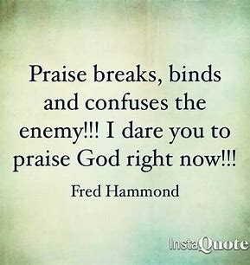

Slide 53
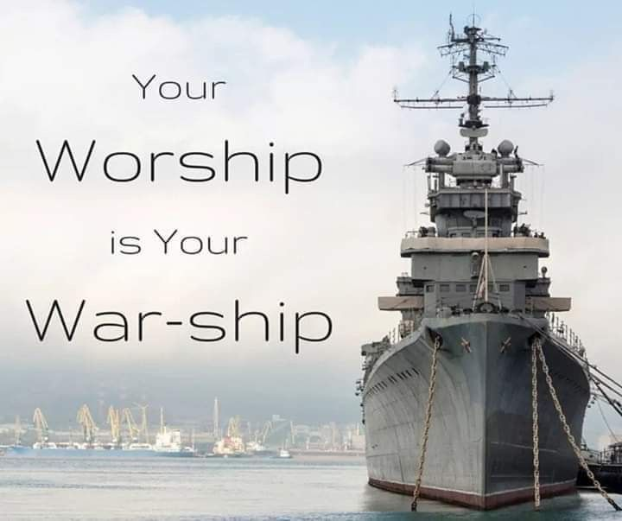

Slide 54
In a church in the Deep South where the preaching
style was a “talk back” sort of style. The pastor was
getting the congregation exited about their
prospective future. The preacher said, “this church
is like a crippled man who needs to get up / walk
under the power of Jesus.” The congregation replied,
“let it walk preacher, let it walk.” Then the preacher
said, “This church like Elijah on Mount Carmel has
got to run.” The congregation replied, “let it run
preacher, let it run.” Then the preacher said,
“This church has got to mount up on wings like
eagles / fly.” The congregation replied w-
enthusiasm, “let it fly preacher, let it fly.” Then the
preacher added, “Now if this church is going to fly
it’s going to take MONEY.” The congregation replied
W- lack of enthusiasm, “let it walk preacher, let it walk.”

Slide 56

Edward Christian Church
Spiritual
Warfare
Pt 11
Our Adversary
Ephesians 6:10-12
July 28, 2024

Slide 57
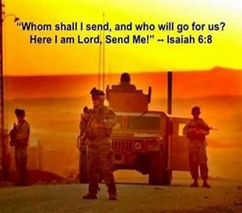
Occupy Til I Come
Occupy
-Does Not Mean
Take Up Space
-It Does Mean –
Take a Stance
Be Productive
Take Back Lost …
…Ground / Property

Slide 58
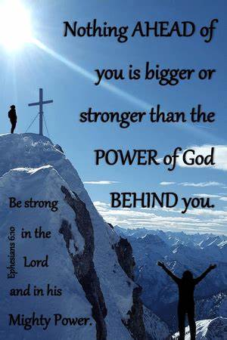
Recognize the Battle
Warning
Be (now-constant)
Strong (infused w- inner ability)
In the Lord (found one place)
Power (overwhelming – irresistible)
Might (strong arm)

Slide 59


Slide 60
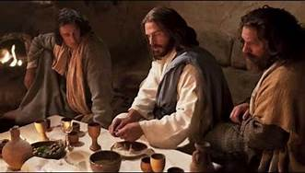
Last Supper
14 Present
Jesus and His Disciples and…
..Satan
He was Looking for a Way to Get to Jesus
A Doorway = an Entry Point in His Life…
…to Affect His Life
He Found None –John 14:30 Hereafter I will not talk much w- you: for the prince of this world cometh, and hath nothing in me.
Every Door was Shut!

Slide 61
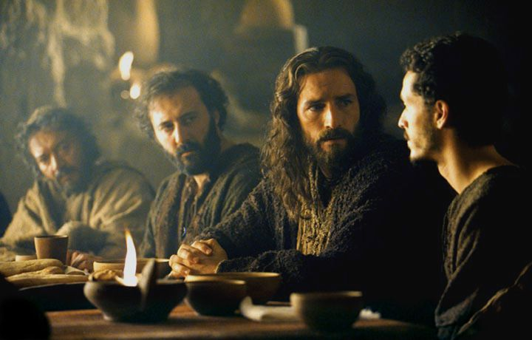
Last Supper
Jesus Lived a Life that Kept the Door Closed
So Satan looked for Someone Close…
…to Get to Him
“Disciples”
There was a Dispute…
Among them
Within them
These Disputes…
…Produced Doors
…Entry Points for Satanic Activity

Slide 62


Slide 63
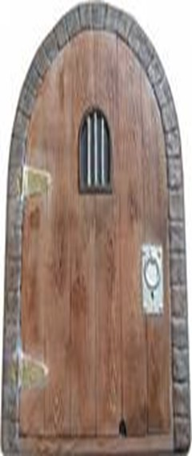
Eph 4:27
no place for Devil (No Door)
Door = Opportunity
There are 5 Doors
#1- Fear
#2- Pride
#3- Forgiveness
#4- Word Deficit
#5- Lack of Stewardship

Slide 64
“Whose Job Is It, Anyway?”
This is a little story about four people named Everybody, Somebody, Anybody, and Nobody.
There was an important job to be done and Everybody was sure that Somebody would do it.
Anybody could have done it, but Nobody did it.
Somebody got angry about that because it was Everybody's job.
Everybody thought that Anybody could do it, but Nobody realized that Everybody wouldn't do it.
It ended up that Everybody blamed Somebody when Nobody did what Anybody could have done
The story may be confusing, but the message is clear: no one took responsibility, so nothing got accomplished.

Slide 65

ABC’s
of
Stewardship
“Blessings”
1 Chron 29:10-16

Slide 66

Stewardship
Using God Given Abilities to…
…Manage God Given Resources,
…to Accomplish God Given Results

Slide 67

Stewardship Areas
Time
Talent
Treasure
Testimony
Temple
Acknowledgement
Attitude
Action

Slide 68
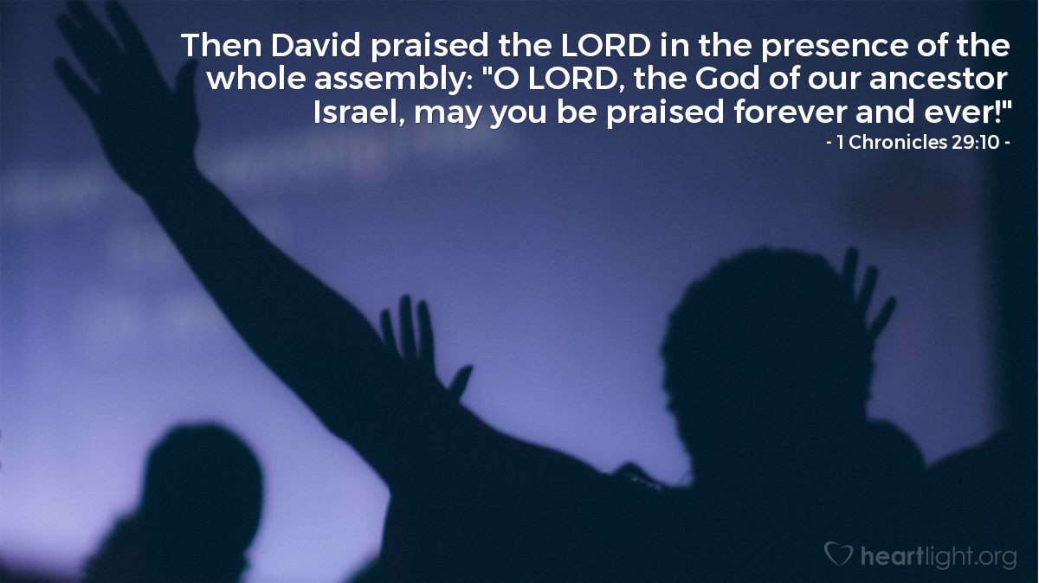
Last Week We Looked At…
…the Attitude of Stewardship
Now Let’s Look at the…
…Blessings of Stewardship

Slide 69
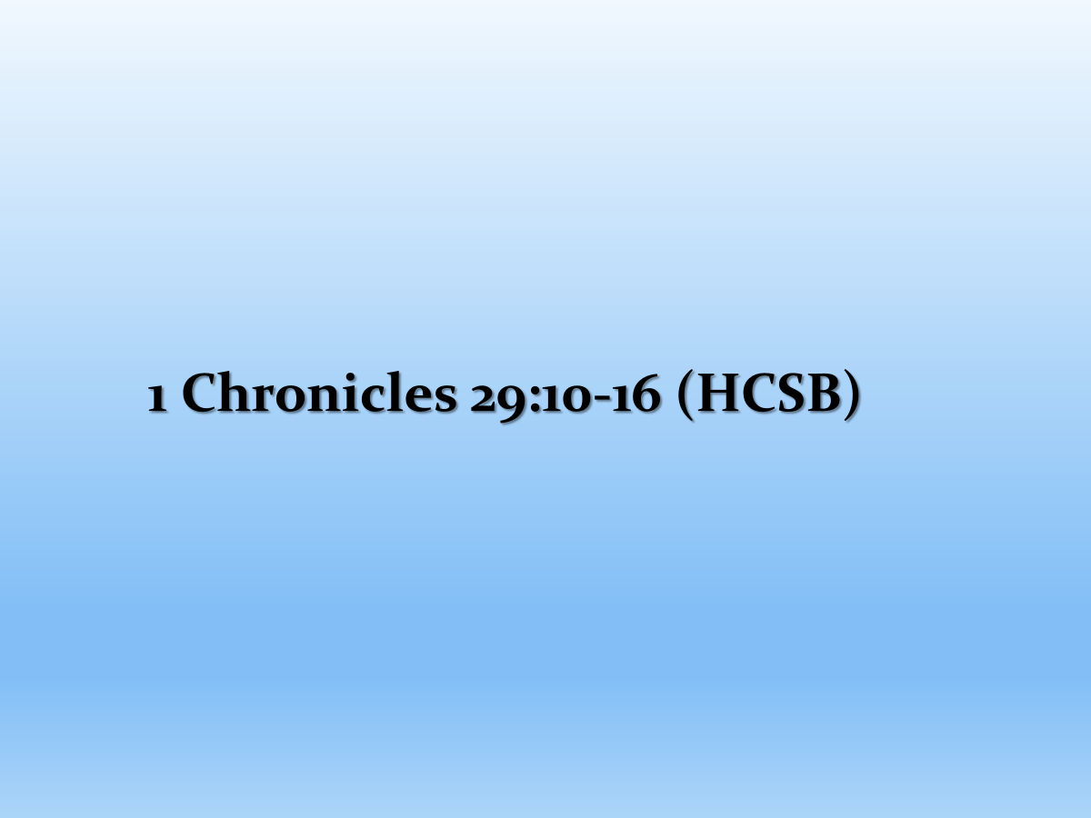
¹⁰ Then David praised the LORD in the sight of all the assembly. David said, May You be praised, LORD God of our father Israel, from eternity to eternity. ¹¹ Yours, LORD, is the greatness and the power and the glory and the splendor and the majesty, for everything in the heavens and on earth belongs to You. Yours, LORD, is the kingdom, and You are exalted as head over all. ¹² Riches and honor come from You, and You are the ruler of everything. Power and might are in Your hand, and it is in Your hand to make great and to give strength to all. ¹³ Now therefore, our God, we give You thanks and praise Your glorious name. ¹⁴ But who am I, and who are my people, that we should be able to give as generously as this? For everything comes from You, and we have given You only what comes from Your own hand. ¹⁵ For we live before You as foreigners and temporary residents in Your presence as were all our ancestors. Our days on earth are like a shadow, without hope. ¹⁶ Yahweh our God, all this wealth that we’ve provided for building You a house for Your holy name comes from Your hand; everything belongs to You.

Slide 70
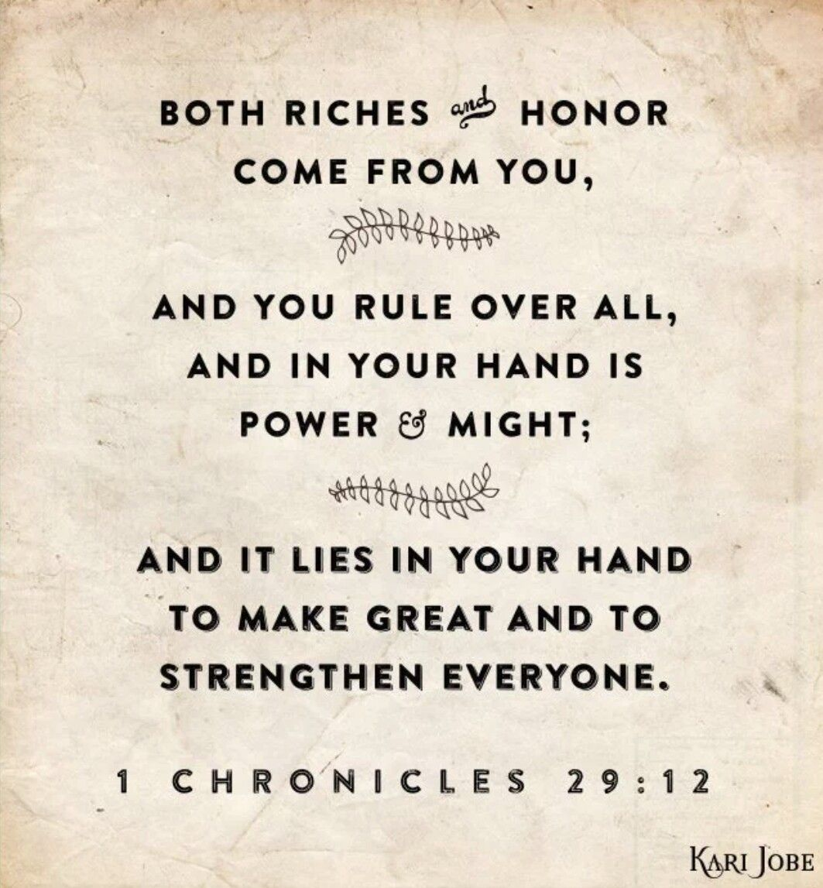
Everything
V11- the Word “everything”
V14- the Phrase, “Everything comes from you”
V16- the Phrase, “and all of it belongs to you”
King David Understood that…
…EVERYTHING Comes from God.
EVERYTHING

Slide 71
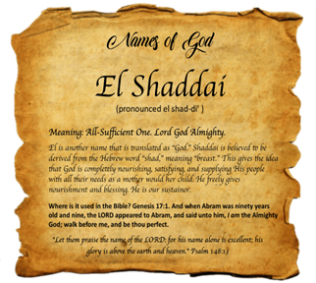
Truth #1
God’s Power: His Ability to Give (12)
But Does God Have the Power to…
…Give to Us What We Need?
The Answer throughout the Scriptures is “YES!”
(12) David said: “Wealth/ honor come from you; you are the ruler of all things. In your hands are strength and power to exalt / give strength to all.”
God is an All-Powerful, All-Sufficient God
He Has the Power to Give to You..
…Everything You Need For Today!

Slide 72
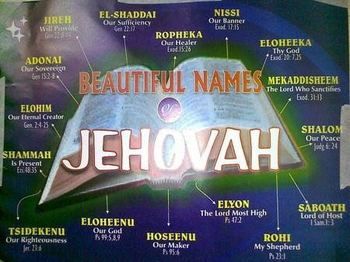
God is Sovereign
Supreme- Jehovah Sabaoth:
"The Lord of Hosts" -Isa 1:24
All-Powerful- El Shaddai:
“God Almighty” -Gen 49:24
All-Sufficient- Elohim:
“Creator, Mighty /Strong” -Gen 17:7
Able to Give- Yahweh-Jireh:
"The Lord Will Provide” -Gen 22:14
Big God- El-Gibhor:
“Mighty God” -Isa 9:6
“And my God will meet all your needs according
to his glorious riches in Christ Jesus” -Phil 4:19

Slide 73
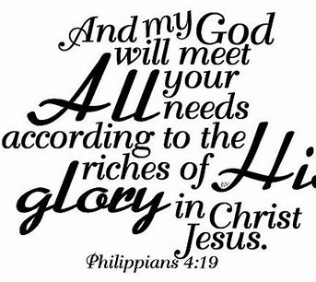
Truth #2
God’s Provision: His Willingness to Give (14)
But Does God Have the Willingness to…
…Give to Us What We Need?
Again, the Answer is “YES!”
“Everything comes from you, and we have given you only what comes from your hand.” (14)
God is Willing to Give to You What You Need.
He Has Already Given us the Resources for Anything He Asks Us

Slide 74
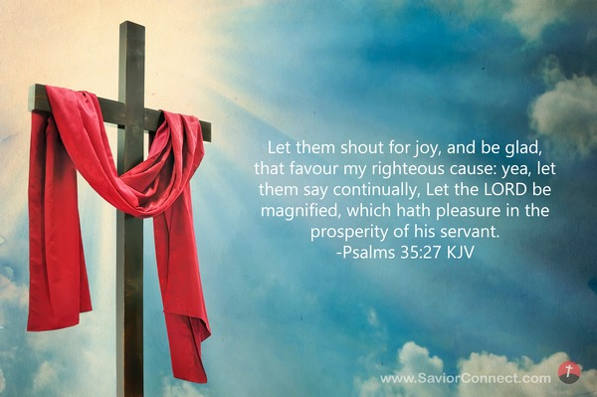
Truth #2
God’s Provision: His Willingness to Give (14)
Revelation that Will Change Your Life!
Do You Want to Know What Causes Problems In This Area?
We Want Resources that We Don’t Need
God Gives Us Today What We Need For Today
Let them shout for joy and rejoice, who favor my vindication and want what is right for me; Let them say continually, “Let the Lord be magnified, who delights and takes pleasure in the prosperity of His servant.” Psa 35:27

Slide 75
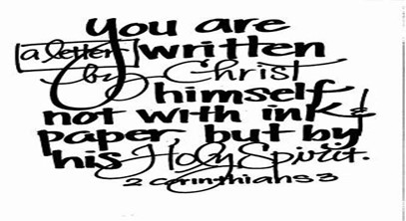
Truth #3
God’s Partnership: His Reason to Give (14, 16)
Why Does God Give to Us?
(16) “O LORD our God, as for all this abundance that we have provided for building you a temple for your Holy Name, it comes from your hand,
and all of it belongs to you.”
God Gives To Us So that We Can…
…Give Back to Him
…and to Others
Because in Our Partnership with Him
…God Wants Us to Be Like Him
…He is a Giving God.

Slide 76
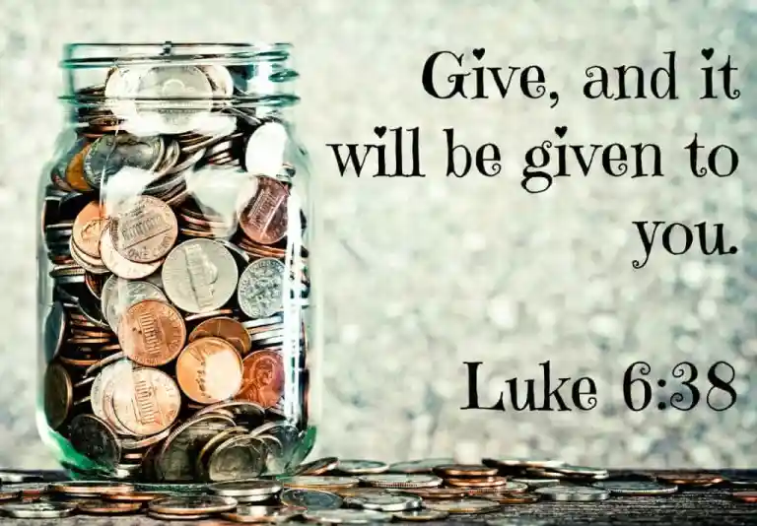
We Need to Remember God is the Initial Giver
He Models It for Us-
He Expects Us to Do Something With It
He Gives Us Things so that We…
…Can Give Them Back to Him
Its Called the “Cycle of Stewardship”
Luke 6:38
Give, and it will be given to you. They will pour into your lap a good measure—pressed down, shaken together, and running over [with no space left for more]. For with the standard of measurement you use [when you do good to others], it will be measured to you in return.”

Slide 77
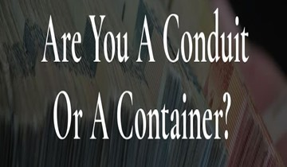
The Partnership Is Not Complete…
…Until We Give Back
Conduit or Container
Nothing has more impact on a Us than
…to be a Blessing
Giving is the Highest Level of Living…
…we Can Achieve.
It’s Not What You Have that…
…Makes the Difference.
It’s What You Do With What You Have.

Slide 78

How Do We Give Back?
We Give to Back to God…
Directly
Bringing Tithe and Offering to Storehouse
Use Our Time, Talent, Treasures, Testimony
…to Bless His House
Indirectly
Giving to Others
Use Our Time, Talent, Treasures, Testimony
…to Bless Others
Partnership of Stewardship that God Calls Us To
Completes the Cycle

Slide 79
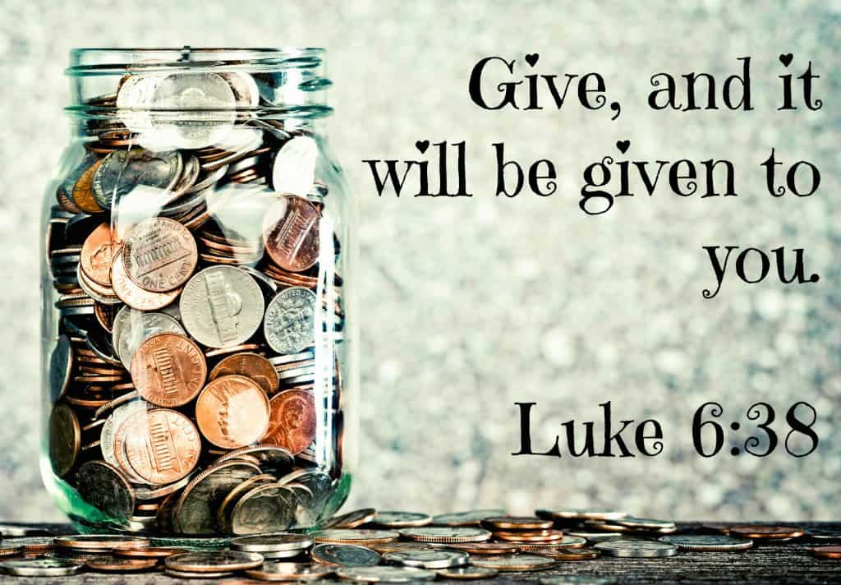
Spiritual Facts about Giving
Giving Makes me Christ-Like
1 Chron. 29:14 "But who am I, / who are my people, that we should be able to give as generously as this? Everything comes from you,/ we have given you only what comes from your hand.
Giving Draws me Closer to God
Matthew 6:19-21 "Do not store up for yourselves treasures on earth, where moth and rust destroy, and where thieves break in and steal. But store up for yourselves treasures in heaven, where moth and rust do not destroy, and where thieves do not break in and steal. For where your treasure is, there your heart will be also.
Giving is an Investment for Eternity
1 Tim. 6:18-19 Command them to do good, to be rich in good deeds, and to be generous and willing to share. In this way they will lay up treasure for themselves as a firm foundation for the coming age, so that they may take hold of the life that is truly life.

Slide 80
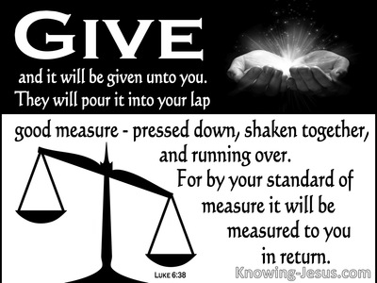
Spiritual Facts about Giving
Giving Blesses me in Return
Proverbs 3:9-10 Honor the Lord with your wealth, with the firstfruits of all your crops; then your barns will be filled to overflowing, and your vats will brim over with new wine.
Luke 6:38 Give, and it will be given to you. A good measure, pressed down, shaken together and running over, will be poured into your lap. For with the measure you use, it will be measured to you."
Giving Makes me Happy
2 Cor. 9:6-7 Remember this: Whoever sows sparingly will also reap sparingly,/ whoever sows generously will also reap generously. Each man should give what he has decided in his heart to give, not reluctantly or under compulsion, for God loves a cheerful giver.
Acts 20:35b “...Lord Jesus himself said:
'It is more blessed to give than to receive.'”

Slide 81
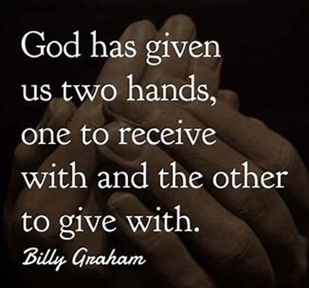
How Do I Shut this Door?
Start By Saying…
Everything I Have
Belongs to Him
I Just Manage It
If I Master This Attitude
I’m A Good Steward

