Slide 1

Edward Christian Church
Spiritual
Warfare
Pt 15
What Are You Doing Here? –pt3
I Kings 19:1-9
September 8, 2024

Slide 2
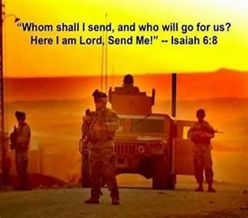
Occupy Til I Come
Occupy
-Does Not Mean
  Take Up Space
-It Does Mean –
  Take a Stance
  Be Productive
  Take Back Lost …
  …Ground / Property

Slide 3

Recognize the Battle
Warning
  Be (now-constant)
  Strong (infused w- inner ability)
  In the Lord (found one place)
  Power (overwhelming – irresistible)
  Might (strong arm)

Slide 4

Although Spiritual Warfare is Fought…
…on a Different Realm
It Can Take a Toil on our Physical Being…
  Emotionally
  Mentally
  Spiritually
          We Need to be..
            Aware
            Active
            Attune
Elijah was Called to Life of Spt Warfare

Slide 5
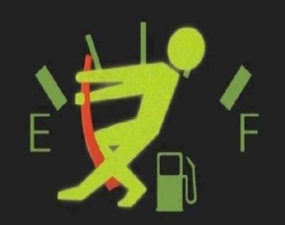
Have You…
  Gone as Far as You Can Go
  Taken All You Can Take
  Given All You Can Give
Welcome to…
…Running on Empty!

Slide 6
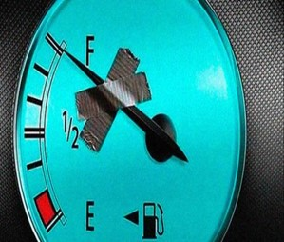
  Mentally
  Physically
  Spiritually
Exhausted
Leads to
Depression

Slide 7
Running on Feeling (Spt High)
  1 Kings 18:46
    Elijah was Running On Emotions
Running on Fear (Spt Low)
  1 Kings 19:1-3
    Elijah Is Up And Running Again.
    This Time, Elijah Is Running On Fear
Running on Fumes (Spt Exhaustion)
  1 Ki 19:4-5
    Elijah Has Run Out Of Gas.

Slide 8
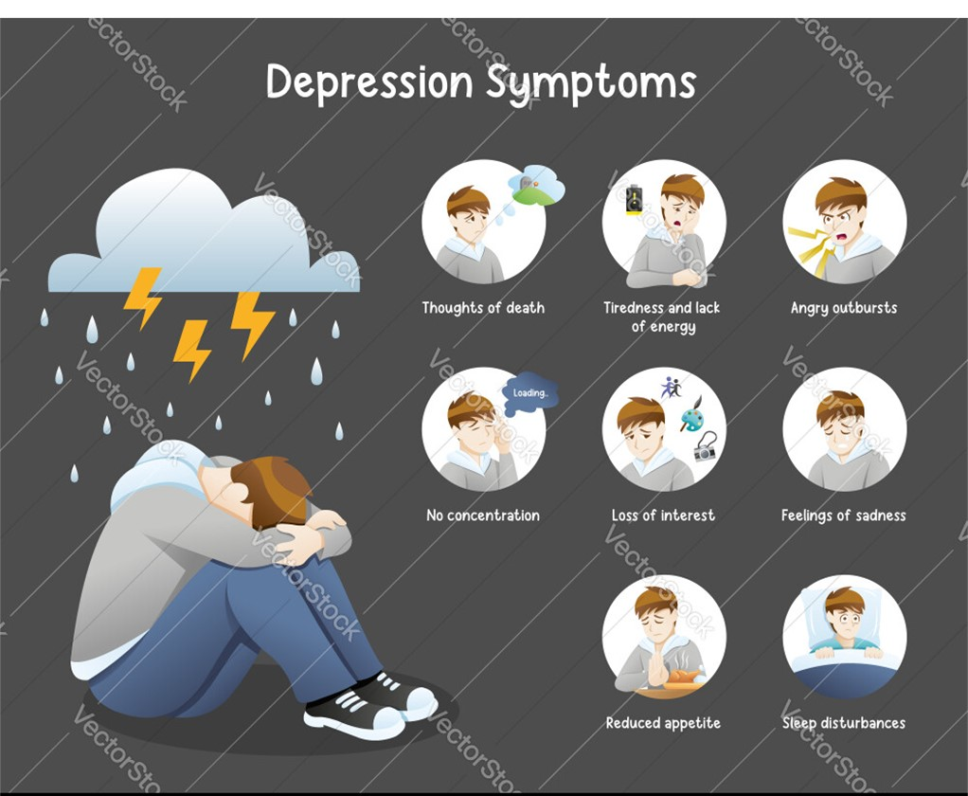

The Key To Elijah’s Tank Drain (3,4)
“When He Saw That ….”
Elijah Changed…
His Focus -Ceased to Walk by Faith
“And when he Saw that…”
His Force -Boldness to Fear
“he arose, and went for his life…”
His Feelings -Became Depressed
“came to Beersheba, which belongeth to Judah,
and left his servant there. ..Juniper Tree…”

Slide 9

How Did God Get Elijah…
…Beyond This?

Slide 10

#1- Fresh Provision (5-8)
“..lay and slept…Angel touched…”
    Recuperated “Slept”
    Reenergized “Ate”
    Recuperated “Slept”
    Reenergized “Ate”
God was Restoring Him Physically
  Prepared His Food/ Gave Him Rest
God was Restoring Him Spiritually
  Propelled Him to Get to Mt. Horeb

Slide 11

#2- Fresh Profession (9-11)
“What Are You Doing Here”
God Knew that He Needed to Unload…
  Proper Person –God
  Proper Way – Mt of God
  1st- We Need to Talk to God About it!
  Then…
We Need to Find Somebody We Can Trust …
  …to Talk it Out!

Slide 12
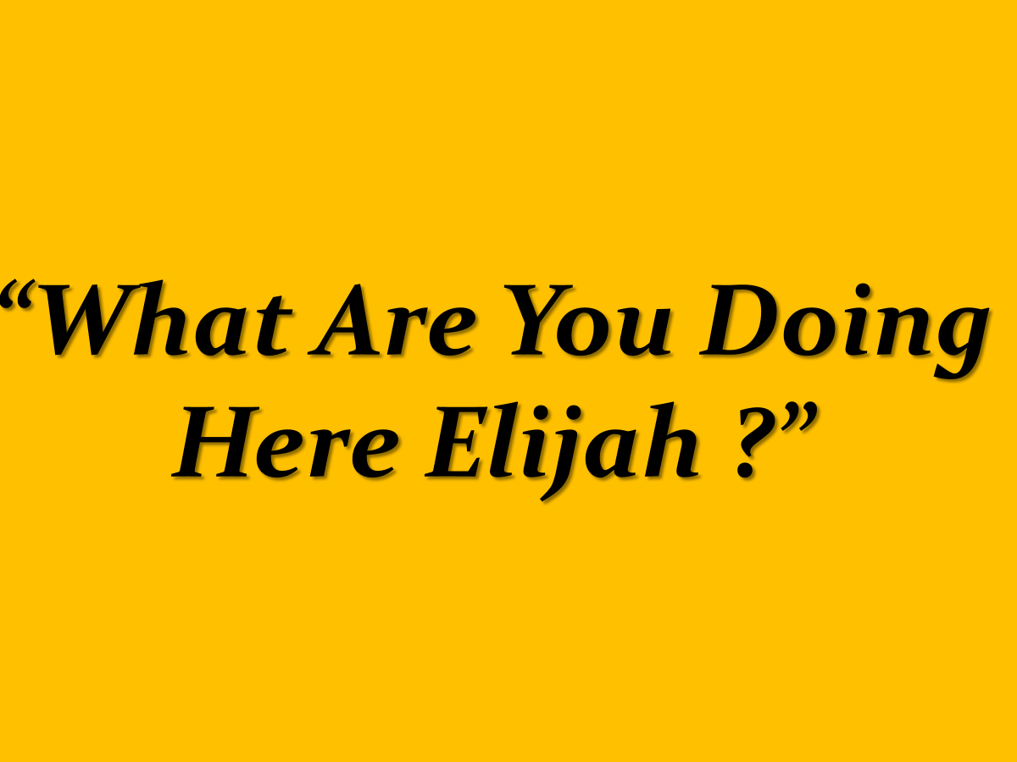
#3- Fresh Perspective (11-14, 18)
“What Doest Thou Here Elijah?”
God Showed Him that He Does Not Always Communicate the Same Way
God Showed Him that His Perspective…
…was Wrong
God Showed Him that He Still Had…
…a Group of People He Could Trust
Realize There is More to It Than I See!

Slide 13

#4- Fresh Purpose (15-17)
“…go anoint…”
Go Take Care of Kingdom Work
  Physical
Go Take Care of My Work
  Spiritual
Elijah Mentored Elisha 10 years
God wasn’t Through with him !!!
God is Not Through with You !!!

Slide 14

#4- Fresh Purpose (15-17)
“…go anoint…”
You Decide If You Get Back Up!
You Decide If this is the Last Chapter
You Don’t Have to Be Defined…
…By Your Situation
Get Back Up!!

Slide 15
Why Does God Allow Us to…
…Get to this Point?
  Points to Power of the Cross…
      We All Need His Help
  Brings Message of Grace/ Mercy to Life
      Now It’s Personal
  Prompts Reliance upon Him/ Others
      We Can’t Do It Alone
  Show Us/ Others We Can Still Be Used…
      Even in the Worst of Situations

Slide 16
Isaiah 40:29 (AMP)
He gives power to the faint and weary, and to him who has no might He increases strength [causing it to multiply and making it to abound].
Matthew 11:28 (AMP)
Come to Me, all you who labor and are heavy-laden and overburdened, and I will cause you to rest. [I will ease and relieve and refresh your souls.]

Slide 17
Fill my cup, Lord
I lift it up, Lord
Come and quench this thirsting of my soul
Bread of Heaven, feed me 'til I want no more
Fill my cup, fill it up and make me whole

Slide 19
A young man called his mother and announced excitedly that he had just met the woman of his dreams. Now what should he do?
His mother had an idea: "Why don't you send her flowers, and on the card invite her to your apartment for a home-cooked meal?"
He thought this was a great strategy, and a week later, the woman came to dinner. His mother called the next day to see how things had gone.
"I was totally humiliated," he moaned. "She insisted on washing the dishes."
"What's wrong with that?" asked his mother.
"We hadn't started eating yet."

