Slide 1
I feel the Rain, I feel the Rain I feel it falling down on me I feel the Rain, I feel the Rain I feel it falling down on me

Slide 2
Well the former and the latter Rain together, and I’m not talking about the weather The holy ghost rain is falling down on me

Slide 3
I feel the Rain, I feel the Rain I feel it falling down on me I feel the Rain, I feel the Rain I feel it falling down on me

Slide 4
Well the former and the latter Rain together, and I’m not talking about the weather The holy ghost rain is falling down on me

Slide 5
When darkness tries to roll over my bones When sorrow comes to steal the joy I own When brokenness and pain is all I know I won't be shaken, no, I won't be shaken

Slide 6
My fear doesn't stand a chance When I stand in Your love My fear doesn't stand a chance When I stand in Your love My fear doesn't stand a chance When I stand in Your love!

Slide 7
Shame no longer has a place to hide I am not a captive to the lies I'm not afraid to leave my past behind Oh, I won't be shaken, no, I won't be shaken!

Slide 8
My fear doesn't stand a chance When I stand in Your love My fear doesn't stand a chance When I stand in Your love My fear doesn't stand a chance When I stand in Your love!

Slide 9
There's power that can break off every chain There's power that can empty out a grave There's resurrection power that can save There's power in Your name, power in Your name

Slide 10
My fear doesn't stand a chance When I stand in Your love My fear doesn't stand a chance When I stand in Your love My fear doesn't stand a chance When I stand in Your love!

Slide 11
My fear doesn't stand a chance When I stand in Your love My fear doesn't stand a chance When I stand in Your love My fear doesn't stand a chance When I stand in Your love!

Slide 12
Oh-oh, oh-oh, I'm standing in Your love Oh, oh-oh, oh, standing on the rock Oh, I'm standing, standing in Your love

Slide 13
You give life, You are love You bring light to the darkness You give hope, You restore every heart that is broken And great are You, Lord

Slide 14
You give life, You are love You bring light to the darkness You give hope, You restore every heart that is broken And great are You, Lord

Slide 15
It's Your breath in our lungs So we pour out our praise, we pour out our praise It's Your breath in our lungs So we pour out our praise to You only

Slide 16
You give life, You are love You bring light to the darkness You give hope, You restore every heart that is broken And great are You, Lord

Slide 17
It's Your breath in our lungs So we pour out our praise, we pour out our praise It's Your breath in our lungs So we pour out our praise to You only

Slide 18
Lord prepare me To be a sanctuary Pure and holy Tried and true And with thanksgiving I'll be a living Sanctuary, oh for You Help me say now

Slide 19
Lord prepare me To be a sanctuary Pure and holy Tried and true And with thanksgiving I'll be a living Sanctuary, oh for You

Slide 20
I love You, Lord And I lift my voice To worship You Oh, my soul rejoice Take joy, my King In what You hear May it be a sweet sweet sound in Your ear

Slide 21
I love You, Lord And I lift my voice To worship You Oh, my soul rejoice Take joy, my King In what You hear May it be a sweet sweet sound in Your ear

Slide 22
May it be a sweet, sweet sound May it be a sweet, sweet sound May it be a sweet, sweet sound in Your ear

Slide 23
For Thou, o Lord, art high above all the earth Thou art exalted far above all gods For Thou, o Lord, art high above all the earth Thou art exalted far above all gods

Slide 24
I exalt Thee, I exalt Thee I exalt Thee, o Lord I exalt Thee, I exalt Thee I exalt Thee, o Lord

Slide 25
Wife: I have a bag full of used clothing I'd like to donate to charity. Husband: Why not just throw these in the trash? That's much easier. Wife: But there are poor starving people who can really use all these clothes. Husband: Honey, anyone who fits into your clothing is not starving.
Husband is currently recovering from a head injury

Slide 26
Edward Christian Church
Spiritual
Warfare
Pt 16
Armor Up!!!
Ephesians 6
September 15, 2024

Slide 27
Occupy Til I Come
Occupy
-Does Not Mean
Take Up Space
-It Does Mean –
Take a Stance
Be Productive
Take Back Lost …
…Ground / Property

Slide 28
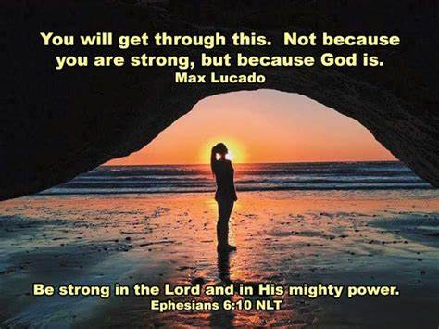
Warning
Be (now-constant)
Strong (infused w- inner ability)
In the Lord (found one place)
Power (overwhelming – irresistible)
Might (strong arm)

Slide 29

The Devil Knows …
He Cannot:
Stop the Building of God’s Church
And I say also unto thee, that thou art
Peter, and upon this rock I will build my church; and the gates of hell shall not prevail against it. -Matthew 16:18
He Can Try:
Stop the Movement of God’s Church!!

Slide 30
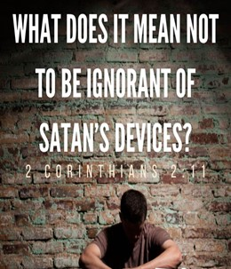
Satan’s Strategy
Personal Attack
Through Any Means Possible
Destroy the Mission of the Church
Satan Desires to…
Affect Your Thinking…
…Life,
…Relationships
In Order to…
Infect Your Thinking…
…Life
…Relationships

Slide 31

Radically Directed
and Expected
Psalms 144:1 (KJV)
Blessed be the LORD my strength, which teacheth my hands to war, /my fingers to fight:
2 Timothy 2:3 (KJV)
Thou therefore endure hardness, as a good soldier of Jesus Christ.
We are Not on a Playground…
…but a Battle Ground !!

Slide 32
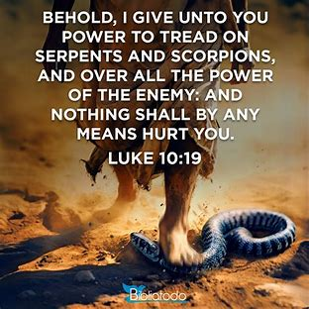
Power for Spiritual Warfare
2 Types of Power
Ability -dunamis
Authority -exousia
2 Types of Attacks -Luke 10:19
Serpents: Cardiovascular System
“No Function”
Scorpions: Central Nervous System
“Inability to Function Properly”

Slide 33
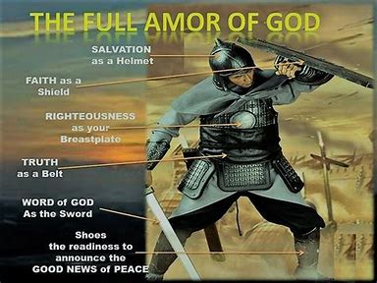
We Have Protection
Ephesians 6:10-11
¹⁰ Finally, my brethren, be strong in the Lord, and
in the power of his might. ¹¹ Put on the whole armor
of God, that ye may be able to stand against the
wiles of the devil.
2 Corinthians 10:4-5
⁴ (For the weapons of our warfare are not carnal, but
mighty through God to the pulling down of strong
holds;) ⁵ Casting down imaginations, and every high
thing that exalteth itself against the knowledge of
God, and bringing into captivity every thought to the
obedience of Christ;

Slide 34
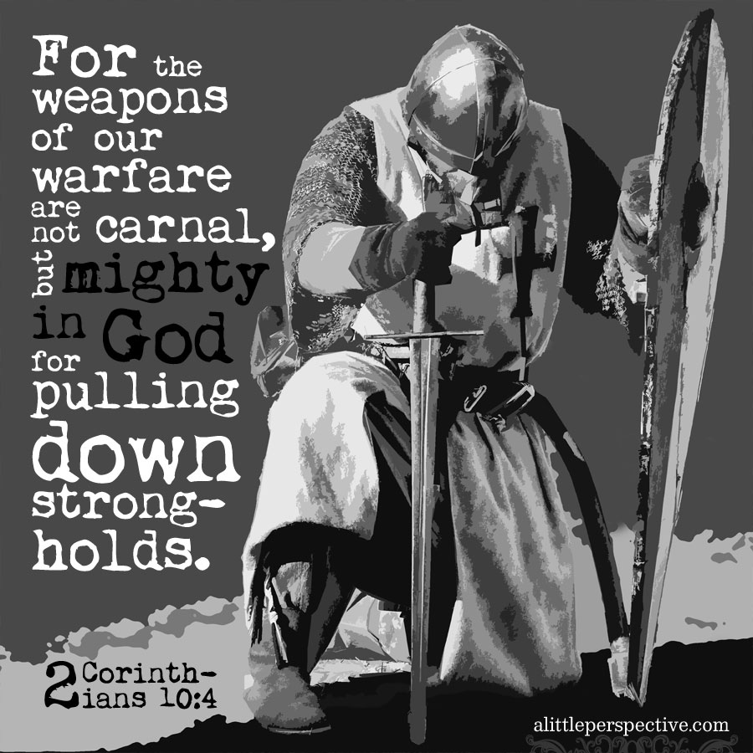
Impenetrable Armor of God
Realize That We Are Equipped to Win
“Put on the Whole Armour of God”
Paul uses the imperative tense
he is not making a suggestion
he is issuing the strongest kind of command
with great urgency to take a particular kind of immediate action.
“Put on the whole armor that comes from God....”

Slide 35
Impenetrable Armor of God
Radical Protection
Three Specific Categories
Each Category has It's Own Merit
in the Fight for Right...........

Slide 36

The Armor Of Consistency 14-15
Loins girt w/ Truth(put all around)
Freedom
Support
“Held Weapons + Medals”
I Pet. 1:13,"gird (gird afresh) up loins of mind"
Prevent from Tangling / Falling
Calls for Truthfulness
John 8:44 - our enemy is a liar
Difference in Fact -vs- Truth
Matt 14- Fact(man heavier than water)
…Truth(come !)

Slide 37
Put on the
Whole Armor

Slide 38
We Are Living in an Age like Gideon’s
Where Gods Army Seems to Decrease
Satan’s Attacks Seems to Increase
But
God Has Not Changed His…
Mind
Muscle
Method

Slide 39
It’s Time to Put on His Armor
And Spread His Message
Don’t Be Afraid
Your Covered!

