Slide 2
Edward Christian Church
Spiritual
Warfare
Pt 17
Armor Up!!! p2
Ephesians 6
September 22, 2024

Slide 3
Occupy Til I Come
Occupy
-Does Not Mean
Take Up Space
-It Does Mean –
Take a Stance
Be Productive
Take Back Lost …
…Ground / Property

Slide 4
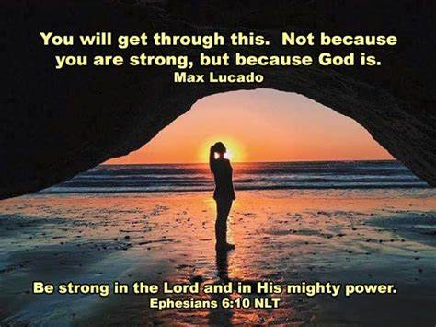
Warning
Be (now-constant)
Strong (infused w- inner ability)
In the Lord (found one place)
Power (overwhelming – irresistible)
Might (strong arm)

Slide 5

The Devil Knows …
He Cannot:
Stop the Building of God’s Church
And I say also unto thee, that thou art
Peter, and upon this rock I will build my church; and the gates of hell shall not prevail against it. -Matthew 16:18
He Can Try:
Stop the Movement of God’s Church!!

Slide 6
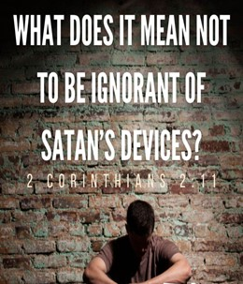
Satan’s Strategy
Personal Attack
Through Any Means Possible
Destroy the Mission of the Church
Satan Desires to…
Affect Your Thinking…
…Life
…Relationships
In Order to…
Infect Your Thinking…
…Life
…Relationships

Slide 7
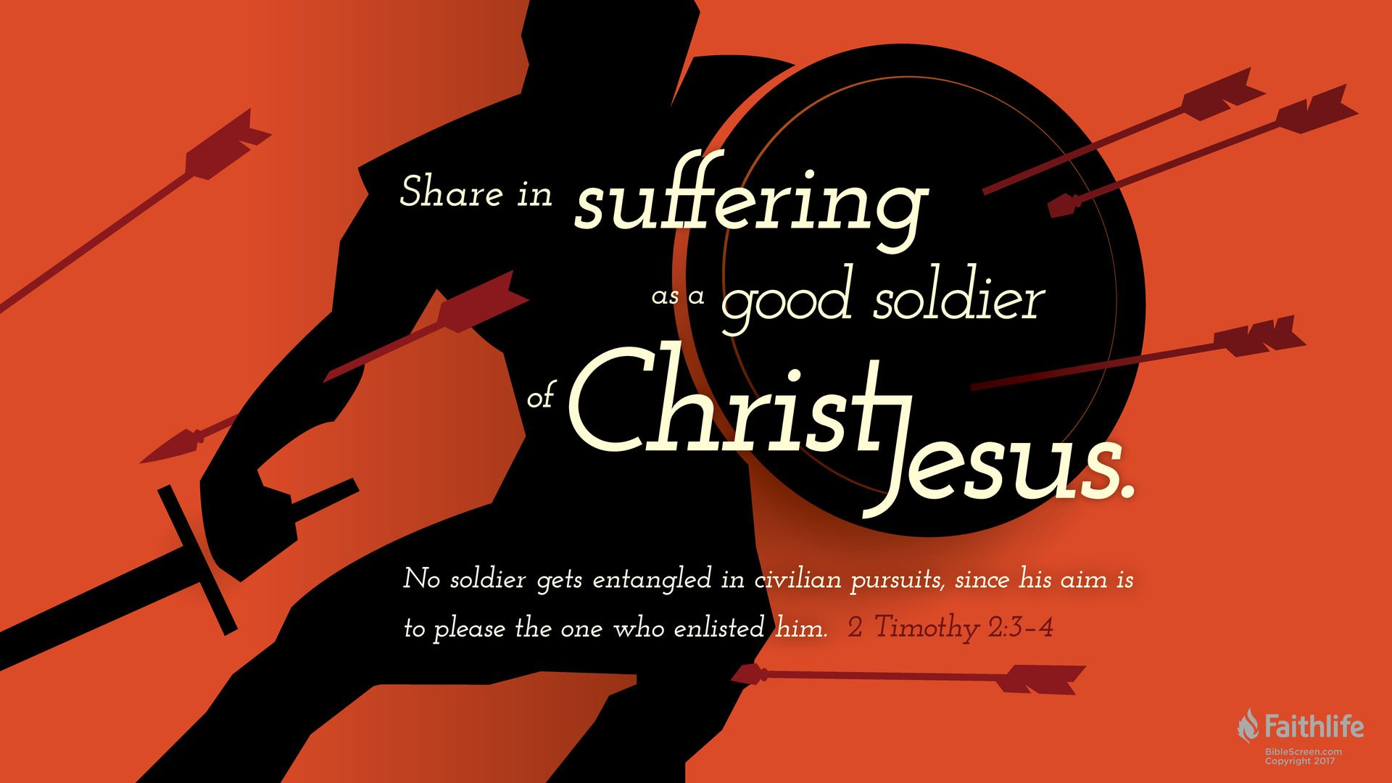
Radically Directed
and Expected
Psalms 144:1 (KJV)
Blessed be the LORD my strength, which teacheth my hands to war, /my fingers to fight:
2 Timothy 2:3 (KJV)
Thou therefore endure hardness, as a good soldier of Jesus Christ.
We are Not on a Playground…
…but a Battle Ground !!

Slide 8
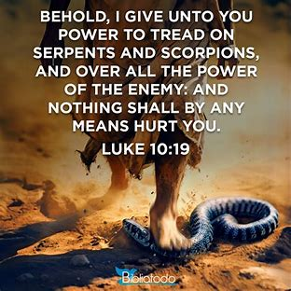
Power for Spiritual Warfare
2 Types of Power
Ability -dunamis
Authority -exousia
2 Types of Attacks -Luke 10:19
Serpents: Cardiovascular System
“No Function”
Scorpions: Central Nervous System
“Inability to Function Properly”

Slide 9
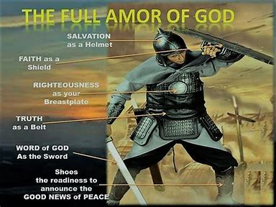
We Have Protection
Ephesians 6:10-11
¹⁰ Finally, my brethren, be strong in the Lord, and
in the power of his might. ¹¹ Put on the whole armor
of God, that ye may be able to stand against the
wiles of the devil.
2 Corinthians 10:4-5
⁴ (For the weapons of our warfare are not carnal, but
mighty through God to the pulling down of strong
holds;) ⁵ Casting down imaginations, and every high
thing that exalteth itself against the knowledge of
God, and bringing into captivity every thought to the
obedience of Christ;

Slide 10
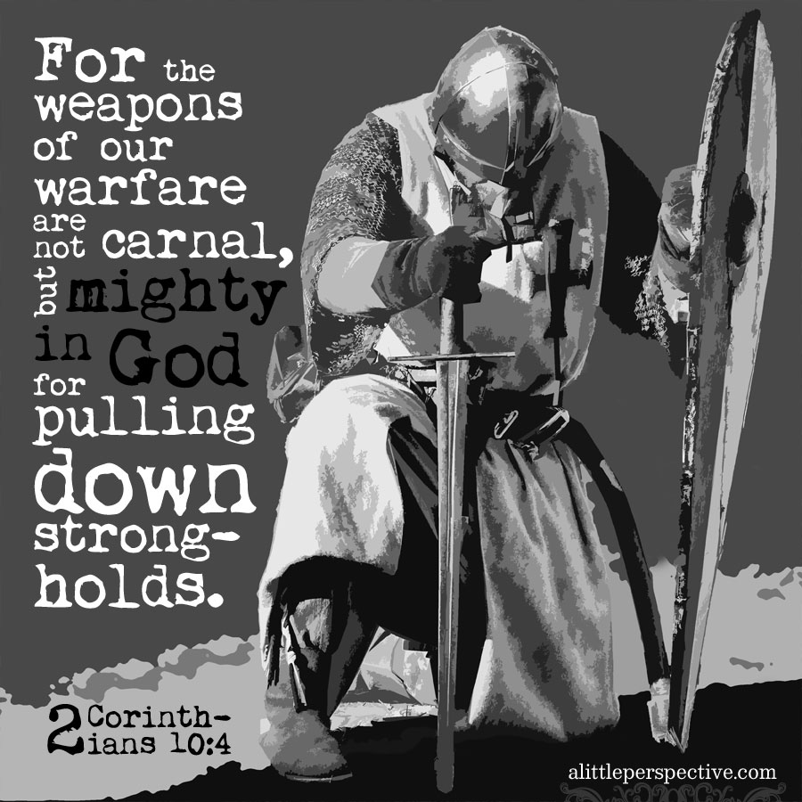
Impenetrable Armor of God
Realize That We Are Equipped to Win
“Put on the Whole Armour of God”
Paul uses the imperative tense
he is not making a suggestion
he is issuing the strongest kind of command
with great urgency to take a particular kind of immediate action.
“Put on the whole armor that comes from God....”

Slide 11
Impenetrable Armor of God
Radical Protection
Three Specific Categories
Each Category has It's Own Merit
in the Fight for Right...........

Slide 12
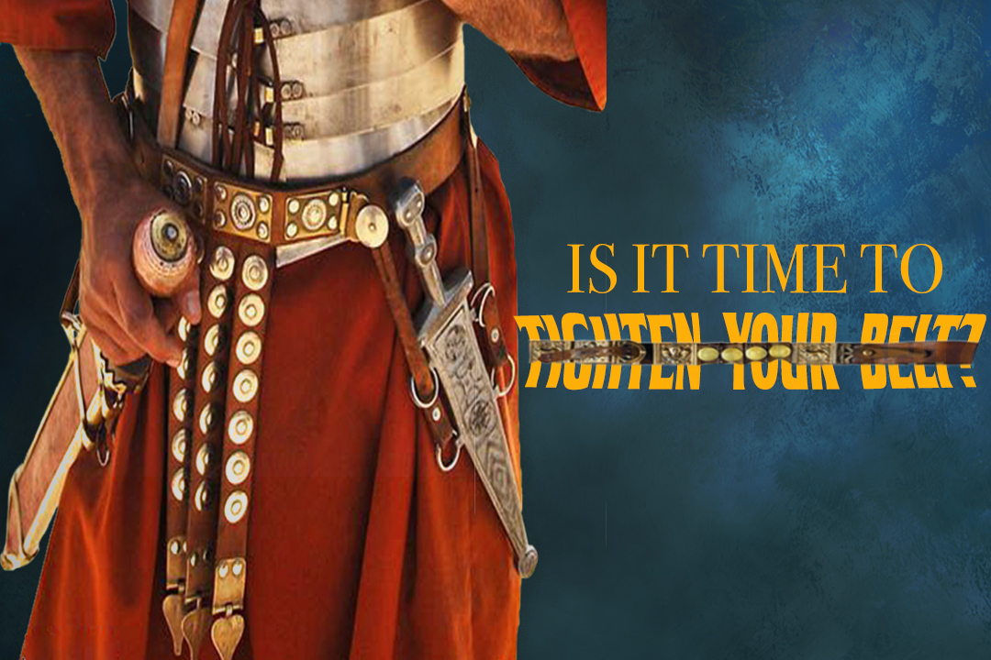
The Armor Of Consistency 14-15
Loins girt w/ Truth(put all around)
Freedom
Support
“Held Weapons + Medals”
I Pet. 1:13,"gird (gird afresh) up loins of mind"
Prevent from Tangling / Falling
Calls for Truthfulness
John 8:44 - our enemy is a liar
Difference in Fact -vs- Truth
Matt 14- Fact(man heavier than water)
…Truth(come !)

Slide 13
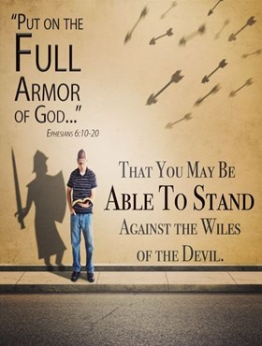
The Armor Of Consistency 14-15
Loins girt w/ Truth(put all around)
Breastplate of Righteousness
Most Beautiful
Heaviest Piece of Armor
Interlocking…
Silver/ Brass

Slide 14

The Armor Of Consistency 14-15
Imputed Righteousness by faith
Romans 4:3
"Abe believed God...counted right"
Imparted Righteousness
Romans 8:4
"right of Law fulfilled walk after Spirit“
Demonstrated Righteousness
Our Response

Slide 15
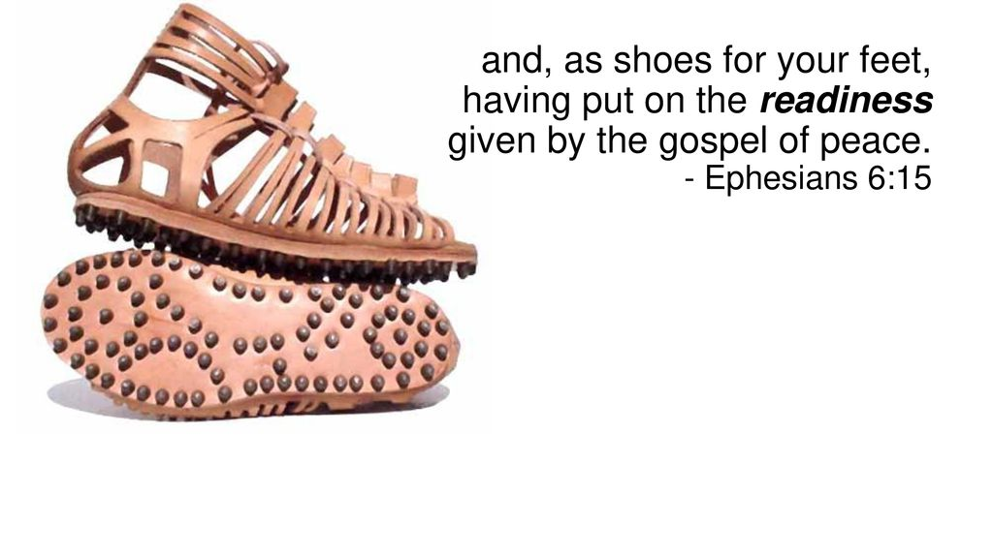
The Armor Of Consistency 14-15
Loins girt w/ Truth(put all around)
Breastplate of Righteousness
Feet Shod(bind tightly) with…
…Preparation of Gospel of Peace

Slide 16
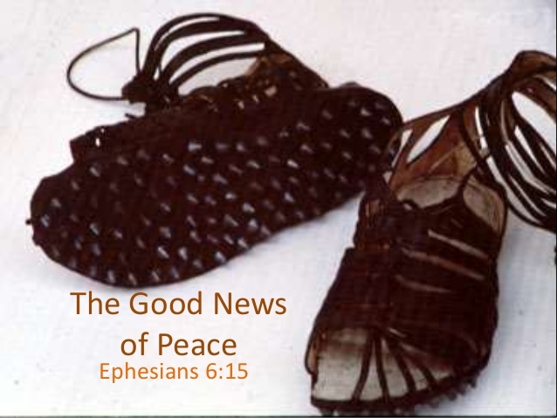
The Armor Of Consistency 14-15
2 Parts
Shoes / Greaves
Surefootedness
Spike of Sole 1"- 3“
Protection
Underfoot
Around Leg(brush/ other boots)
Rom 16:20
God of Peace shall bruise under ft shortly

Slide 17
It’s Time to Put on His Armor
And Spread His Message
Don’t Be Afraid
Your Covered!

Slide 18
Don’t Fall for Satan Lies
Telling You that Your Not Good Enough
You Have His
Truth
Righteousness
Peace

Slide 20
Wife: I have a bag full of used clothing I'd like to donate to charity. Husband: Why not just throw these in the trash? That's much easier. Wife: But there are poor starving people who can really use all these clothes. Husband: Honey, anyone who fits into your clothing is not starving.
Husband is currently recovering from a head injury

