Slide 1
We stand and lift up our hands For the joy of the Lord is our strength We bow down and worship Him now How great, how awesome is He And together we sing

Slide 2
Holy is the Lord, God Almighty The earth is filled with His glory Holy is the Lord, God Almighty The earth is filled with His glory The earth is filled with His glory

Slide 3
We stand and lift up our hands For the joy of the Lord is our strength We bow down and worship Him now How great, how awesome is He And together we sing And everyone sing

Slide 4
Holy is the Lord, God Almighty The earth is filled with His glory Holy is the Lord, God Almighty The earth is filled with His glory The earth is filled with His glory

Slide 5
Yeah, it's rising up all around It's the anthem of the Lord's renown It's rising up all around It's the anthem of the Lord's renown

Slide 6
Yeah, it's rising up all around It's the anthem of the Lord's renown It's rising up all around It's the anthem of the Lord's renown

Slide 7
Together we sing And everyone sing

Slide 8
Holy is the Lord, God Almighty The earth is filled with His glory Holy is the Lord, God Almighty The earth is filled with His glory The earth is filled with His glory

Slide 9
O Taste and see that the Lord is good O Taste and see that the Lord is good to me You have turned my mourning into dancing Put off my rags and clothed me with gladness And I will arise, and I will praise you I'll sing and not be silent

Slide 10
O Lord my God I will give thanks to you forever O Lord my God I will give thanks to you

Slide 11
O Taste and see that the Lord is good O Taste and see that the Lord is good to me You have turned my mourning into dancing Put off my rags and clothed me with gladness And I will arise, and I will praise you I'll sing and not be silent

Slide 12
O Lord my God I will give thanks to you forever O Lord my God I will give thanks to you

Slide 13
Even though I walk through the valley of the shadow of death Your perfect love is casting out fear And even when I'm caught in the middle of the storms of this life I won't turn back I know You are near

Slide 14
And I will fear no evil For my God is with me And if my God is with me Whom then shall I fear? Whom then shall I fear?

Slide 15
Oh no, You never let go Through the calm and through the storm Oh no, You never let go In every high and every low Oh no, You never let go Lord, You never let go of me

Slide 16
And I can see a light that is coming for the heart that holds on A glorious light beyond all compare And there will be an end to these troubles But until that day comes We'll live to know You here on the earth

Slide 17
And I will fear no evil For my God is with me And if my God is with me Whom then shall I fear? Whom then shall I fear?

Slide 18
Oh no, You never let go Through the calm and through the storm Oh no, You never let go In every high and every low Oh no, You never let go Lord, You never let go of me

Slide 19
Yes, I can see a light that is coming for the heart that holds on And there will be an end to these troubles But until that day comes Still I will praise You, still I will praise You

Slide 20
Yes, I can see a light that is coming for the heart that holds on And there will be an end to these troubles But until that day comes Still I will praise You, still I will praise You

Slide 21
Oh no, You never let go Through the calm and through the storm Oh no, You never let go In every high and every low Oh no, You never let go Lord, You never let go of me Oh, You never let go, You never let go

Slide 22
As the Deer Paneth for the water So my soul longs after thee You alone are my hearts desire and I long to worship You

Slide 23
You alone are my strength my shield To you alone will my spirit yield You alone are my hearts desire and I long to worship you

Slide 24
I want You more than gold and silver Only You can satisfy. You alone are the real joy giver And on You I can rely

Slide 25
You alone are my strength my shield To you alone will my spirit yield You alone are my hearts desire and I long to worship you

Slide 26
You're my friend and You are my brother Even though You are the King I love You more than any other So much more than any thing

Slide 27
You alone are my strength my shield To you alone will my spirit yield You alone are my hearts desire and I long to worship you

Slide 28
If you can start the day without caffeine, If you are always cheerful,
If you can eat the same food every day and be grateful for it,
If you are understanding when your loved ones are too busy for you,
If you never treat a rich friend better than a poor friend,
If you face the world without lies and deceit, then you are probably the family dog!

Slide 29
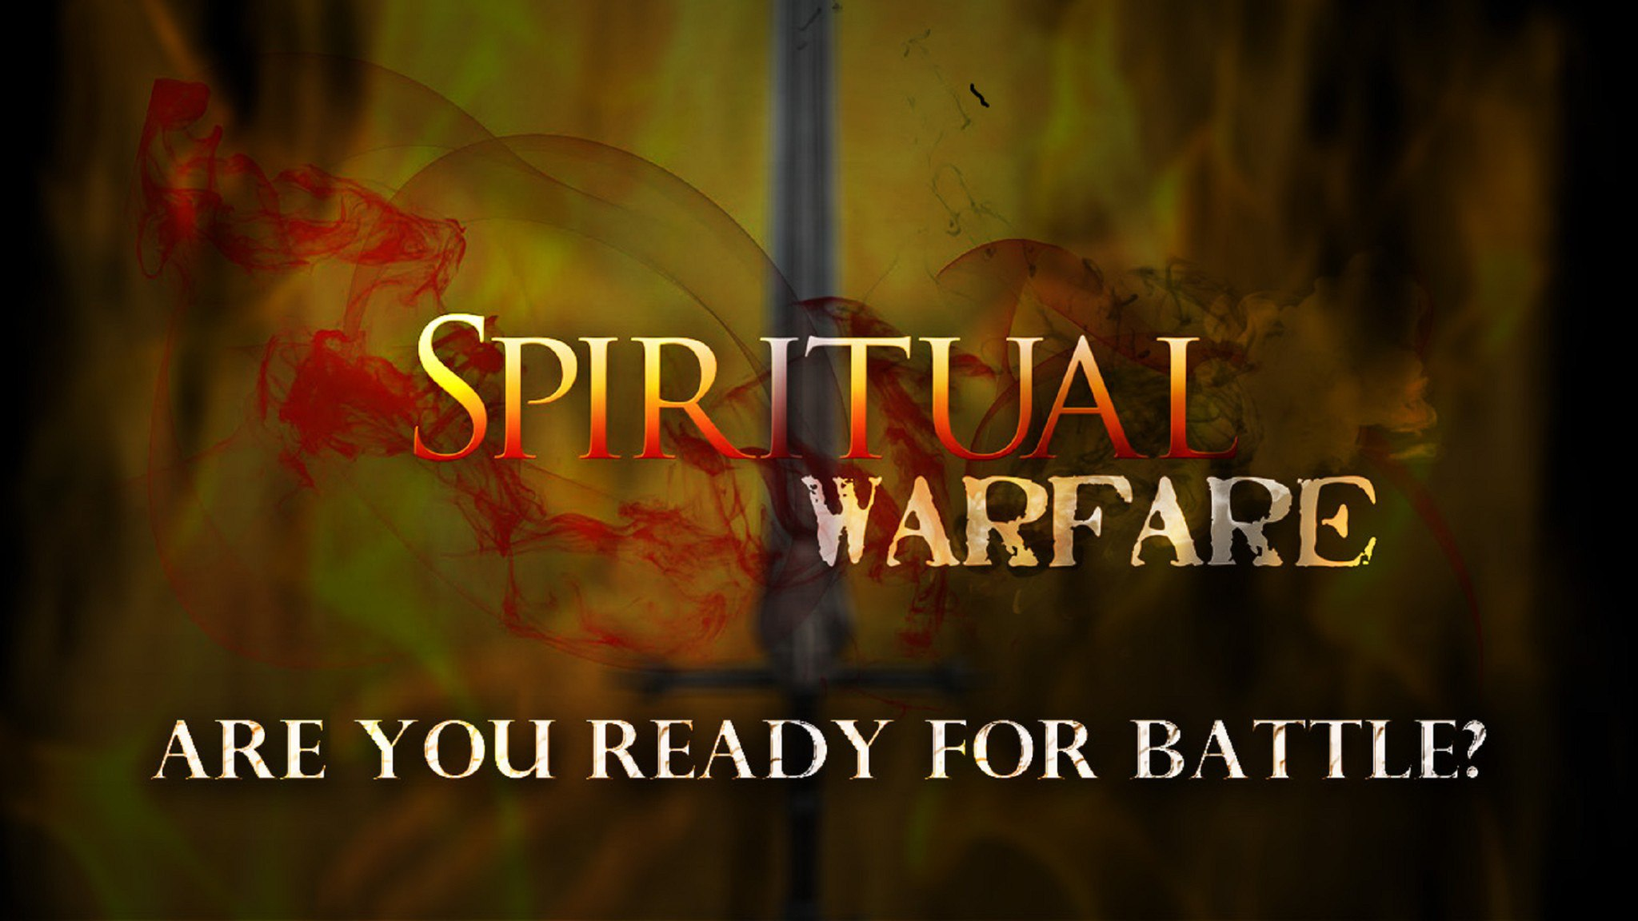
Edward Christian Church
Spiritual
Warfare
Pt 18
Armor Up!!! p3
Ephesians 6
September 29, 2024

Slide 30
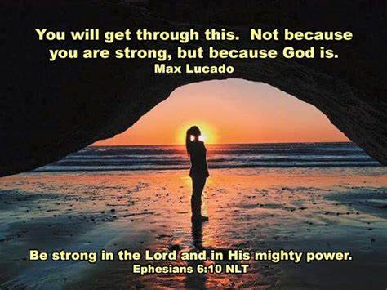
Warning
Be (now-constant)
Strong (infused w- inner ability)
In the Lord (found one place)
Power (overwhelming – irresistible)
Might (strong arm)

Slide 31

The Devil Knows …
He Cannot:
Stop the Building of God’s Church
And I say also unto thee, that thou art
Peter, and upon this rock I will build my church; and the gates of hell shall not prevail against it. -Matthew 16:18
He Can Try:
Stop the Movement of God’s Church!!

Slide 32
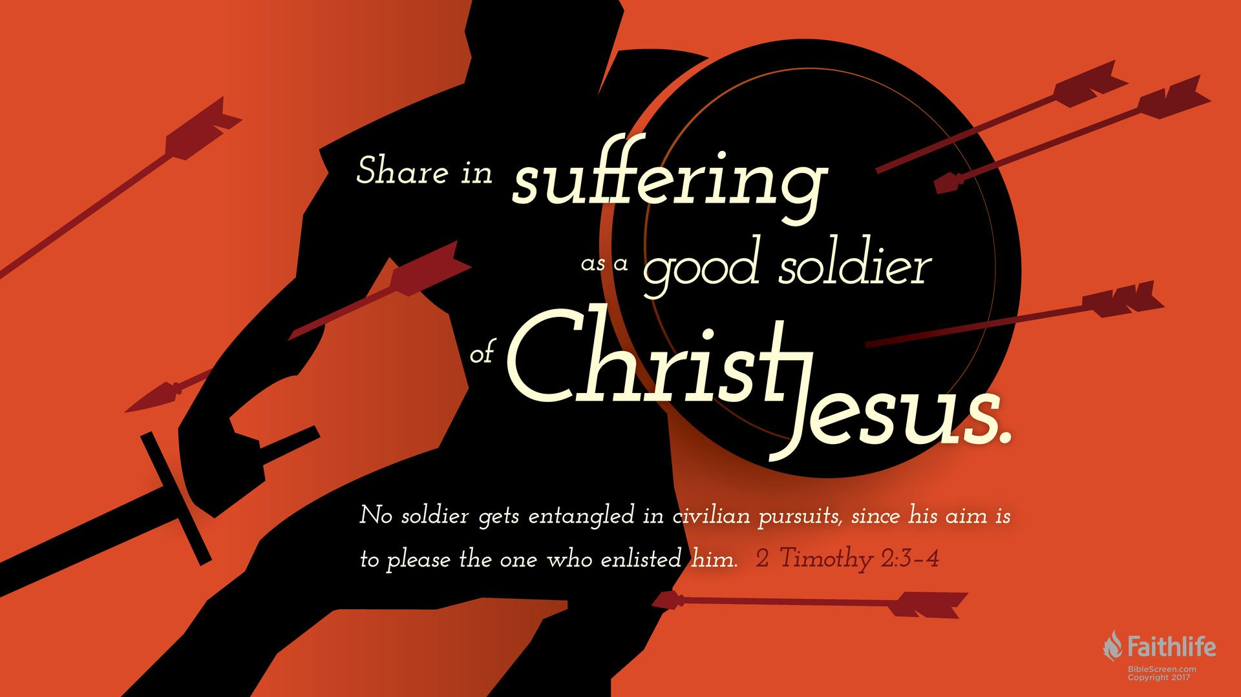
Radically Directed
and Expected
Psalms 144:1 (KJV)
Blessed be the LORD my strength, which teacheth my hands to war, /my fingers to fight:
2 Timothy 2:3 (KJV)
Thou therefore endure hardness, as a good soldier of Jesus Christ.
We are Not on a Playground…
…but a Battle Ground !!

Slide 33
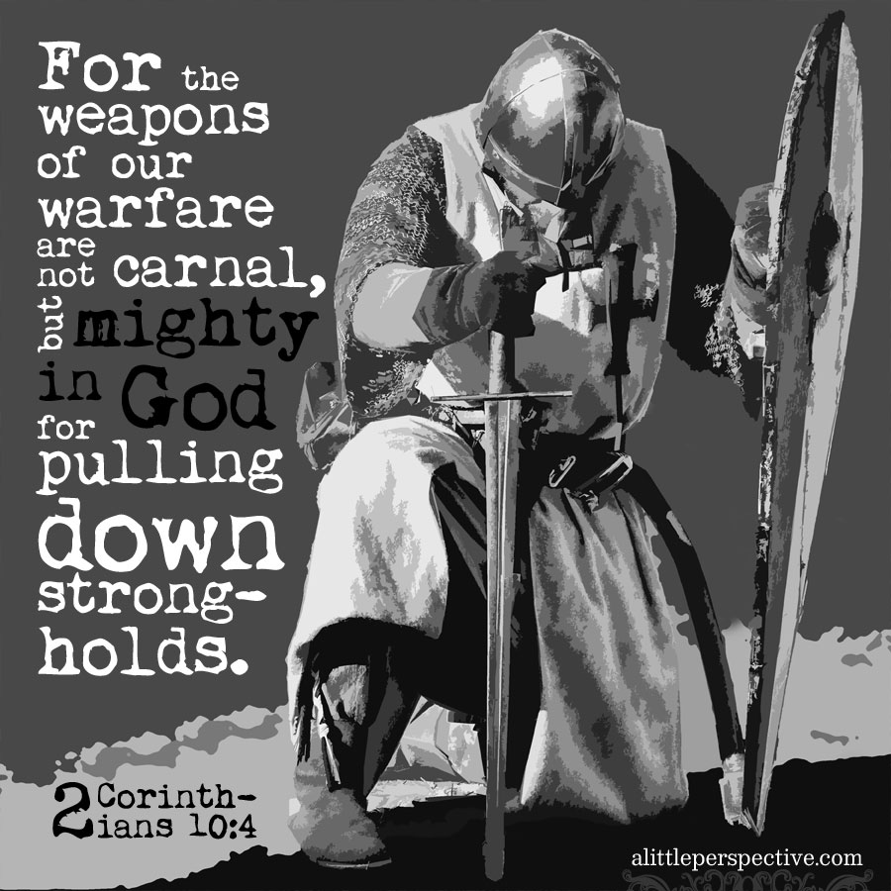
Impenetrable Armor of God
Realize That We Are Equipped to Win
“Put on the Whole Armour of God”
Paul Is Not…
Making a suggestion
But strongest kind of command
Take immediate action.
“Put on the whole armor that comes from God....”

Slide 34
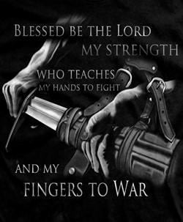
Impenetrable Armor of God
Radical Protection
Three Specific Categories
Each Category has It's Own Merit
in the Fight for Right...........

Slide 35
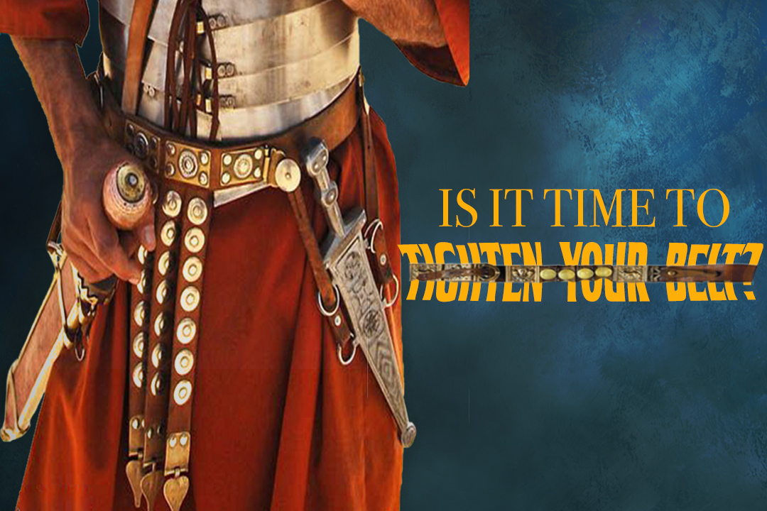
The Armor Of Consistency 14-15
Loins girt w/ Truth(put all around)
Freedom
Support
“Held Weapons + Medals”
I Pet. 1:13,"gird (gird afresh) up loins of mind"
Prevent from Tangling / Falling
Calls for Truthfulness
John 8:44 - our enemy is a liar
One of his most effective weapons

Slide 36
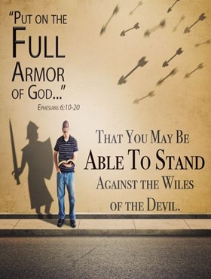
The Armor Of Consistency 14-15
Loins girt w/ Truth(put all around)
Breastplate of Righteousness
Most Beautiful
Heaviest Piece of Armor
Interlocking…
Silver/ Brass

Slide 37
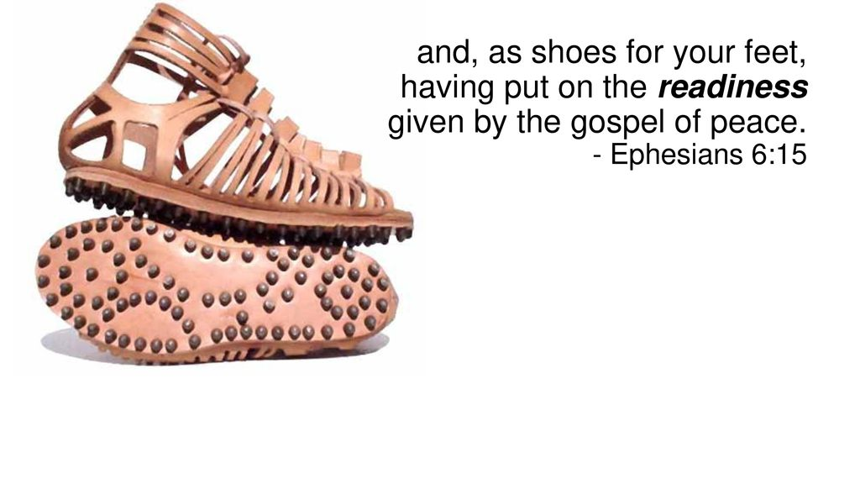
The Armor Of Consistency 14-15
Loins girt w/ Truth(put all around)
Breastplate of Righteousness
Feet Shod(bind tightly) with…
…Preparation of Gospel of Peace

Slide 38
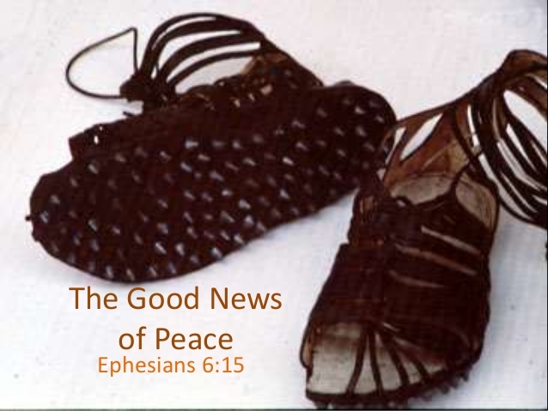
The Armor Of Consistency 14-15
2 Parts
Shoes / Greaves
Surefootedness
Spike of Sole 1"- 3“
Protection
Underfoot
Around Leg(brush/ other boots)
Rom 16:20
God of Peace shall bruise under ft shortly

Slide 39
The Armor Of Confidence 16-17
Shield of Faith
Roman soldiers owned two shields
1st- public parades ceremonies
small, round decorative shield
2nd- used in battle
shaped like a door
#1- in battle shield completely covered a Roman soldier!
#2- This tells us that God has given us enough faith to make sure we are completely covered

Slide 40
The Armor Of Confidence 16-17
This Shield was composed of multiple layers (6)
thick animal hide
tightly woven together.
became almost as strong as steel.
it was extremely strong and exceptionally long-lasting and hard-wearing.
LIkewise, your faith is extremely tough and exceptionally durable
No matter how hard /long the enemy beats against your faith…
…your faith can outlast his attack.

Slide 41
Important for the Soldier to Take Good Care of It
Although the shield was ext strong and durable
could become stiff and breakable
Properly care for them
daily schedule for maintaining condition
Each morning thoroughly rub oil into the leather
keep it soft and pliable.
to ignore daily application of oil to was the equivalent of his inviting certain death
Faith that is ignored nearly always breaks and falls to pieces during a confrontation with the enemy

Slide 42
There was another reason the Roman soldier’s shield was made out of animal hide.
Before battle placed his shield in a tub of water
soaking until shield was completely saturated.
enemies used arrows that carried fire!
wet surface would extinguish on impact!
gave the soldier the upper hand in battle
We must make certain that we are allowing the Holy Spirit to freshly anoint our lives on a daily basis as we regularly saturate our faith with the water of the Word.

Slide 43
3-Arrow Types:
Plain
Dipped in Tar and Set on Fire
Combustible Fluids/ Burst in Flames
These fluid-filled arrows were not used in normal combat situations
Reserved to inflict damage on a fortified place or an encampment.
Our Enemy Seeks to Control Our Fortified Places - Our Emotions and Heart

Slide 44
Above All
Describes position over other pieces
It could be better translated, “out in front of all” or “covering all.”
Shields Joined Together Formed a Hood
…Protected fr. Massive Overhead Attacks
“Testudo Formation”
Faith is designed to be out in front where it can completely cover you in every situation of life!

Slide 45
Don’t Fall for Satan Lies
Telling You that Your Not Good Enough
You Need to Pick Up / Apply His…
Truth
Righteousness
Peace
Faith
Salvation
That Way,
Having Done All to Stand
You Can Stand!!

Slide 46
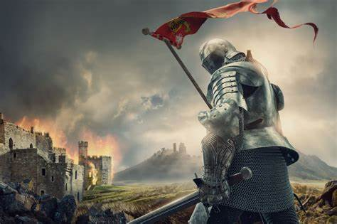
It’s Time to Put on His Armor
And Spread His Message
Don’t Be Afraid
Your Covered!

