Slide 1
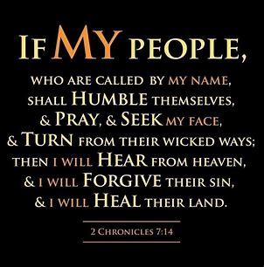
How to Truly Make America Great Again!

Slide 2

This is Much Bigger Than Politics
We Are In Crisis as a Nation
We Need God to Intervene
No Matter Our Political Viewpoint
Let Us Join Together
Seek God

Slide 3
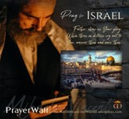

Psalm 17:7-9 -Complete Jewish Bible
⁷ Show how wonderful is your grace, savior of those who seek at your right hand refuge from their foes. ⁸ Protect them like the pupil of your eye, hide them in the shadow of your wings ⁹ from the wicked, who are assailing them, from their deadly enemies, who are all around them.
And All of the Innocent Victims
on Both Sides

Slide 4
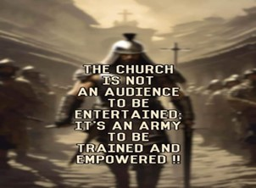
Repeat
These are the 2 Most Important Hours of My Week – Help Me to Cherish Them
I Am Here Today to Worship
Not to Be Entertained
I Am Singing to An Audience of One
Accept My Worship Oh Lord!

Slide 5

Repeat
I Lift My Offering to You
Let It Please You Oh Lord
This is My Seed
Although It Leaves My Hand
It will Never Leave My Life
You Will Multiply It!
Accept My Seed Oh Lord!

Slide 6
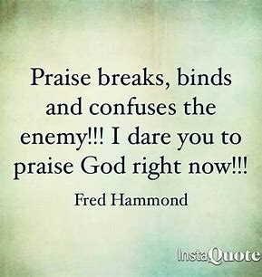

Slide 7
Edward Christian Church
Spiritual
Warfare
Pt 19
Armor Up!!! p4
Ephesians 6
Genesis 3
6 October 2024

Slide 8
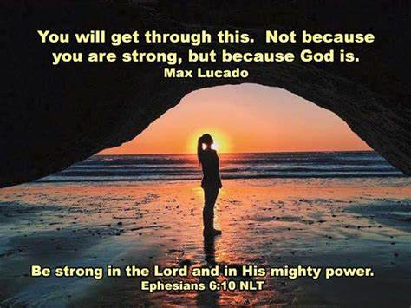
Warning
Be (now-constant)
Strong (infused w- inner ability)
In the Lord (found one place)
Power (overwhelming – irresistible)
Might (strong arm)

Slide 9
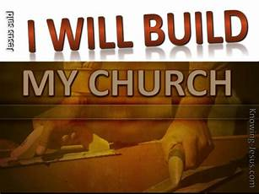
The Devil Knows …
He Cannot:
Stop the Building of God’s Church
And I say also unto thee, that thou art
Peter, and upon this rock I will build my church; and the gates of hell shall not prevail against it. -Matthew 16:18
He Can Try:
Stop the Movement of God’s Church!!

Slide 10
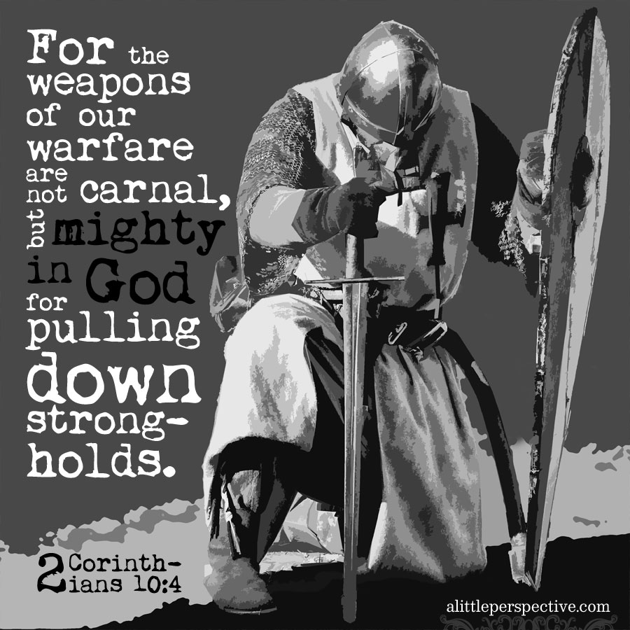
Impenetrable Armor of God
Realize That We Are Equipped to Win
“Put on the Whole Armour of God”
Paul Is Not…
Making a suggestion
But strongest kind of command
Take immediate action.
“Put on the whole armor that comes from God....”

Slide 11
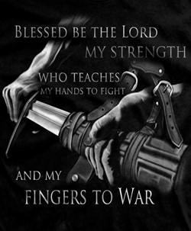
Impenetrable Armor of God
Radical Protection
Three Specific Categories
Each Category has It's Own Merit
in the Fight for Right...........

Slide 12
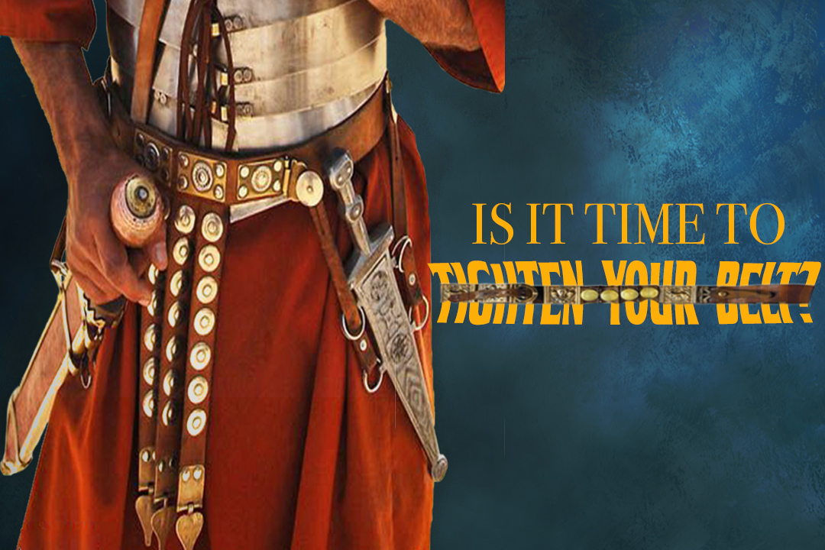
The Armor Of Consistency 14-15
Loins girt w/ Truth(put all around)
Freedom
Support
“Held Weapons + Medals”
I Pet. 1:13,"gird (gird afresh) up loins of mind"
Prevent from Tangling / Falling
Calls for Truthfulness
John 8:44 - our enemy is a liar
One of his most effective weapons

Slide 13
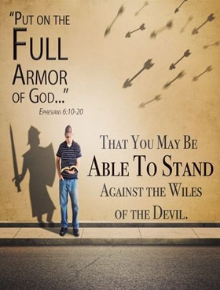
The Armor Of Consistency 14-15
Loins girt w/ Truth(put all around)
Breastplate of Righteousness
Most Beautiful
Heaviest Piece of Armor
Interlocking…
Silver/ Brass

Slide 14
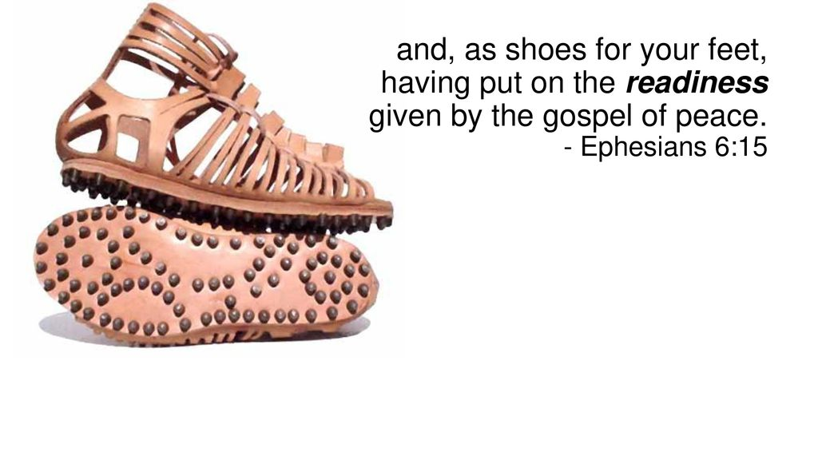
The Armor Of Consistency 14-15
Loins girt w/ Truth(put all around)
Breastplate of Righteousness
Feet Shod(bind tightly) with…
…Preparation of Gospel of Peace

Slide 15
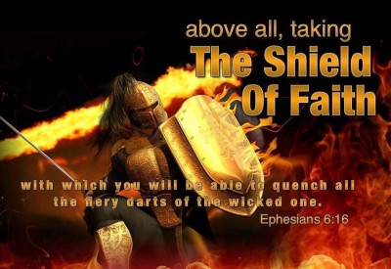
The Armor Of Confidence 16-17
Shield of Faith
Roman soldiers owned two shields
1st- public parades ceremonies
small, round decorative shield
2nd- used in battle
shaped like a door
#1- in battle shield completely covered a Roman soldier!
#2- This tells us that God has given us enough faith to make sure we are completely covered

Slide 16

The Armor Of Confidence 16-17
This Shield was composed of multiple layers (6)
thick animal hide
tightly woven together.
strong as steel.
extremely strong/ long-lasting/ hard-wearing.
Annointed with oil
Saturated with water

Slide 17
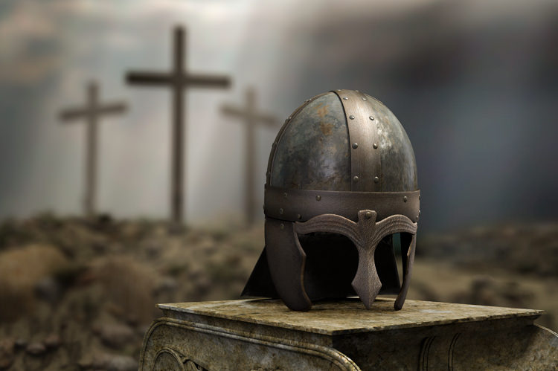
The Armor Of Confidence 16-17
Helmet of Salvation
The iconic helmets worn by the Roman Legion…
Made of leather/ bronze plates for protection
include neck and cheek guards.
some helmets were entirely cast-metal
except ornamental plumes of horsehair
Their primary function was to deflect blows
from enemy broadswords and arrows.

Slide 18
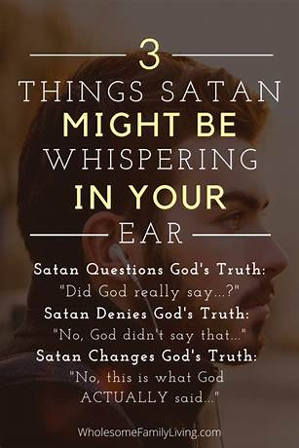
The helmet is a metaphor for protecting the mind
Paul warns us to guard our thoughts
If the devil can tamper with our thoughts…
he can meddle with our lives
how we perceive Christ / His teachings
it affects all of life.

Slide 19
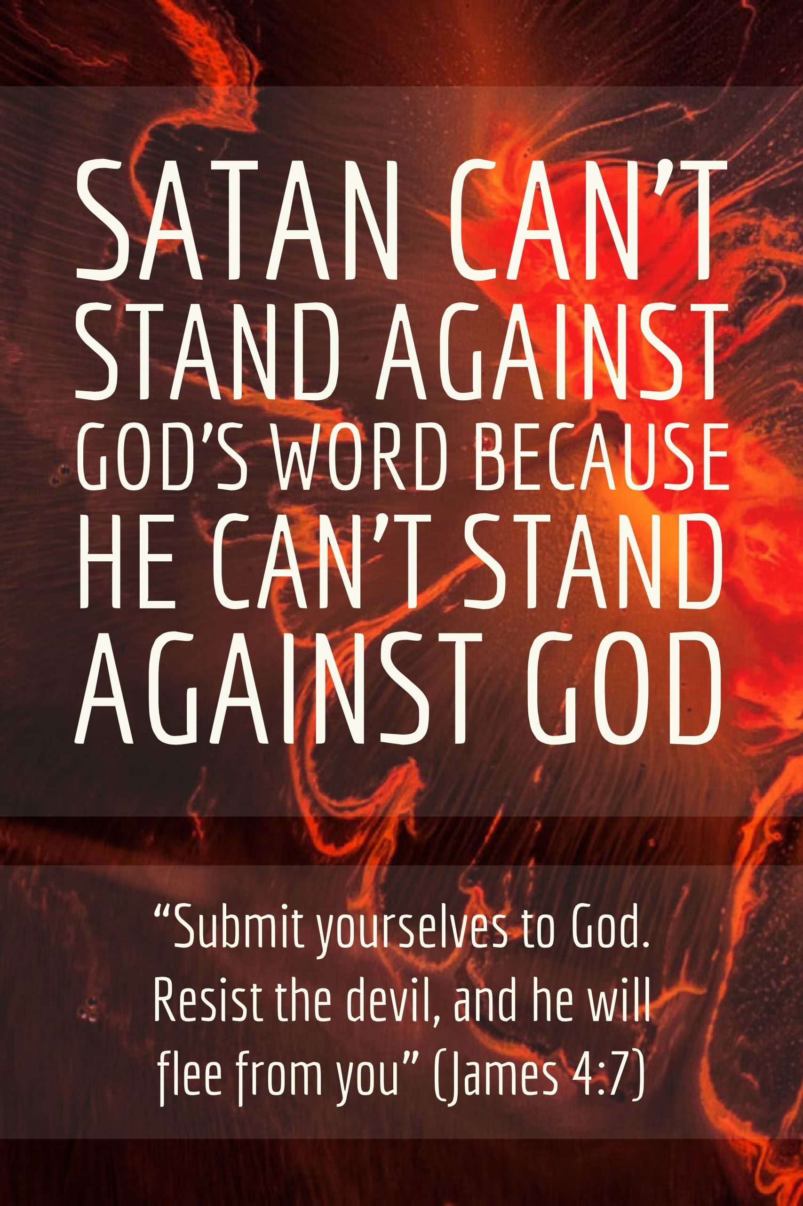
Devil’s Goal
seize your mind, paralyze it with fear
then flood it with allegations that are not true.
He captivates your thinking / reasoning…
to convince you to believe that his lies are true
then his fiery darts can then release their damnable destruction in your life and mind
II Cor. 10:3-5,"weapons not carnal …mighty
…pulling down…cast...imaginations"

Slide 20
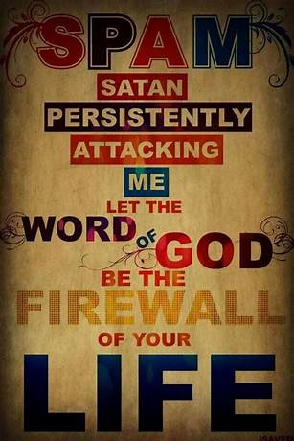
We’ve been issued the “helmet of salvation.”
Salvation is God doing for us…
…what we cannot do for ourselves.
We can be condemned by ourselves…
…but not saved by ourselves.
“There are no do-it-yourself Christians”
“Salvation is not the end of our journey…
…but the end of our wandering”
Neither is it the end of our battle with sin.
The battlefield of the mind…
…is constantly under assault.

Slide 21
Don’t Fall for Satan Lies
Telling You that Your Not Good Enough
You Need to Pick Up / Apply His…
Truth
Righteousness
Peace
Faith
Salvation
That Way,
Having Done All to Stand
You Can Stand!!

Slide 22
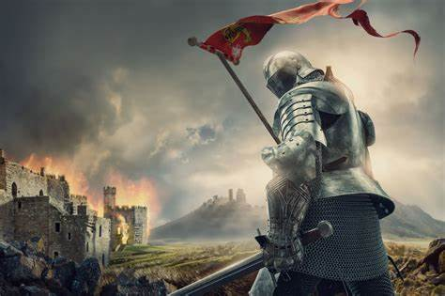
It’s Time to Put on His Armor
And Spread His Message
Don’t Be Afraid
Your Covered!

Slide 24
GOD SPEED
A very wealthy, religious little old lady was a soft touch for any panhandler she happened to meet on the street.
One day she met a very shabbily dressed man and impulsively pressed a five dollar bill into his hand, smiled warmly and whispered, “God speed.”
The next day the shabbily dressed man knocked at the door of her house and said, “Here’s your hundred dollars. Godspeed came in first and paid twenty to one.”

