Slide 1
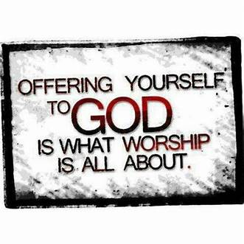

Slide 2

Repeat
I Lift My Offering to You
Let It Please You Oh Lord
This is My Seed
Although It Leaves My Hand
It will Never Leave My Life
You Will Multiply It!
Accept My Seed Oh Lord!

Slide 3
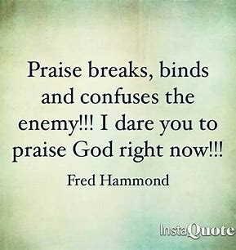

Slide 4
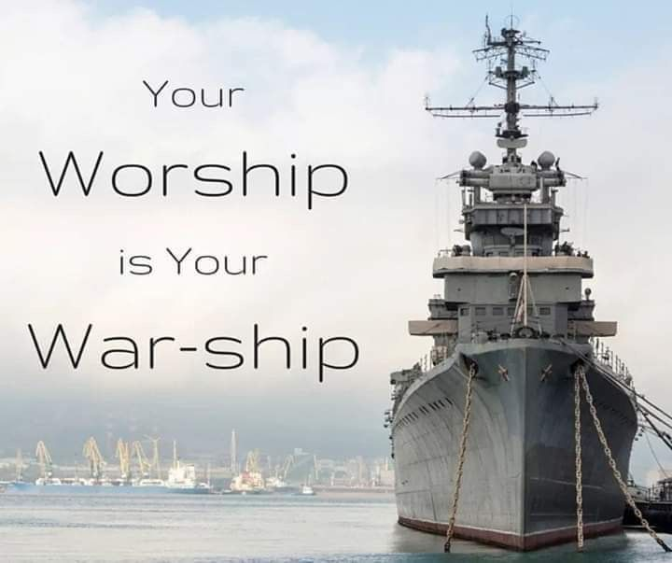

Slide 6

Edward Christian Church
Spiritual
Warfare
Pt 22
Reach Up!!! p2
Ephesians 6
Nov 10, 2024

Slide 7
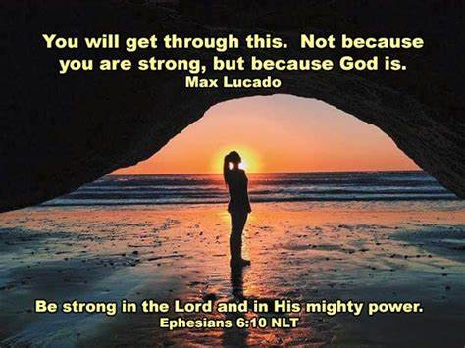
Warning
Be (now-constant)
Strong (infused w- inner ability)
In the Lord (found one place)
Power (overwhelming – irresistible)
Might (strong arm)

Slide 8

The Devil Knows …
He Cannot:
Stop the Building of God’s Church
And I say also unto thee, that thou art
Peter, and upon this rock I will build my church; and the gates of hell shall not prevail against it. -Matthew 16:18
He Can Try:
Stop the Movement of God’s Church!!

Slide 9
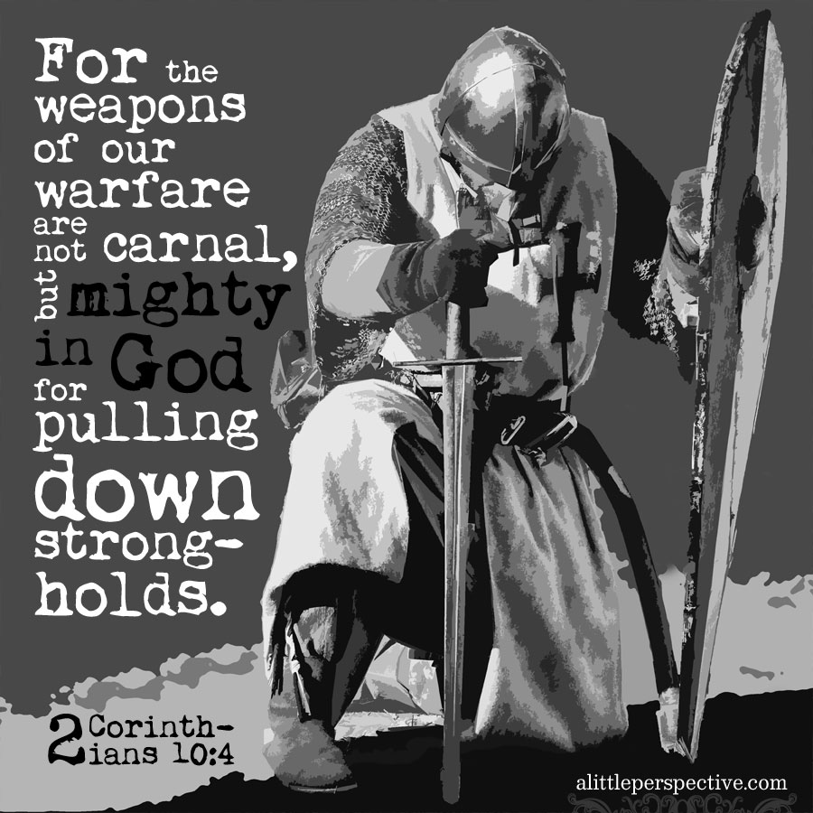
Impenetrable Armor of God
Realize That We Are Equipped to Win
“Put on the Whole Armour of God”
Paul Is Not…
Making a suggestion
But strongest kind of command
Take immediate action.
“Put on the whole armor that comes from God....”

Slide 10

Impenetrable Armor of God
Radical Protection
Three Specific Categories
Each Category has It's Own Merit
in the Fight for Right...........

Slide 11

The Armor Of Consistency 14-15
Loins girt w/ Truth(put all around)
Breastplate of Righteousness
Feet Shod(bind tightly) with…
…Preparation of Gospel of Peace

Slide 12
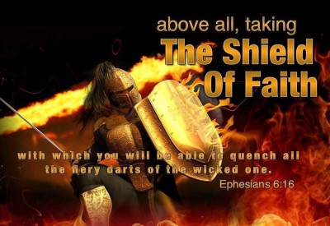
The Armor Of Confidence 16-17
Shield of Faith
Helmet of Salvation

Slide 13
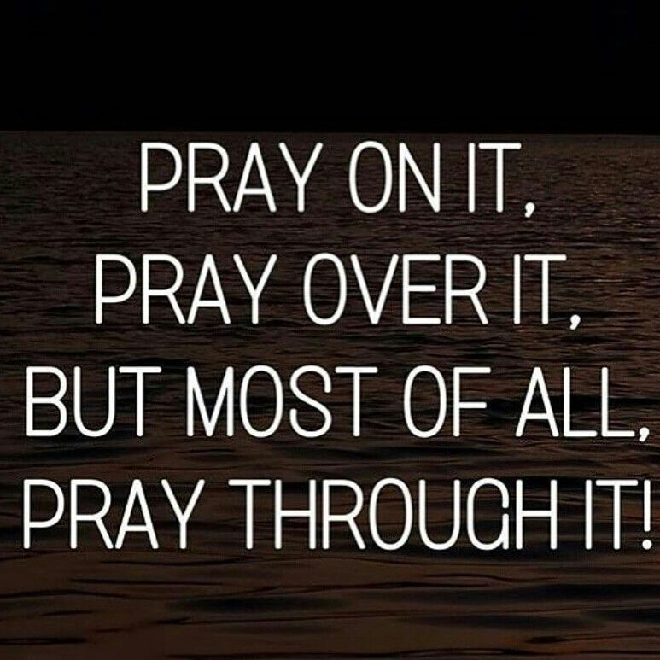
Armor Of Communication (17-19)
Sword of the Spirit
Praying Always(whole + period)
I Thess. 5:17,"Pray w/ out ceasing....“
Why Does the Devil Try to Stop Us
From Praying Without Ceasing?

Slide 14

Prayer is Way We Commune w/ God
P- Powerful
R- Responsive
A- Armor
Y- Yield
Prayer is a Powerful Force
It is Life-Changing

Slide 15
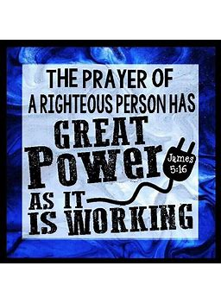
Paul Calls Us to Use One of the Most Powerful Weapons Available : Prayer . .
Paul Saves It For Last In This List-
it is the MOST IMPORTANT WEAPON of Battle!
Not that it Should be Used as the Last Resort
or When All Else Fails! No!
He says to pray ON ALL OCCASIONS!
And to ALWAYS KEEP ON PRAYING!
He Told the church at Thessalonica
‘pray without ceasing!’ -1 Thess. 5:17
Why?

Slide 16
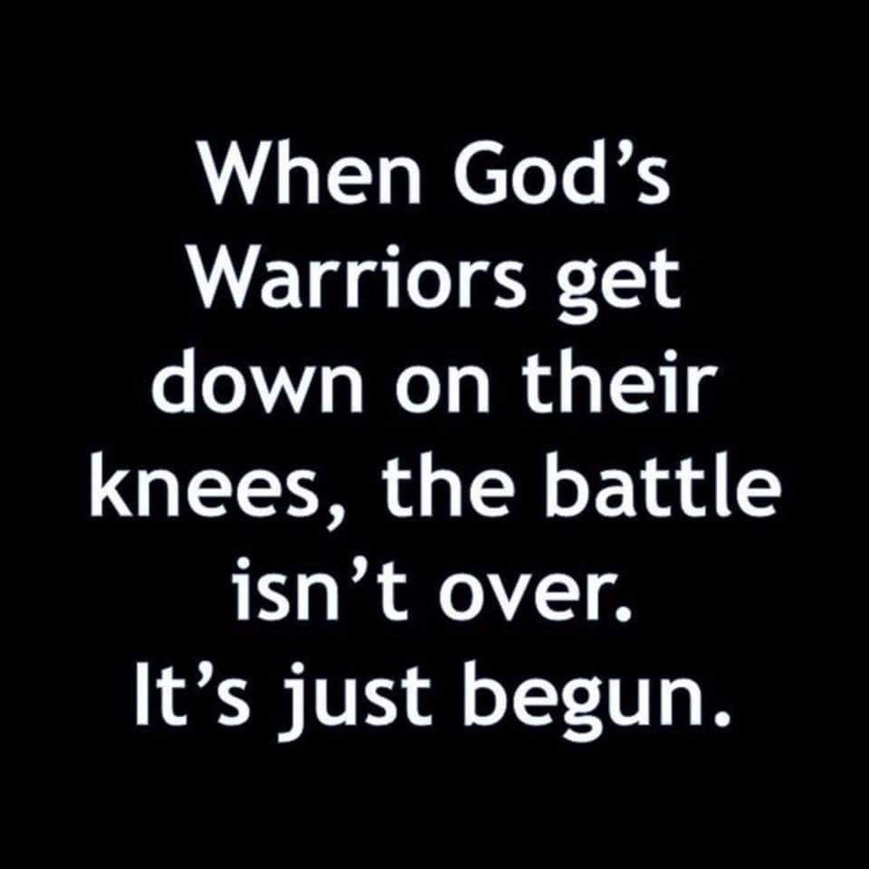
Prayer is a Divine Connection to an Impotent God
Because Nothing Is Impossible to God…
…Nothing Is Beyond the Reach of Prayer
“Praying always with all prayer and supplication in the Spirit, and watching thereunto with all perseverance and supplication for all saints” - Eph 6:18

Slide 17
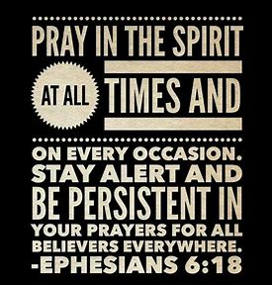
There Is Public Prayer- Private Prayer
Individual Prayer- Corporate Prayer
Long Prayers- Short Prayers
Standing Prayers - Sitting Down Prayers
Laying On Face Prayers, While You Walk Prayers
The Prayer Of Faith, Petition, Intercession
The Prayer Of Submission, Repentance
The Believer Hasn’t Even Begun To Fight
Until He Learns To Pray

Slide 18
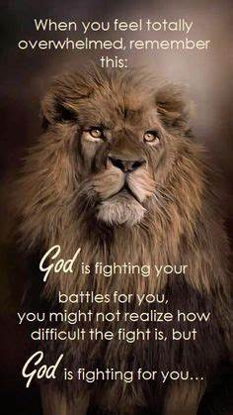
Paul Is Calling For
More Than Specific Prayers
He’s Calling for a Lifestyle Of Prayer!

Slide 19
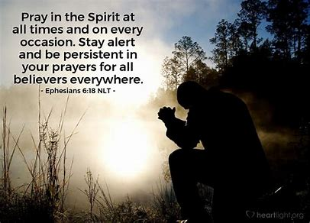
Three Things That He Says About Prayer.
It Must Be Constant
Our tendency is to pray only in great crises of life;
but it is daily prayer that we will find daily strength.
It Must Be Intense
Limp prayer never got a man anywhere.
Prayer demands the concentration upon God.
It Must Be Unselfish
The Jews had a saying, “Let a man unite himself with the community in his prayers.” Often our prayers are too much for ourselves / too little for others.
We must learn to pray as much for others and with others as for ourselves.

Slide 20
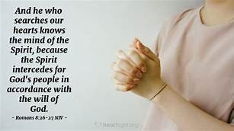
Paul calls on Christians to pray IN THE SPIRIT.
What does it mean to pray ‘in the Spirit’?
To pray ‘in the Spirit’ is to pray ‘under the influence of the Spirit.’
This is a call to be guided / led by the Holy Spirit of God in Our prayers!
He is the one who motivates and enables and energizes your prayer.

Slide 21

A - Assistance:
Ask God for His assistance, empowering/ directing in fulfilling His will so that the person will operate under the Biblical obedience and the Spirit’s control.
B - Boldness:
Pray that the person speaks the word of God with boldness, confidence and articulative effectiveness.
C - Comfort:
Ask God for comfort when one is discouraged, broken-hearted or stressed out. Pray that the Lord will help them trust and obey regardless of the opposition.

Slide 22
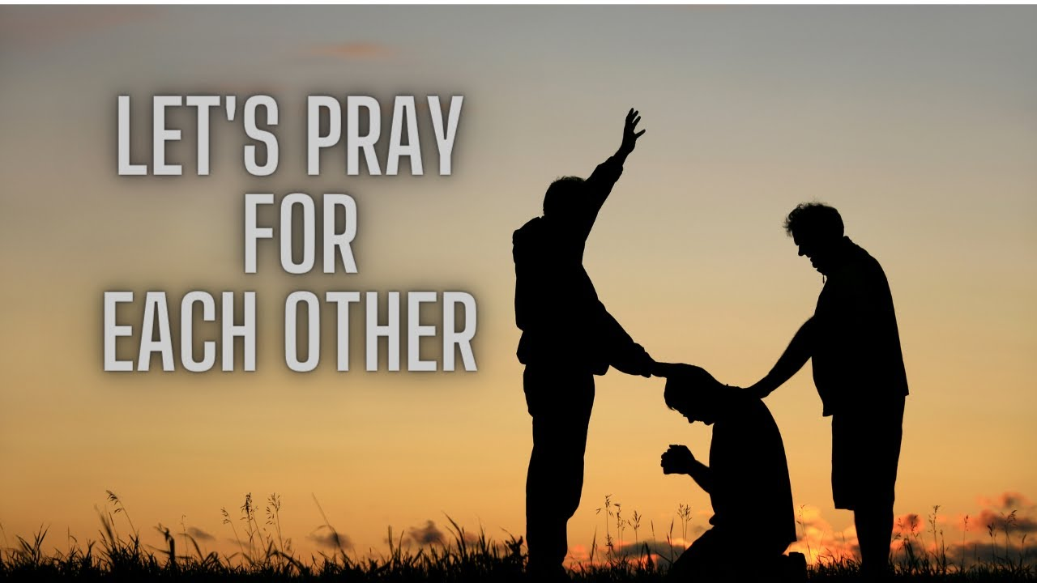
D - Direction:
Ask the Lord that the person will sense God’s specific direction in activities, ministries and relationships.
E - Encouragement:
Ask God to send someone or something to the person to allow the person to be a blessing to many. Trust God for the renewing of the joy of the Lord as their strength.

Slide 23
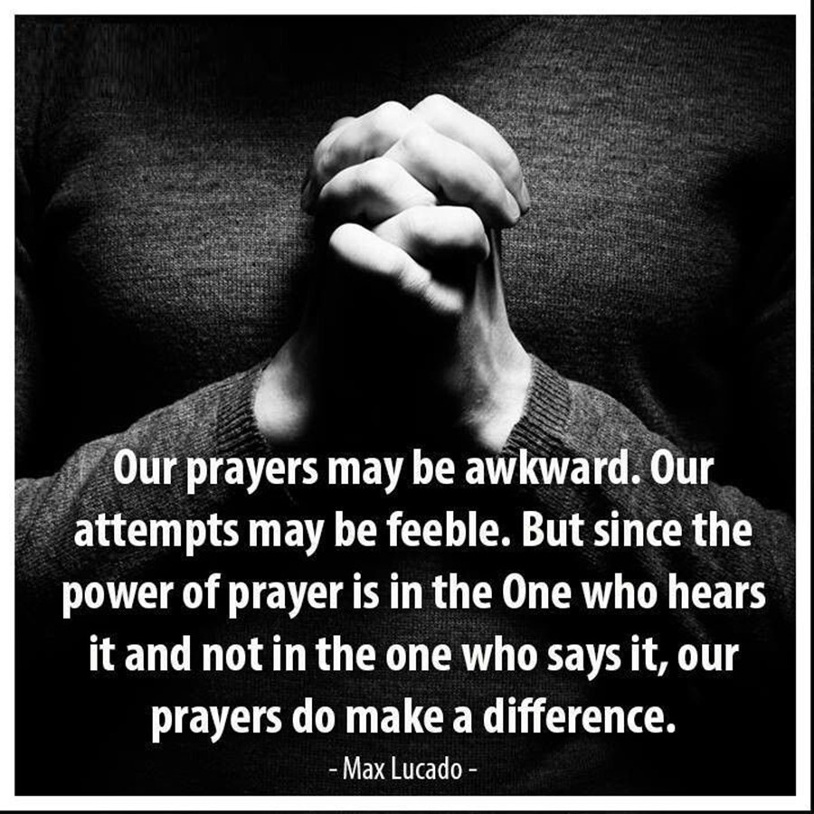
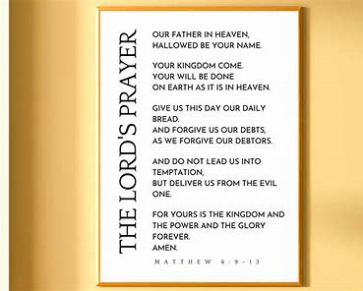

Slide 25
The pastor of a local church had a kitten that climbed up a tree in his backyard and was afraid to come down. The pastor coaxed, offered warm milk, etc. The kitty would not come down. The tree was not sturdy enough to climb, so the pastor decided that if he tied a rope to his car and drove away so that the tree bent down, he could then reach up and get the kitten. He did all this, checking his progress in the car frequently, then figured if he went just a little bit further, the tree would be bent sufficiently for him to reach the kitten. But as he moved a little further forward, the rope broke. The tree went BOING and the kitten instantly sailed through the air - out of sight.
The pastor felt terrible. He walked all over the neighborhood asking people if they'd seen a little kitten. No. Nobody had seen a stray kitten. So he prayed, "Lord, I just commit this kitten to your keeping," and went on about his business.
A few days later he was at the grocery store, and met one of his church members. He happened to look into her shopping cart and was amazed to see cat food. Now this woman was a cat hater and everyone knew it, so he asked her, "Why are you buying cat food when you hate cats so much?"
She replied, "You won't believe this," and told him how her little girl had been begging her for a cat, but she kept refusing. Then a few days before, the child had begged again, so the Mom finally told her little girl, "Well if God gives you a cat, I'll let you keep it."
She told the pastor, "I watched my child go out in the yard, get on her knees, and ask God for a cat. And really, Pastor, you won't believe this, but I saw it with my own eyes. A kitten suddenly came flying out of the blue sky, with its paws outspread, and landed right in front of her."

