Slide 1
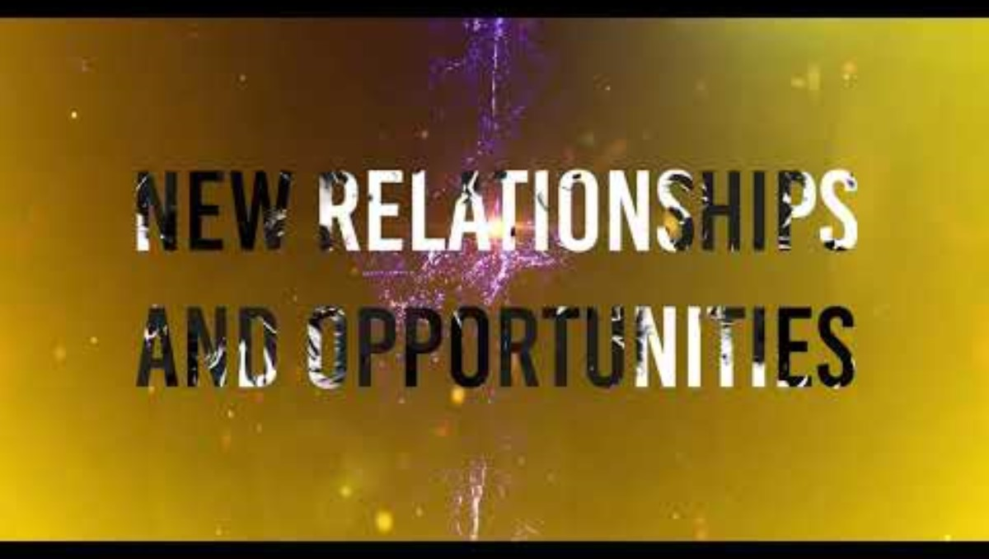

Slide 2
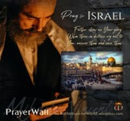
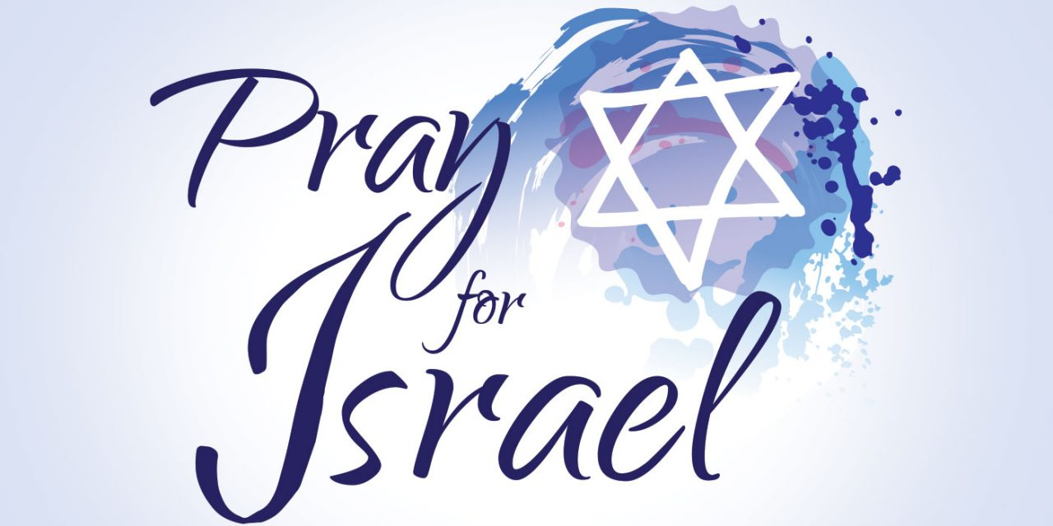
Psalm 17:7-9 -Complete Jewish Bible
⁷ Show how wonderful is your grace, savior of those who seek at your right hand refuge from their foes. ⁸ Protect them like the pupil of your eye, hide them in the shadow of your wings ⁹ from the wicked, who are assailing them, from their deadly enemies, who are all around them.
And All of the Innocent Victims
on Both Sides

Slide 3
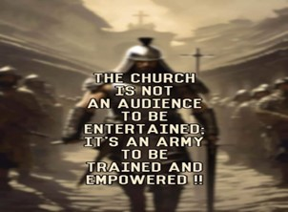
Repeat
These are the 2 Most Important Hours of My Week – Help Me to Cherish Them
I Am Here Today to Worship
Not to Be Entertained
I Am Singing to An Audience of One
Accept My Worship Oh Lord!

Slide 4
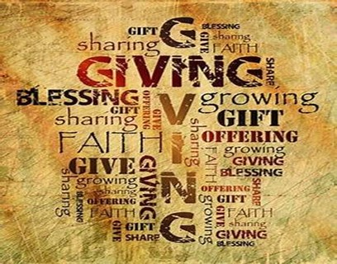
Repeat
I Lift My Offering to You
Let It Please You Oh Lord
This is My Seed
Although It Leaves My Hand
It will Never Leave My Life
You Will Multiply It!
Accept My Seed Oh Lord!

Slide 5
A person calls a pet store: "Send me thirty-thousand cockroaches, at once."
Astonished clerk: "What in the world do you want with thirty-thousand cockroaches?"
Caller: "I'm moving out today, and my lease says I must leave the premises in exactly the same condition I found them.“
Sounds like this man doent know much about my topic today

Slide 6
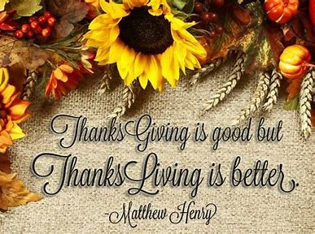
Living a Life of Thanksgiving 1 Thessalonians 5:16-18
Edward Church
November 17, 2024

Slide 7
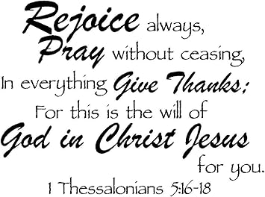
Rejoice always, pray continually, give thanks in all circumstances; for this is God’s will for you in Christ Jesus. —1 Thess 5:16-18
Three Simple Directives…
…Packed With Profound Implications
Rejoicing, Praying, and Giving Thanks
Not Just In Times of Prosperity and Joy
but in All Circumstances
This is the Divine Will of God for us
the Blueprint for a Life Lived in the Fullness of Christ Jesus.

Slide 8
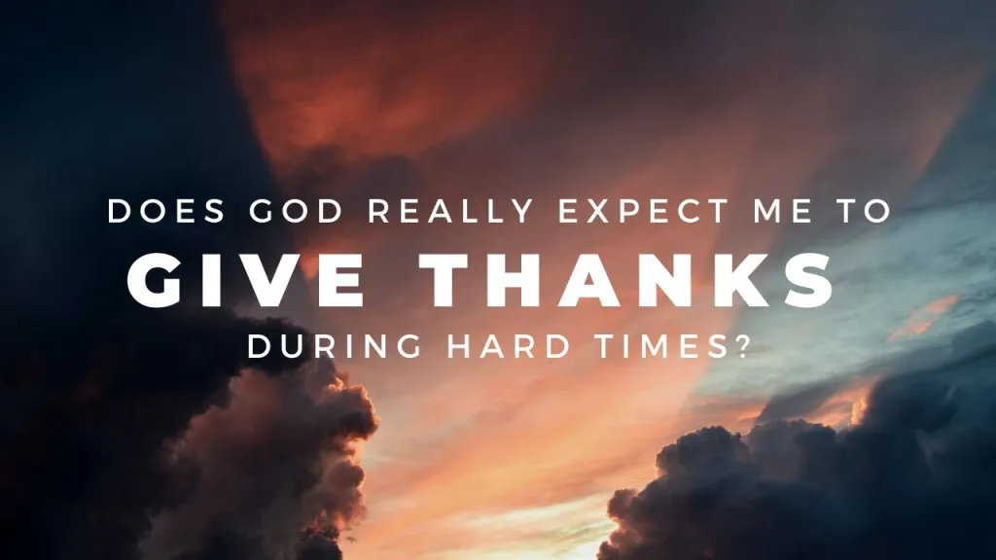
Challenging Command
How can we give thanks in midst of Trials / Tribulations?
How can we Rejoice in Times of Sorrow?
How can we Maintain a Posture of Prayer…
…When We are Surrounded by Chaos and Uncertainty?

Slide 9
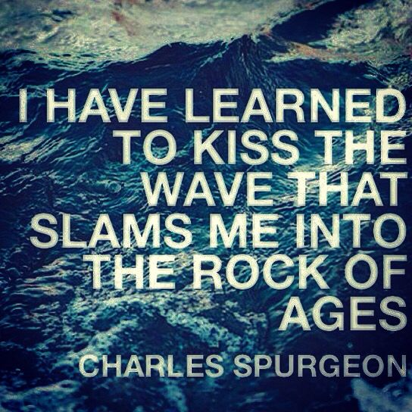
"I have learned to kiss the wave that…
…slams me against the Rock of Ages."
This Quote Encapsulates the Essence of Our Hope
It Speaks of a Thankfulness that Transcends Circumstances
A Rejoicing Born Out of Trials
A Prayerful Attitude that
Remains Unshaken By The Storms of Life

Slide 10
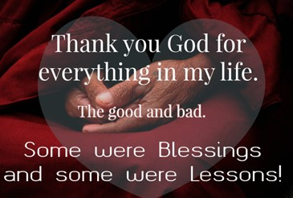
Thankfulness Transcends Circumstances
In the midst of life's trials, it can be challenging to maintain a heart of thankfulness.
Valley, Hardship, Loss, Disappointment
Where the rubber meets the road, where our faith is truly tested.
It's Not About What's Happening Around Us…
…But What's Happening Within Us
We can choose to focus on our problems, or our blessings.
We can choose to dwell on what's wrong, or what's right.
Thankfulness is a Choice:
We actively choose, It's a decision that we make…
…regardless of what life throws our way.

Slide 11
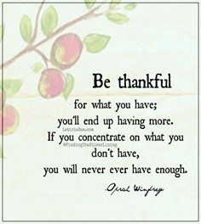
Thankfulness Is Not Contingent On Our Circumstances:
Thankfulness is a Discipline:
It’s Doesn’t Come Naturally, It’s Work to Cultivate
It's like a muscle we have to exercise, a skill we have to develop
It's a habit we have to form, a practice we have to maintain
It's a journey we have to embark on, a path we have to tread

Slide 12
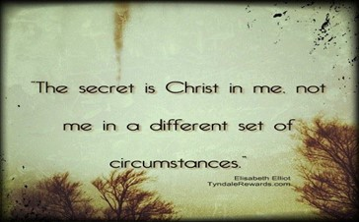
Thankfulness is a Virtue:
It's not optional for us as followers of Christ.
It's something expected / required of us.
It's a mark of spiritual maturity, a sign of godly character.
It's a fruit of the Spirit, a reflection of the divine nature.
It's a testament to our faith, a witness to our hope.
Thankfulness is a Blessing:
It's not something that's burdensome but beneficial
It's a source of joy, peace.
It's a gateway to contentment, a pathway to fulfillment.
It's a gift from God, a treasure from heaven.

Slide 13
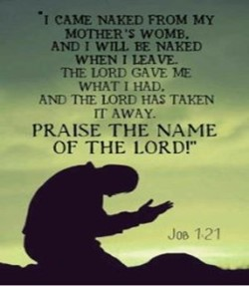
Job:
He had everything - wealth, family, health/ deep reverence for God
His wealth was plundered, his children were killed, his health gone
Yet, in midst of suffering, his response was one of thankfulness.
"Naked I came from my mother’s womb, and naked I will depart. The Lord gave and the Lord has taken away; may the name of the Lord be praised." -Job 1:21
Job's thankfulness was not tied to his circumstances…
…but to his understanding of God's sovereignty
He recognized that everything he had was from God…
…therefore, even in loss, he chose to give thanks

Slide 14
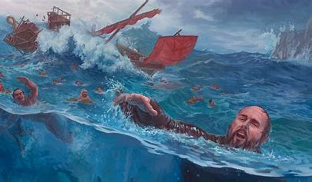
Paul:
Despite being Imprisoned, Beaten, Shipwrecked, and Facing Numerous Other Hardships for the Sake of the Gospel,
Paul’s Letters are Filled with Expressions of Thankfulness.
"I have learned to be content whatever the circumstances. I know what it is to be in need, / I know what it is to have plenty. I have learned the secret of being content in any / every situation, whether well fed or hungry, whether living in plenty or in want." -Phil 4:11-12
Paul’s Thankfulness was Not Tied to His Physical Condition or Circumstances, but to his Contentment in Christ.

Slide 15
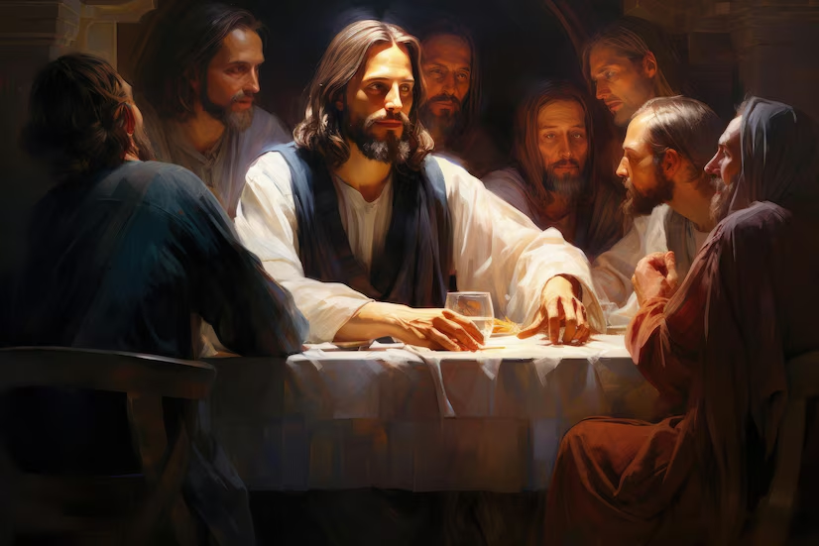
1 Thes 5:18 "give thanks" -Greek= “eucharisteo"
This word is used in other passages in the New Testament.
Jesus uses this word when He breaks the bread at Last Supper
"And he took bread, gave thanks (eucharisteo) and broke it, and gave it to them, saying, 'This is my body given for you; do this in remembrance of me.’" -Luke 22:19
Jesus is giving thanks for the bread that…
…symbolizes His body which will be broken for us
Paul recounts the Last Supper, "and when he had given thanks (eucharisteo), he broke it and said, 'This is my body, which is for you; do this in remembrance of me.'" 1 Corinthians 11:24
Paul is emphasizing the act of giving thanks as a central part of the Christian practice of communion.

Slide 16
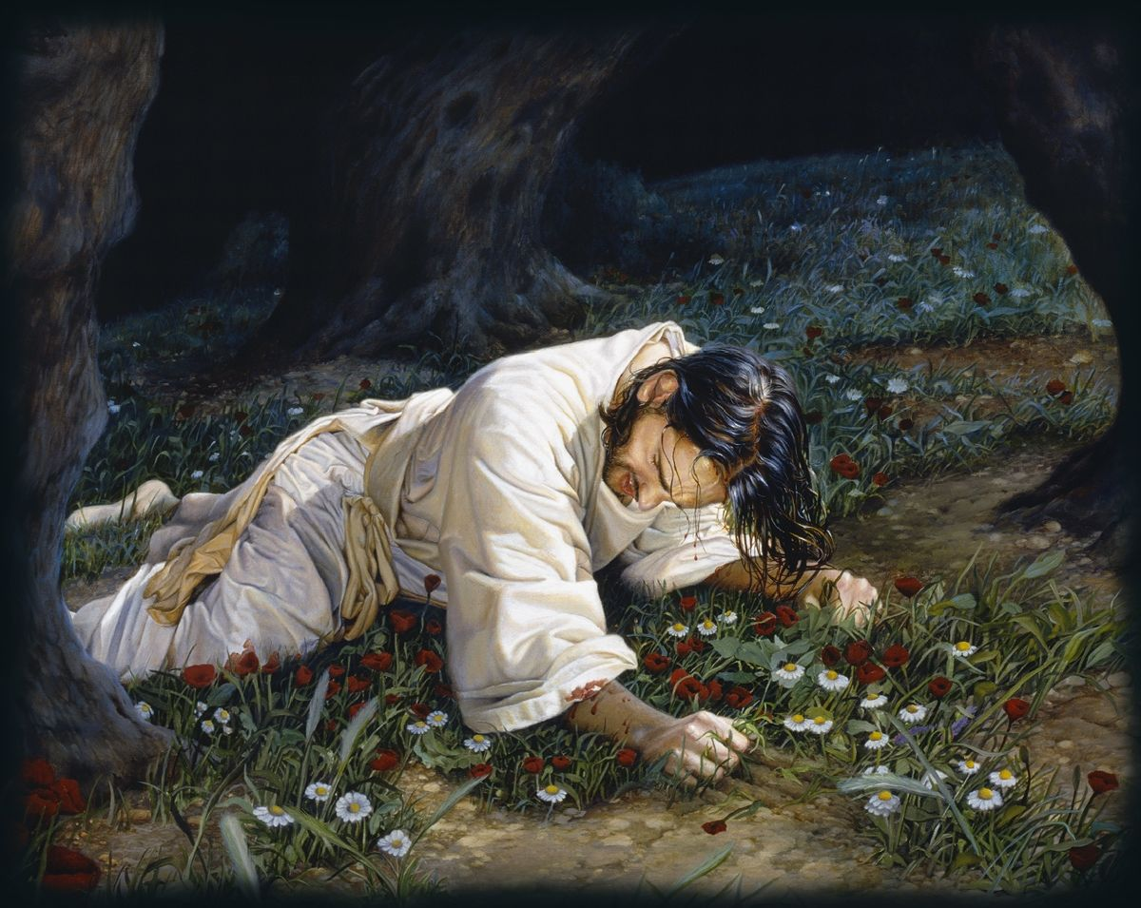
"eucharisteo" is used in a context of sacrifice and self-giving love.
Gives a deeper understanding of what it means to…
…give thanks in all circumstances".
It is not a superficial but a deep, sacrificial thankfulness …
…recognizes God's love and provision even…
…in the midst of hardship / suffering.
In the Life of Jesus:
We see the ultimate example of thankfulness.
In Gethsemane, facing the imminent pain / humiliation
Jesus prayed, "Father, if you are willing, take this cup from me; yet not my will, but yours be done" -Luke 22:42
Jesus' thankfulness was not based on His circumstances, but on His submission to the Father's will.

Slide 17
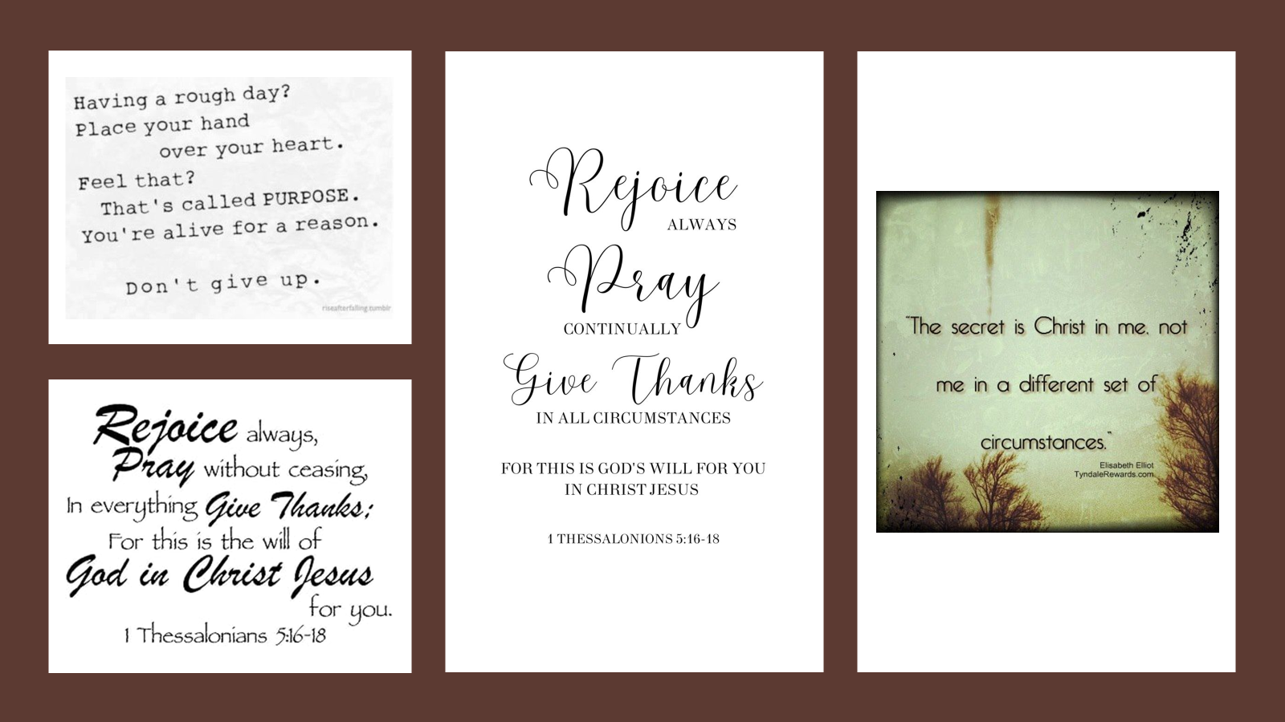
Thanksgiving as a lifestyle transcends the temporal and touches the eternal, it reflects not just our faith, but the very character of God Himself.
It is the constant, unchanging element that holds everything together, even when the colors of our circumstances change.
Thanksgiving has the power to change not just our perspective, but our very lives.
When we cultivate a lifestyle of thanksgiving, we are not merely changing our attitude but our hearts, our minds, and our spirits.
We are aligning ourselves with the heart of God, who is the source of all blessings.
It's not just about expressing gratitude in words, but living out that gratitude in our actions, in our relationships, in our choices, and in our daily walk with God

Slide 18
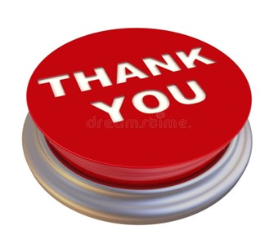
Want to Have a Better Week…
…No Matter What?
This Week Try This…
Instead of
Complaining
Comparing
Try Being Thankful!
Maybe Not for the Circumstances
But to the One…
…Over All Circumstances
The True Giver of Peace in the Midst of It All!

