Slide 1


Slide 2
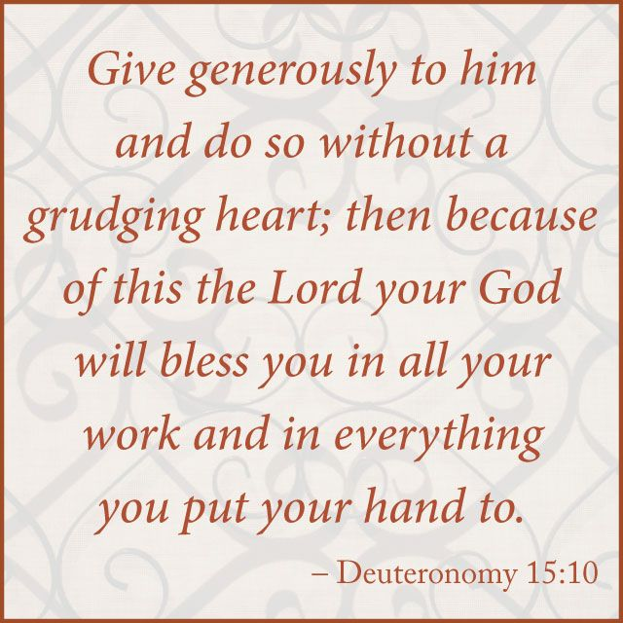
Repeat
I Lift My Offering to You
Let It Please You Oh Lord
This is My Seed
Although It Leaves My Hand
It will Never Leave My Life
You Will Multiply It!
Accept My Seed Oh Lord!

Slide 4
Two preachers were on the roadside with a sign that read, "The End is Near - turn around now before it’s too late". A passing driver yelled "leave us alone you religious nuts". Then the preachers heard a loud splash. One preacher said to the other, "Do you think we should have just said "Bridge Out".
Do u remember Buckwheat fr the Little Rascals?
I heard some news this week
He has converted to Islam
They changed his name to…
“Kareem of Wheat”

Slide 5
“The Power of Thanksgiving”
Edward Christian Church
Luke 17:11-19

Slide 6
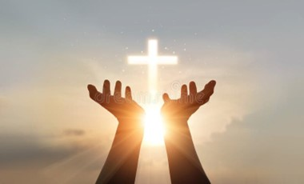
Three Things Available to Child of God in Any Situation:
Faith
Belief God has Control of the Situation
Leads to…
Praise
Acknowledge His Control of the Situation
Leads to…

Slide 7
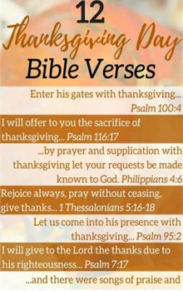
Three Things Available to Child of God in Any Situation:
Thanksgiving
Expression of Gratitude to God
Leads to…
Victory!!!

Slide 8

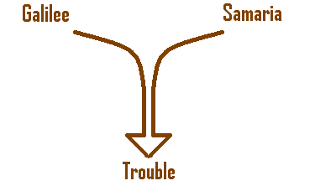
The Power of Trouble
It Has a Unifying Effect (11-13)
In Spirit (11)
under normal circumstances…
two would be bitter enemies
now something in common

Slide 9

The Power of Trouble
It has a Unifying Effect (11-13)
In Spirit (11) continued
I Samuel 22 cave of Adullam
(the Place of the Squeeze)
Psalm 119:67, “before I was afflicted…
…I went astray…”
Psalm 119:71, “It is good for me that…
…I have been afflicted…”

Slide 10

The Power of Trouble
It has a Unifying Effect (11-13)
In Purpose (13) “lifted their voices..”
They spoke “Same Word”
At “Same Time”
To “Same Person”

Slide 11
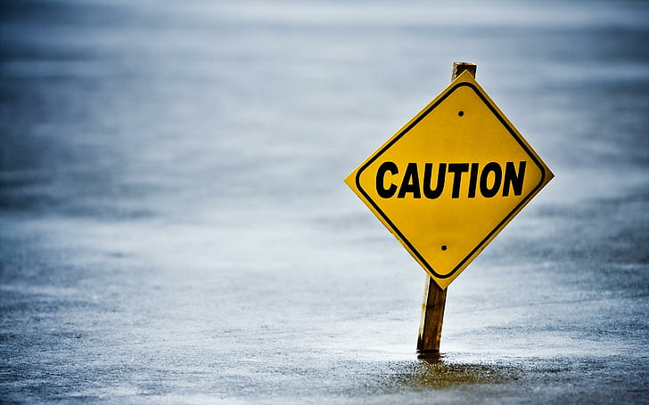
The Power of Trouble
It has a Dividing Effect
easier to blame…
…than to spread hope
That’s where Satan wants us!

Slide 12
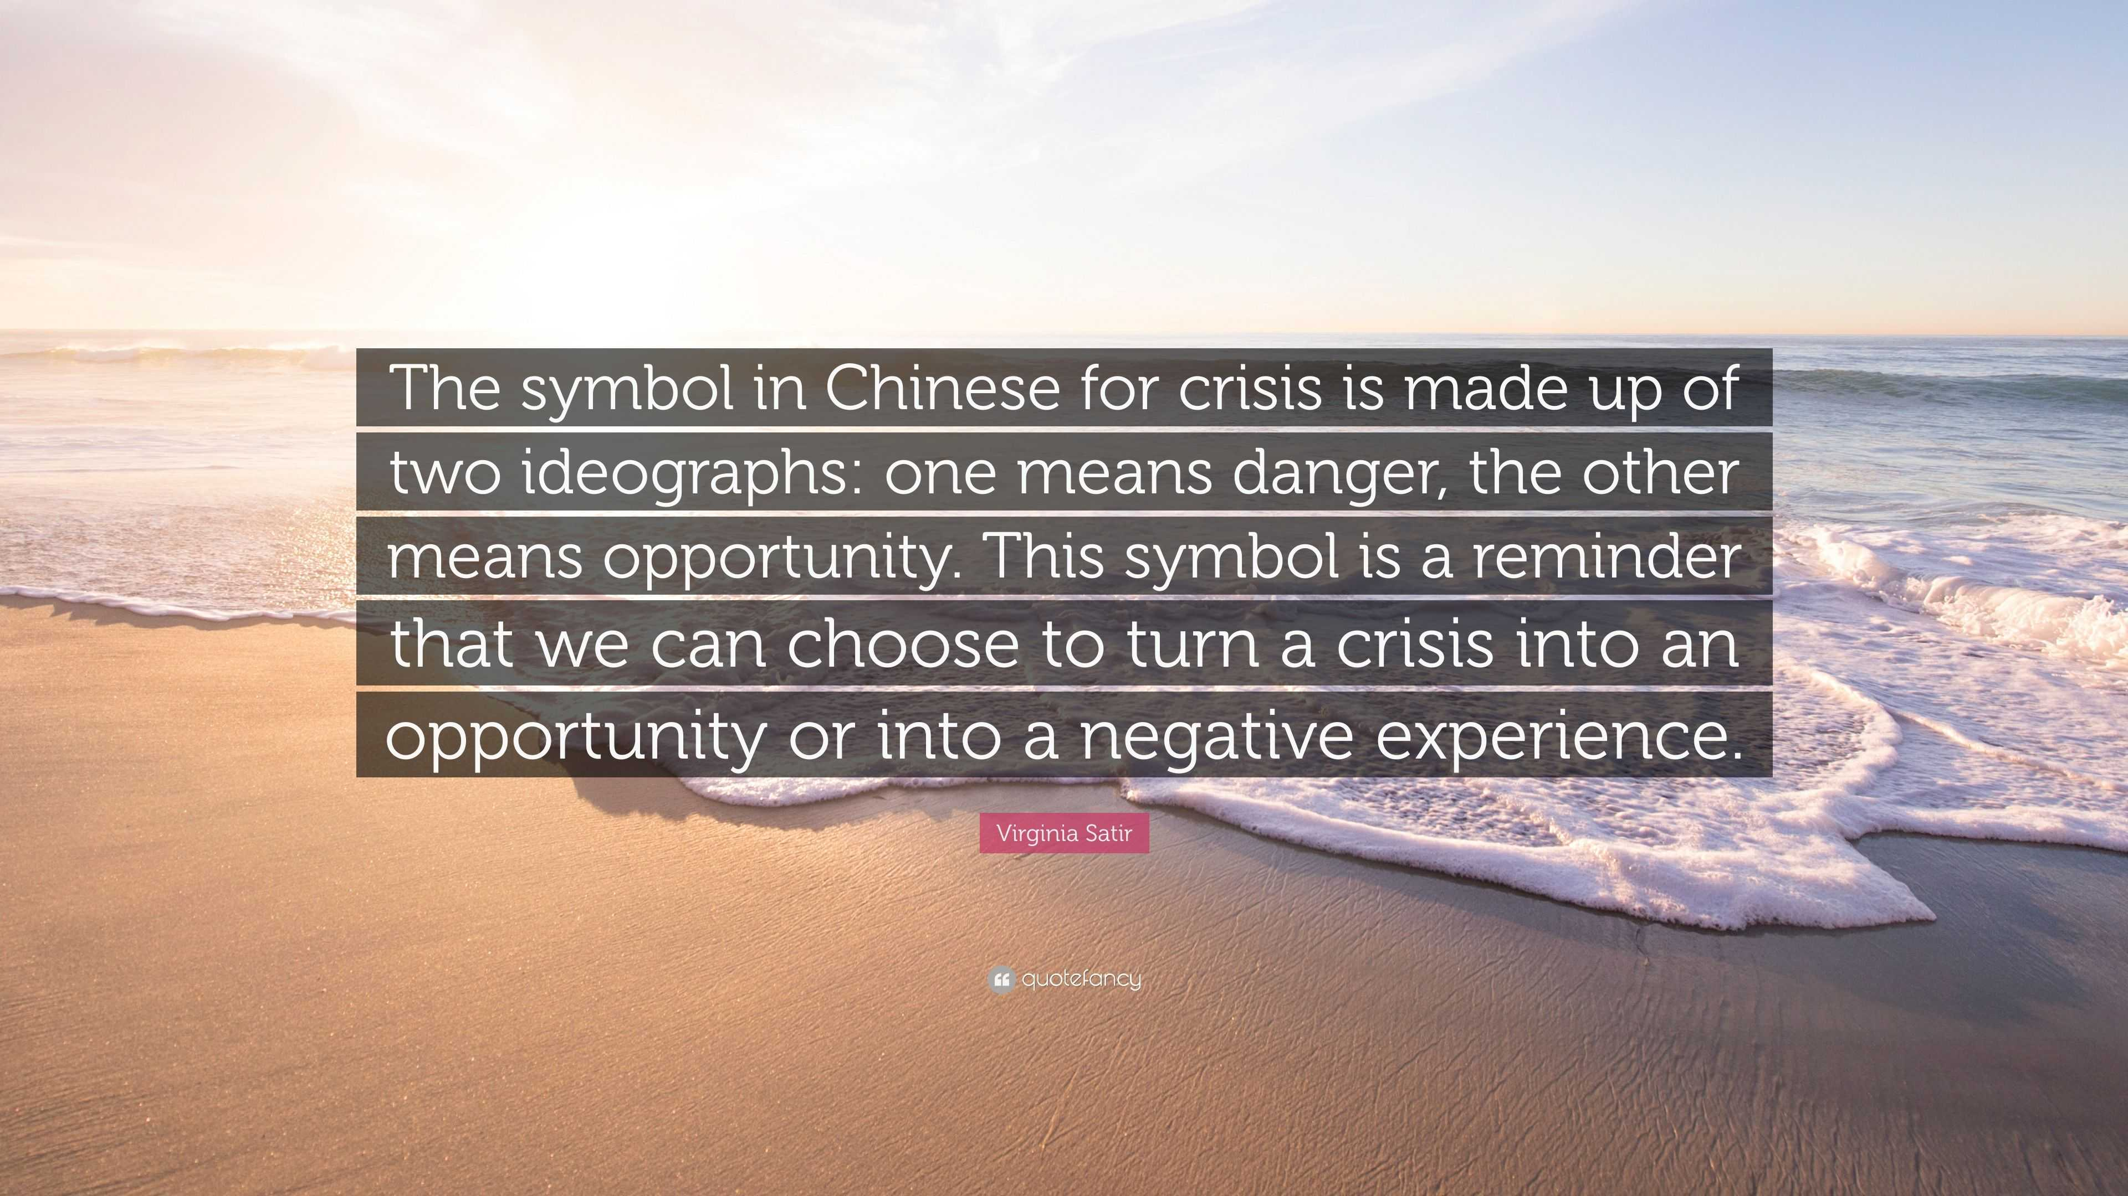
Trouble Brings Many Things
But We Have the Power
To Move Beyond
Stale
Stability
But We Need Wisdom
To Navigate the Move
Find Lessons
Focus on Big Picture
Forward Movement

Slide 13
End Part 1

Slide 14
A Thanksgiving Cookbook by Mrs. Geraghty's Kindergarten Class
1- Moriah - Turkey
First you cut the bones out. Then you put it in the oven
for 10 hours at 600 degrees. Then you put it on the
table and eat it.
2- Jordyn - Turkey
First you have to cut it up and put it on a plate in the
oven for 9 minutes and 18 degrees. Then you dig it out
of the oven and eat it.
3-Alan - Turkey
First you shoot it and then you cut it. And then you put it
it in the oven and cook it for 10 minutes and 20 degrees.
You put it on plates and then you eat it.

Slide 15
A Thanksgiving Cookbook by Mrs. Geraghty's Kindergarten Class
4- Andrew - Pizza
Buy some dough, some cheese and pepperoni. Then
you cook it for 10 hours at 5 degrees. Then you eat it.
5- Jennie - Corn
My mom buys it. Then you throw it. Then you cook it.
Then you eat it.
6- Shelby - Applesauce
Go to the store and buy some apples, and then you
squish them up. Then you put them in a jar that says,
"Applesauce". Then you eat it.

Slide 16
A Thanksgiving Cookbook by Mrs. Geraghty's Kindergarten Class
7- Christopher - Pumpkin Pie
First you buy a pumpkin and smash it. Then it is all done.
And you cook it in the oven for 12 minutes and 4
degrees. Then you eat it.
8- Joplyn - Apple Pie
Take some apples, mash them up. Take some bread and
make a pie with it. Get some dough and squish it. Shape
the dough into a pie shape. Put the apples in it. Then bake
it at 9 degrees for 15 minutes.

Slide 17
A Thanksgiving Cookbook by Mrs. Geraghty's Kindergarten Class
9- Christa - Cookies
Buy some dough and smash it and cut them out. Then put
them in the oven for 2 hours at 100 degrees. Then take
them out and dry them off. Then it's time to eat them.
10- Jarryd - Deer Jerky
Put it in the oven overnight at 20 degrees. Then you go
hunting and bring it with you. Then you eat it.

