Slide 1
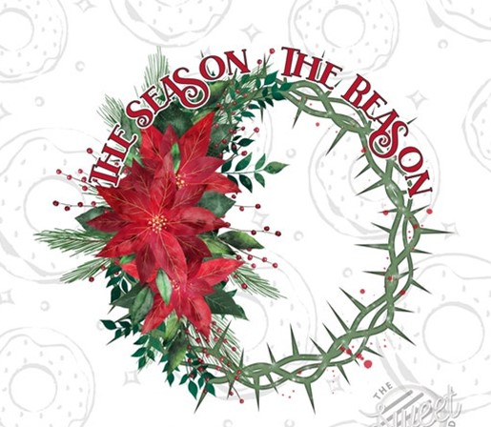
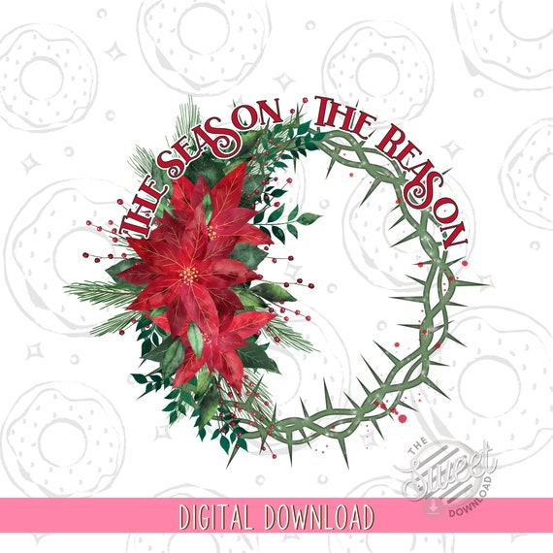

Slide 2

This Thanksgiving and Christmas: Don’t Miss What You’ve Got… By Missing What You’re Missing!
Getting Beyond the Holiday Blues
Edward Church
1 Thes 5:18
Dec 8, 2024

Slide 3

Signs
feeling sad/ discouraged
loss of interest
Appetite weight change
restless
lack of energy
feeling hopeless
difficulty concentrating
persistent thoughts of death or suicide
withdrawal
various physical symptoms
Too Many Singing…
…the Holiday Blues

Slide 4
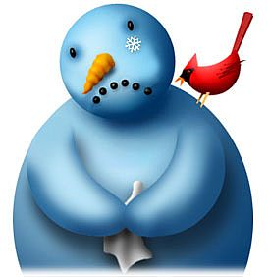
In Order to
Change Your Attitude
Become Grateful Again
Enjoy the Season of Thankfulness
You Have to Make a Conscience Effort to Change Your…

Slide 5

FAITH
Keep Faith that God Really Is In Control…
…You CAN Trust Him To Take Care of the Situation,
…In HIS Time, in HIS Way – Which Is the BEST Way.
“Jesus responded, ‘Why are you afraid? You have so little
faith!’ Then he got up and rebuked the wind and waves, and
suddenly there was a great calm.” -Matthew 8:26 (NLT)

Slide 6
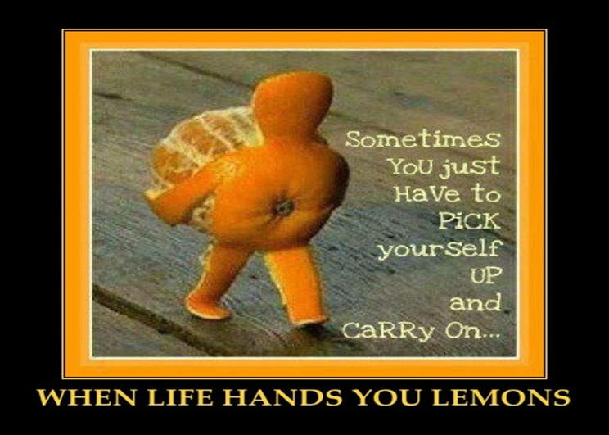
FORGIVE
Forgive the Past
Forgive Yourself
Forgive Those in Front of You
Forgive Those Who are Not in Front of You
Remember: They May Need to Forgive You, Too!
“If you forgive those who sin against you, your heavenly Father
will forgive you. But if you refuse to forgive others, your Father
will not forgive your sins.” -Matthew 6:14-15 (NLT)

Slide 7
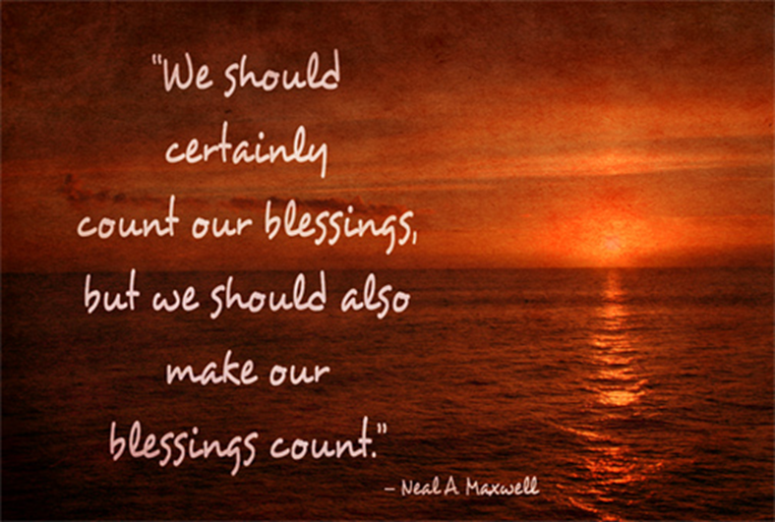
FACE
Keep Your Eyes on Jesus
Look Forward, not Backward!
Seek HIS face
Let Him Take Care of the Rest.
“Seek the Kingdom of God above all else, and live righteously,
and he will give you everything you need.” –Matthew 6:33 (NLT)

Slide 8
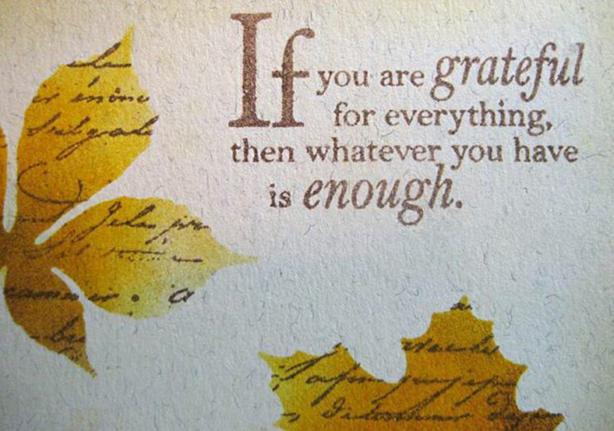
FOCUS
Focus On…
GIFTS in Front of You
On What You Have – Not What You Don’t Have
THANK God for the Gifts in Front of You…
…TRUST God for the Gifts that are Coming
Focus on the ETERNAL Reward –
…Not on Your Temporary Home Here on Earth

Slide 9
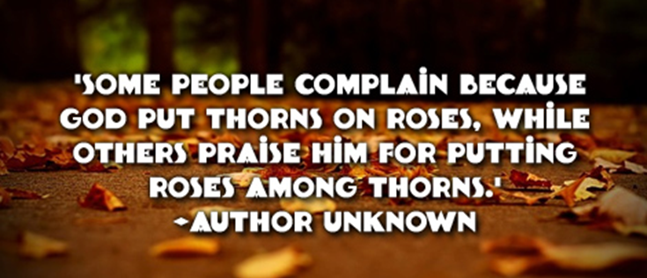
FORGET NOT
…the True Meaning of Thanksgiving
…And Christmas
God Provided for Our Spiritual / Physical Needs
Tell God How Thankful You Are for
What He Has Given to You
What He Has Not Given You

Slide 10
1 Thess 5:18, “give thanks in all circumstances; for this is God's will for you…”
T- Take Nothing for Granted
H- Humble Yourself Before God
A- Action- Keep Moving Forward…
…Don’t Let Circumstances Stop You
N- Never Forget God Is Always In Control
K- Keep Your Eyes on the Blesser..
…Not the Blessing
S- Say Thanks Often

Slide 11

Your Christmas May Not Be Perfect
But the Reason For Christmas Is!
Focus on Him!!

Slide 13

Repeat
These are the 2 Most Important Hours of My Week – Help Me to Cherish Them
I Am Here Today to Worship
Not to Be Entertained
I Am Singing to An Audience of One
Accept My Worship Oh Lord!

Slide 14

Repeat
I Lift My Offering to You
Let It Please You Oh Lord
This is My Seed
Although It Leaves My Hand
It will Never Leave My Life
You Will Multiply It!
Accept My Seed Oh Lord!

Slide 16
Young man stole a goose for Christmas –got to his conscience
Confessor: I have stolen a fat goose from a poultry yard!
Priest: That is very wrong.
Confessor: Would you like to accept it, Father?
Priest: Certainly not- return it to the man from whom you stole it.
Confessor: But I have offered it to him and he won't have it.
Priest: In that case you may keep it yourself.
Confessor: Thank you, Father.
The Priest arrived home to find one of his geese had been stolen

