Slide 1
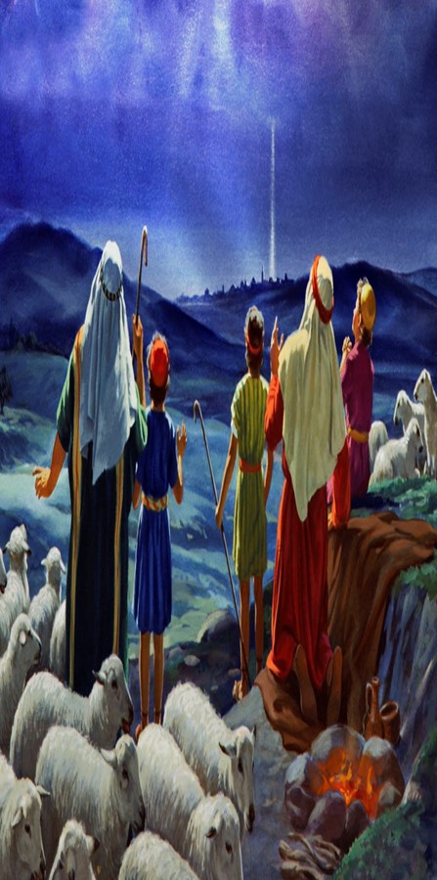
Oh Come Let Us Adore Him!!!
Christmas 2024

Slide 3
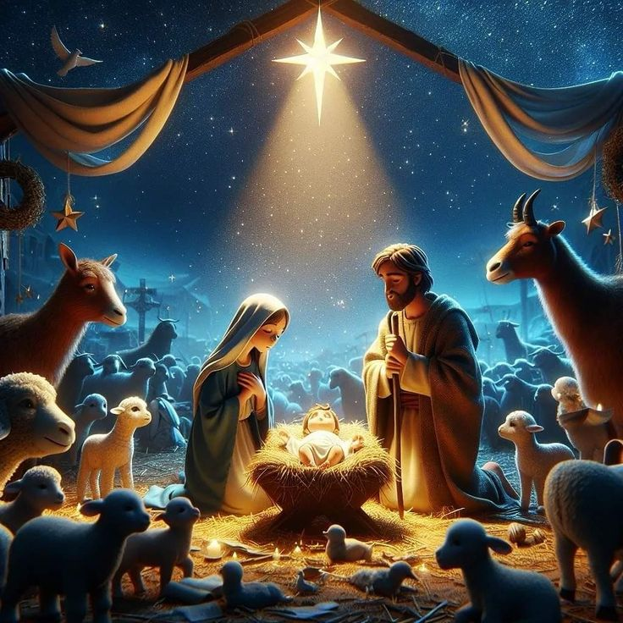
Among Us: The First Christmas Gift
Edward Church
John 1:14
22 December 2024

Slide 4
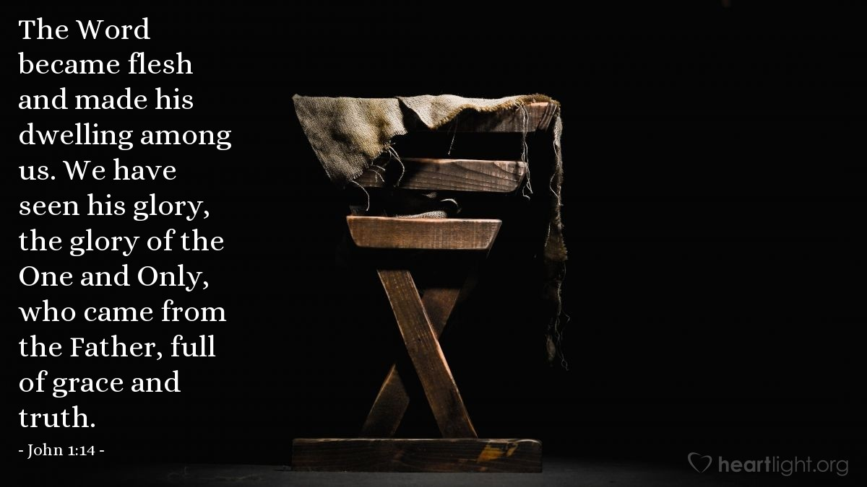

Slide 5
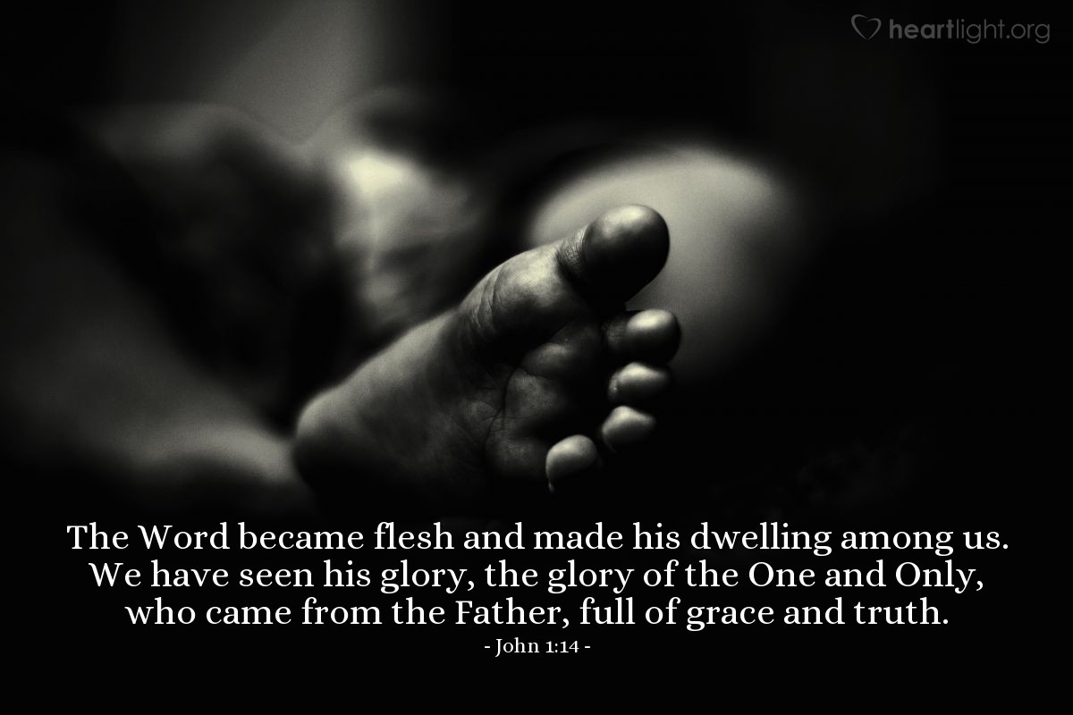
"The Word became flesh and made his dwelling among us. We have seen his glory, the glory of the one and only Son, who came from the Father, full of grace and truth."
This verse is a proclamation of the Incarnation of Jesus Christ.
It is a Testament of His Divine Nature, His Human Nature
And His Dwelling Among Us.
It is an Affirmation of His Glory, the Glory of the One and Only
Son, who came from the Father, Full of Grace and Truth.

Slide 6

Jesus is the Embodiment of Hope:
He came to earth, lived among us, offered us a way to be reconciled with God.
This Hope Is Not Just a Wish Or a Dream:
It's not just a desire for things to get better.
It can sustain us through the darkest times and the most difficult challenges.
This Hope Is Not Just for the Future:
It's a hope for the present. It's a hope that can transform our lives right now.
It gives us peace in the midst of turmoil, strength in the midst of weakness.
This Hope Is Not Just For Us:
It's a hope for the world.
It can bring healing to the broken, reconciliation to the divided.
It can bring justice to the unjust, mercy to the merciless, grace to the graceless.
This Hope Is Not Just a Concept:
It's a person. It's Jesus.
He is the hope that does not disappoint or fade, and does not fail.

Slide 7

A Love that is Unconditional, Sacrificial, and Everlasting:
Not based on our performance or our worthiness.
Freely given, lavished upon us,
Demonstrated in the person and work of Jesus Christ.
It Accepts Us:
as we are/ transforms us into the image of Christ.
Compels us to love God with all our heart, soul, mind, strength,
and to love our neighbors as ourselves.
The Love of Jesus is a Love that Compels Us to Action:
Motivates us to serve others, to give generously,
and to live selflessly.

Slide 8

The Heart of Joy:
Not found in the twinkling lights, or the festive decorations.
True heart of Joy is found in Jesus, who is the embodiment of joy & love.
A Joy That Surpasses Mere Happiness:
Not dependent on our circumstances or our feelings.
Grounded in the person and work of Jesus Christ.
This joy is a gift from God that fills our hearts and overflows into our lives.
Sustains and Strengthens:
Sustains us in times of sorrow and strengthens us in times of weakness.
Gives us hope in times of despair and peace in times of turmoil.
Enables us to rejoice in the Lord always, even in midst of trials- tribulations.
The Joy of Jesus is a Joy that is Contagious:
Spreads to others, bringing light into their darkness, hope into despair.
It is a joy that transforms lives, changes hearts, and impacts the world.

Slide 9

The Heart of Peace
Not a mere absence of conflict or a temporary respite from the storms of life.
Transcends our circumstances, anchors our souls in tumultuous waves of life.
This Peace Is Beautifully Encapsulated in John 14:27
"Peace I leave with you; my peace I give you. I do not give to you as the world gives. Do not let your hearts be troubled and do not be afraid."
Love is not contingent on our circumstances…
…but is rooted in His unchanging character and unfailing.
Jesus is Not Merely Offering a Peace That Is External Or Superficial
Permeates every aspect of our lives.
Brings wholeness and harmony to our souls.
Calms our fears, soothes our anxieties, and brings rest to our weary souls.
This Peace is an Active Peace
Actively guards our hearts and minds in Christ Jesus.
Philippians 4:7 tells us. It is a peace that actively reconciles us to God.
Colossians 1:20 tells us. It is a peace that actively brings unity and harmony.

Slide 10

Peace "eirene," = "to join" or "to bind together that which has been separated."
It is a peace that joins us to God, that binds us together in unity and harmony.
And Can restore our relationship with God and with each other.
Romans 5:1: "Therefore, since we have been justified through faith, we have peace (eirene) with God through our Lord Jesus Christ."
Here, the peace that Jesus offers is not just a feeling of tranquility, but a state of being at peace with God, a state of being justified and reconciled to God through faith in Jesus Christ.
Philippians 4:7: Paul writes, "And the peace (eirene) of God, which transcends all understanding, will guard your hearts and your minds in Christ Jesus."
Here, the peace that Jesus offers is not just a human peace, but a divine peace, a peace that transcends our human understanding, a peace that guards our hearts and minds in Christ Jesus.

Slide 11
Steadfast and Unchanging:
In midst of turbulent world, we find a peace that is steadfast / unchanging.
Not a fleeting emotion or a transient state of mind…
grounded in His love, anchored in His promises, secured in His victory.
Calming and Comforting:
In midst of our fears & anxieties, we find a peace that is calming/ comforting.
Not a mere distraction or a temporary escape…
It is a genuine, lasting peace.
It calms our fears, soothes our anxieties, brings rest to our weary souls.
Empowering and Liberating:
In midst of our struggles/ trials, it is empowering and liberating.
This peace is not a mere resignation or a passive acceptance.
It is a dynamic, transformative peace that comes from the heart of Jesus.
It is a peace that empowers us to face our struggles with courage,
a peace that leads us to victory in Christ.

Slide 12
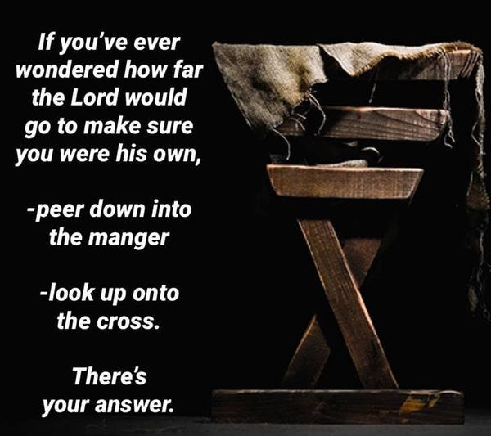
We have explored the heart of our faith, the heart of our hope, peace, joy, and love - Jesus Christ.
We've journeyed through the scriptures, we've been reminded of the miracle of grace that we are, and the transformative power of His love in our lives.
We in all our imperfections, are loved so deeply by a perfect God.
We in all our shortcomings, are pursued so relentlessly by a God who lacks nothing.
We in all our brokenness, are made whole by a God who is the epitome of wholeness.
That's the kind of God we serve. A God who loves us not because of who we are, but because of who He is.

Slide 13
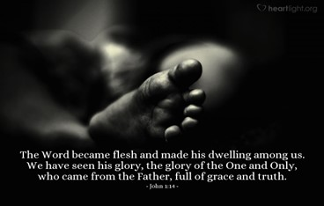
Have a Blessed Christmas!

Slide 15

Repeat
These are the 2 Most Important Hours of My Week Help Me to Cherish Them
I Am Here Today to Worship
Not to Be Entertained
I Am Singing to An Audience of One
Accept My Worship Oh Lord!

Slide 16
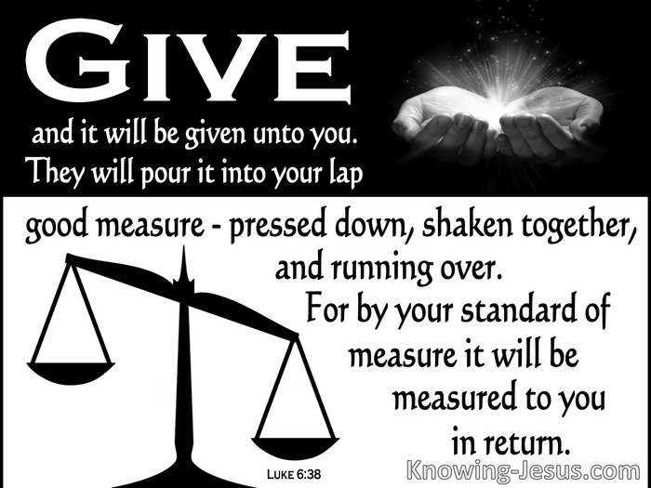
Repeat
I Lift My Offering to You
Let It Please You Oh Lord
This is My Seed
Although It Leaves My Hand
It will Never Leave My Life
You Will Multiply It!
Accept My Seed Oh Lord!

Slide 17
Ralph Mertz went Christmas shopping for his wife. He was looking around the ladies perfume area of a store when a sales clerk ask ed if she could help. He replied that he was looking for something for his wife for Christmas, so the clerk brought him a bottle of perfume, he asked how much is it? She said $50, He told that was too much could she find something cheaper, so returned with a smaller bottle of perfume, he again asked how much, she replied $30. He again said that was too much. Next she brought a very small bottle for $15. This time he was getting frustrated and told her he was wanting to see something really cheap. The clerk returned and said “if you want to see something really cheap look at this.” She handed him a mirrow.

