Slide 1

Repeat
These are the 2 Most Important Hours of My Week – Help Me to Cherish Them
I Am Here Today to Worship
Not to Be Entertained
I Am Singing to An Audience of One
Accept My Worship Oh Lord!

Slide 2

Thank You God
For This NEW…
Year
Start
Opportunities
Challenges
Victories
Help Me to Take Advantage
of These
New Opportunities

Slide 3
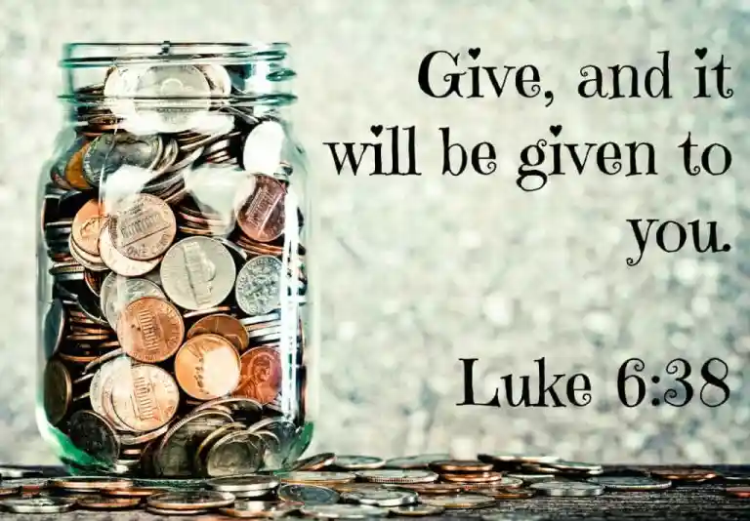
Repeat
I Lift My Offering to You
Let It Please You Oh Lord
This is My Seed
Although It Leaves My Hand
It will Never Leave My Life
You Will Multiply It!
Accept My Seed Oh Lord!

Slide 5
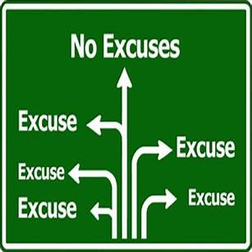


Getting Past Excuses
Edward Church
Dec 29, 2024

Slide 6
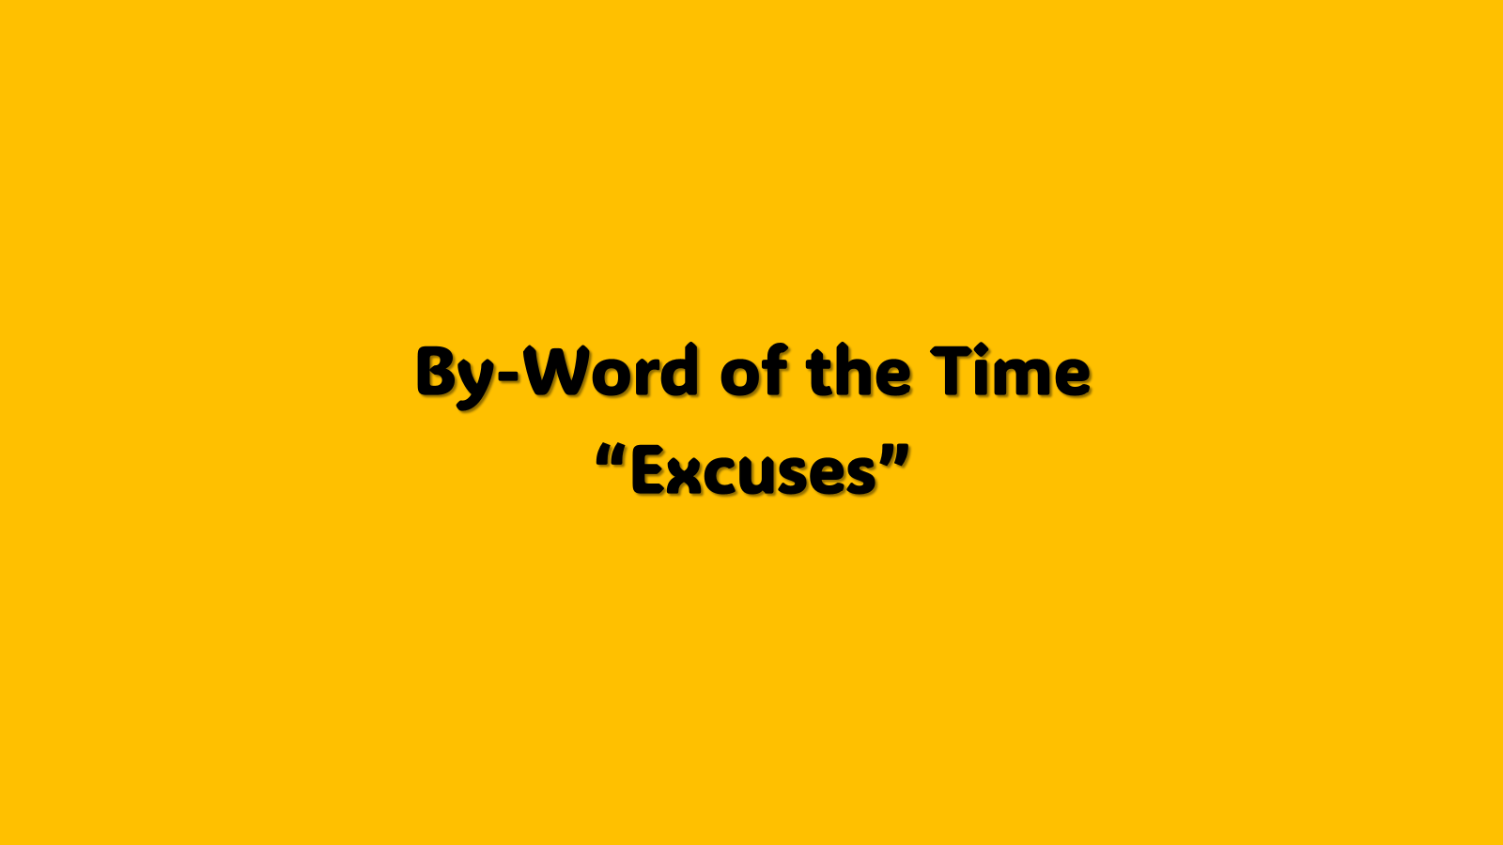
In The Time When We Need People…
Step Up
Take Up
Responsibility
Make a Difference
The World Instead…
Step Back
Give Up
Responsibility
Make an Excuse

Slide 7

Focus On What You Can Do
Instead of
What You Can’t Do
Focus On What You Do Have
Instead of
What You Don’t Have

Slide 8

Come they told me, pa rum pum pum pum A new born King to see, pa rum pum pum pum Our finest gifts we bring, pa rum pum pum pum To lay before the King, pa rum pum pum pum, Rum pum pum pum, rum pum pum pum,
So to honor Him, pa rum pum pum pum, When we come.
Baby Jesus, pa rum pum pum pum I am a poor boy too, pa rum pum pum pum I have no gift to bring, pa rum pum pum pum That's fit to give the King, pa rum pum pum pum, Rum pum pum pum, rum pum pum pum,
Focus “Don’t Haves”
Self
What He Has
What He Has to Give

Slide 9
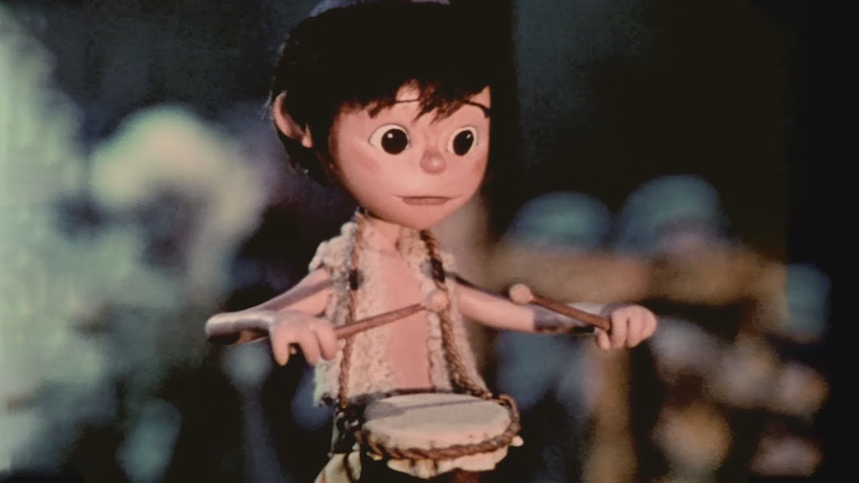
Shall I play for you, pa rum pum pum pum, On my drum?
Mary nodded, pa rum pum pum pum The ox and lamb kept time, pa rum pum pum pum I played my drum for Him, pa rum pum pum pum I played my best for Him, pa rum pum pum pum, Rum pum pum pum, rum pum pum pum,
Then He smiled at me, pa rum pum pum pum Me and my drum.
Focus “Do Haves”
What He Can Do
What He Does Have
It IS Noticed
Did it w- All Heart
It Pleased God

Slide 10
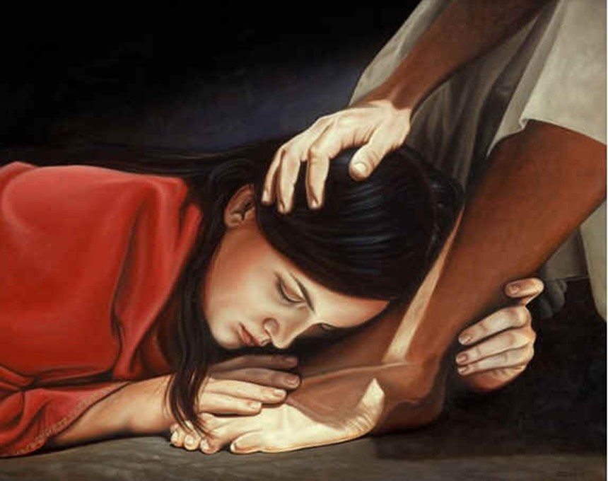
¹ It was now two days before Passover and the Festival of Unleavened Bread. The leading priests and the teachers of religious law were still looking for an opportunity to capture Jesus secretly and kill him. ² “But not during the Passover celebration,” they agreed, “or the people may riot.” ³ Meanwhile, Jesus was in Bethany at the home of Simon, a man who had previously had leprosy. While he was eating, a woman came in with a beautiful alabaster jar of expensive perfume made from essence of nard. She broke open the jar/ poured the perfume over his head. ⁴ Some of those at the table were indignant. “Why waste such expensive perfume?” they asked. ⁵ “It could have been sold for a year’s wages and the money given to the poor!” So they scolded her harshly. ⁶ But Jesus replied, “Leave her alone. Why criticize her for doing such a good thing to me? ⁷ You will always have the poor among you, and you can help them whenever you want to. But you will not always have me. ⁸ She has done what she could and has anointed my body for burial ahead of time. ⁹ I tell you the truth, wherever the Good News is preached throughout the world, this woman’s deed will be remembered and discussed.” - Mark 14:1-9 (NLT2)

Slide 11
She Recognized Her Opportunity… (3)
Some Make Excuses..
“Think” …of what They Would Do
Their Life Overshadowed by “What If ?”
If I had certain talent, skill, ability
“Complain” …about what Others Do
Their Life Overshadowed by “Why Them?”
“Complain” …about what Others Don’t Do
Their Life Overshadowed by…
…“Why Not Someone Else?”

Slide 12
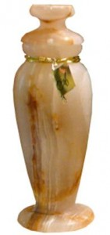
She Recognized...She Couldn’t Do All
…But She Could Do Something (3)
Instead of Excuses..
…This Woman Did Something
She:
“Sought out” of her Best
Alabaster Box (Spikenard)
“Counted out” the Cost
300 denari –yrs wage
“Gave out” Freely
Broke/ Poured

Slide 13
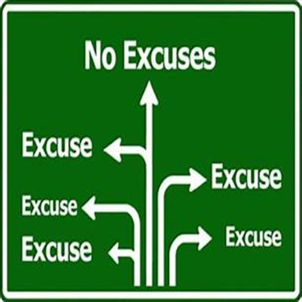

She Did What She Could Do...
…While She Could Do It (3, 8)
Excuses Paralyze / Lead to Procrastination
3 Signs:
Some are Going to Do Something…
Sometime
Ecc 11:4, “..observeth wind..not sow..”
Tomorrow
Matt 6:33-34, “seek 1st..not thought ..”
Waiting for Right Time
II Cor 6:2, “now accepted time..”

Slide 14
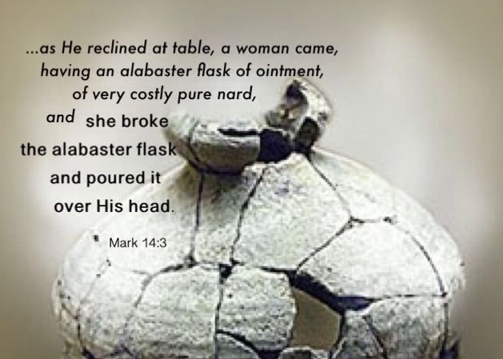
Jesus Recognized Her Effort
Recognized the Timing (1-3)
Rebuked Her Critics (4-6)
Recognized Her Effort (7-8)
Rewarded Her Sacrifice (9)

Slide 15

2025
Year of
Getting Past Excuses
This Weeks Challenge
Be Quick to Take Responsibility
Begin to See Problems as Opportunities
Build a No Excuse Attitude
Luke 9:62 – “Jesus replied, ‘No one who puts a hand to the plow and looks back is fit for service in the kingdom of God.’”

Slide 17
Why not promise to do something you can actually accomplish?
Gain weight. At least 30 pounds.
Stop exercising. Waste of time.
Read less. Makes you think.
Procrastinate more. Starting tomorrow.
Create loose ends.
Get further in debt.
Don't believe politicians.
Don't swim with piranhas or sharks.
Wait for opportunity to knock.
Focus on the faults of others.
Never make New Year's resolutions again.

Slide 18
New Year's Resolutions
2021: I will get my weight down below 180 pounds.
2022: I will follow my new diet religiously until I get below 200 pounds.
2023: I will develop a realistic attitude about my weight.
2024: I will work out 3 days a week.
2025: I will try to drive past a gym at least once a week.
My goal for 2025 is to accomplish the goals set in 2024 which I should have done in 2023 because I promised to in 2022 and planned to do in 2021.

