Slide 2
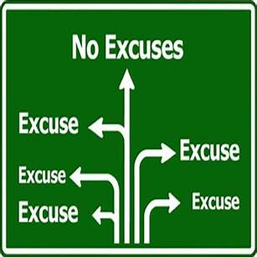


Getting Past Excuses pt 2
Edward Church
January 5, 2025

Slide 3

In The Time When We Need People…
Step Up
Take Up
Responsibility
Make a Difference
The World Instead…
Step Back
Give Up
Responsibility
Make an Excuse
Instead of Getting By
Give God Your Best
Refuse to Give Him Leftovers

Slide 4

Anybody Notice How Hard Things Have Been Lately ?
“Challenge” is the Word of this Season
Satan Sends Challenges to Break Us
Break Our Commitment, Calling, Concentration
God Allows Challenges to Build Us
Build Our Commitment, Calling, Concentration
The Final Decision is Always Ours
One Way to Discover Which Way We Are Leaning?
Are We Giving God Leftovers…
Is Our Commitment Waning?
Our Calling Doubted?
Our Concentration Broken?
Has Excuses Become Our Norm?

Slide 5
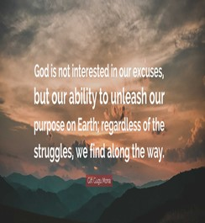
A Good Way to Build vs Break Our…
Commitment, Calling, Concentration
Starts By Refusing to…
  Give God Our Leftovers
  Place Blame vs Accept Responsibility
  Live Comfortable in Our Excuses

Slide 6
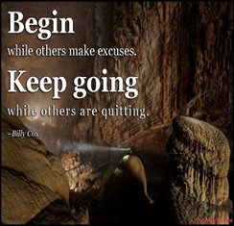
God exhorts us to do all for the glory of God- 1 Cor. 10:31
To work at whatever we do with all our heart- Col. 3:23
Do it all in the name of the Lord Jesus- Col. 3:17
Do your best to present yourself to God as one approved-
2 Tim 2:15
“run in such a way as to get the prize … not like
someone running aimlessly” - 1 Cor. 9:24-27

Slide 7

Mark 14:1-9
“She Had Little (ONE Thing)”
She Focused on What She Had
Verses
What She Didn’t Have
She Didn’t Hesitate to Give Him Her Best
Jesus Responded with His Best
“Remembered and Discussed”

Slide 8

Mark 12:41-44 (KJV)
⁴¹ And Jesus sat over against the treasury, and beheld how the people cast money into the treasury: and many that were rich cast in much.
⁴² And there came a certain poor widow, and she threw in two mites, which make a farthing. ⁴³ And he called unto him his disciples, and saith unto them, Verily I say unto you, That this poor widow hath cast more in, than all they which have cast into the treasury: ⁴⁴ For all they did cast in of their abundance; but she of her want did cast in all that she had, even all her living.
Mark 12:41-44 (MSG)
⁴¹ Sitting across from the offering box, he was observing how the crowd tossed money in for the collection. Many of the rich were making large contributions. ⁴² One poor widow came up and put in two small coins—a measly two cents. ⁴³ Jesus called his disciples over and said, "The truth is that this poor widow gave more to the collection than all the others put together.
⁴⁴ All the others gave what they'll never miss; she gave extravagantly what she couldn't afford—she gave her all."

Slide 9
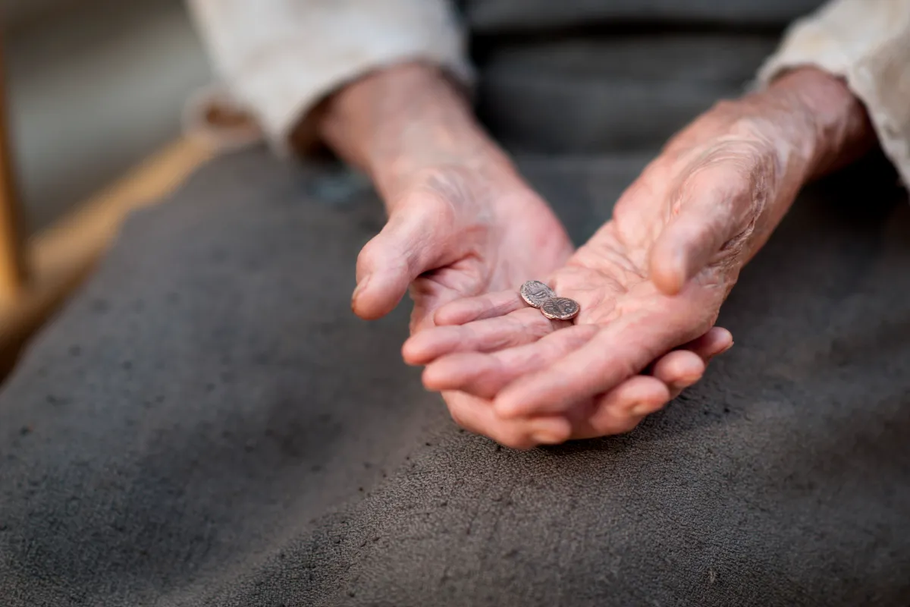
Widow’s Mite
“She Had Very Little”
Two Mites, Together Worth Half a Cent
Smallest Copper Coins In Circulation
Represented The Smallest Contribution Lawful to Make
Jesus Said She Gave More than the Others
Her Attitude was Greater than Her Actions
God Loves a “Cheerful Giver”
2 Corinthians 9:6-7 (KJV)
⁶ But this I say, He which soweth sparingly shall reap also sparingly; and he which soweth bountifully shall reap also bountifully. ⁷ Every man according as he purposeth in his heart, so let him give; not grudgingly, or of necessity: for God loveth a cheerful giver.

Slide 10

2 Samuel 24:24-25 (KJV)
²⁴ And the king said unto Araunah, Nay; but I will surely buy it of thee at a price: neither will I offer burnt offerings unto the LORD my God of that which doth cost me nothing. So David bought the threshingfloor and the oxen for fifty shekels of silver. ²⁵ And David built there an altar unto the LORD, and offered burnt offerings and peace offerings. So the LORD was intreated for the land, and the plague was stayed from Israel.
2 Samuel 24:24-25 (MSG)
²⁴ But the king said to Araunah, "No. I've got to buy it from you for a good price; I'm not going to offer GOD, my God, sacrifices that are no sacrifice." So David bought the threshing floor and the ox, paying out fifty shekels of silver. ²⁵ He built an altar to GOD there and sacrificed burnt offerings and peace offerings. GOD was moved by the prayers and that was the end of the disaster.

Slide 11
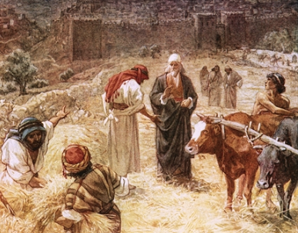
David’s Powerful Choice
“He Had Everything”
But Peace
His Kingdom had a Problem
God Said He Could Have Peace w- a Sacrifice
God Named the Place, the Plan…
But David Named the Price
“I Refuse to Offer that which Costs Me Nothing”
The Plague was Stayed

Slide 12

What it Means to Give God Your Best
Your Best Involves Giving God Your Total Being
“Widow and Her Mite”
Greatest Commandment “love the Lord with all your heart / with all your soul / with all your mind” -Matt. 22:37
Your Best Involves Giving God Your First of Everything
“Mary / Alabaster Box”
Israelites giving God the first fruits/best of the flock.
We serve the same God, still worthy of the first / best of our time, efforts, and resources.
Your Best Involves Giving God Your Most Superior Work “David”
To give God a half-hearted or sloppy effort falls short of…
“doing whatever we do for the glory of God” -1 Cor. 10:31

Slide 13

In Order to Give God our Best…
…Be Determined to Move…
Forward
Strong
Excuse Free
Col 3:23 (AMP)
²³ Whatever may be your task,
work at it heartily (from the soul),
as [something done] for the Lord and not for men

Slide 14



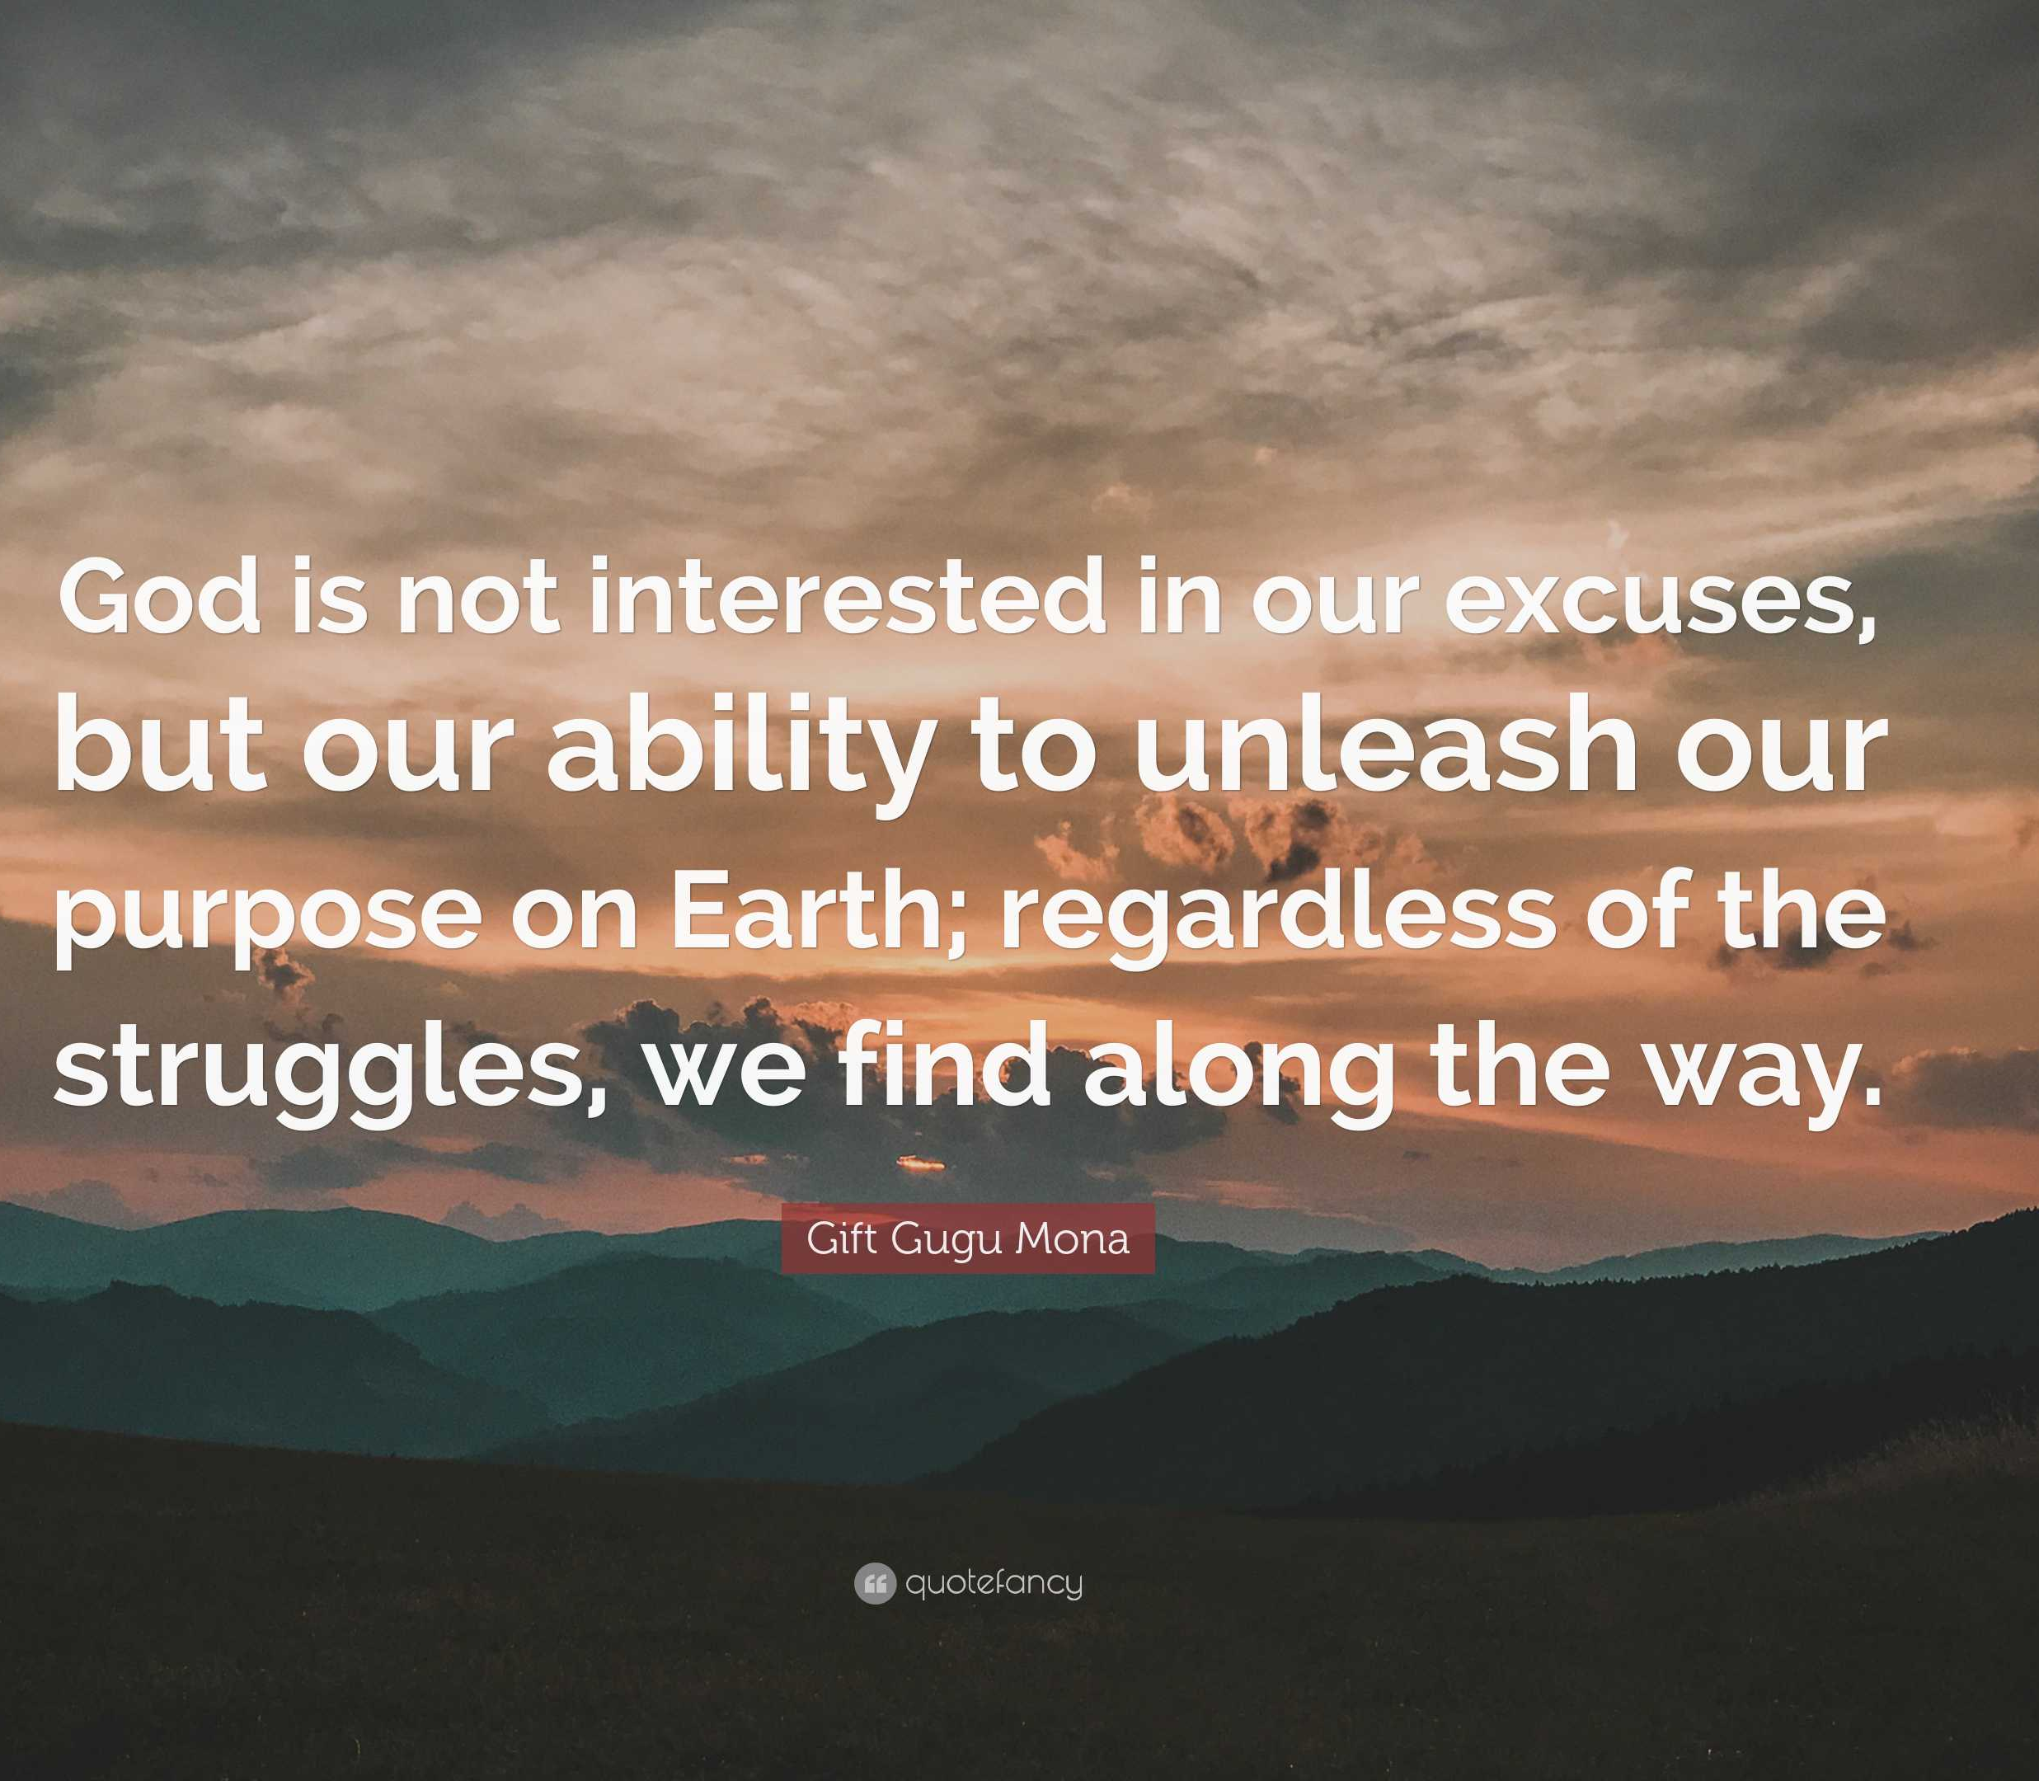
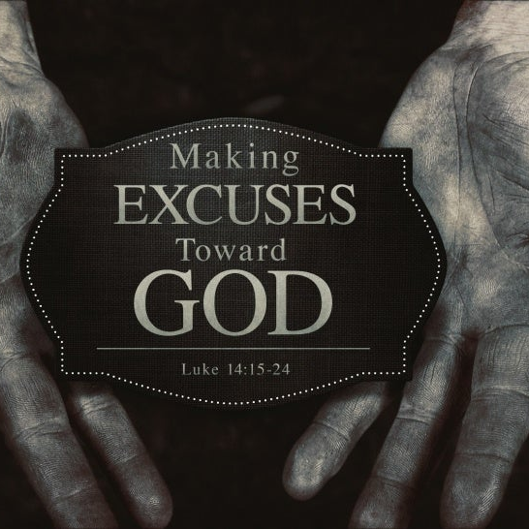
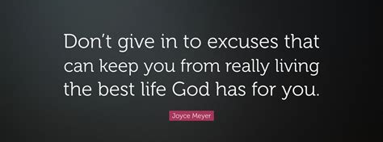
This Week’s Challenge
Be Quick to Take Responsibility
Begin to See Problems as Opportunities
Build a No Excuse Attitude
Focus Haves vs Have Nots
...and Keep Moving Forward

Slide 16
Pastor went to his church office on Monday morning and discovered a dead mule in the church yard. He telephoned the police. Since there did not appear to be any foul play, the police referred the Pastor to the Health Department. They explained, "Since there was no health threat you'll need to call the Sanitation Department." When the pastor called the Sanitation Department, the Manager of the Sanitation Department said, "I can't pick up that dead mule without authorization from the mayor." The Pastor was not at all too eager to call the mayor, who possessed a very bad temper and was always extremely unpleasant and hard to deal with, but, eventually, the Pastor called the mayor anyway.
The mayor did not disappoint the Pastor. The mayor immediately began to rant and rave. After his continued rant at the pastor, the mayor finally said, "Why did you call me any way? Isn't your job to bury the dead?"
The pastor paused for a brief prayer, and asked the Lord to direct his response. The lord led the pastor to the words he was seeking, "Yes, Mayor, it IS my job to bury the dead, BUT I always like to notify the next of kin first!

