Slide 1
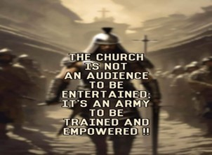
Repeat
These are the 2 Most Important Hours of My Week – Help Me to Cherish Them
I Am Here Today to Worship
Not to Be Entertained
I Am Singing to An Audience of One
Accept My Worship Oh Lord!

Slide 2

Thank You God
For This NEW…
Year
Start
Opportunities
Challenges
Victories
Help Me to Take Advantage of These New Opportunities

Slide 3

Repeat
I Lift My Offering to You
Let It Please You Oh Lord
This is My Seed
Although It Leaves My Hand
It will Never Leave My Life
You Will Multiply It!
Accept My Seed Oh Lord!

Slide 4
At a naval barracks the enlisted men were being given their shots prior to going overseas. One lad, having received his whole series of injections, asked for a glass of water.
"What's the matter?" asked the hospital corpsman. "Do you feel light-headed?"
"No, just checking to see if I'm still watertight."

Slide 5
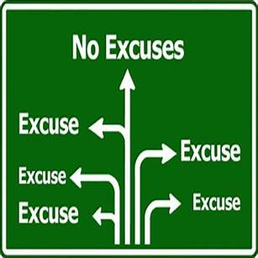


Getting Past Excuses pt 3
Edward Church
January 12, 2025

Slide 6

In The Time When We Need People…
Step Up
Take Up
Responsibility
Make a Difference
The World Instead…
Step Back
Give Up
Responsibility
Make an Excuse

Slide 7

“To succeed at life, you need three things: a wishbone, a backbone, and a funny bone.”
-Reba McEntire
Relevant Bible Passage?
Realize this is “Year of No Excuses”
Recognize Passage Addresses Both…
Joshua 1

Slide 8

¹ Now after the death of Moses the servant of the LORD it came to pass, that the LORD spake unto Joshua the son of Nun, Moses' minister, saying, ² Moses my servant is dead; now therefore arise, go over this Jordan, thou, and all this people, unto the land which I do give to them, even to the children of Israel. ³ Every place that the sole of your foot shall tread upon, that have I given unto you, as I said unto Moses. ⁴ From the wilderness and this Lebanon even unto the great river, the river Euphrates, all the land of the Hittites, and unto the great sea toward the going down of the sun, shall be your coast. ⁵ There shall not any man be able to stand before thee all the days of thy life: as I was with Moses, so I will be with thee: I will not fail thee, nor forsake thee. ⁶ Be strong and of a good courage: for unto this people shalt thou divide for an inheritance the land, which I sware unto their fathers to give them. ⁷ Only be thou strong and very courageous, that thou mayest observe to do according to all the law, which Moses my servant commanded thee: turn not from it to the right hand or to the left, that thou mayest prosper whithersoever thou goest. ⁸ This book of the law shall not depart out of thy mouth; but thou shalt meditate therein day and night, that thou mayest observe to do according to all that is written therein: for then thou shalt make thy way prosperous, and then thou shalt have good success. ⁹ Have not I commanded thee? Be strong and of a good courage; be not afraid, neither be thou dismayed: for the LORD thy God is with thee whithersoever thou goest. Joshua 1:1-9

Slide 9
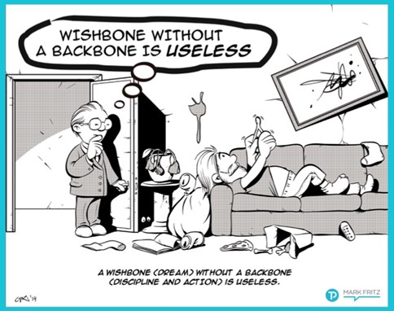
In Order to Grow in the Lord…
…to Be a Successful Spiritually
…Esp in this Year of No Excuses
…We Need These Three Bones

Slide 10
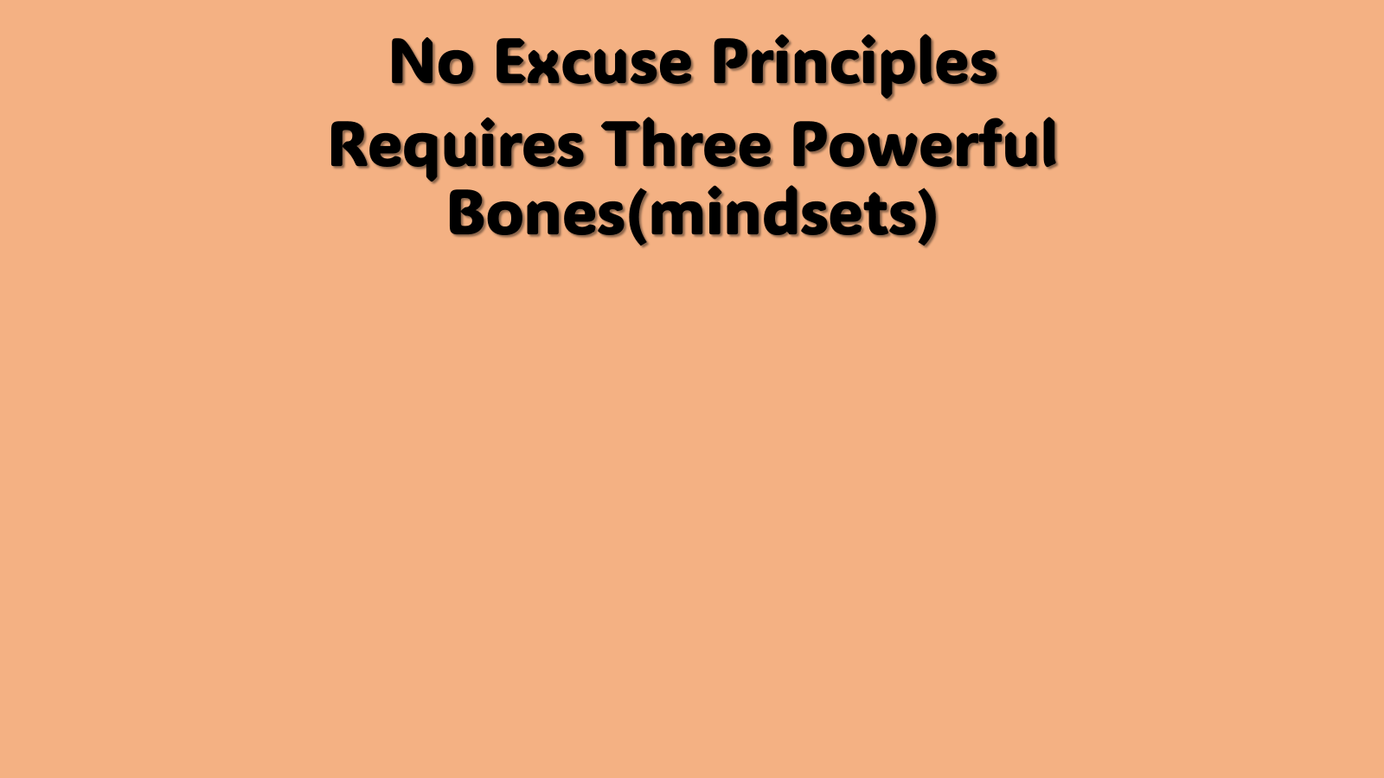
Wishbone (mindset) is for a Dream, Vision, Hope
Backbone (mindset) is for Strength, Courage
Funnybone (mindset) is for Humor.
In Hard Times, You’ll Need All Three …
To Overcome “Excuses”
The Order or the Degree Might Shift and Change
The Priority for Each Might Vary, and that’s Okay
as Long as You have All Three in Some Form Or the Other

Slide 11
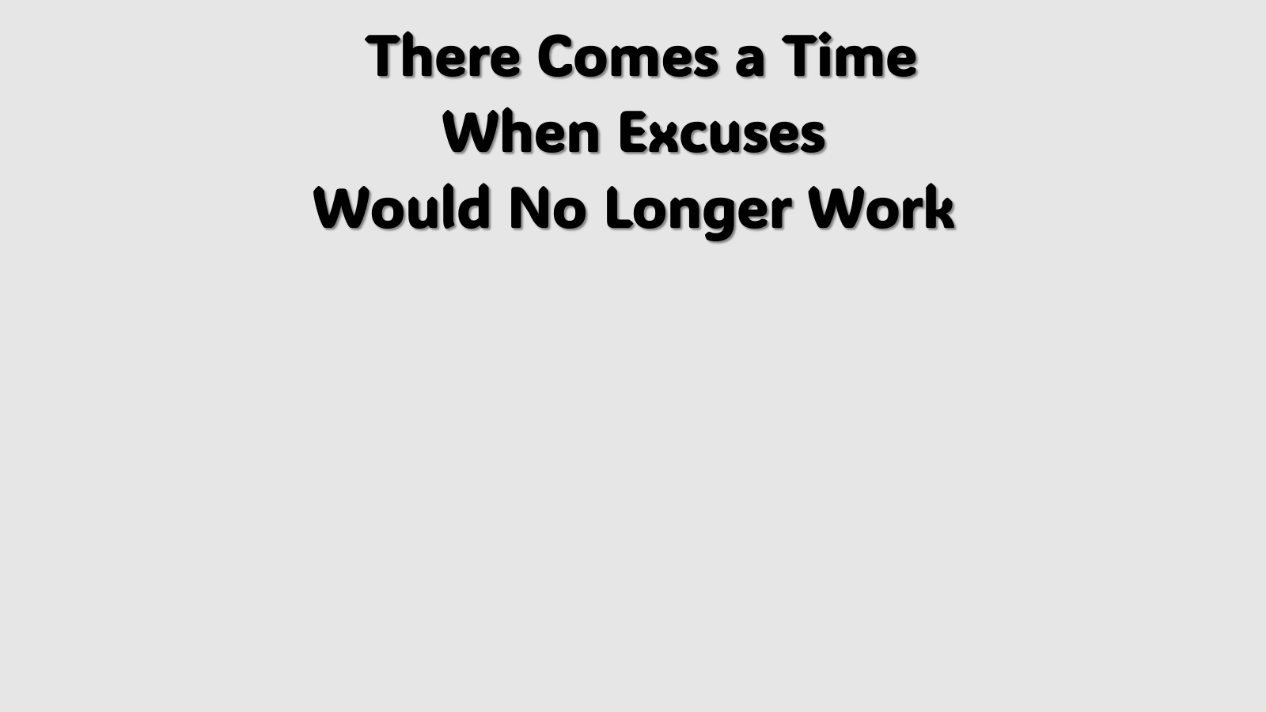
AFTER THE death of Moses the servant of the Lord, the Lord said to Joshua son of Nun, Moses' minister, ² Moses My servant is dead. So now arise [take his place], go over this Jordan, you / all this people, into the land which I am giving to them, the Israelites. Josh 1:1-2 AMP
  Moses Dead= Things Are Changing (Then)
  Now Arise= Quit Mourning What Used Be
  Go Over= Get Back Into the Game (Now)

Slide 12

³ Every place upon which the sole of your foot shall tread, that have I given to you, as I promised Moses. ⁴ From the wilderness and this Lebanon to the great river Euphrates—all the land of the Hittites [Canaan]—and to the Great [Mediterranean] Sea on the west shall be your territory. Joshua 1:3-5 (AMP)

Slide 13

God’s Promises Are Unlimited
  Based on His Ability
    Our Acceptance is Limited
      Based on Faith in His Ability + Ours
God Dares Us to Dream…
…and Stretch Our Faith

Slide 14

⁵ No man shall be able to stand before you all the days of your life. As I was with Moses, so I will be with you; I will not fail you or forsake you. ⁶ Be strong (confident) and of good courage, for you shall cause this people to inherit the land which I swore to their fathers to give them. ⁷ Only you be strong and very courageous, that you may do according to all the law which Moses My servant commanded you. Turn not from it to the right hand or to the left, that you may prosper wherever you go. Joshua 1:5-7 (AMP)

Slide 15

Strong - Action
Courageous - Attitude
Repeated 3 Times - Attack
Our Back Bone Assists Our Wishbone
  Stability
  Support
  Spring

Slide 16
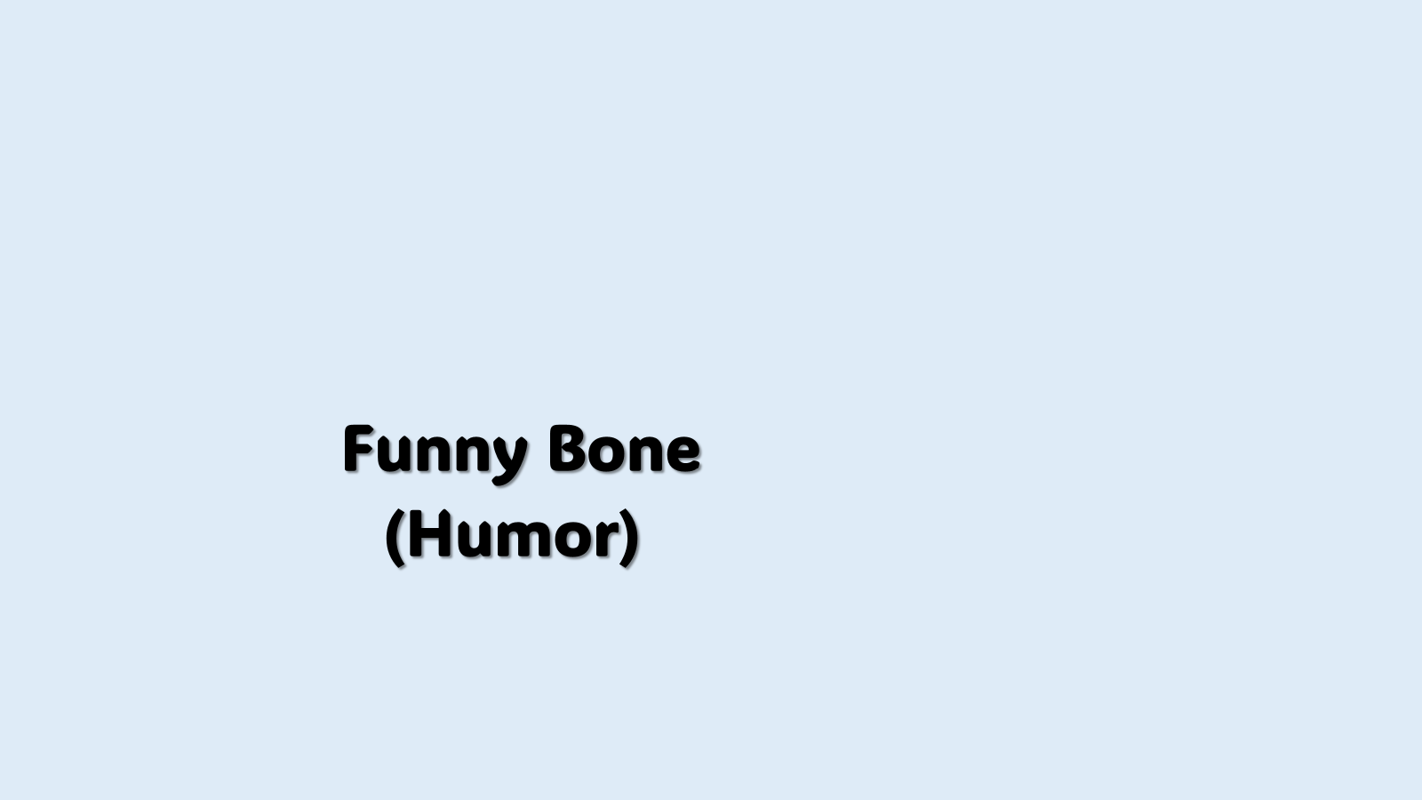
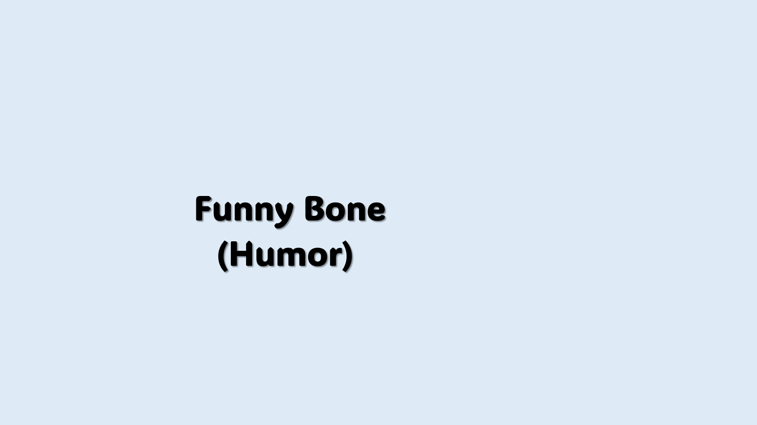
⁸ This Book of the Law shall not depart out of your mouth, but you shall meditate on it day and night, that you may observe / do according to all that is written in it. For then you shall make your way prosperous, / then you shall deal wisely / have good success. ⁹ Have not I commanded you? Be strong, vigorous, / very courageous. Be not afraid, neither be dismayed, for the Lord your God is with you wherever you go. Joshua 1:8-9 (AMP)
Be Not- do not be in a continual state of
Afraid- harassed, Full of Dread
Dismayed- break down, by confusion and fear :- be (make) afraid, beat down, discourage, go down, scare, terrify.

Slide 17
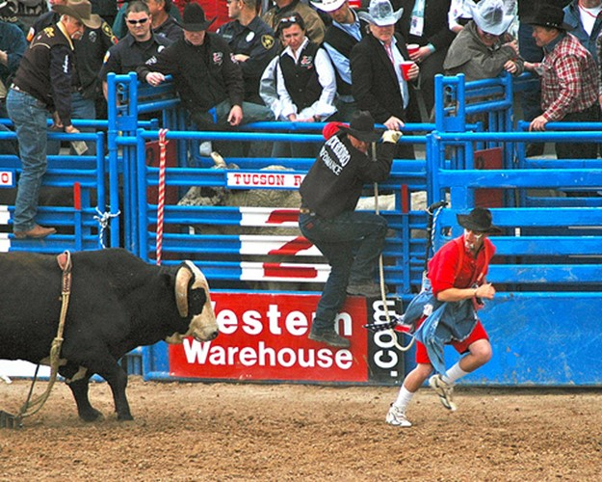
A Back Bone Without a Funny Bone…
…Can Be Painful
Proverbs 17:22 (KJV)
²² A merry heart doeth good like a medicine:
but a broken spirit drieth the bones.
Proverbs 17:22 (MSG)
²² A cheerful disposition is good for your health;
gloom and doom leave you bone-tired.
Proverbs 15:13 (KJV)
¹³ A merry heart maketh a cheerful countenance:
but by sorrow of the heart the spirit is broken.
Proverbs 15:13 (MSG)
¹³ A cheerful heart brings a smile to your face; a sad heart makes it hard to get through the day.

Slide 18
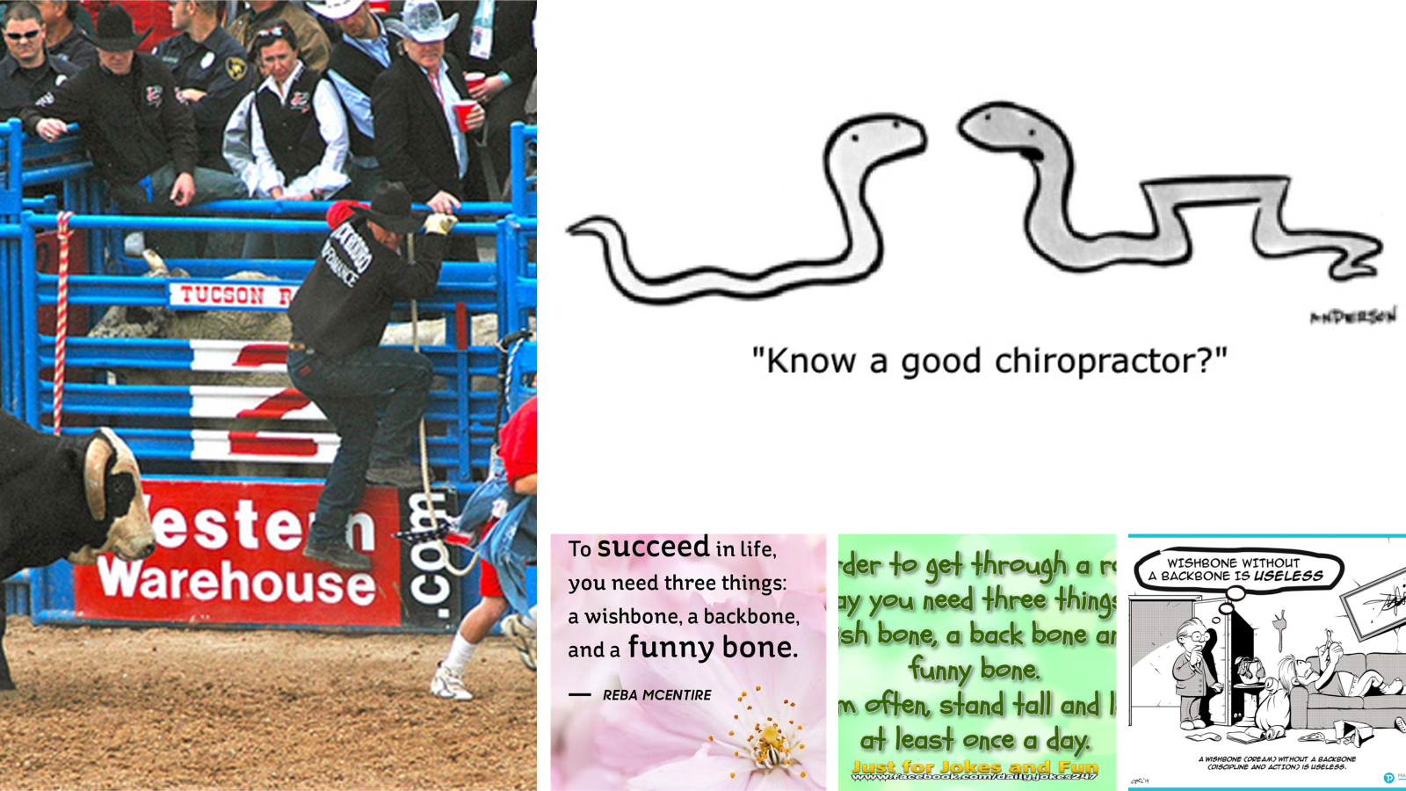
We All Need a Wish Bone
a vision, a dream, something to provide motivation
and a goal for you to strive towards.
We All Need a Back Bone
to have some gumption, some fortitude, some stick-to-it-ness, something to keep you going when things get tough, and the toughness to stand your ground in the face of opposition.
We All Need a Funny Bone
to have a sense of humor, a willingness to look for the silver lining in every dark cloud, something to keep a smile on your face
when you want to run, hide, or cry.

Slide 19


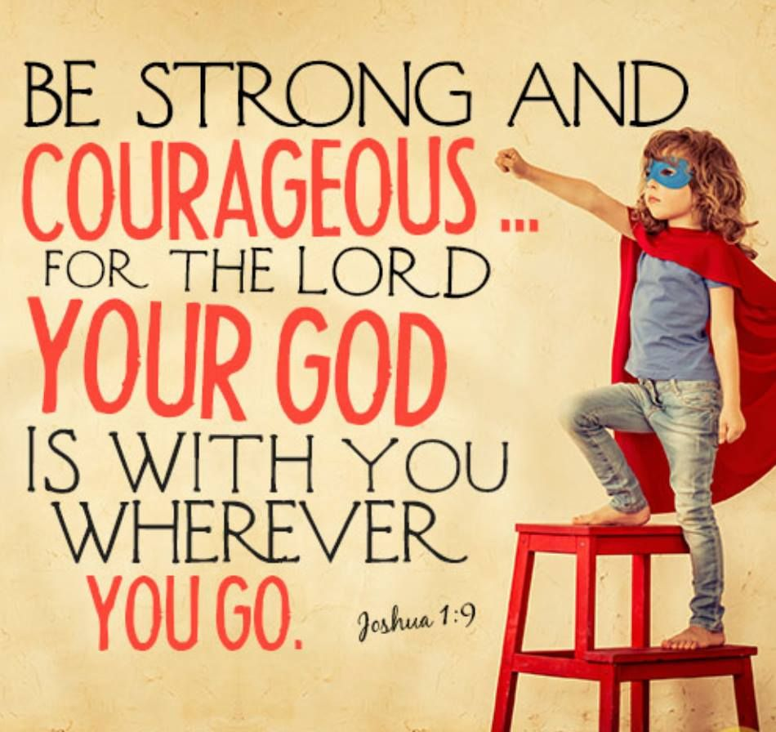
Yes - Our World is Changing
Yes - Our Ethics Are Haywire
No- Our God Will Never Change!

Slide 20
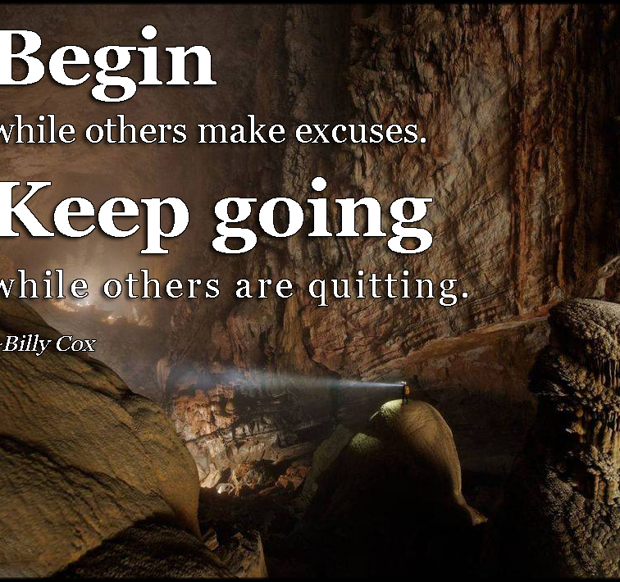
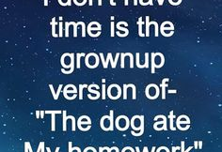
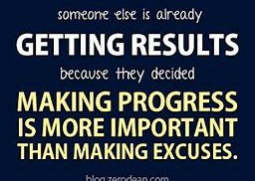
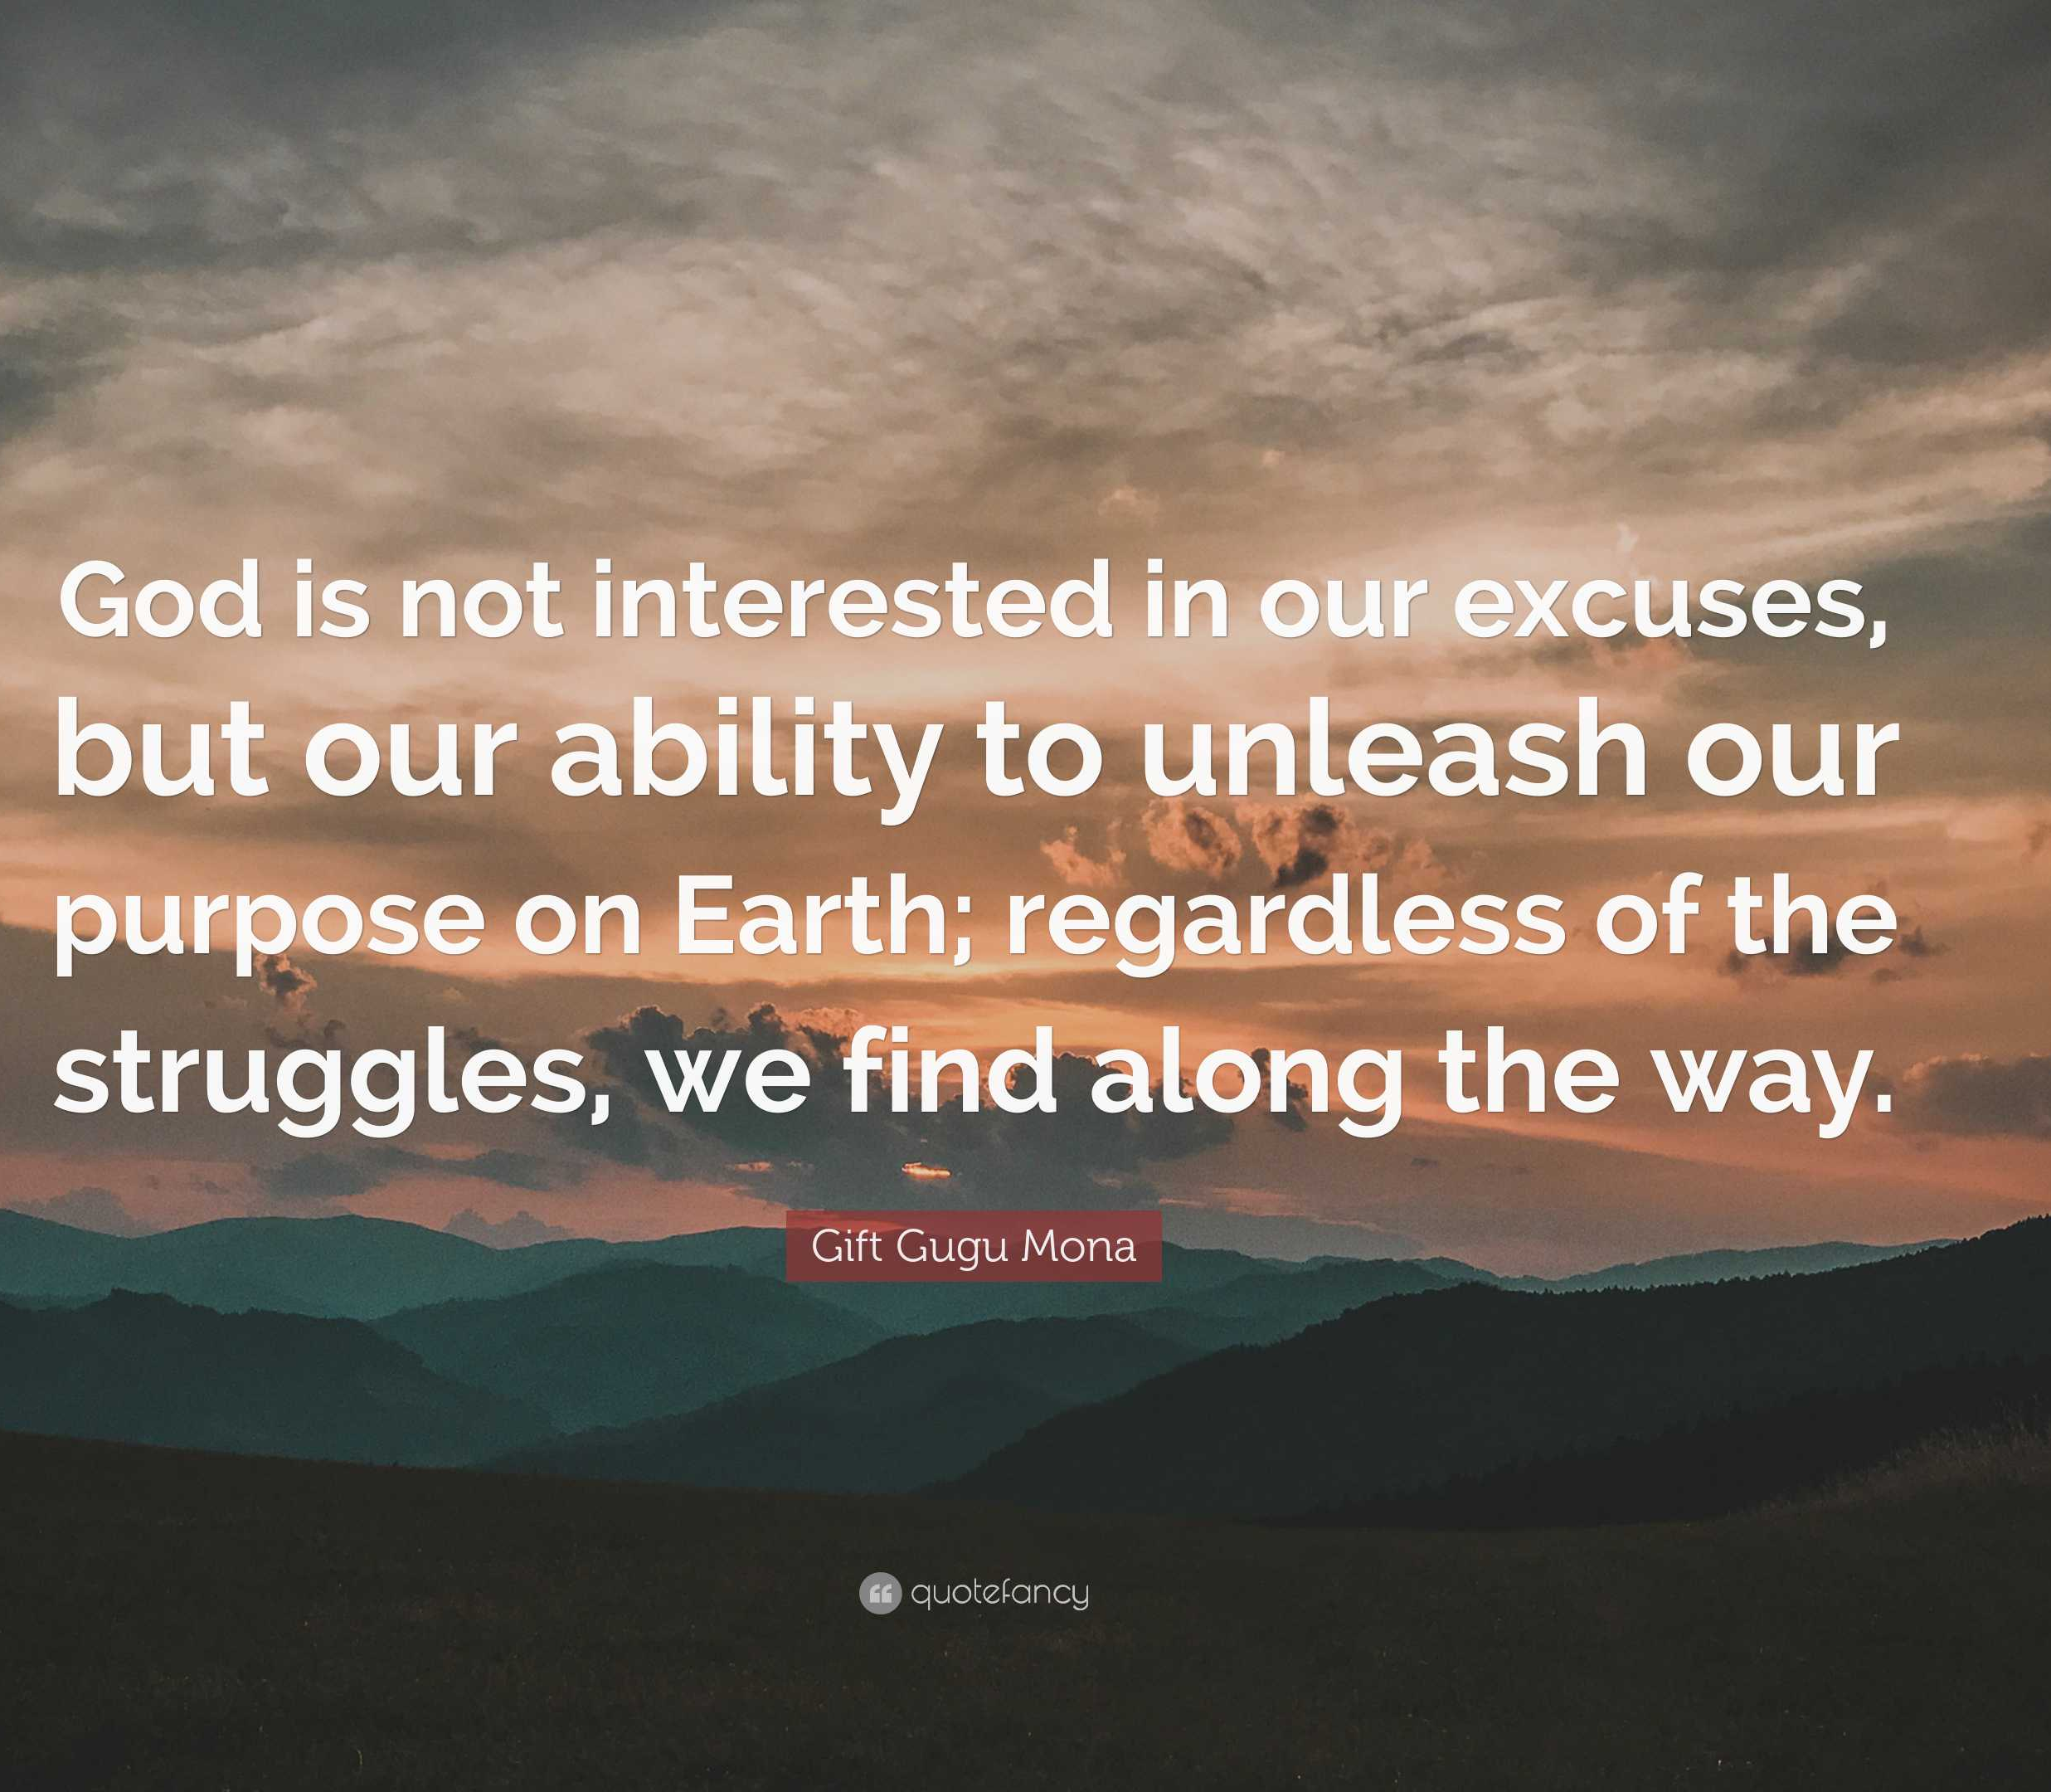
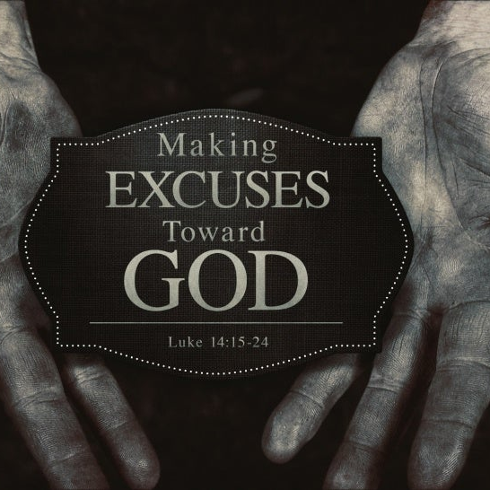
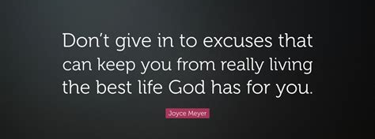
This Week’s Challenge
Be Quick to Take Responsibility
Begin to See Problems as Opportunities
Build a No Excuse Attitude
Ask God to Help You Develop
Wish Bone
Back Bone
Funny Bone

