Slide 1

Repeat
These are the 2 Most Important Hours of My Week – Help Me to Cherish Them
I Am Here Today to Worship
Not to Be Entertained
I Am Singing to An Audience of One
Accept My Worship Oh Lord!

Slide 2

Thank You God
For This NEW…
Year
Start
Opportunities
Challenges
Victories
Help Me to Take Advantage of These
New Opportunities

Slide 3

Repeat
I Lift My Offering to You
Let It Please You Oh Lord
This is My Seed
Although It Leaves My Hand
It will Never Leave My Life
You Will Multiply It!
Accept My Seed Oh Lord!

Slide 4



Getting Past Excuses pt 4
Edward Church
January 19, 2025

Slide 5

In The Time When We Need People…
Step Up
Take Up
Responsibility
Make a Difference
The World Instead…
Step Back
Give Up
Responsibility
Make an Excuse

Slide 6
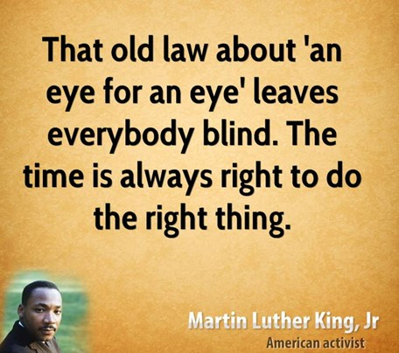
The World is Collapsing Around Us
There seems to be No Formidable Solution (Glue)
Attitudes Have Gotten Out of Control
The Solution is Not “An Eye for An Eye”
BUT
Plain
Powerful
Pleasing – to God and Man
Pushes Beyond Excuses
It’s the Golden Rule

Slide 7
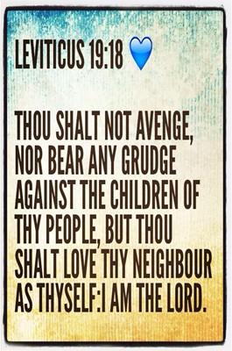
The Golden Rule is the Ethical Principle of Treating Others
as One would Prefer to Be Treated.
One of Jesus' Most Famous and Impactful Teachings,
the Golden Rule can be Found…
“So in everything, do to others what you would have them do
to you, for this sums up the Law /the Prophets.” Matt 7:12
“Do to others as you would have them do to you.” Luke 6:31

Slide 8

All the Major Religions
Have a Code of Ethics…
…Dealing with Others
But
There is a Difference…
All of the Others…
…Focus on the Negative
Only Jesus…
...Focuses on the Positive
…Brings Positive Change
Golden Rule =
Positive Change

Slide 9

Positive Action (Change)
“Do not do unto others as you would not want done to you”
Known as the “Silver Rule”
this Inversion of the Golden Rule Reminds Us to Not Do What We Would Prefer Not to Happen to Ourselves.
This is the Negative Version of the Golden Rule
It IS Also an Excuse Not to Follow It!

Slide 10
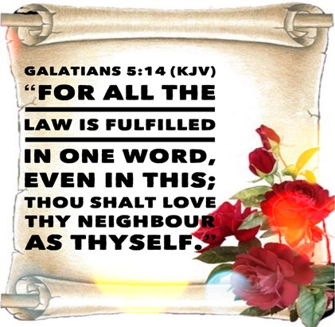
Universal Action (Change)
“It applies to every relationship in our lives”
“In everything, do to others what you want them to do to you.”
In Marriage, Parenting, Business, Friendships, Traffic.
This Should Be Our Thought in Every Relationship.
This Will Cause You to Bring Change in Most Situations

Slide 11

Empathetic Action (Change)
“Put yourself in their shoes”
Golden Rule is a call to Empathy and Understanding Another’s Situation and Point of View
Calls upon us to Picture Ourselves as our Fellow Human and Recognize this Will Bring Positive Change

Slide 12





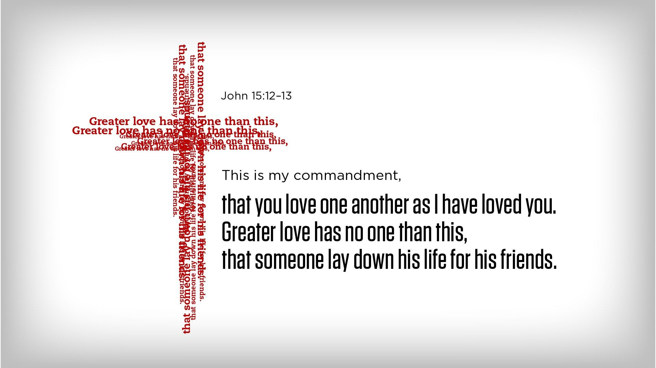
How Can You Apply the Golden Change?
Be Observant
Pay close attention to those around you.
When you “look out . . . for the interests of others,” you will likely find opportunities to say or do something helpful. -Philippians 2:4
Be Empathetic
Imagine yourself in the other person’s place. How would you feel if you were in the same situation? (Romans 12:15) When you try to understand the feelings of others, you may feel moved to help them.
Be Flexible
Keep in mind that everyone is different. What others would like to have done for them may not be the same as what you would want to have done for you. Try to choose what they will appreciate most.-1 Cor 10:24

Slide 13

Challenge - Be the Change
There are 3 Degrees of Change
#3 - Practicing the Silver Rule
#2 - Practicing the Golden Rule
#1 - Living the Golden Rule
Practicing = You Look for Opportunities
Living = Opportunity Looks for You
Now You Become the Change

Slide 14
What’s Your Excuse?
Be the Change

Slide 15
Joke
A preacher recently quit the ministry after more than 20 years of faithful, dedicated service and became a funeral director. When asked why he changed vocations, he said:
"I spent 10 years trying to straighten out John and he’s still an alcoholic. Then I spent three and one-half years trying to straighten out Harold and Susan’s marriage problems and they ended up getting a divorce. Later I tried for two years to help Bob kick his drug habit and he is still an addict. Now, at the funeral home, when I straighten them out, they stay straight!"

