Slide 1
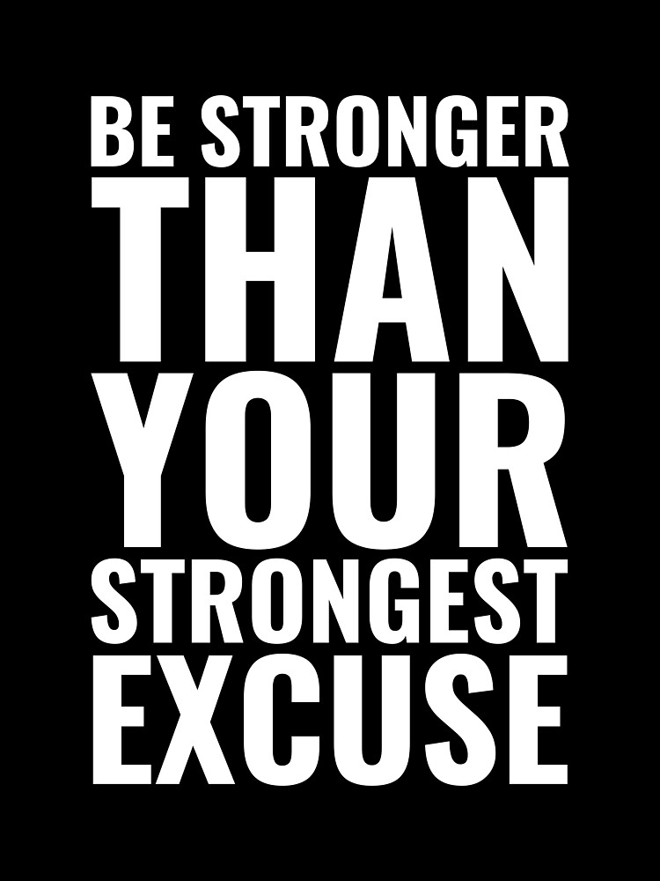

Slide 2
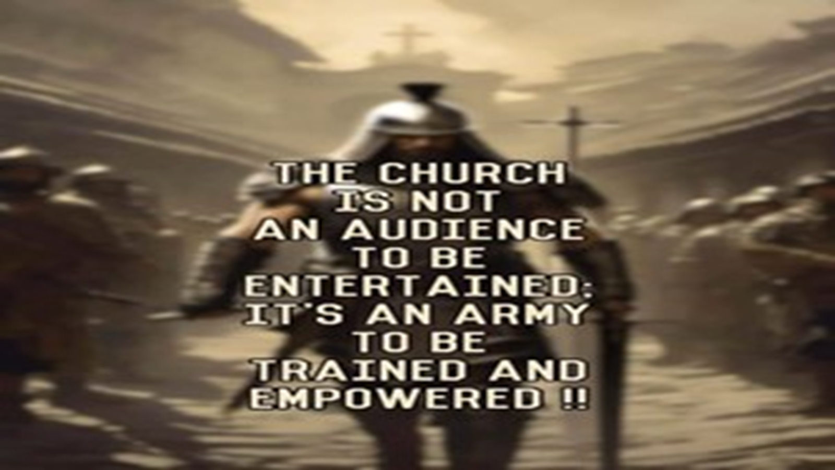
Repeat
These are the 2 Most Important Hours of My Week – Help Me to Cherish Them
I Am Here Today to Worship
Not to Be Entertained
I Am Singing to An Audience of One
Accept My Worship Oh Lord!

Slide 3

Repeat
I Lift My Offering to You
Let It Please You Oh Lord
This is My Seed
Although It Leaves My Hand
It will Never Leave My Life
You Will Multiply It!
Accept My Seed Oh Lord!

Slide 5
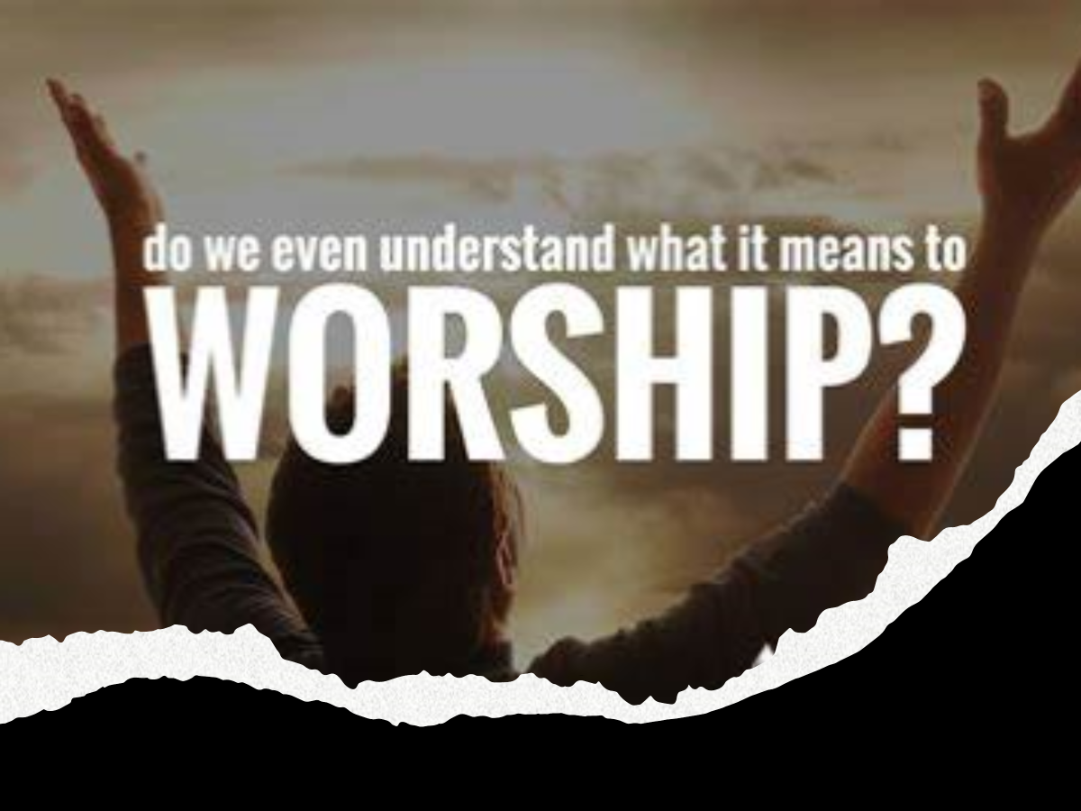
Edward Church
Jan 25, 2025
The Act Of Worship
Has Five Powerful Effects
On The Believer –pt1

Slide 6
How would you like to go into a Fire …
…without a Hose
How would you like a Jump out of Plane
…without Parachute
How would you like to Go into Snow…
…without a Coat
And The List Goes On…
How would you like to Face World
….without God
How would you like to Face God
…without Worship

Slide 7
Think of All that God Has Given Us…
The Only Thing We Can Truly Give to God…
Our Worship!
Knowing this Truth…
What Can Be Our Excuse…
…Not to Worship Him?

Slide 8
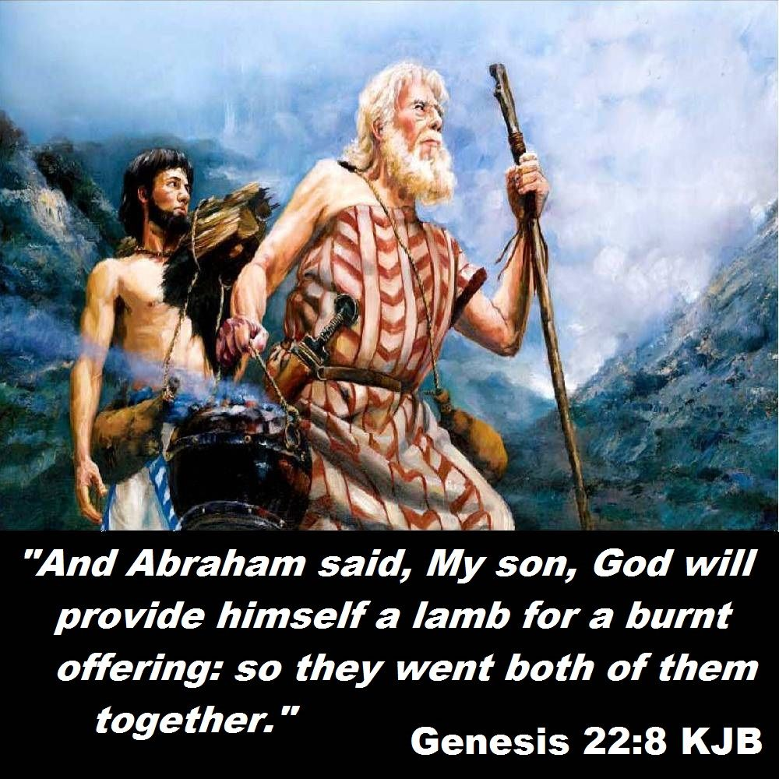
Genesis 22
First Mention of Worship in Bible
Worship= to bow down
Abraham’s Act of Worship=
Act of
Trust
Self-Denial
Giving Up Own Will
“I and the Lad go yonder to worship and we come back again..” Gen 22:5

Slide 9
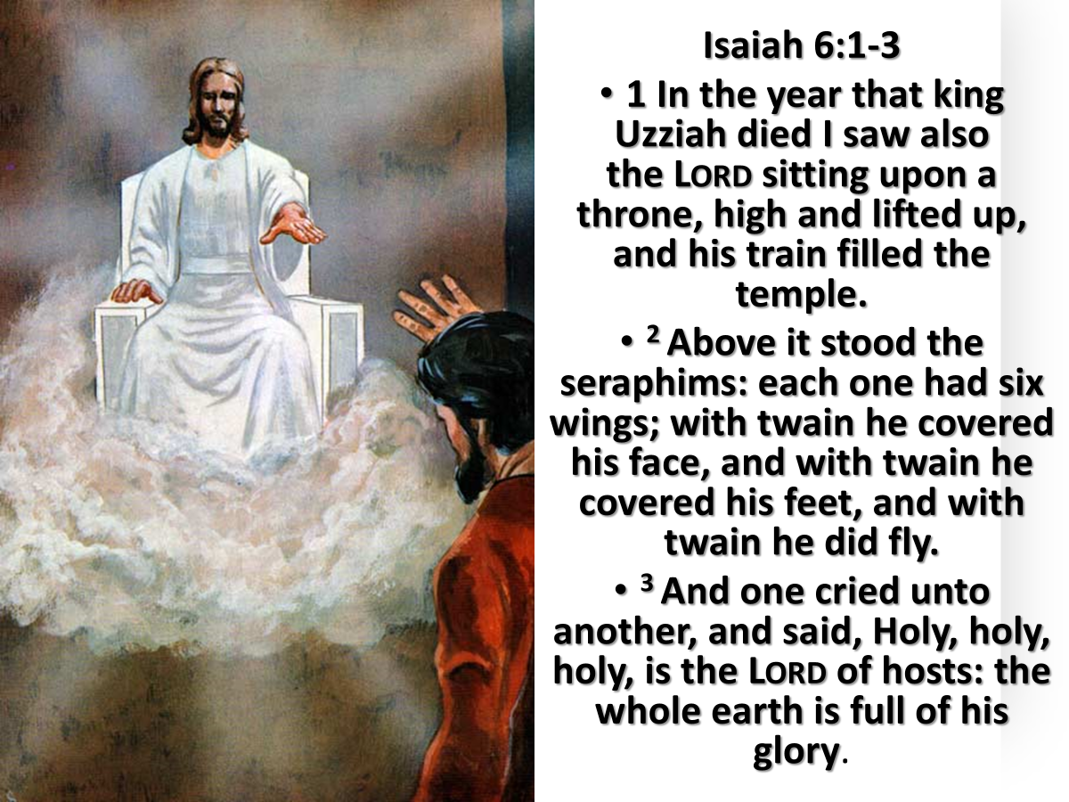
Worship Transforms of Our Hearts
Clarifies Our Vision Of God
Isaiah saw the Lord as high, exalted, holy
Isaiah 6:1-3
He is More Than Enough!
Transforms from the Inside Out
Turns Brokenness Into Beauty

Slide 10
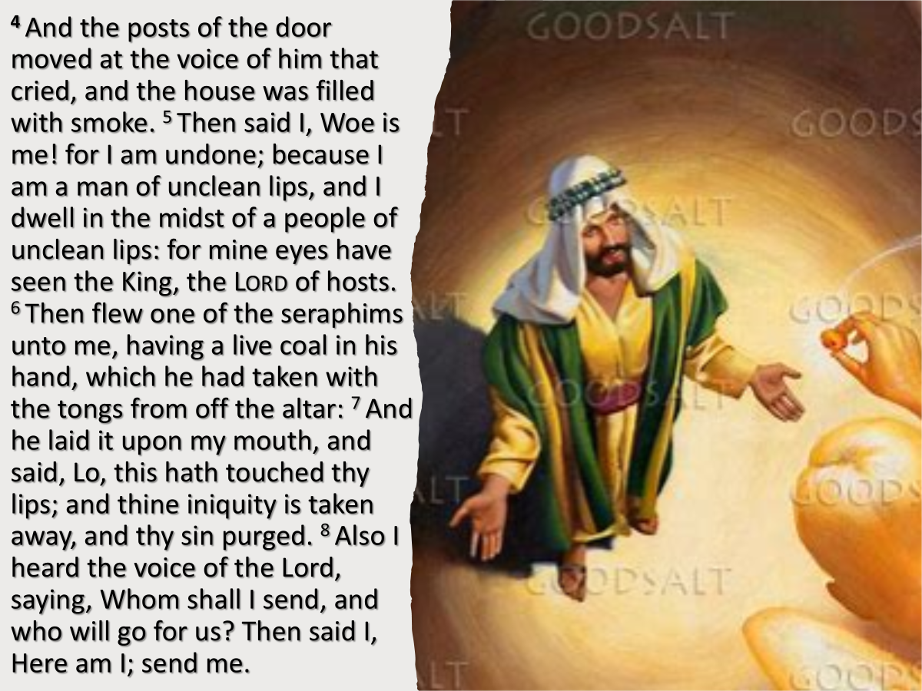
Worship Brings Us Closer to God.
It's Like A Bridge that Connects Us to Him
Why?
It Changes My Perspective
Isaiah Realized / Confessed His Nature.
God Cleansed and Emboldened Isaiah
He Gained a New Perspective, Going From Cautious to Courageous.
Isaiah 6:4-8

Slide 11
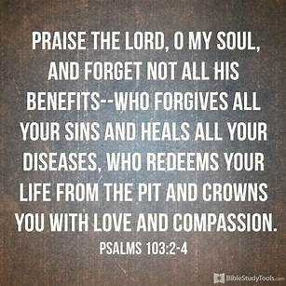
It Strengthens Our Faith
Ready to Face Whatever Life Throws at Us.
Psalm 103:1-5
Recounts Benefits and Blessings from God—Forgiveness, Healing, Redemption, Renewal
Which Leads to Praising God’s Holy Name.

Slide 12
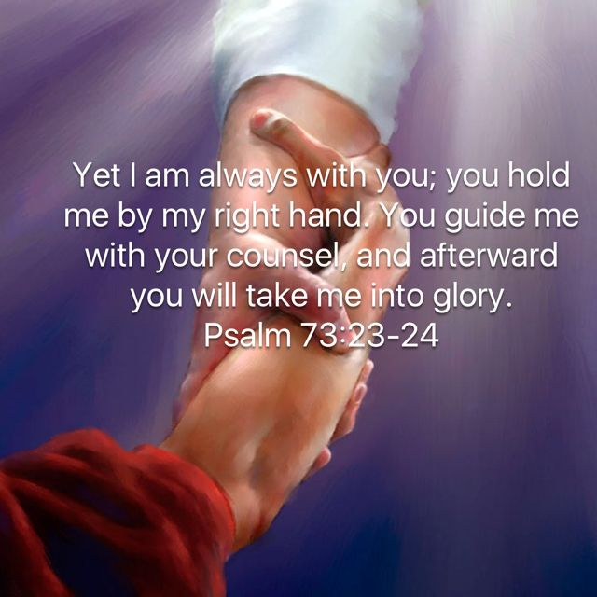
It Reassures Us of God’s Presence…
…When I Am Down
We Give Him Our Worship…
…He Gives Us His Presence
There Is Healing For Our Hearts.
Psalm 73: 23-26

Slide 13
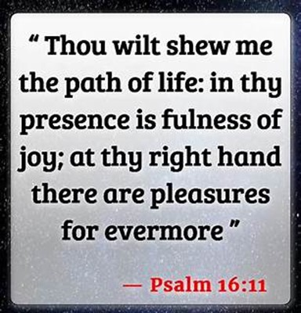
Worship Produces Joy
And in His Presence, there is Fullness of Joy
Peace that Surpasses All Understanding,
Psalm 16:11

Slide 14
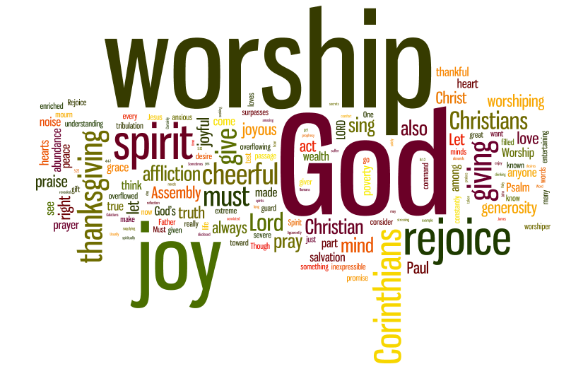
When You Need a Pick-Me-Up
In The Middle Of Your…
Battle
Disappointments
Hurts and Pains
a Few Moments of Worship…
Can Improve Your Perspective / Bring Joy
Worshipping God…
…the Quicker Picker Upper

Slide 15
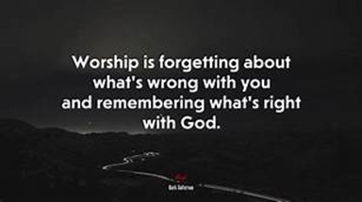
Assignment for the Week
Check Your Focus
Grow Your Focus
Lock Your Focus
Worship serves as a profound method of connecting with God.
Engaging in moments of praise can provide a clearer perspective, shifting focus from individual circumstances to the divine sovereignty of the Lord.
Let This Be Your Go to This Week

