Slide 1
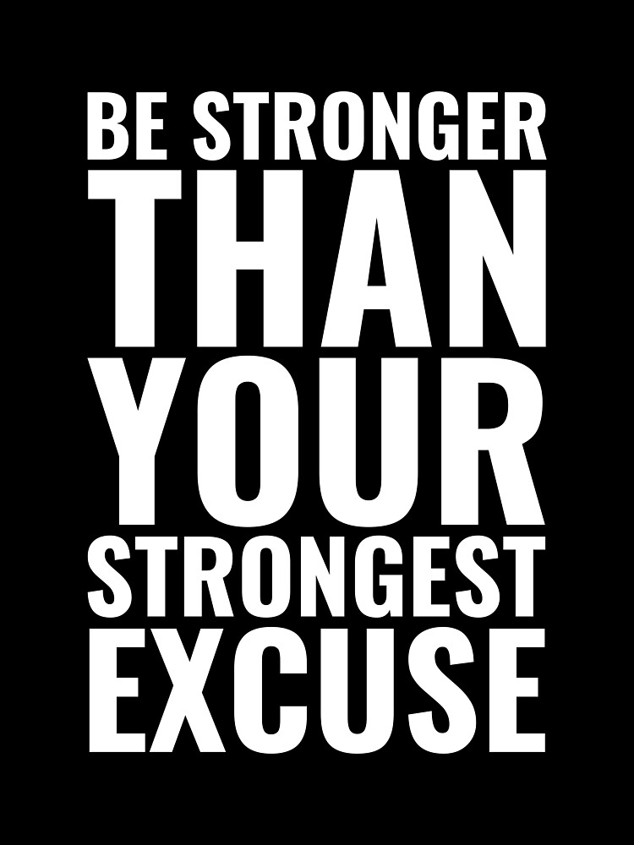

Slide 2
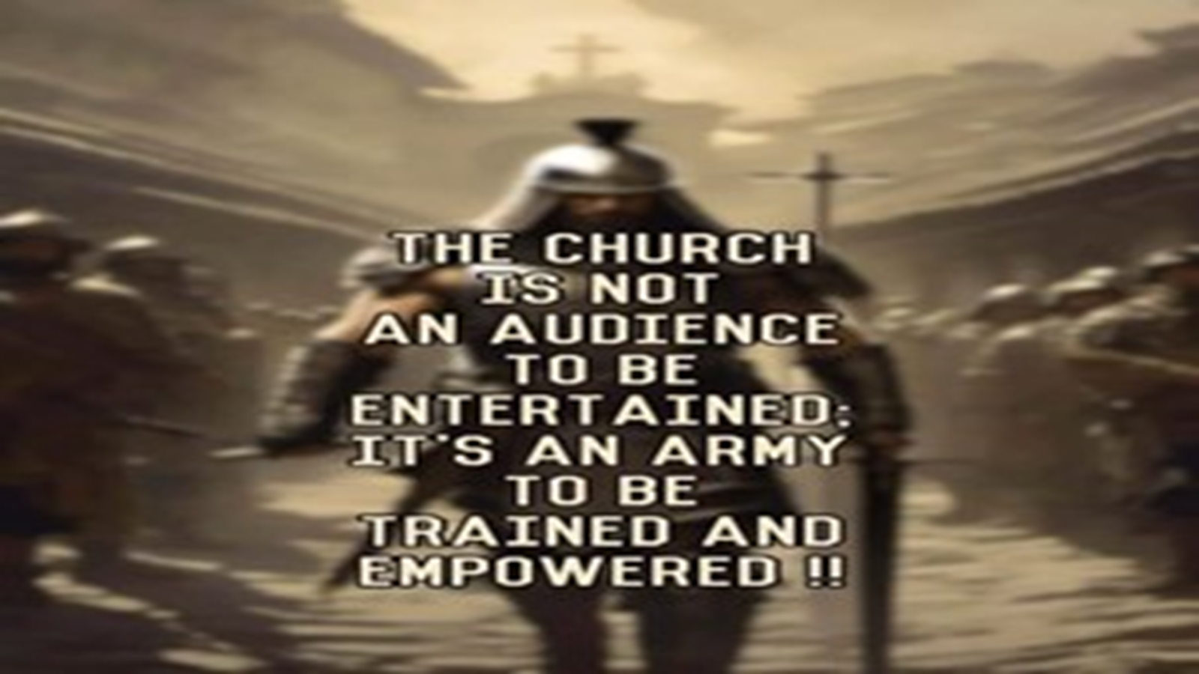
Repeat
These are the 2 Most Important Hours of My Week – Help Me to Cherish Them
I Am Here Today to Worship
Not to Be Entertained
I Am Singing to An Audience of One
Accept My Worship Oh Lord!

Slide 3
Soon and very soon we are going to see the King. Soon and very soon we are going to see the King. Soon and very soon we are going to see the King. Hallelujah, hallelujah, we’re going to see the King.

Slide 4
No more crying there we are going to see the King. No more crying there we are going to see the King. No more crying there we are going to see the King. Hallelujah, hallelujah, we’re going to see the King.

Slide 5
No more dying there we are going to see the King. No more dying there we are going to see the King. No more dying there we are going to see the King. Hallelujah, hallelujah, we’re going to see the King.

Slide 6

Repeat
I Lift My Offering to You
Let It Please You Oh Lord
This is My Seed
Although It Leaves My Hand
It will Never Leave My Life
You Will Multiply It!
Accept My Seed Oh Lord!

Slide 7
Jesus, Jesus, Jesus; There’s just something about that name! Master, Savior, Jesus, Like the fragrance after the rain. Jesus, Jesus, Jesus, Let all heaven and earth proclaim. Kings and kingdoms will all pass away, but there’s something about that name!

Slide 8
He is Lord, He is Lord. He has risen from the dead and He is Lord. Every knee shall bow. Every tongue confess That Jesus Christ is Lord.

Slide 9
You are Lord, You are Lord. You have risen from the dead and You are Lord. Every knee shall bow. Every tongue confess That Jesus Christ is Lord.

Slide 10
A minister was called to a local nursing home to perform a wedding. An anxious old man met him at the door. The pastor sat down to counsel the old man and asked several questions. "Do you love her?" The old man replied, "I guess." "Is she a good Christian woman?" The old man answered, "I don't know for sure.
Does she have lots of money? I doubt it- then why? –
because she can still drive at night!

Slide 12
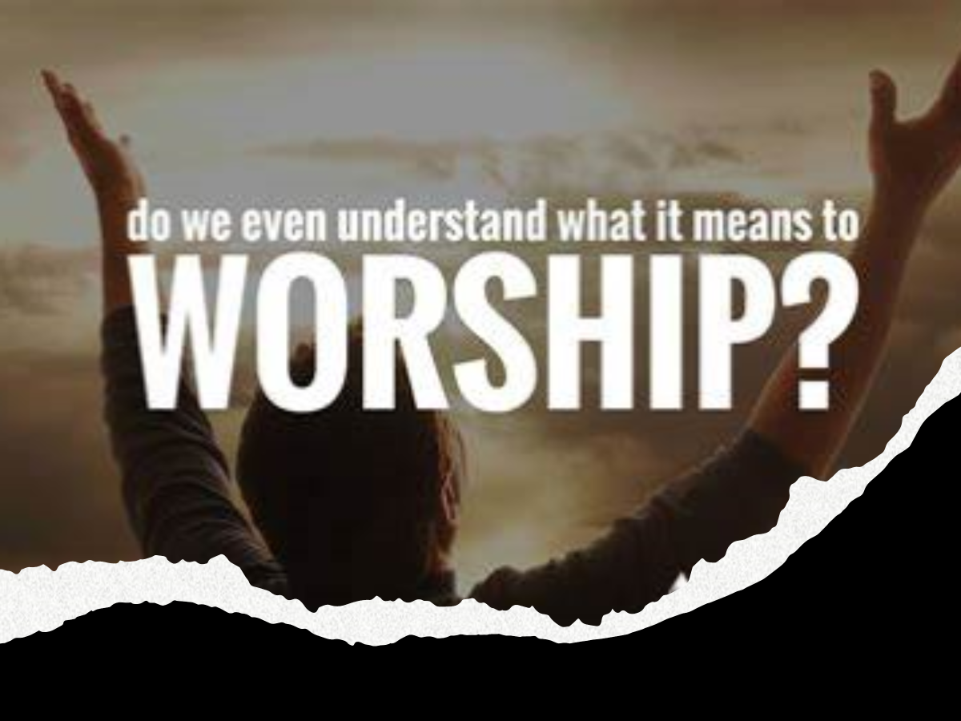
The Act Of Worship
8 Points of Misinformation
Pt 1

Slide 13
How would you like to go into a Fire …
…without a Hose
How would you like a Jump out of Plane
…without Parachute
How would you like to Go into Snow…
…without a Coat
And The List Goes On…
How would you like to Face World
….without God
How would you like to Face God
…without Worship

Slide 14
Think of All that God Has Given Us…
The Only Thing We Can Truly Give to God…
Our Worship!
Knowing this Truth…
What Can Be Our Excuse…
…Not to Worship Him?

Slide 15
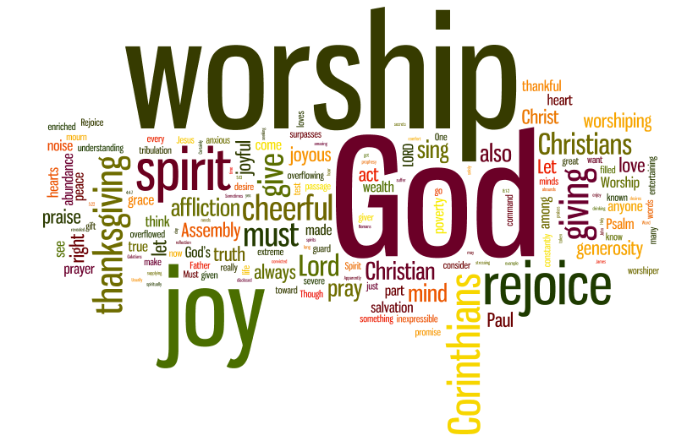
When You Need a Pick-Me-Up
In The Middle Of Your…
Battle
Disappointments
Hurts and Pains
a Few Moments of Worship…
Can Improve Your Perspective / Bring Joy
Worshipping God…
…the Quicker Picker Upper

Slide 16
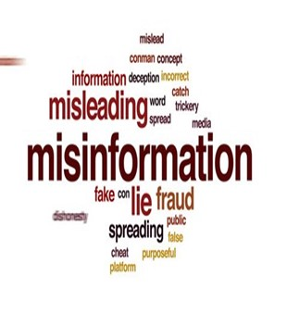
Misinformation
By-Word of the Season
Strong Word that Has Been Diluted
Used As Political Ploy
Not Much Weight
This Day Spiritual Truth
Carries Much Weight
A Lot of Misinformation on
“Worship”

Slide 17
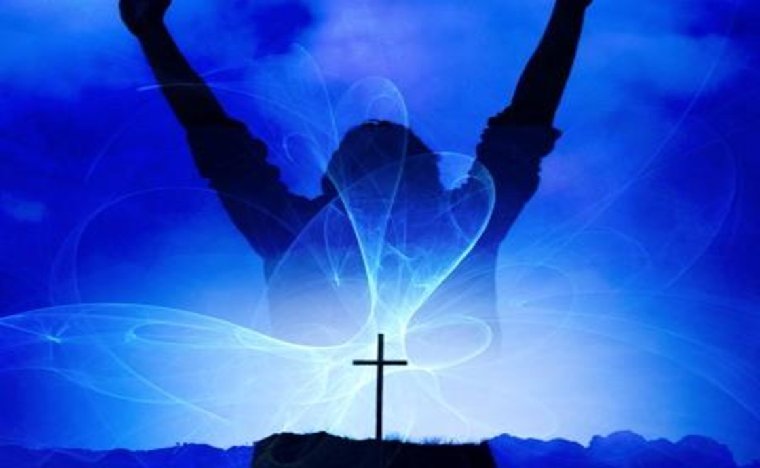

True Worship
God Designed His Creation to Worship Him
Rom 1:20
“For the invisible things of him from the
Creation…. so that they are without excuse”
Rom 1:25
“changed the truth of God into a lie,
worshipped / served the creature > the Creator”
Isa 55:12
“The mountains and hills will burst into song,/ the trees of the field will clap their hands!”
Whenever God Communes With Us..
…We Respond With
Thanksgiving.. Praise ..Worship

Slide 18


The Difference
Praise is…
Worship is…
About God
Opening Up
Boldly Declaring
Praise Applauds What...
…God Has Done
to God
Entering In
Humbly Bowing
Worship is Honoring…
…God for Who He Is

Slide 19
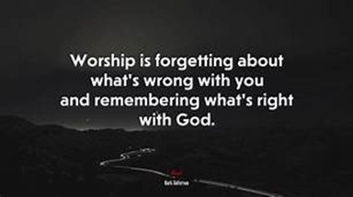
Our Purpose(goal) in Worship
Misinformation #1:
Worship is when we Talk about God
Truth #1:
Worship is when we Come into..
…the Presence of God
True “God Encounter”
Psalm 22:3 (NASB77)
Yet Thou art holy,
O Thou who art enthroned upon the praises of Israel.

Slide 20
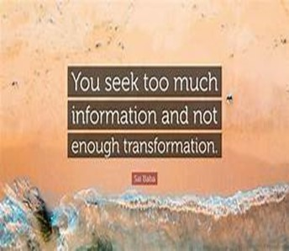
The Product(result) of Worship
Misinformation #2:
True Worship Leaves Me Feeling Pleased
Truth #2:
True Worship Leaves God Feeling Pleased
Eph 5:10 (AMP)
¹⁰ And try to learn [in your experience] what is pleasing to the Lord [let your lives be constant
proofs of what is most acceptable to Him].
Many Christians believe that they are the audience; in truth, God is the Audience (of One)

Slide 21

The Point of Focus in Worship
Misinformation #3:
In Worship, the Focus is on the Activity
(Performance Driven)
Truth #3:
In Worship, the Focus is on God
(Driven to Performance)
Worship is an Inside Job!

Slide 22
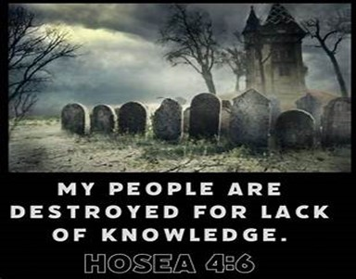
The Pathway to Worship
Misinformation #4:
True Worship Happens when the Music
and Message are Good
It Definitely Enhances but…
Truth #4:
True Worship Happens When We
Worship in Spirit / Truth
John 4:21-24

Slide 23
The Pathway to Worship
“The true worshipers will worship the Father in spirit / truth, for they are the kind of worshipers the Father seeks.” -John 4:23
Worship in Spirit= Attitude
...Beyond Surface
...Beyond Situation
Worship in Truth= Foundation
...Beyond Human Reasoning
...Beyond Human Reaction

Slide 24
Assignment for the Week
Check Your Focus
Grow Your Focus
Lock Your Focus
Worship serves as a profound method of connecting with God.
Engaging in moments of Worship can provide a clearer perspective, shifting focus from individual circumstances to the divine sovereignty of the Lord.
Let This Be Your Go to This Week

