Slide 1


Slide 2
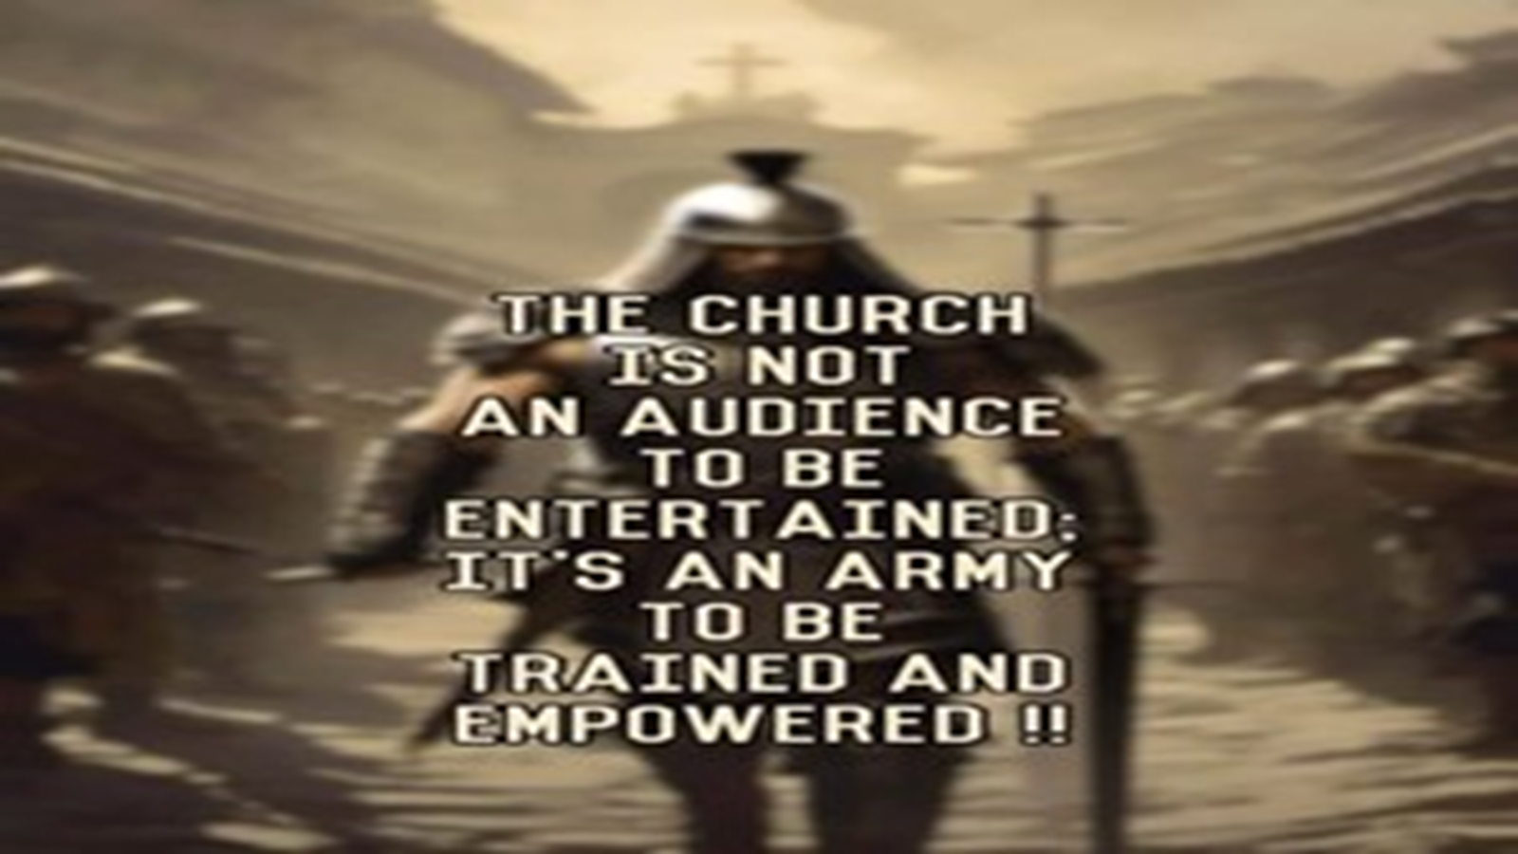
Repeat
These are the 2 Most Important Hours of My Week – Help Me to Cherish Them
I Am Here Today to Worship
Not to Be Entertained
I Am Singing to An Audience of One
Accept My Worship Oh Lord!

Slide 3

Repeat
I Lift My Offering to You
Let It Please You Oh Lord
This is My Seed
Although It Leaves My Hand
It will Never Leave My Life
You Will Multiply It!
Accept My Seed Oh Lord!

Slide 5
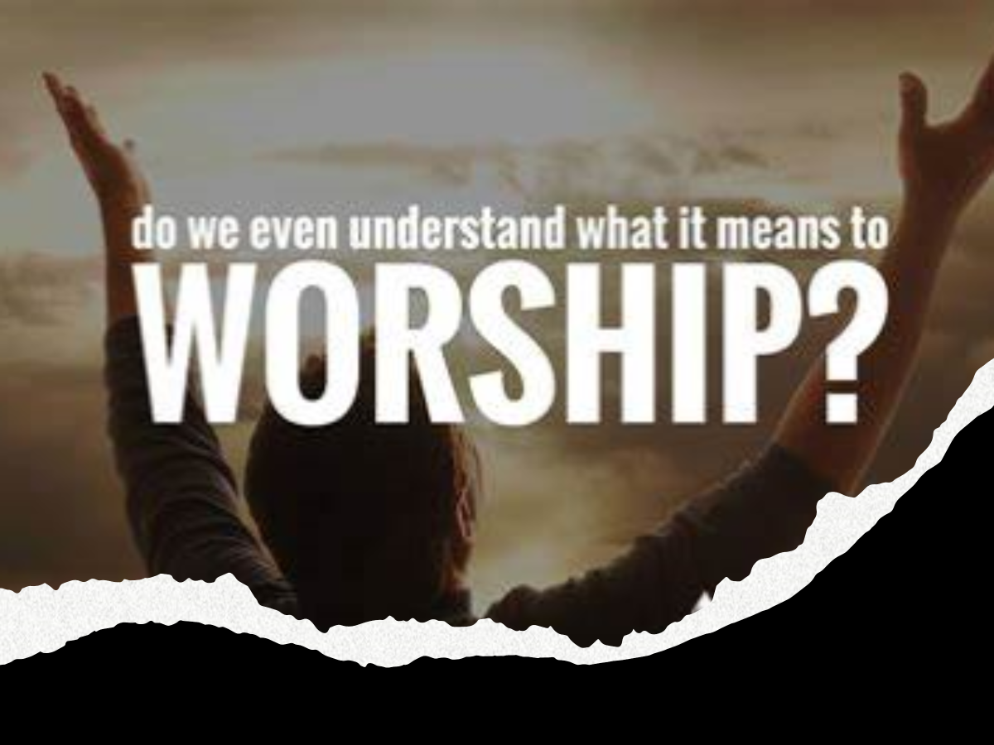
The Act Of Worship
8 Points of Misinformation
Pt 2

Slide 6
How would you like to go into a Fire …
…without a Hose
How would you like a Jump out of Plane
…without Parachute
How would you like to Go into Snow…
…without a Coat
And The List Goes On…
How would you like to Face World
….without God
How would you like to Face God
…without Worship

Slide 7
Think of All that God Has Given Us…
The Only Thing We Can Truly Give to God…
Our Worship!
Knowing this Truth…
What Can Be Our Excuse…
…Not to Worship Him?

Slide 8
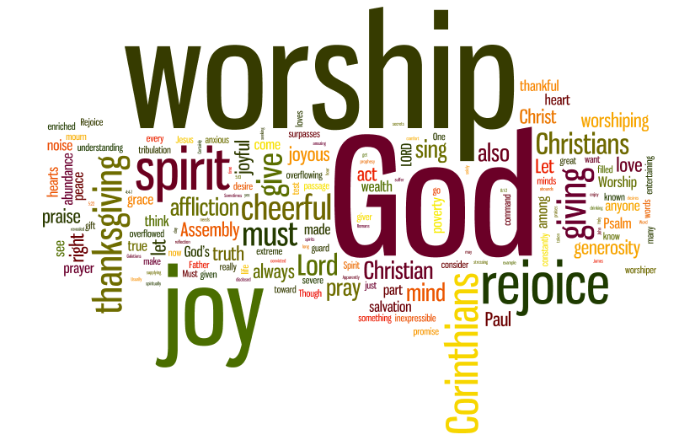
When You Need a Pick-Me-Up
In The Middle Of Your…
Battle
Disappointments
Hurts and Pains
a Few Moments of Worship…
Can Improve Your Perspective / Bring Joy
Worshipping God…
…the Quicker Picker Upper

Slide 9
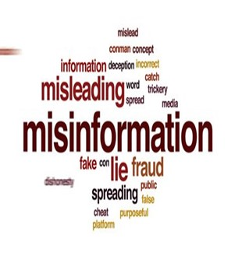
Misinformation
By-Word of the Season
Strong Word that Has Been Diluted
Used As Political Ploy
Not Much Weight
This Day Spiritual Truth
Carries Much Weight
A Lot of Misinformation on
“Worship”

Slide 10
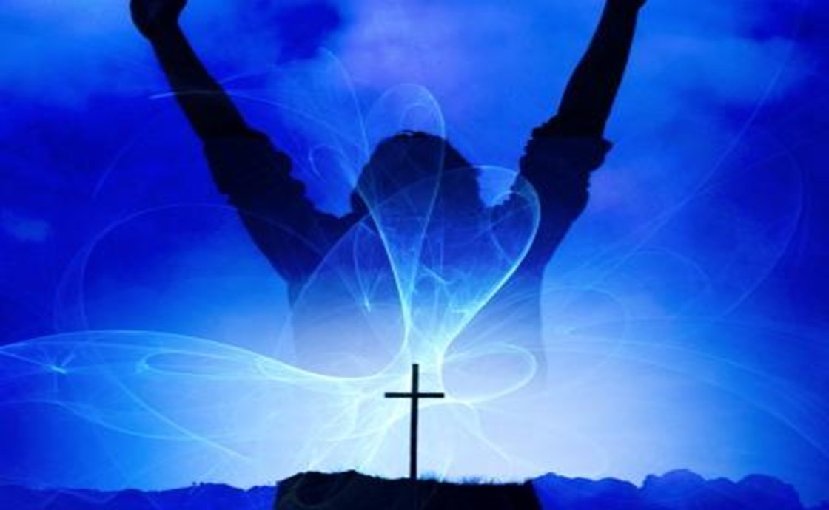

Praise and Worship
God Designed His Creation to Worship Him
Rom 1:20
“For the invisible things of him from the
Creation…. so that they are without excuse”
Rom 1:25
“changed the truth of God into a lie,
worshipped / served the creature > the Creator”
Isa 55:12
“The mountains and hills will burst into song,/ the trees of the field will clap their hands!”
Whenever God Communes With Us..
…We Respond With
Thanksgiving.. Praise ..Worship

Slide 11

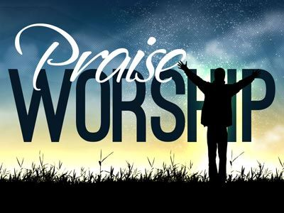
The Difference
Praise is…
Worship is…
About God
Opening Up
Boldly Declaring
Praise Applauds What...
…God Has Done
to God
Entering In
Humbly Bowing
Worship is Honoring…
…God for Who He Is

Slide 12
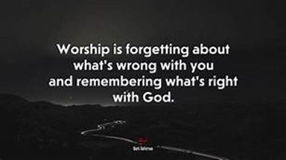
Our Purpose(goal) in Worship
Misinformation #1:
Worship is when we Talk about God
Truth #1:
Worship is when we Come into..
…the Presence of God
True “God Encounter”
Psalm 22:3 (NASB77)
Yet Thou art holy,
O Thou who art enthroned upon the praises of Israel.

Slide 13
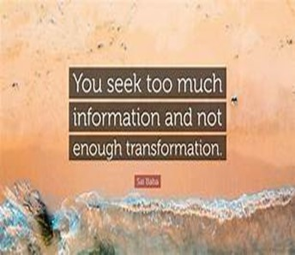
The Product(result) of Worship
Misinformation #2:
True Worship Leaves Me Feeling Pleased
Truth #2:
True Worship Leaves God Feeling Pleased
Eph 5:10 (AMP)
¹⁰ And try to learn [in your experience] what is pleasing to the Lord [let your lives be constant
proofs of what is most acceptable to Him].
Many Christians believe that they are the audience; in truth, God is the Audience (of One)

Slide 14

The Point of Focus in Worship
Misinformation #3:
In Worship, the Focus is on the Activity
(Performance Driven)
Truth #3:
In Worship, the Focus is on God
(Driven to Performance)
Worship is an Inside Job!

Slide 15
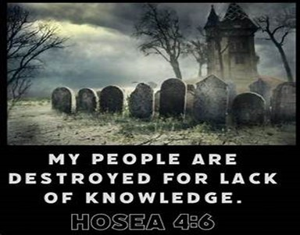
The Pathway to Worship
Misinformation #4:
True Worship Happens when the Music
and Message are Good
It Definitely Enhances but…
Truth #4:
True Worship Happens When We
Worship in Spirit / Truth
John 4:21-24

Slide 16
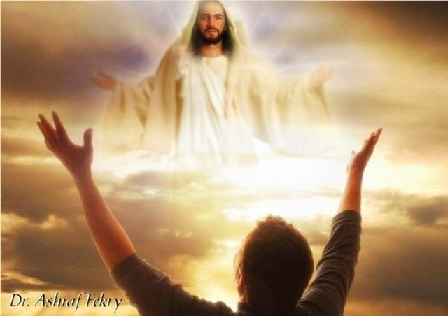
Preparation for Worship
Misinformation #5:
Worship happens in Church –Only
Truth #5:
Worship is an Everyday Thing
Psalm 119:164 ,“Seven times a day do I praise thee because of thy righteous judgments”
Worship can happen anytime we are
Open to the Reality and Presence of God.

Slide 17
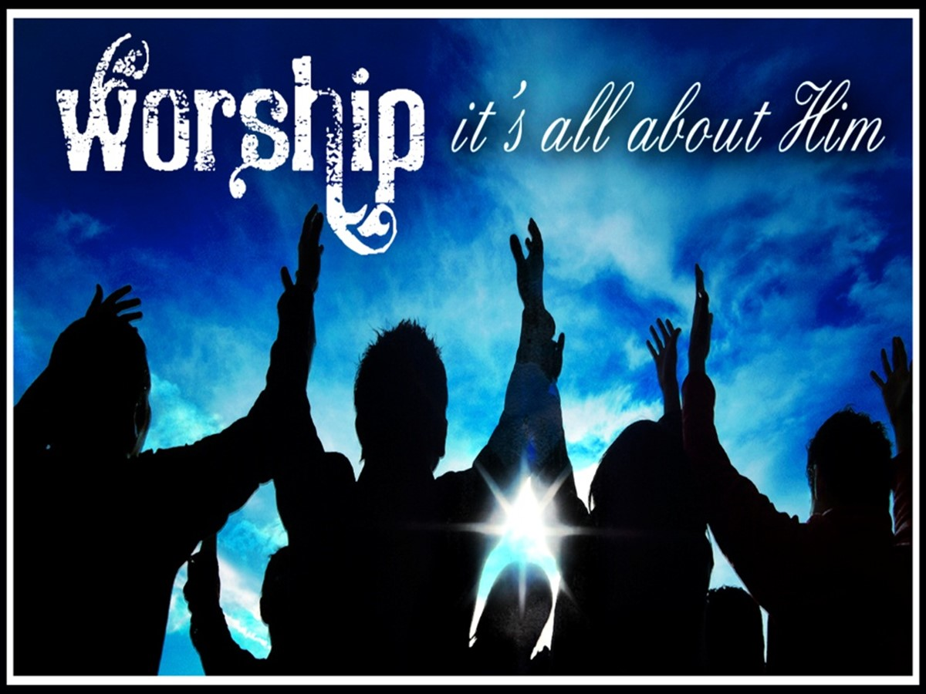
Passion for Worship
Misinformation #6:
I’m willing to Worship if we All Get Involved
Truth #6:
I’m willing to Worship if it’s Me Alone
Psalm 103:1, “Bless the LORD, O my soul: / all that is within me, bless his holy name”

Slide 18
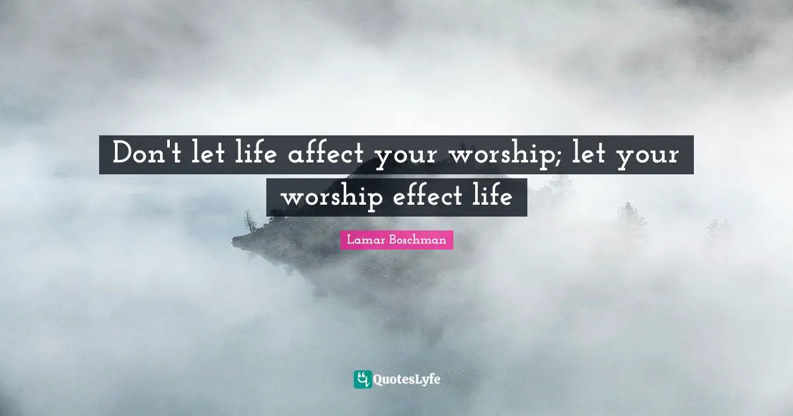
Need for Worship
Misinformation #7:
Worship Does Not Effect my Life (not need it)
Truth #7:
Worship is a Life Altering Experience
(can’t live without it)
Psalm 27:4 (NASV)
“One thing I have asked from the LORD, that I
shall seek: That I may dwell in the house of
the LORD all the days of my life,
To behold the beauty of the LORD, And
to meditate in His temple.”

Slide 19
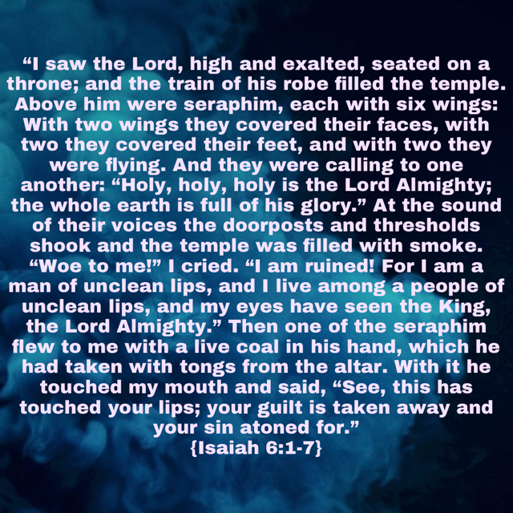

Slide 20
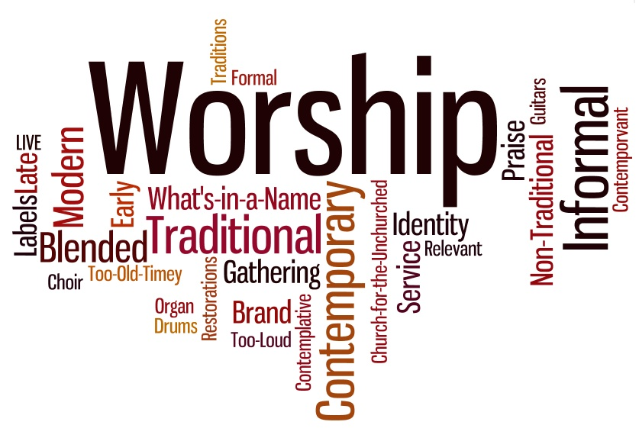
Our Style of Worship
Misinformation #8
Worship Must Follow a Specific Format
Truth #8:
God Values the Why More Than the How
Authentic Worship Is…
Individual
Collective
Not Restrained
Consistently Pleasing
**Brings Us Closer –to God / one another

Slide 21
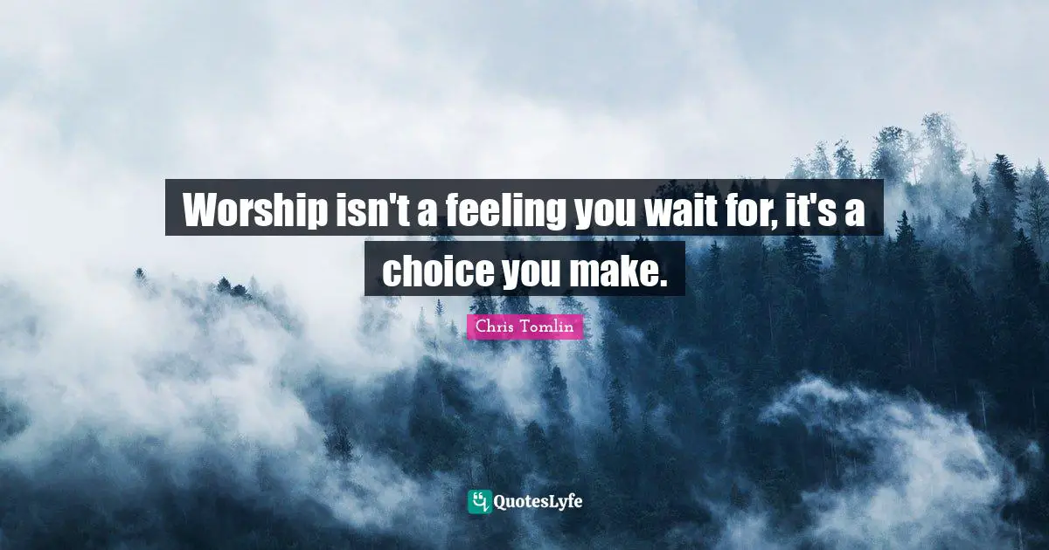
Our Style of Worship
Worship is an…
“Inside Job”
Once it Starts it Moves…
“Out…
…and Up!”
God’s Heart is Touched…
…Ours is Lifted Up!

Slide 22
Assignment for the Week
Check Your Focus
Grow Your Focus
Lock Your Focus
Worship serves as a profound method of connecting with God.
Engaging in moments of Worship can provide a clearer perspective, shifting focus from individual circumstances to the divine sovereignty of the Lord.
Let This Be Your Go to This Week

Slide 24
A nun is sitting with her Mother Superior, chatting. "I used some horrible language this week and feel absolutely terrible about it.“ "When did you use this awful language?" asks the elder. "Well, I was golfing and hit an incredible drive that looked like it was going to go over 280 yards, but it struck a phone line that's hanging over the fairway and fell straight down to the ground after going only about 100 yards.“ 'Is that when you swore?’ "No, Mother," says the nun. "After that a squirrel ran out of the bushes and grabbed my ball in its mouth and began to run away.“ "Is THAT when you swore?" asks the Mother Superior again. "Well, no." says the nun. "You see, as the squirrel was running, an eagle came down out of the sky, grabbed the squirrel in his talons and began to fly away!“ "Is THAT when you swore?" asks the amazed elder nun. "No, not yet. As the eagle carried the squirrel away in its claws, it flew near the green and the squirrel dropped my ball.“ "Did you swear THEN?" asked Mother Superior, becoming impatient. "No, because the ball fell on a big rock, bounced over the sand trap, rolled onto the green, and stopped about a foot from the hole.“ The two nuns were silent for a moment. Then Mother Superior sighed and asked, "You missed the putt, didn't you?"

