Slide 2


Slide 4


Edward Christian Church
February 16, 2025
“No Excuse”
Valentine pt1

Slide 5

Quotes by Children About Love:
Glenn, age 7 - If falling love is anything like
learning how to spell, I don’t want to do it. It takes
too long.
Tom, age 5 - Once I’m in kindergarten, I’m going to
find me a wife.
Kenny, age 7 -It gives me a headache to think about
that stuff. I’m just a kid, don’t need that kind of
trouble.
Regina, age 10 - I’m not rushing into love. I’m
finding fourth grade hard enough.

Slide 6
Quotes by Children About Love:
Angie, age 10 - Most men are brainless, so you
might have to try more than once to find a live one.
Dave, age 8 - Love will find you, even if you are
trying to hide from it. I’ve been trying to hide from
it since I was five, but the girls keep finding me.
Ava, age 8 - One of you should know how to write
a check. Because, even if you have tons of love,
there is still going to be a lot of bills.
Manuel, age 8 - I think you’re supposed to get shot
with an arrow or something, but the rest of it isn’t
supposed to be painful.

Slide 7

Misrepresented
Misunderstood
Used
As An Excuse
Over-Used
Under-Used

Slide 8

Types of Love in Bible
“Eros"
Love arises from passion, sexual attraction
It is the love (passion) of a man for a woman
It Gives and Expects to Receive
“Storge"
Love arises from affection of a family
Love and natural affection between parent/ child
It Gives and Expects to Receive
“Phileo"
Love of deep affection/
feelings toward those very near your heart
It Gives and Expects to Receive

Slide 9
Types of Love in Bible
“Eros" - “Storge" - “Phileo"
All Give and Expect to Receive
“Agape" Love
Sacrificial Love that Does Well No Matter…
…the Circumstance or Cost to Self
It Demonstrates Kindness, Benevolence
…even in Midst of Stormy Situations.
Cares, Gives, / Works for Another’s Good
It Gives Without Expecting to Receive

Slide 10

Agape
(1-3) …Is Not Measured by
Words
Intentions
Actions
But By…
Attitude…
…In Action
…No Excuses

Slide 11

Agape Explained
What It is Not:
Philia - Brotherly Affection
Eros - Physical Affection
Storge - Kinship Affection
All Based Upon Emotions
and Mutual Attraction
Rise and Fall According to…
…Emotional Rationale
All are Reciprocal
“Limits/ Excuses”

Slide 12

Agape Explained
What It Is:
Agape
Is an Active Determination of Your Will
to Benefit Another…
…without Regard
…for Your Own Benefit
Never Based upon Emotion
Seldom Reciprocal
No Excuses

Slide 13

Agape Explained
John 3:16
Agape is Compassion in Action
“For God so loved the world...”
For Our Lost Situation
About Our Sorrows
Agape is Committed to Giving
“…that he gave his only son”
God Committed His Son
Jesus Committed Himself
No Excuses

Slide 14

Agape Explained
John 3:16
Agape is Completely Forgiving
“…whosoever believes shall have…”
God Completely Saves
God Completely Satisfies
Agape is Contagious
“if I be lifted up…draw all men...”
It Can’t be Stopped
It Must be Spread
No Excuses

Slide 15
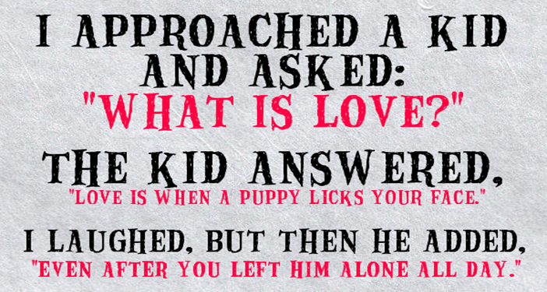
The Beatles had It Almost Right
All You Need Is Love…
“Agape Love”
This is the Catalyst that WILL …
…Begin to HEAL this Nation

Slide 16


Slide 17

AGAPE
Never Fails
No Excuses!!

Slide 19

Repeat
These are the 2 Most Important Hours of My Week – Help Me to Cherish Them
I Am Here Today to Worship
Not to Be Entertained
I Am Singing to An Audience of One
Accept My Worship Oh Lord!

Slide 20

Repeat
I Lift My Offering to You
Let It Please You Oh Lord
This is My Seed
Although It Leaves My Hand
It will Never Leave My Life
You Will Multiply It!
Accept My Seed Oh Lord!

