Slide 1


Slide 2

Repeat
These are the 2 Most Important Hours of My Week – Help Me to Cherish Them
I Am Here Today to Worship
Not to Be Entertained
I Am Singing to An Audience of One
Accept My Worship Oh Lord!

Slide 3

Repeat
I Lift My Offering to You
Let It Please You Oh Lord
This is My Seed
Although It Leaves My Hand
It will Never Leave My Life
You Will Multiply It!
Accept My Seed Oh Lord!

Slide 5

Edward Christian Church
February 23, 2025
“No Excuse”
Valentine pt2

Slide 6

10. "You know you're the only one for me!"
9. "Do you come here often?"
8. "Trust me, this was meant to be!"
7. "Look around, baby. All the other guys around here are animals!"
6. "I already feel like you're a part of me!"
5. "Honey, you were made for me!"
4. "Why don't you come over to my place and we can name some animals?"
3. "You're the girl of my dreams!" (Gen. 2:21)
2. "I like a girl who doesn't mind being ribbed!"
And the number one pick up line from Adam is:
"You're the apple of my eye!" *

Slide 7

Misrepresented
Misunderstood
Used
As An Excuse
Over-Used
Under-Used

Slide 8

Types of Love in Bible
“Eros" Love arises from passion, sexual attraction
It is the love (passion) of a man for a woman
  It Gives and Expects to Receive
“Storge" Love arises from affection of a family
Love and natural affection between parent/ child
  It Gives and Expects to Receive
“Phileo" or “Philadelphia" Love of deep affection/
feelings toward those very near your heart
  It Gives and Expects to Receive

Slide 9

Types of Love in Bible
“Eros" - “Storge" - “Phileo"
    All Give and Expect to Receive
“Agape" Love
Sacrificial Love that Does Well No Matter…
…the Circumstance or Cost to Self
It Demonstrates Kindness, Benevolence
…even in Midst of Stormy Situations.
Cares, Gives, / Works for Another’s Good
  It Gives Without Expecting to Receive

Slide 10

Agape
(1-3) …Is Not Measured by
  Words
  Intentions
  Actions
But By…
  Attitude…
  …In Action
  …No Excuses

Slide 11

John 3:16
Tells us of God’s Love…
Expressed…
...through the Life of Christ
“No Excuses”
1 Corinthians 13:4-13
Tells us of God’s Love…
Exemplified…
…through the Life of a Believer
“No Excuses”

Slide 12
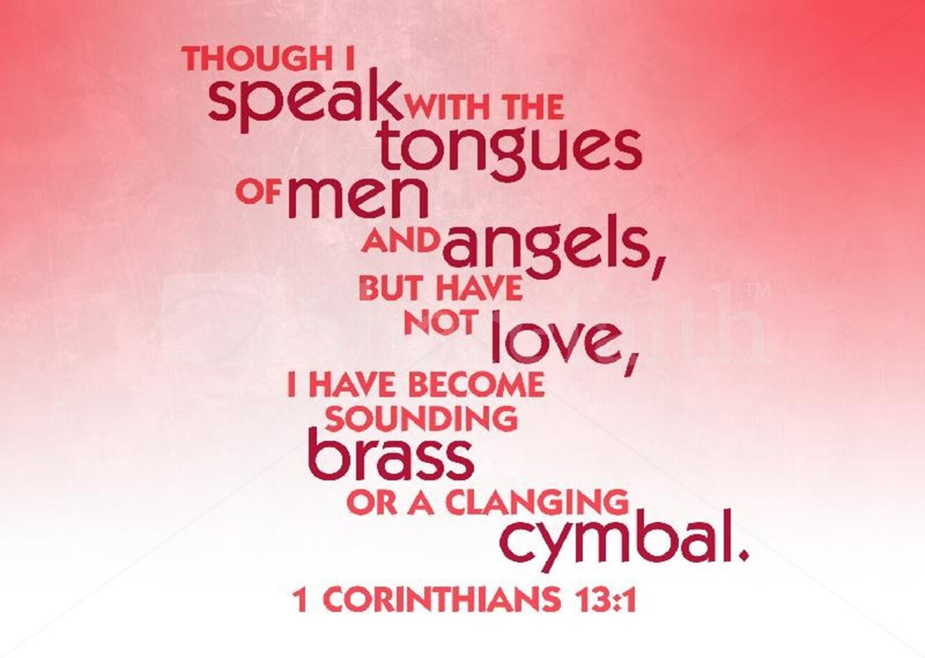
Characteristics of Agape
Love is Patient
“long” and “tempered”
  “power to avenge self but will not”
  “endure difficult people w-out losing love for them”
Love is Kind
“To show oneself useful”
  “Taking patience one step further”

Slide 13

Characteristics of Agape
Love Knows No Envy
“to boil”
  “what’s in it for me -it’s all about me”
Love is Not Boastful
“play the braggart”
  “boasting is playing a part”
  “Not Just Feelings but Actions”

Slide 14

Characteristics of Agape
Love is Not Proud
  “puffs up-to inflate”
Love is Not Rude
“unshapely”
  “not pretty to look at”

Slide 15
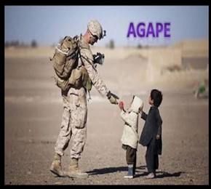
Characteristics of Agape
Love is Not Self-Seeking
  “worship yourself”
Love is Not Easily Angered
  “exasperate -to sharpen alongside”
  the Opposite of Patience

Slide 16

Characteristics of Agape
Love Keeps No Record of Wrongs
  “dwelling on someone else as evil”
Love Does Not Delight in Evil
  “be happy when an injustice occurs”
Love Rejoices with the Truth
  “to sympathize with gladness”
Love Always Protects
  “to roof over”

Slide 17

Characteristics of Agape
1 Cor 13:13, “And now abideth Faith, Hope, Charity,
these three; but the greatest of these is charity”
Charity= Love (Agape)
All 3 are Import to Spiritual Life…
…But Love is the Driving Force
…Love Brings
          Life
          Passion
          Purpose

Slide 18






