Slide 1


Slide 2

Repeat
These are the 2 Most Important Hours of My Week – Help Me to Cherish Them
I Am Here Today to Worship
Not to Be Entertained
I Am Singing to An Audience of One
Accept My Worship Oh Lord!

Slide 3

Repeat
I Lift My Offering to You
Let It Please You Oh Lord
This is My Seed
Although It Leaves My Hand
It will Never Leave My Life
You Will Multiply It!
Accept My Seed Oh Lord!

Slide 5
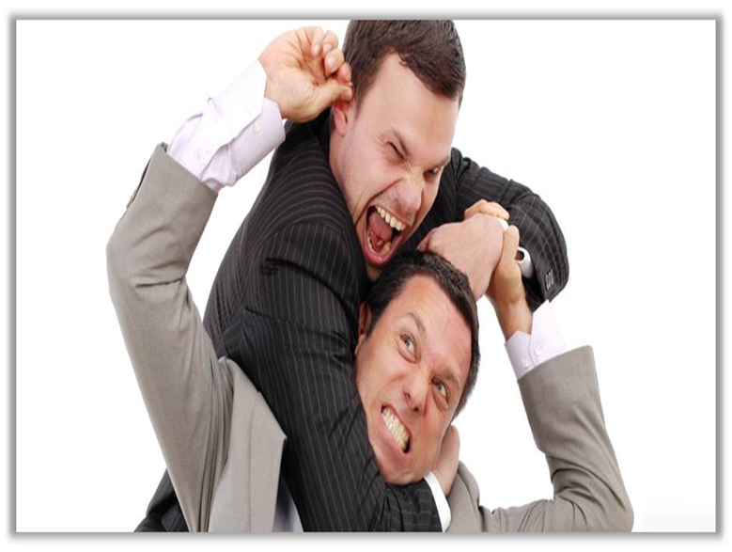

Dealing With Sandpaper People Pt 1
March 9, 2025
Edward Church
Philippians 2:3-4

Slide 6
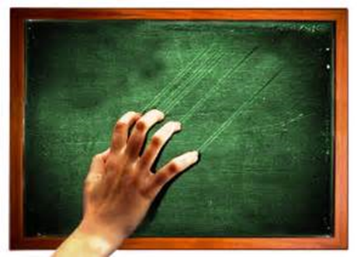
How Many Know People Who… …Remind You of This?
We All Have Them…
…in Our
Past
Present
Future
Can’t Always Avoid…
..but Can Learn How to Handle

Slide 7

All of Us Can Be Grumpy & Difficult to Deal With
From Time to Time We Will…
…Encounter Folks Who Behave in the Same Way, or Worse
When You to Deal With Sandpaper People (And You Will)…
…The Following Tips Should Help:

Slide 8

Sandpaper People Come in Two Categories Difficult and Toxic
Difficult
Believe They Are Right
Have a Hard Time…
…Listening to Others
Calloused to Their Ways
Hard to Change
Usually Don’t Know
Can Turn Toxic
Toxic
Believe They Are Right
Have a Hard Time…
…Listening to Others
Controlling in Their Ways
Seek to Change You
They Know
Are Also Difficult
Proverbs 14:12 (AMP) There is a way which seems right to a man and appears straight before him, but at the end of it is the way of death

Slide 9

Realize
Sandpaper People Are a Part of Life
You Can’t Always Avoid them
If You Don’t Deal w- Them Correctly
They Will Sap Your Energy
Weigh You Down
But Dealt With Correctly
Both Will Be Bettered

Slide 10
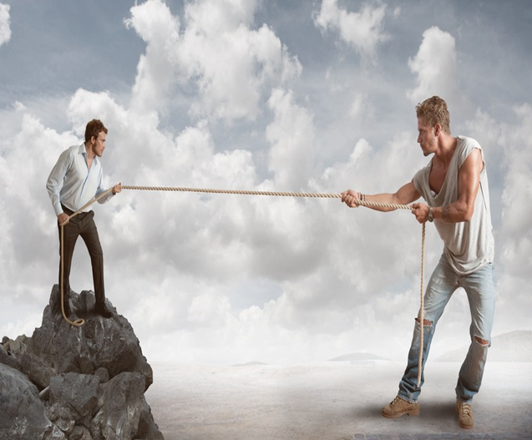
Do Make Sure You’re Not the One Sanding
The Problems May Have Their Origin Within Your Own Heart
If So, Fix Yourself First
Philippians 2:3-4
Let nothing be done through selfish ambition or conceit, but in lowliness of mind let each esteem others better than himself. 4Let each of you look out not only for his own interests, but also for the interests of others.
³ Don't push your way to the front; don't sweet-talk your way to the top. Put yourself aside, and help others get ahead. ⁴ Don't be obsessed with getting your own advantage. Forget yourselves long enough to lend a helping hand. Phil 2:3-4 (MSG)

Slide 11

Don’t Try to Change the Other Person
People Change When THEY Want To…
…Not When YOU Want Them To.
We Don’t Don’t How to Break Them…
…Where to Break Them
…Or How Much
…This is God’s Job
"For it is God which worketh in you both to will and to do of His good pleasure" -Philippians 2:13
Consider This:
They May Be God’s Sand Paper
God Could Be Changing You
Philippians 2:13 (AMP) ¹³ [Not in your own strength] for it is God Who is all the while effectually at work in you [energizing and creating in you the power and desire], both to will and to work for His good pleasure and satisfaction and delight.

Slide 12


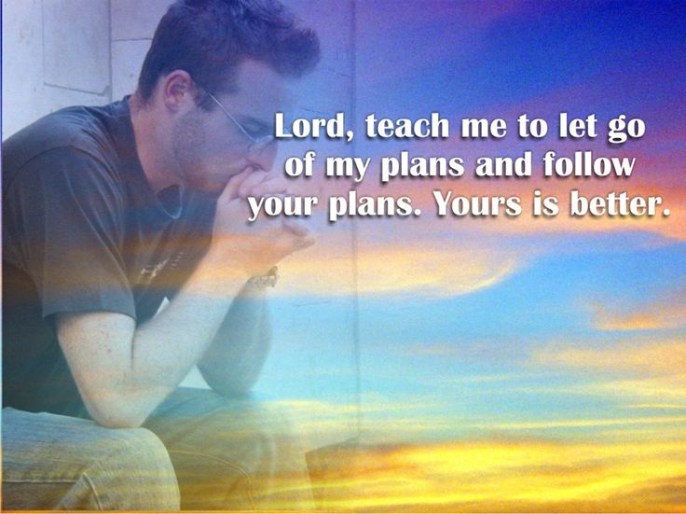
Jeremiah 29:11 (MSG) ¹¹ I know what I'm doing. I have it all planned out—plans to take care of you, not abandon you, plans to give you the future you hope for.

Slide 14
Jokes
It's been a strange day! First, I found a hat full of money on the sidewalk.
Then I was chased by an angry man with a guitar.
You never appreciate what you have til it’s gone…
Toilet paper is a good example

