Slide 1


Slide 2

Repeat
These Are the 2 Most Significant Hours
of My Week
– Assist Me in Treasuring Them
I Am Present Today to Praise
Not for Entertainment
I Am Singing to an Audience of One
Receive My Worship, Oh Lord!

Slide 3

Repeat
I Lift My Offering to You
Let It Please You Oh Lord
This is My Seed
Although It Leaves My Hand
It will Never Leave My Life
You Will Multiply It!
Accept My Seed Oh Lord!

Slide 5
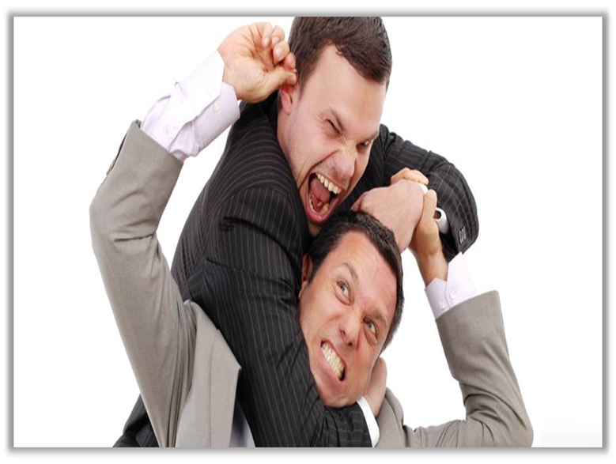

Dealing With Difficult People Pt 2
May 16, 2025
Edward Church
The “Don’ts”
Philippians 2:3-4

Slide 6

How Many Know People Who… …Remind You of This?
We All Have Them…
…in Our
Past
Present
Future
Can’t Always Avoid…
..but Can Learn How to Handle

Slide 7

All of Us Can Be Grumpy & Difficult to Deal With
From Time to Time We Will…
…Encounter Folks Who Behave in the Same Way, or Worse
When You to Deal With Difficult People (And You Will)…
…The Following Tips Should Help:

Slide 8
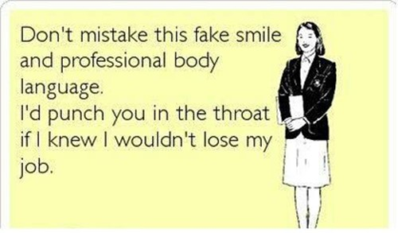
Realize
Difficult People Are a Part of Life
You Can’t Always Avoid them
If You Don’t Deal w- Them Correctly
They Will Sap Your Energy
Weigh You Down
But Dealt With Correctly
Both Will Be Bettered

Slide 9

Check Self - Don’t Be the One Being Difficult
Don’t Try to Change the Other Person
Philippians 2:3-4
Let nothing be done through selfish ambition or conceit, but in lowliness of mind let each esteem others better than himself. 4 Let each of you look out not only for his own interests, but also for the interests of others.

Slide 10

Don’t Lecture
Lectures Can Turn Into Nagging; Building Walls Instead of Bridges
Since Nagging Usually Creates More Problems Than It Solves…
…Save Your Breath.
Prov 15:1, A soft answer turns away wrath, But a harsh word stirs up anger.
Prov 21:9, Better to dwell in a corner of a housetop, Than in a house shared with a contentious woman (or man)

Slide 11
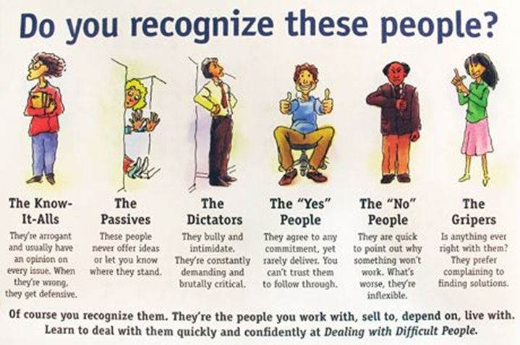
Do Not Protect Them from Consequences
When You Protect Other People From Their Consequences…
You’re Doing Them A Disservice
You’re Becoming An Enabler.
Most People Don’t Learn New Behaviors Until…
…The Old Behaviors Stop Working,
Hebrews 12:5-6
5 And you have forgotten the exhortation which speaks to you as to sons: “My son, do not despise the chastening of the LORD, Nor be discouraged when you are rebuked by Him; 6 For whom the LORD loves He chastens, And scourges every son whom He receives.”

Slide 12
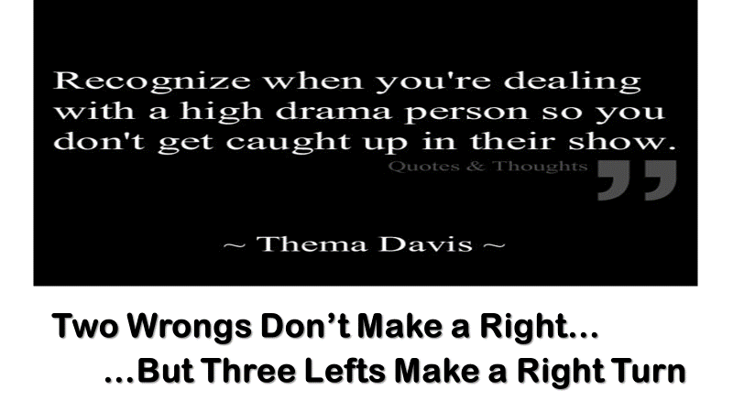
Don’t Allow Yourself to Become Caught Up in the Other Person’s Emotional Outbursts
If Someone is Ranting, or Worse, You Have the Right to Get Up/ Leave.
Remember:
Emotions are Highly Contagious, You Could Become Angry, Too.
Make the Conscious Effort to Remain Calm (Proverbs 22:24, 25)
24Make no friendship with an angry man, And with a furious man do not go, 25Lest you learn his ways And set a snare for your soul.

Slide 13
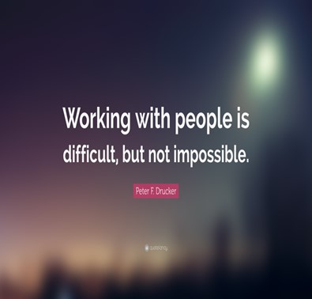
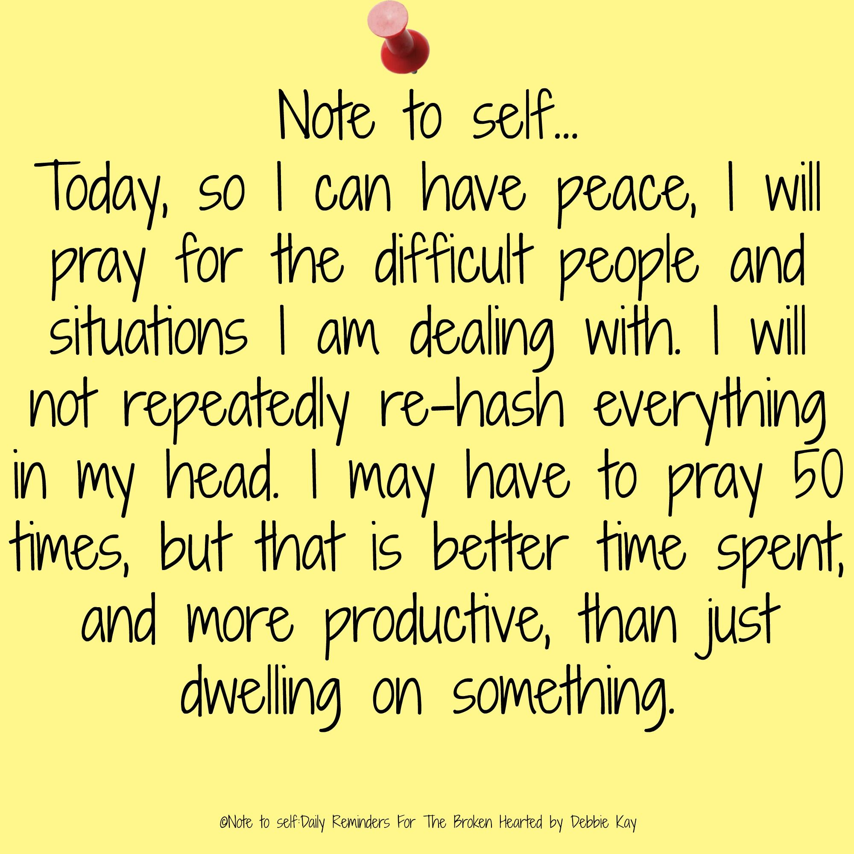

Slide 16
My husband works as a service technician for a large exterminating company.
One of the rules of the company is that he has to confirm each appointment by phone the night before his service call to that household.
One evening he made such a call, and when a man answered the phone, he said, "Hi, this is Gary from A to Z Pest Control Company. Your wife phoned us."
There was a long silence, and then my husband heard the man on the other end say, "Honey, it's for you....someone wants to talk to you about your relatives."

