Slide 1


Slide 2

Repeat
These Are the 2 Most Significant Hours
of My Week
Assist Me in Treasuring Them
I Am Present Today to Praise
Not for Entertainment
I Am Singing to an Audience of One
Receive My Worship, Oh Lord!

Slide 3
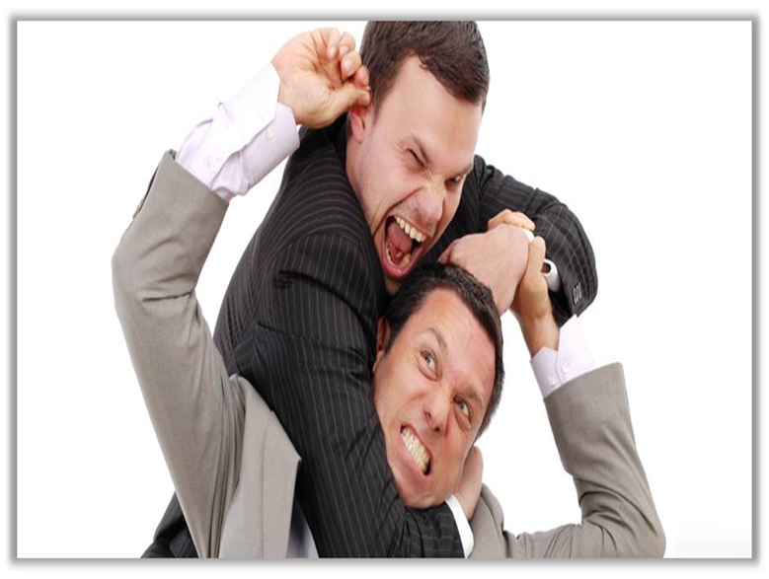

Dealing With SandPaper People Pt 3
March 23, 2025
Edward Church
The “Do’s”
Philippians 2:3-4

Slide 4
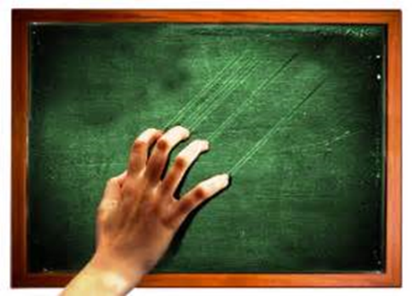
How Many Know People Who… …Remind You of This?
We All Have Them…
…in Our
Past
Present
Future
Can’t Always Avoid…
..but Can Learn How to Handle

Slide 5

All of Us Can Be Grumpy & Difficult to Deal With
From Time to Time We Will…
…Encounter Folks Who Behave in the Same Way, or Worse
When You to Deal With Difficult People (And You Will)…
…The Following Tips Should Help:

Slide 6
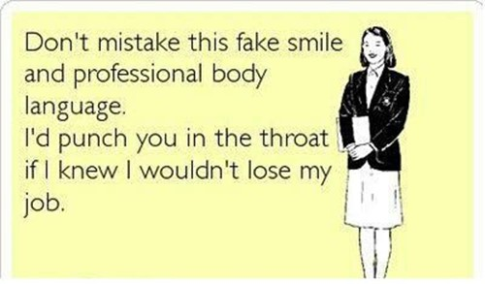
Realize
Difficult People Are a Part of Life
You Can’t Always Avoid them
If You Don’t Deal w- Them Correctly
They Will Sap Your Energy
Weigh You Down
But Dealt With Correctly
Both Will Be Bettered

Slide 7

Check Self - Don’t Be the One Being Difficult
Don’t Try to Change the Other Person
Don’t Lecture
Do Not Protect Them from Consequences
Don’t Allow Yourself to Become Caught Up in the Other Person’s Emotional Outbursts

Slide 8
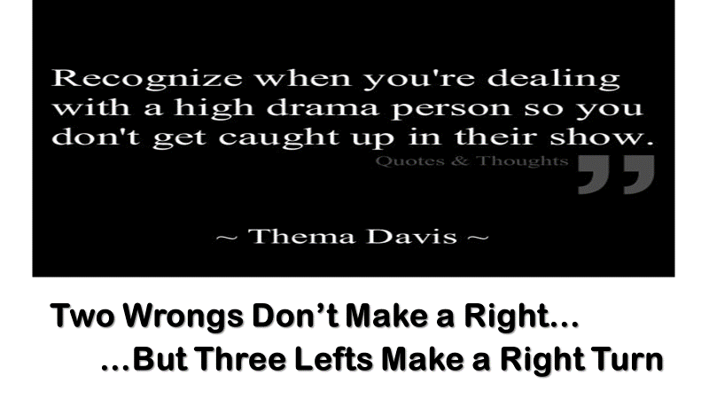
Don’t Allow Yourself to Become Caught Up in the Other Person’s Emotional Outbursts
If Someone is Ranting, or Worse, You Have the Right to Get Up/ Leave.
Remember:
Emotions are Highly Contagious, You Could Become Angry, Too.
Make the Conscious Effort to Remain Calm (Proverbs 22:24, 25)
24Make no friendship with an angry man, And with a furious man do not go, 25Lest you learn his ways And set a snare for your soul.

Slide 9

Do Stand Up for Yourself
If You’re Being Mistreated…
Physically
Emotionally
It’s Time to Start Taking Care of Yourself.
It Doesn’t Require an Angry Outburst
But in a Calm, Mature, Resolute Manner.
For He Himself has said, “I will never leave you nor forsake you.” 6So we may boldly say: “The LORD is my helper; I will not fear. What can man do to me?” -Heb 13:5

Slide 10
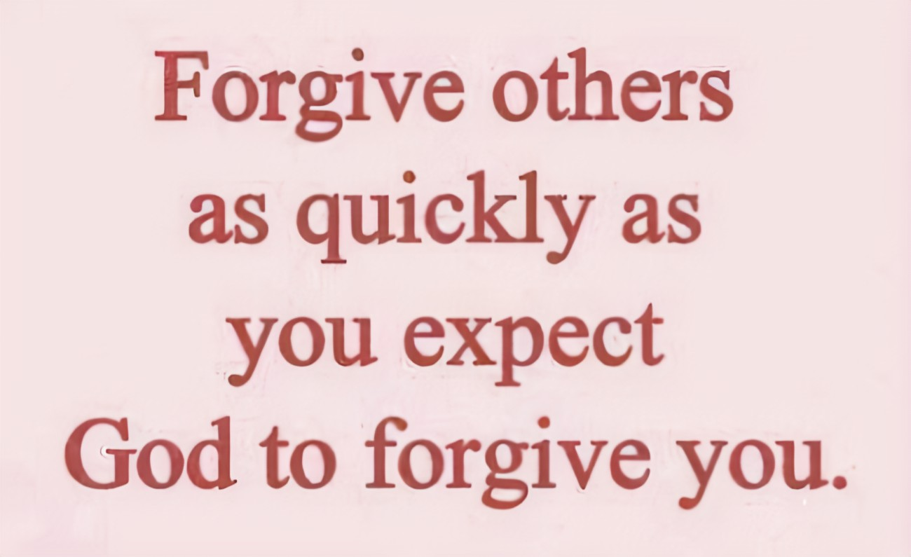
Do Forgive
If You Can’t Forgive Those Who Have Hurt You,
You’re Hurting Yourself More Than You’re Hurting Anyone Else.
Forgiveness Should Not Be Confused With Enabling
After You’ve Forgiven The Difficult Person In Your Life…
…You Are Not Compelled To Accept Continued Mistreatment
14“ For if you forgive men their trespasses, your heavenly Father will also forgive you. 15“ But if you do not forgive men their trespasses, neither will your Father forgive your trespasses. –Matt 6:14-15

Slide 11
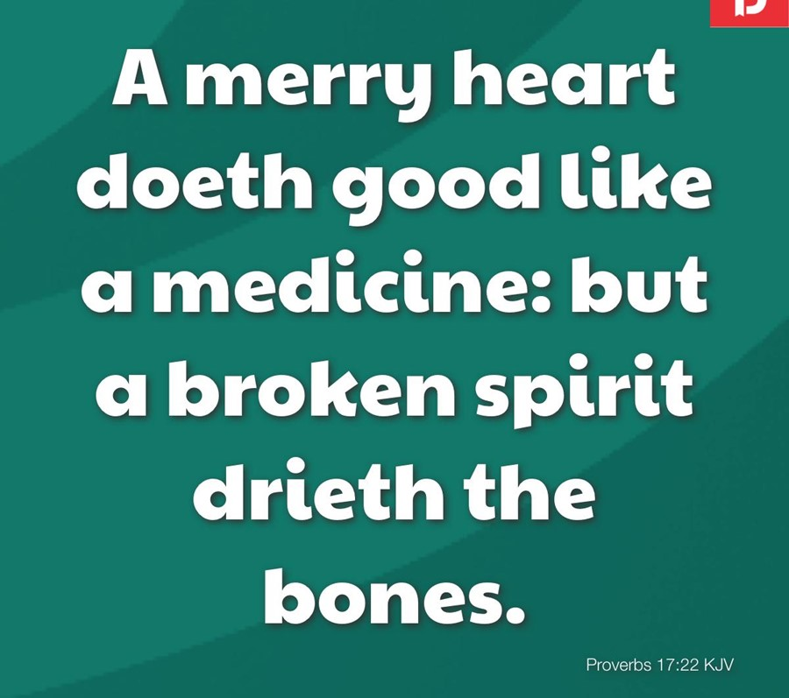
Do Learn to Laugh in the Difficult Times
Life Has a Lighter Side—Look For It…
…Especially When Times are Tough.
Laughter is medicine for the soul, so take your medicine early and often. (Proverbs 17:22) the Message
Proverbs 17:22 NLT - A cheerful heart is good medicine, but a broken spirit saps a person’s strength.
Proverbs 15:13 NLT - A glad heart makes a happy face; a broken heart crushes the spirit.
Proverbs 15:13 The Message - A cheerful heart brings a smile to
your face; a sad heart makes it hard to get through the day.

Slide 12
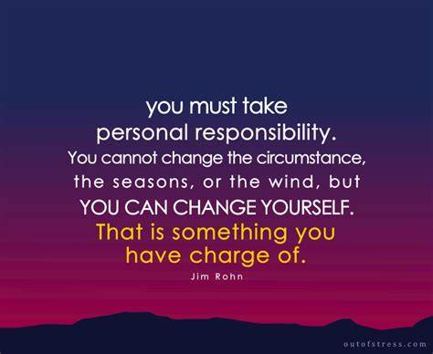
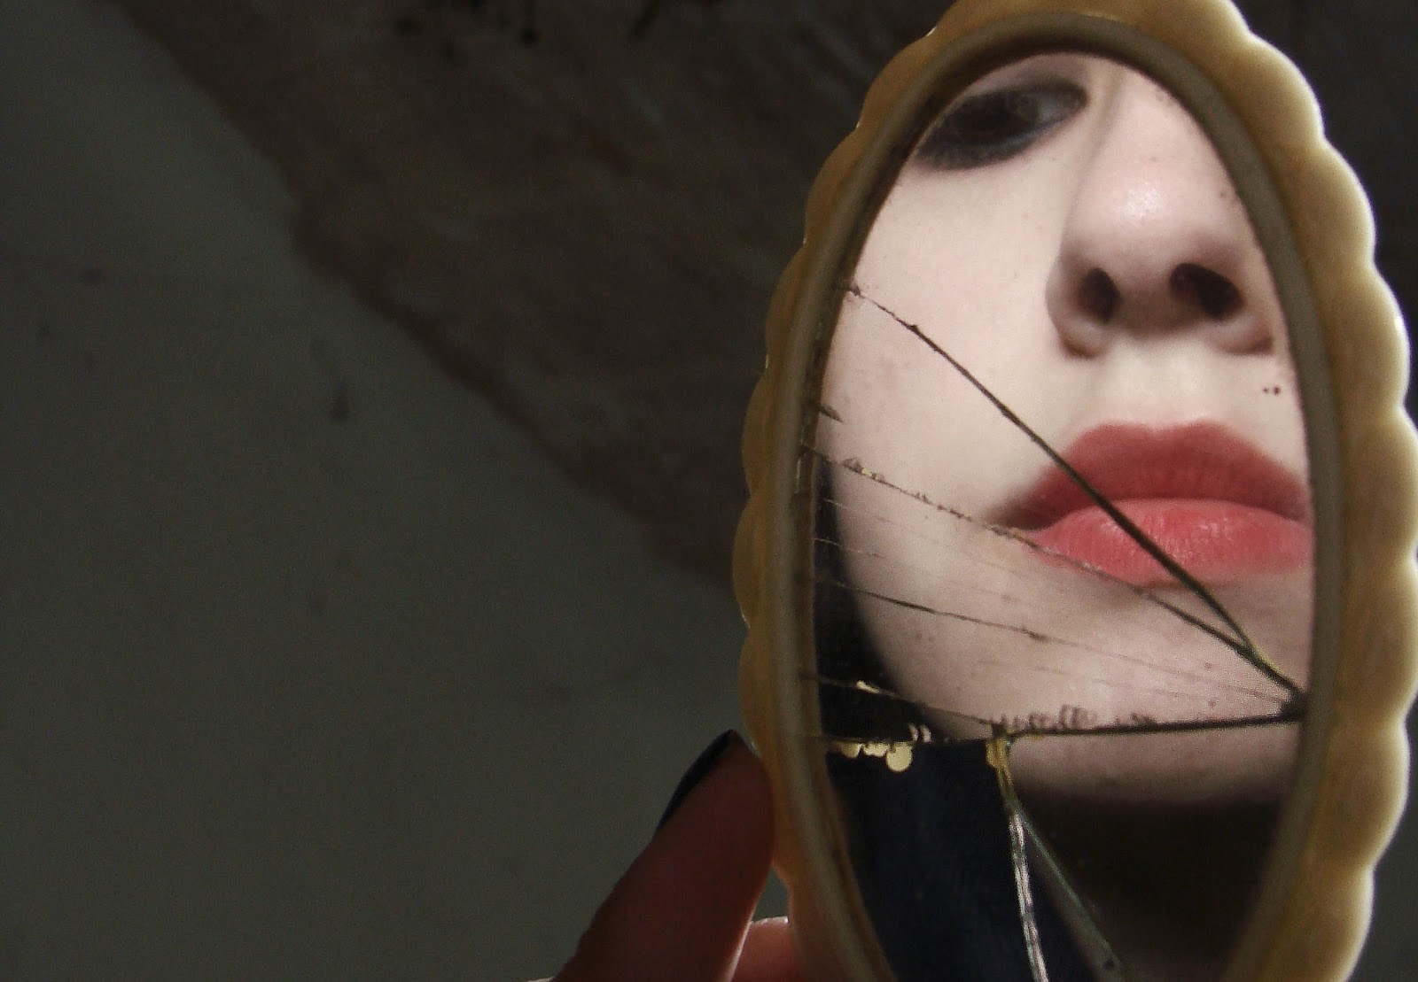
Do Accept Personal Responsibility…
Make Your Own Corner of the World Peaceful, Productive, Purposeful
If Your World Is a Little Crazy…
…Perhaps It’s Time to Consult Who You See in the Mirror.
No One Can Drive YOU Crazy
UNLESS
YOU GIVE THEM YOUR KEYS

Slide 13
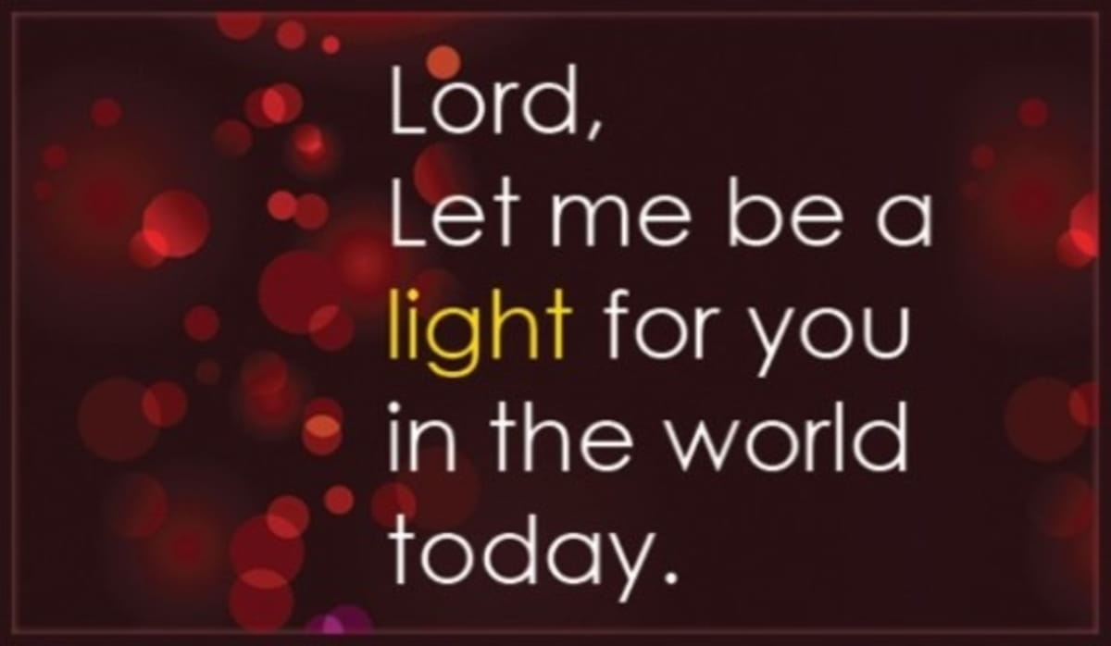
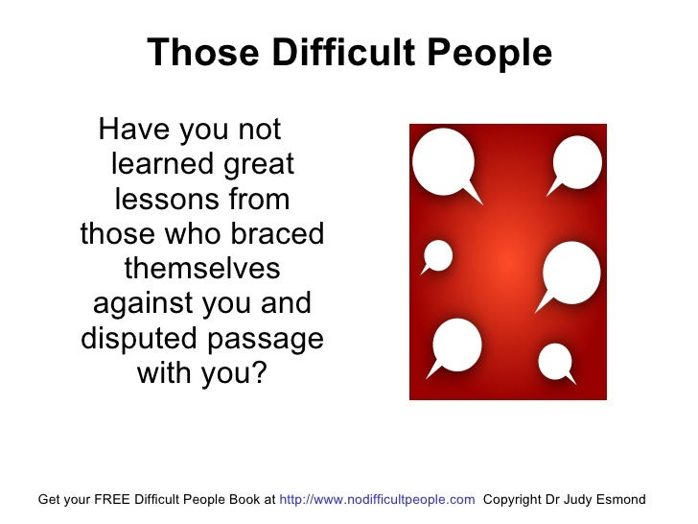

Slide 14



Slide 15
A DEA (Drug Enforcement Administration) officer stops at a ranch in Montana and talks with an old rancher. He tells the rancher, "I need to inspect your ranch for illegally grown drugs.“ The old rancher says, "Okay, but do not go in that field over there," as he points out the location. The DEA officer verbally explodes, saying, "Mister, I have the authority of the federal government with me." Reaching into his rear pants pocket, he removes his badge and proudly displays it to the farmer. "See this badge? This badge means I am allowed to go wherever I wish, on any land. No questions asked or answers given. Have I made myself clear? Do you understand?"
The old rancher nods politely, apologizes, and goes about his chores.
A short time later, the old rancher hears loud screams and sees the DEA officer running for his life, chased close behind by the rancher's prize bull. With every step, the bull is gaining ground on the officer, and it seems likely that he'll get "horned" before he reaches safety. The officer is clearly terrified. The old rancher throws down his tools, runs to the fence, and yells at the top of his lungs, "Your badge! Show him your badge!

Slide 16
My husband works as a service technician for a large exterminating company.
One of the rules of the company is that he has to confirm each appointment by phone the night before his service call to that household.
One evening he made such a call, and when a man answered the phone, he said, "Hi, this is Gary from A to Z Pest Control Company. Your wife phoned us."
There was a long silence, and then my husband heard the man on the other end say, "Honey, it's for you....someone wants to talk to you about your relatives."

Slide 17

Repeat
I Lift My Offering to You
Let It Please You Oh Lord
This is My Seed
Although It Leaves My Hand
It will Never Leave My Life
You Will Multiply It!
Accept My Seed Oh Lord!

Slide 18
Do Accept Personal Responsibility…
Make Your Own Corner of the World Peaceful, Productive, Purposeful
If Your World Is a Little Crazy…
…Perhaps It’s Time to Consult Who You See in the Mirror.

