Slide 2
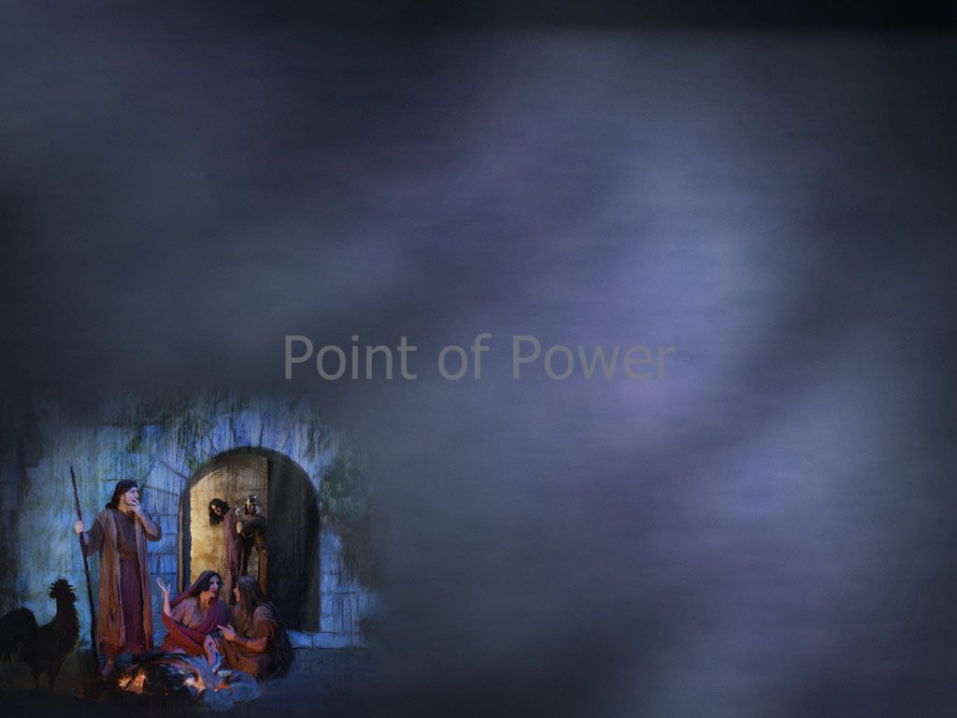
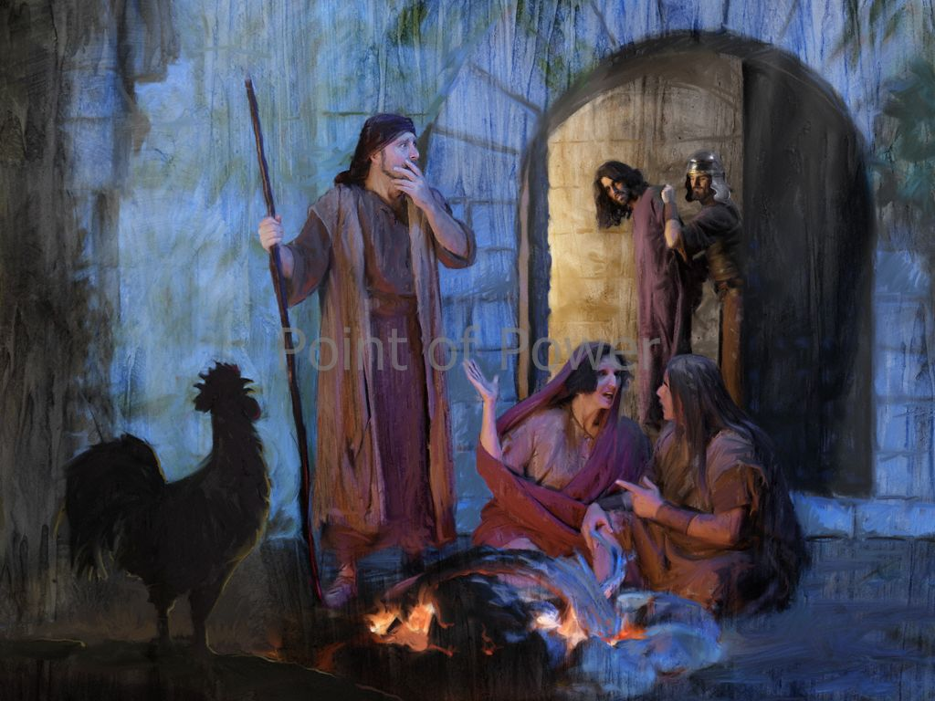
Luke 22:54-62
Edward Christian Church March 30, 2025
Help I Have Fallen…
…But I Can Get Up!!!
Pt 1

Slide 3
Have You Ever Fallen Down Spiritually…
…While Running This Race ?
…Been Tripped Up By The Devil?
Peter Did Just That…and Denied The Lord,
This Would Go Down in Peter’s Memory as
the Worst Night of His Life !
But in Spite of It All…
God Gave Him a New Start …
Peter Learned How to Benefit From Failure !

Slide 4
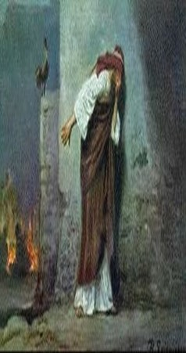
Fail … “Biblically”
Old Test-
Relinquish, Abandon, Let Go,
Cross Boundary Bet Right / Wrong
New Test-
to Drop Away, Drive Off Course
Fall Short, Be Deficient, Inefficient
Fall Powerless
Peter Experienced All This Night!

Slide 5
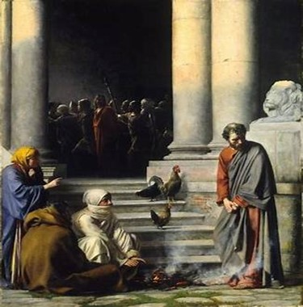
Facts about Failure
Remember- Everyone Fails
it’s Universal
Realize- Failure is Not Final
it’s One Piece of Life’s Puzzle
Recognize the Benefits of Failure
Each Failure Comes w/ a Lesson
Educates Us
Makes Us Less Judgmental
Aids in Interaction w/ Others

Slide 6
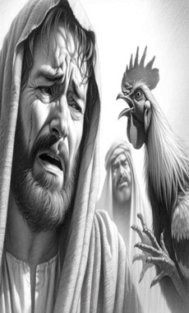
Failure Comes with a Choice
it can be
…a Hitching Post
(Fall Down/ Stay Down)
or
…a Guiding Post
(Fall Down/ Get Back Up)
Difference in…
Learning from Failure
or Losing from Failure

Slide 7
Failure Comes with a Choice
Guide Post
Take Responsibility
Learn from Mistake
Realize Failing is…
…Part of Progress
Maintain Positive Att
…Expect to Cont Fail.
Willing To Take…
…New Risks
Persevere
Hitching Post
Place Blame
Repeat Mistake
Expect Never…
…to Fail Again
Expect To Cont Fail
…Breeds Neg Att
Limited By Past
…Mistakes
Quit

Slide 8
Failure Comes with a Choice
Remember…
Failure Has More to Do with…
Your Attitude
Than
Your Circumstances

Slide 9
Failure Comes Often at the Point of our Greatest Strength (33)
That’s Why We are Usually so Disappt w/ Self
Peter’s Greatest Strength was His Courage!
a- Matt 14 - We Focus on…
…Peter Losing Focus / Sinking
We Forget…
…He Got Out of the Boat!
b- John 18:10- Peter Pulled Sword to Defend
Matt 26:69 - Afraid before a Teenage Girl…
…in the Area of His Greatest Strength!

Slide 10
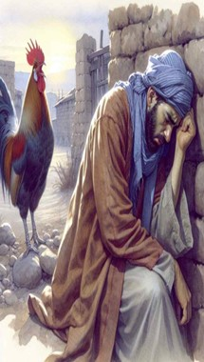
Failure Comes Often at the Point of Our Greatest Strength (33)
Tendency to Trust Too Much in Self…
…Produces Over-Confidence
I Cor. 10:12,“let him that thinketh he standeth..
…take heed lest he fall”
Prov. 16:18,“pride goes before destruction”
But Fully Depending on the Lord…
…Produces God-Confidence
II Cor. 12:10,“when I am weak, them am I strong!”

Slide 11
The Result of God-Confidence…
Proverbs 24:16 (KJV) For a just man falleth seven times, and riseth up again: but the wicked shall fall into mischief.
Just (to mount up; Resurrected)
Falleth (to be trampled down)
Seven Times (complete –utterly)
Riseth (to get back up)
Wicked (ungodly…without profit; worthless)
Shall Fall (totter, waver, weak in the knees)
Mischief (exceeding great grief)

Slide 12
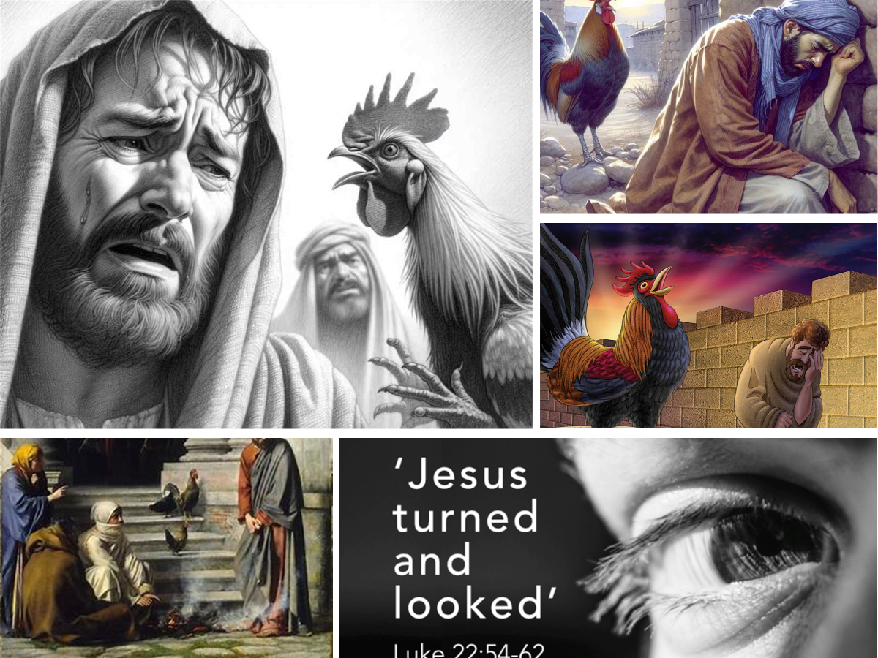
Proverbs 24:16 (KJV) ¹⁶ For a just man falleth seven times, and riseth up again: but the wicked shall fall into mischief.
Failure is Not a Person…
…it IS an Event,
Teaches More than Success
Failure is Not Final…
…Unless You Refuse
...to Get Back Up!!!
But We Don’t Have to Stay Down…
Mark 16:7, “But go.., tell his disciples and Peter…”
He Rose Up and Helped Change the World!

Slide 13
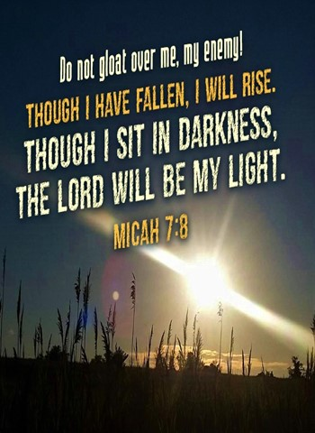
You May Be Here Today
And May Have Fallen
You Decide If It’s a
Speed Bump or a Stop Sign
Realize that God Wants You
To Get Up

Slide 16


Slide 17
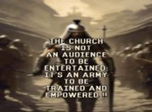
Repeat
These Are the 2 Most Significant Hours
of My Week
Assist Me in Treasuring Them
I Am Present Today to Praise
Not for Entertainment
I Am Singing to an Audience of One
Receive My Worship, Oh Lord!

Slide 18

Repeat
I Lift My Offering to You
Let It Please You Oh Lord
This is My Seed
Although It Leaves My Hand
It will Never Leave My Life
You Will Multiply It!
Accept My Seed Oh Lord!

Slide 20
A nun stepped out of the doctor's office, saying her rosary rather loudly as she hurried down the hospital corridor.
Another doctor witnessed this, and went to ask her doctor about it.
"Hey, what happened? The nun ran out of here praying her rosary as though it were the end of the world!"
"Oh, I just told her she was pregnant." The first doctor replied.
"Oh my! Is she?"
"No, but it sure cured her hiccups!"

