Slide 1


Slide 3
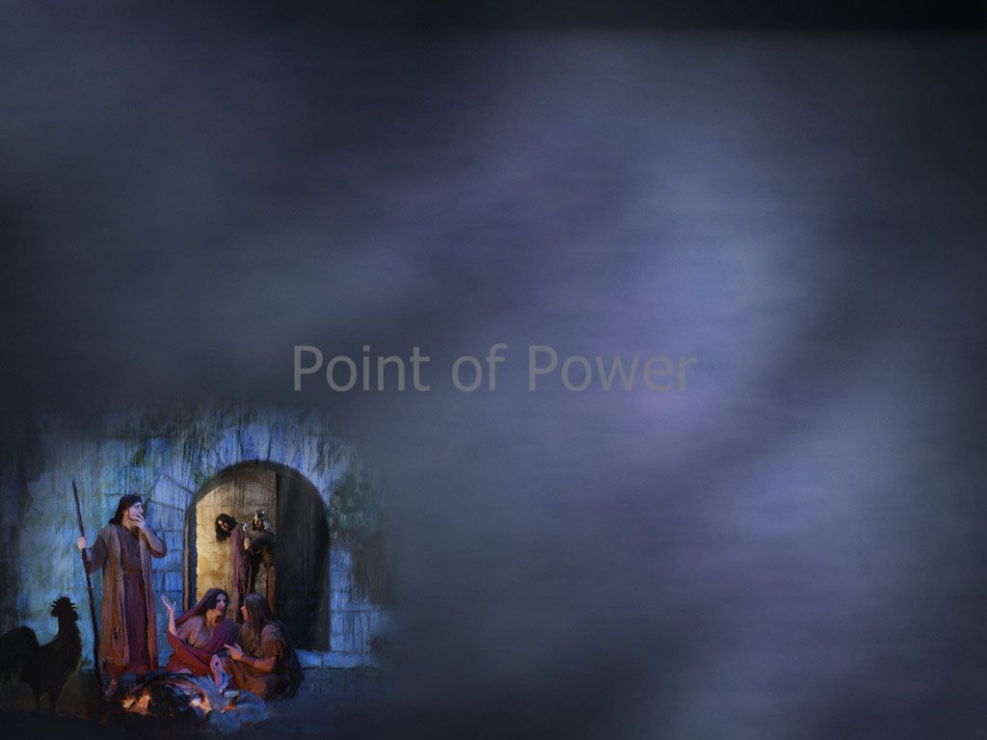
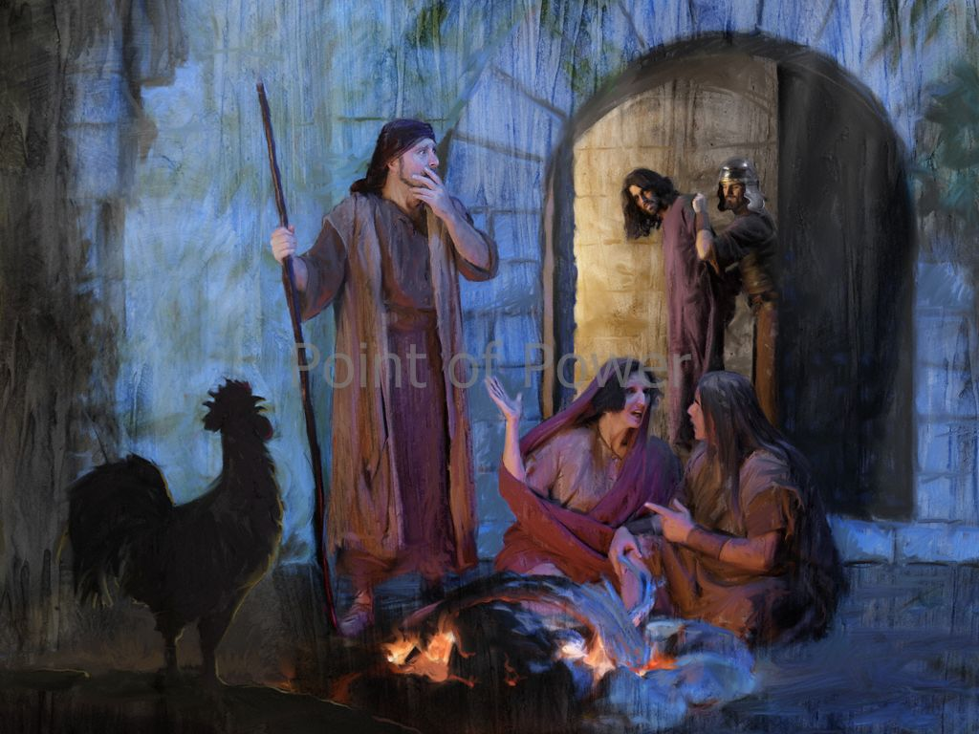
Luke 22:54-62
Edward Christian Church April 6, 2025
Help I have Fallen…
…But I Can Get Up!!!
Pt 2

Slide 4
Have You Ever Fallen Down Spiritually…
…While Running This Race ?
…Been Tripped Up By The Devil?
Peter Did Just That…and Denied The Lord,
This Would Go Down in Peter’s Memory as
the Worst Night of Life !
But in Spite of It All…
God Gave Him a New Start …
Peter Learned How to Benefit From Failure !

Slide 5
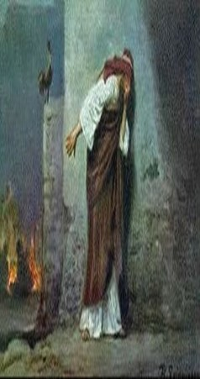
Fail … “Biblically”
Old Test-
Relinquish, Abandon, Let Go,
Cross Boundary Bet Right / Wrong
New Test-
to Drop Away, Drive Off Course
Fall Short, Be Deficient, Inefficient
Fall Powerless
Peter Experienced All This Night!

Slide 6
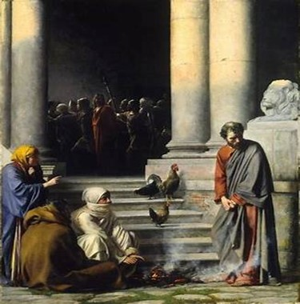
Facts about Failure
Remember that Everyone Fails
it’s Universal
Realize that Failure is Not Final
it’s One Piece of Life’s Puzzle
Recognize the Benefits of Failure
Each Failure Comes w/ a Lesson
Educates Us
Makes Us Less Judgmental
Aids in Interaction w/ Others

Slide 7
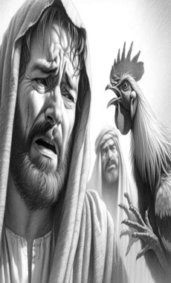
Failure Comes with a Choice
it can be
…a Hitching Post
(Fall Down/ Stay Down)
or
…a Guiding Post
(Fall Down/ Get Back Up)
Difference in…
Learning from Failure
or Lose from your Failure

Slide 8
Failure Comes with a Choice
Remember…
Failure Has More to Do with…
Your Attitude
Than
Your Circumstances

Slide 9
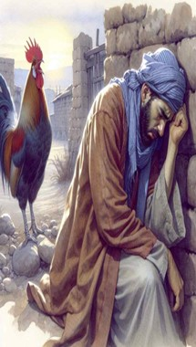
Failure Comes Often at the Point of Our Greatest Strength (33)
Tendency to Trust Too Much in Self…
…Produces Over-Confidence
I Cor. 10:12,“let him that thinketh he standeth..
…take heed lest he fall”
Prov. 16:18,“pride goes before destruction”
But Fully Depending on the Lord…
…Produces God-Confidence
II Cor. 12:10,“when I am weak, them am I strong!”

Slide 10
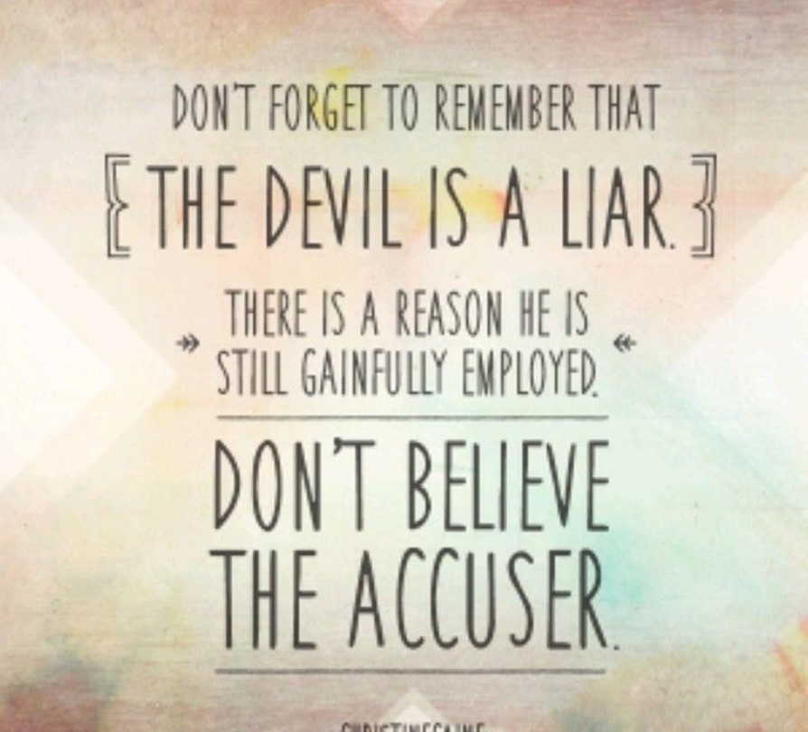
Failure comes with… …Message from Satan
Before We Sin,
…the Devil is Our Tempter;
After We Sin,
the Devil is Our Accuser

Slide 11
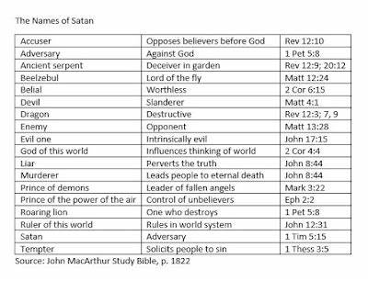
Failure comes with… …Message from Satan
16+ Different Names for Satan in Bible
Devil(diablos- > 40 x’s 2 words
dia(thru/ penetrate) +
ballo(I throw)
Satan/ Accuser(shantana-to hate / to accuse)
> 50 x’s -Rev 12:10, “accuser.. bro..”
Satan’s Goal for You to Fall Down…
And Stay Down…
We Need to Learn How to Fail Forward!

Slide 12
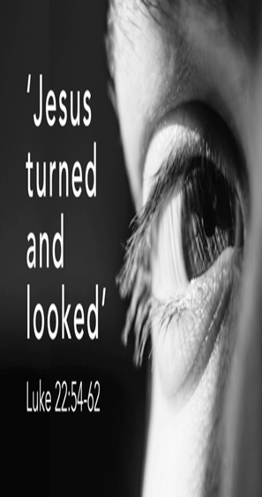
Three Comforting Truths
When We Fail, God is Still Sovereign (60)
Sovereign = “in Control”
Rooster Crowing Brought 2 Messages
(61) Peter is Out of Control
(60) God is Still in Control

Slide 13
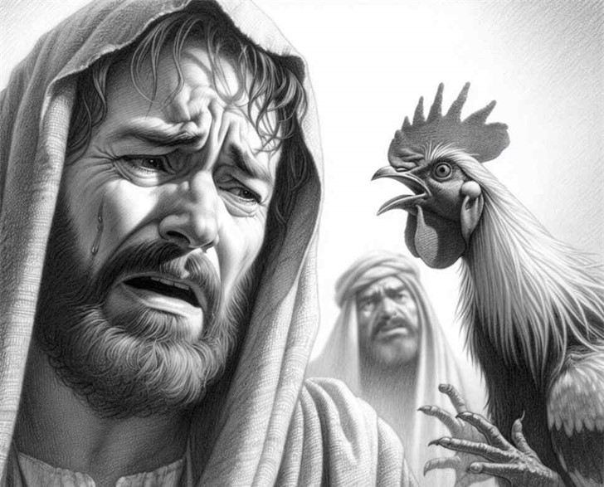
Three Comforting Truths
When We Fail, God is Still Sovereign (60)
II Timothy 2:13,“.. abideth faithful…”
Rom. 8:28 says “All Things…
…Work Together For Good”
…that Includes Our Failures!

Slide 14
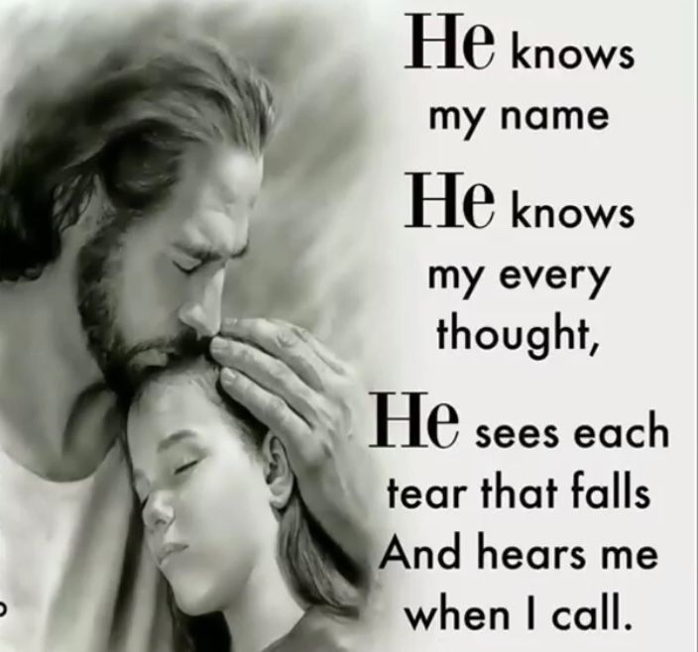
Three Comforting Truths
- “ “” “ Sympathetic / Still Watching (61)
God is Not Changing Us So He Can Love Us…
…He Loves Us Enough to Change Us
Our Failures Do Not Disappoint God
God Does Not Love Us Because…
…We Are Valuable
…We Are Valuable Because
…He Loves Us!

Slide 15
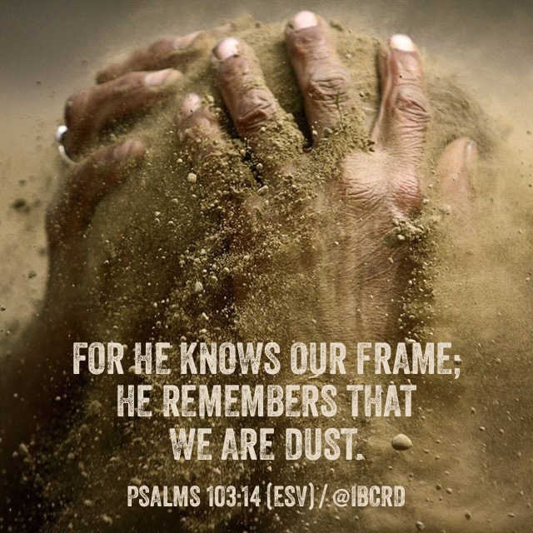
Three Comforting Truths
2- “ “” “Sympathetic and Still Watching (61)
Psalms 103:14,“For he knoweth our frame; he
remembereth that we are dust.”
He is Sympathetic…
…He is Sovereign

Slide 16
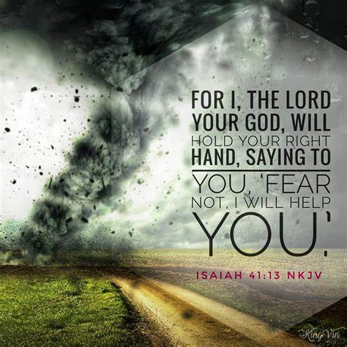
Three Comforting Truths
“ ““ We are Secure in His Promises (31-32)
1- the Pride -v31a, 33 -he thought had it together
2- the Passion -v31b -“desired”
Asked Permission…Satan Has to Ask!
Sifting Process:
Satan Wanted to Sift Peter to Condemn…
Jesus Allowed so as to Cleanse Peter.

Slide 17
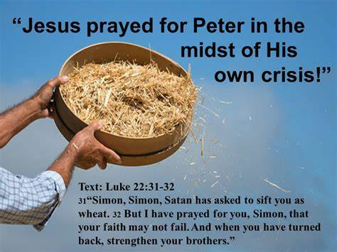
Three Comforting Truths
“ “ We are Secure in His Promises (31-32)
1- the Pride -v31a, 33
2- the Passion -v31b
3- the Prayer -v32
Salvation Doesn’t Depend Upon YOU?
(31-32)
Satan Concentrates on the Chaff = to Destroy
Jesus Concentrates on the Wheat = to Cleanse

Slide 18
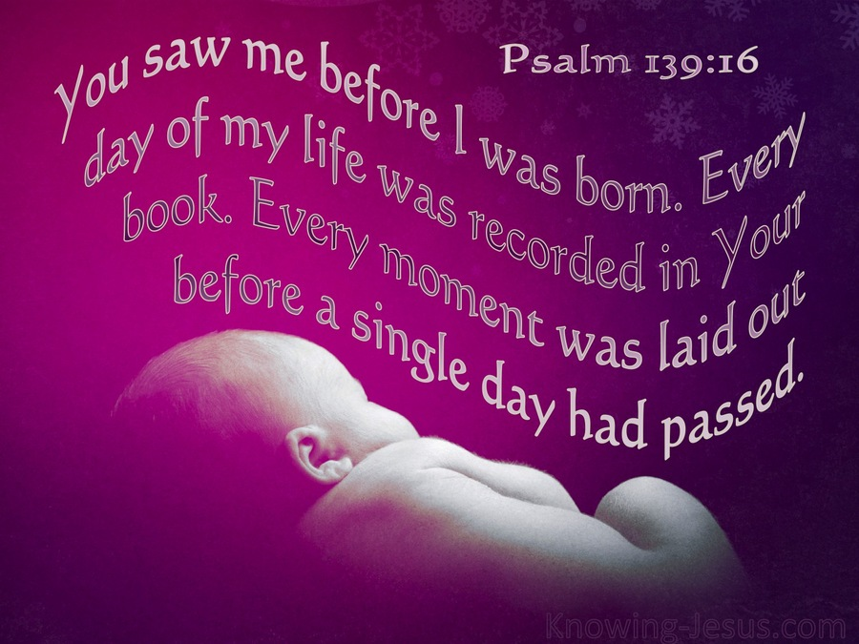
3 Things Jesus Knew About Peter:
Failure -he had Failure in his life
Faith -he had Faith
-it can pull you from Failure and
…push you to your Future
Future - he had a Future
-God was not through w/ him yet

Slide 19
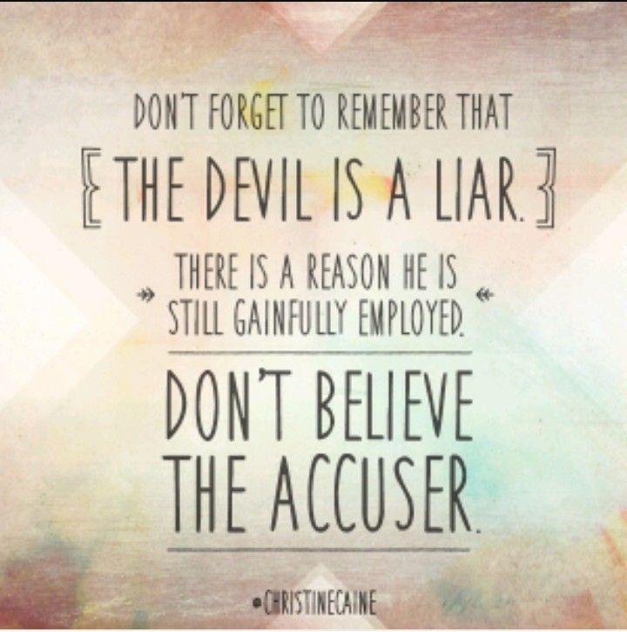
3 Things Jesus Knows About You
Your..
Failures
Faith
Future
God is Not Through w/ You Yet!

Slide 20
End Part 2

Slide 21
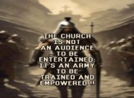
Repeat
These Are the 2 Most Significant Hours
of My Week
Assist Me in Treasuring Them
I Am Present Today to Praise
Not for Entertainment
I Am Singing to an Audience of One
Receive My Worship, Oh Lord!

Slide 22

Repeat
I Lift My Offering to You
Let It Please You Oh Lord
This is My Seed
Although It Leaves My Hand
It will Never Leave My Life
You Will Multiply It!
Accept My Seed Oh Lord!

Slide 24
Doctor: "I see you're over a month late for your appointment. Don't you know that nervous disorders require prompt and regular attention? What's your excuse?
Patient: "I was just following your orders, Doc."
Doctor: "Following my orders? What are you talking about? I gave you no such order.
Patient: "You told me to avoid people who irritate me.

Slide 26
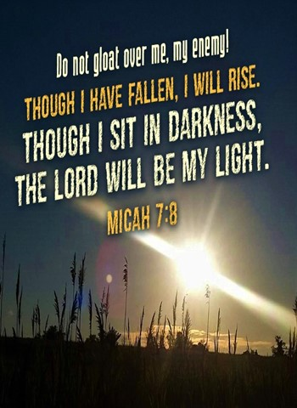
You May Be Here Today
And May Have Fallen
You Decide If It’s a
Speed Bump or a Stop Sign
Realize that God Wants You
To Get Up

Slide 27
End Part 1

