Slide 1


Slide 2
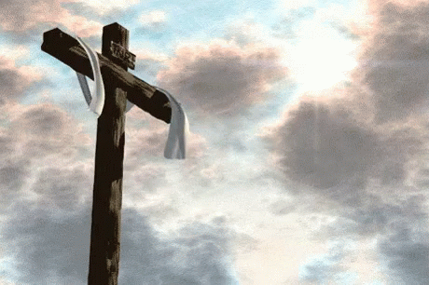

Repeat
These are the 2 Most Important Hours of My Week – Help Me to Cherish Them
I Am Here Today to Worship
Not to Be Entertained
I Am Singing to An Audience of One
Accept My Worship Oh Lord!

Slide 3

Repeat
I Lift My Offering to You
Let It Please You Oh Lord
This is My Seed
Although It Leaves My Hand
It will Never Leave My Life
You Will Multiply It!
Accept My Seed Oh Lord!

Slide 5
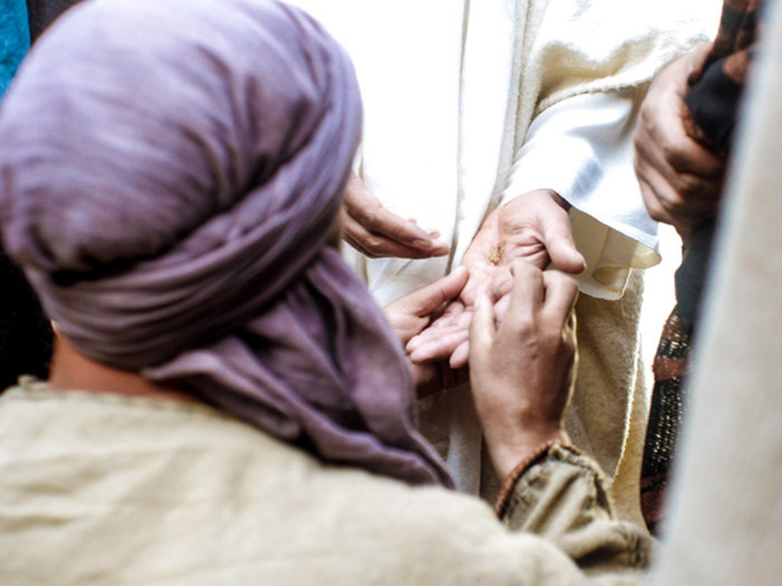

The Power of Our Wounds
Part 1
Easter 2025
John 20:19-22
Edward Christian Church
April 13, 2025

Slide 6
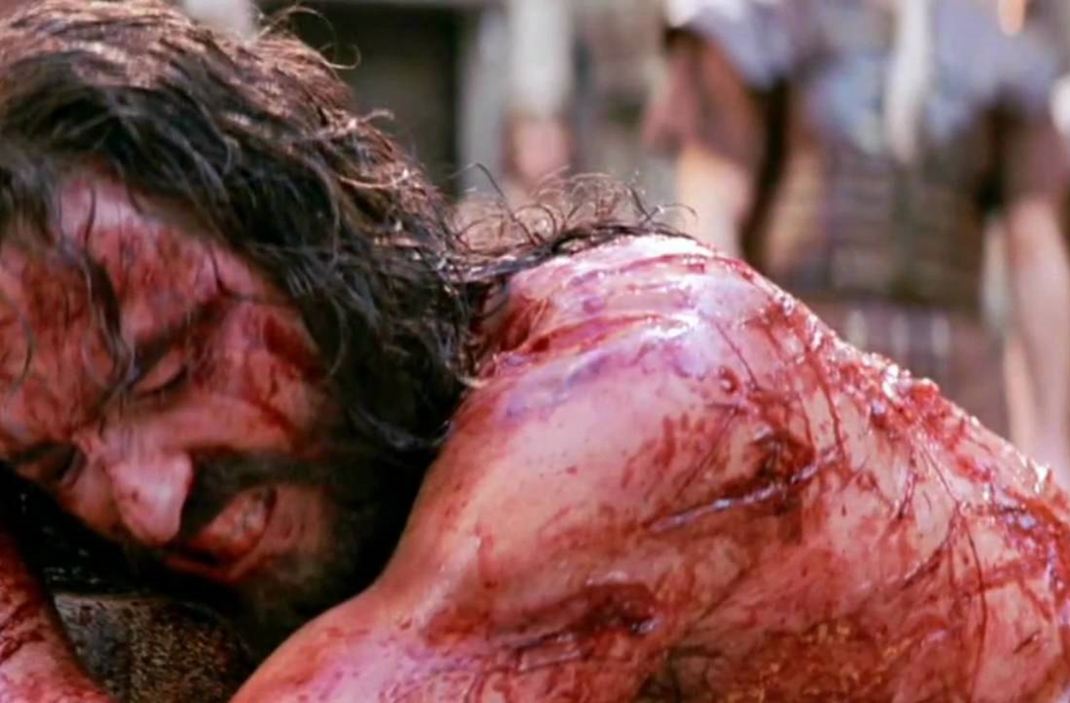
Time of Crisis
It Was Soon After the Cross …
the Crisis Was Still…
…Fresh In Their Minds
It Played Over / Over Again
The Terror Was Still Real
Their Hope Shattered
So Many Questions Left …
…Unanswered

Slide 7
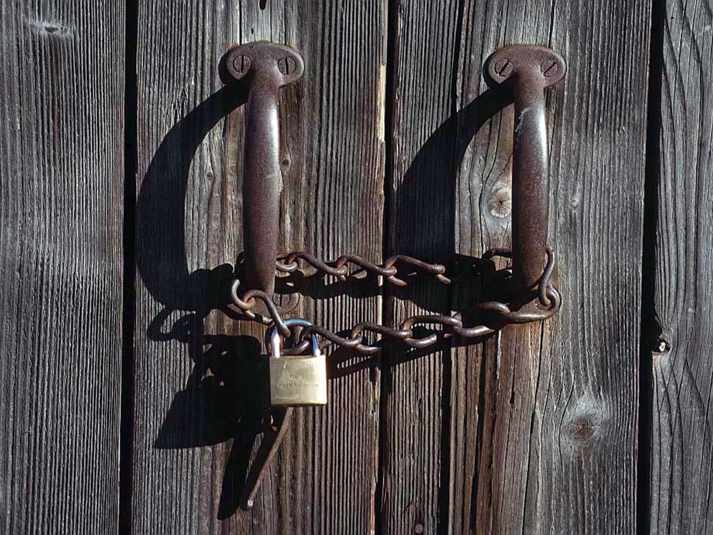
Hiding Behind Locked Doors
Their Motivating Factor…
…Fear – Phobia
Fear is Actually a Reaction…
…to What?
Confusion-
…Misunderstood His Words
Depression-
…Unmet Expectations
Desperation-
…Needed Answers

Slide 8
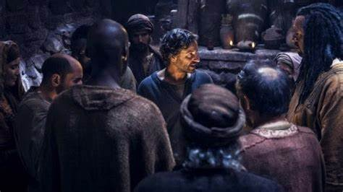
Hiding Behind Locked Doors
Faith Has to Be Active
in Order to Be Effective
They Moved from Faith…
…Attacking the Situation
…to the Situation
…Attacking Their Faith
Jesus Was About to Teach
“Valuable Lesson”

Slide 9
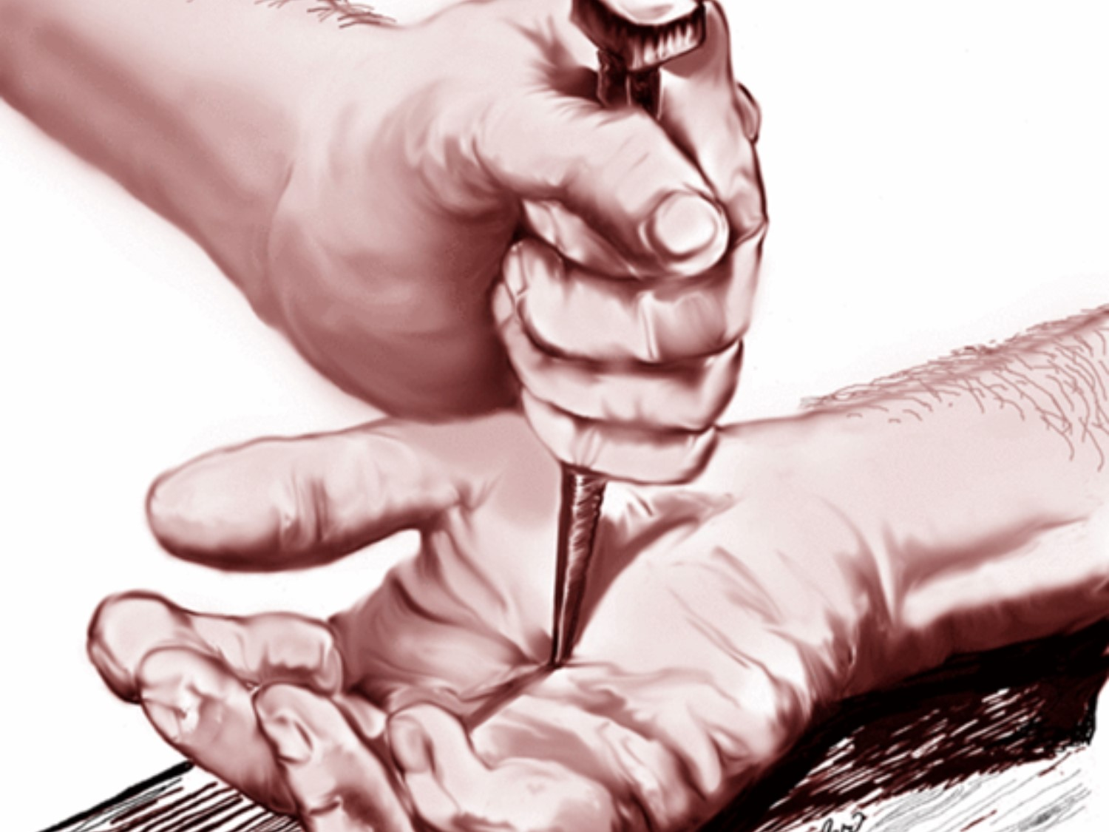
Our Wounds are Very Powerful
We Can Let Them Consume Us
And Be of Help to No One
Or
We Can Overcome…
Through the Power of God
And Help Many

Slide 10
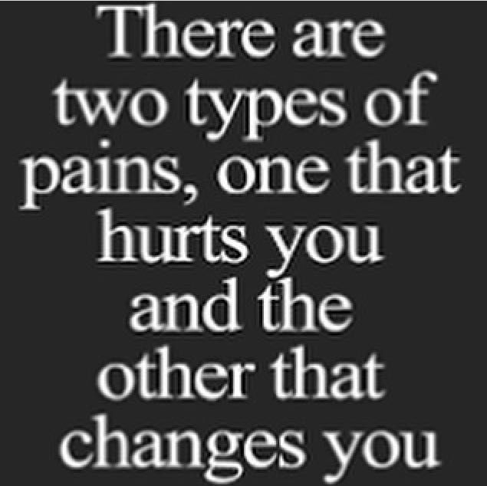
P= Powerful
A= All Experience it
I= Identify with Others
N= Never Wasted by God

Slide 11
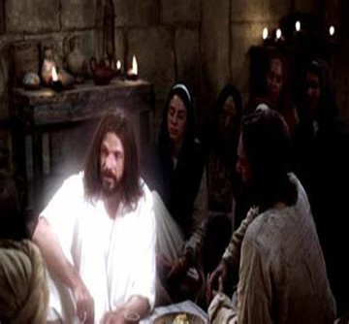
Our Wounds Propel Our Message (19)
No Peace
Limited Reach
“assembled together…”
  Direction Unsure
    Flee to Familiar
Limited Relationships
“…disciples..”
  Dependence Unsure
    Isolated
      Limit Contacts

Slide 12
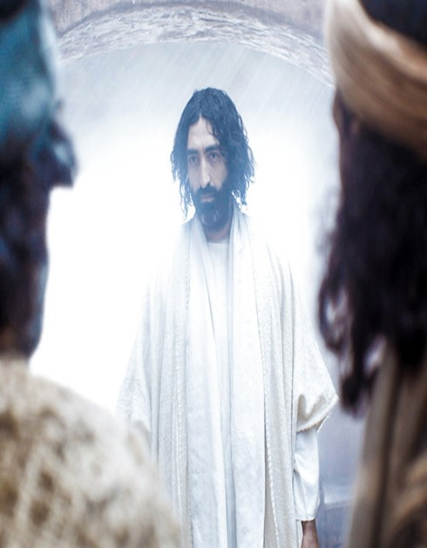

Our Wounds Propel Our Message (19)
No Peace
Limited Resources “Door shut..”
  Remove Opportunity…
…to Happen Again
Power
Beyond Barriers
“locked doors”
  Plan –let no one in
  Power –not able to stop

Slide 13
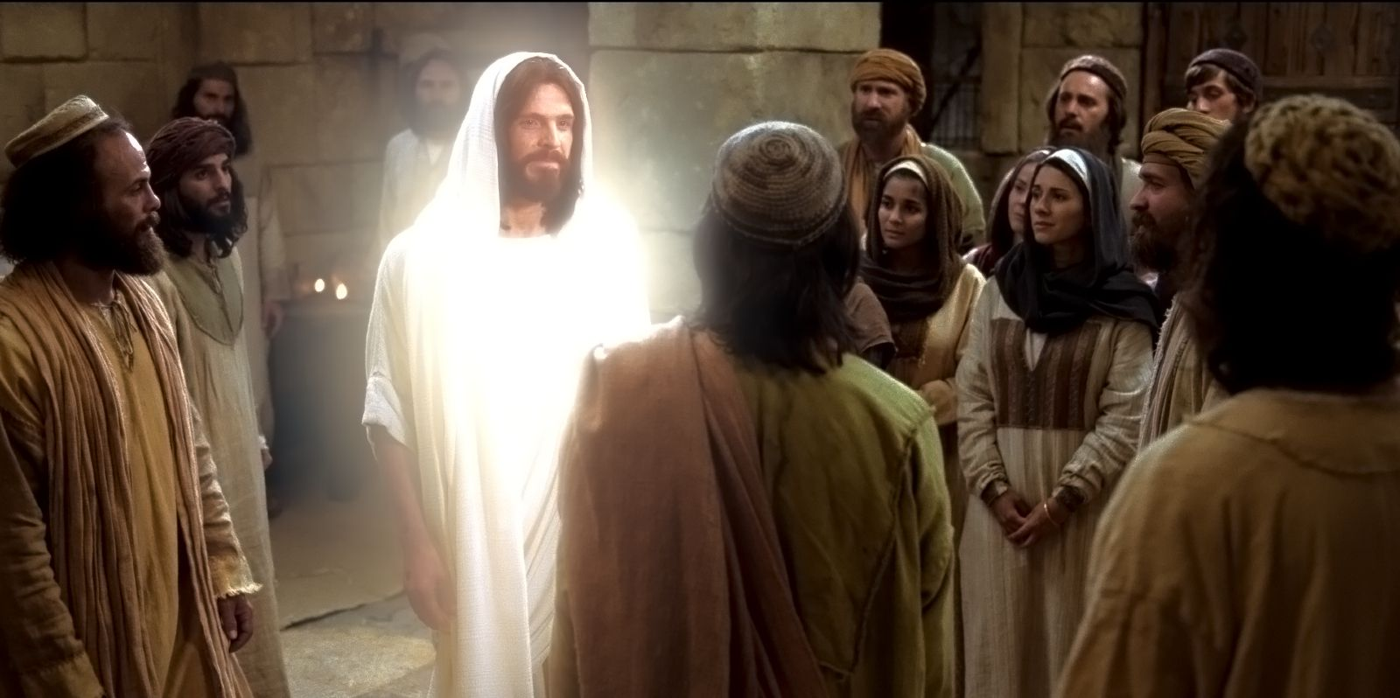
All the Walls We Build…
…All the Doors We Lock
…Can’t Lock Out the Pain
CANNOT KEEP JESUS OUT!

Slide 14

He Sympathized…
  He Came Down From Heaven
He Emphasized…
  He Carried a Cross
But He Gave Greatest Hope
  He Arose

Slide 15
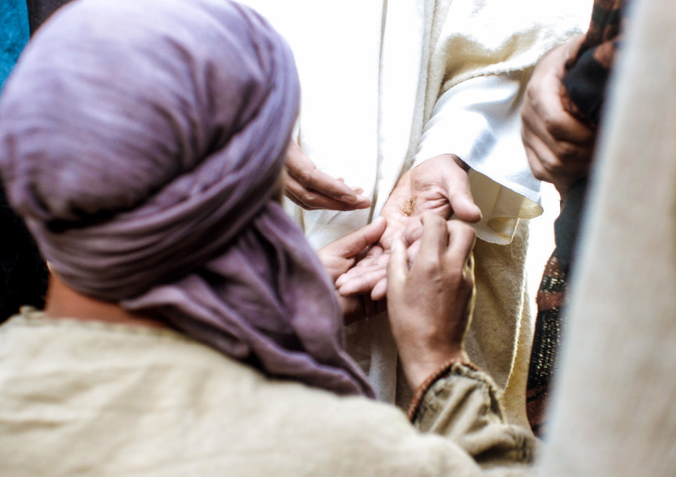
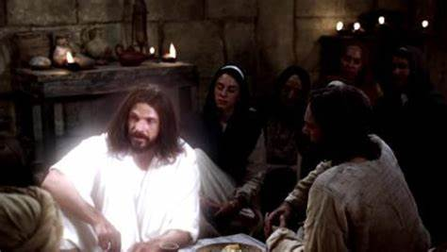


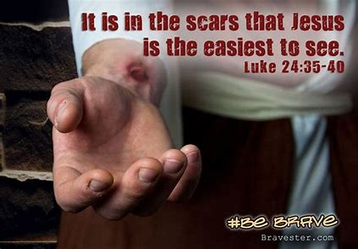
If He Can Defeat the Grave…
He Can Help You Defeat the Gravestones in You Life…

Slide 17
It was Palm Sunday but because of a sore throat, 5-year-old Bobby stayed
home from church with a baby-sitter. When the family returned home,
they were carrying several palm fronds. Bobby asked them what they were for.
'People held them over Jesus' head as he walked by,' his father told him.
'Wouldn't you know it,' Bobby fumed, 'the one Sunday I don't go and he
shows up.'

