Slide 1
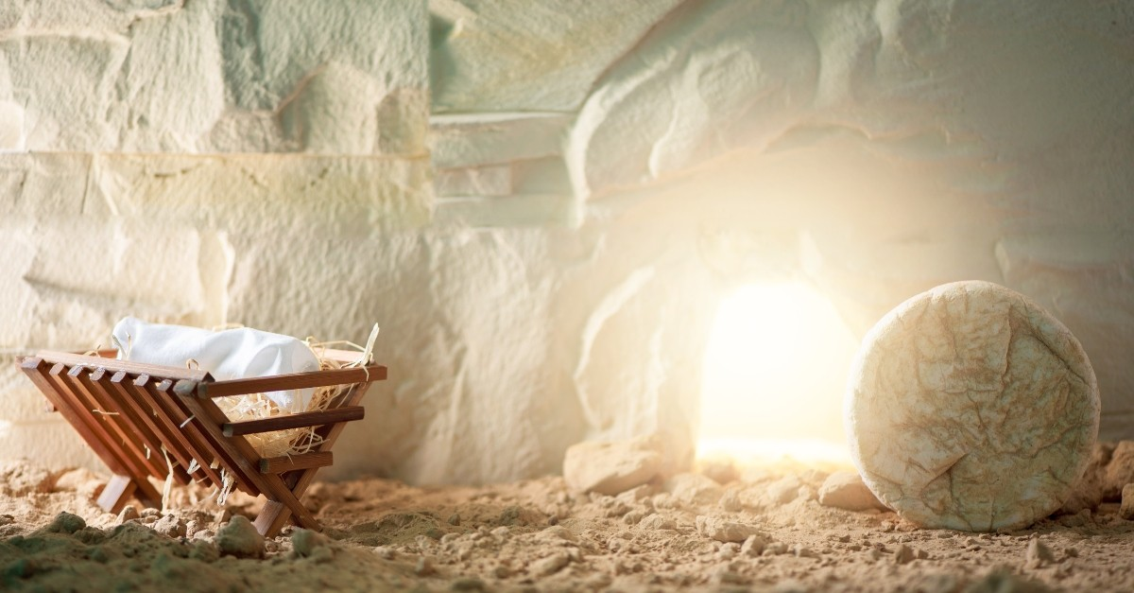
Thank You Lord
For
Resurrection Morning!
Happy Easter 2025

Slide 2


Slide 4
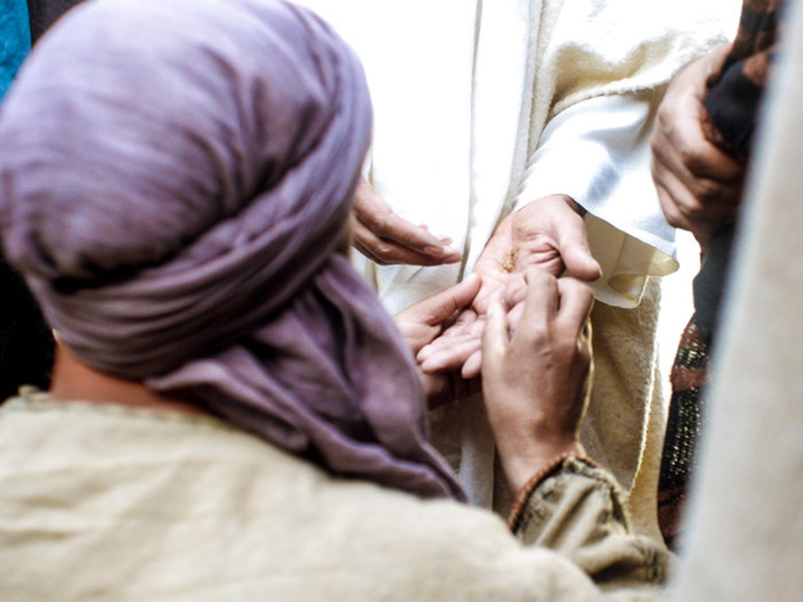

The Power of Our Wounds Part 2
Easter 2025
John 20:19-22
Edward Christian Church
April 20, 2025

Slide 5
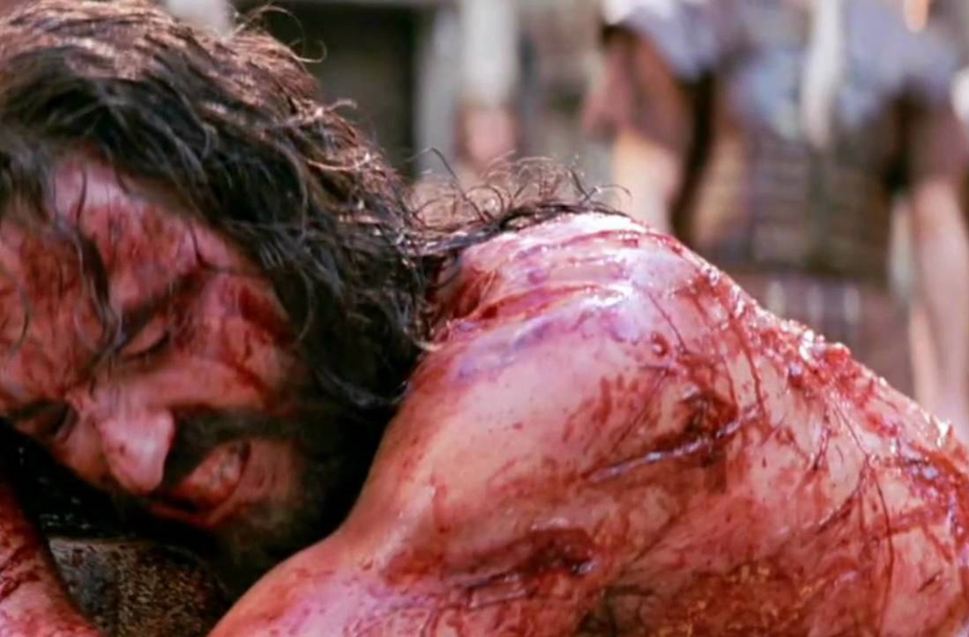
Time of Crisis
It Was Soon After the Cross …
the Crisis Was Still…
…Fresh In Their Minds
It Played Over / Over Again
The Terror Was Still Real
Their Hope Shattered
So Many Questions Left …
…Unanswered

Slide 6
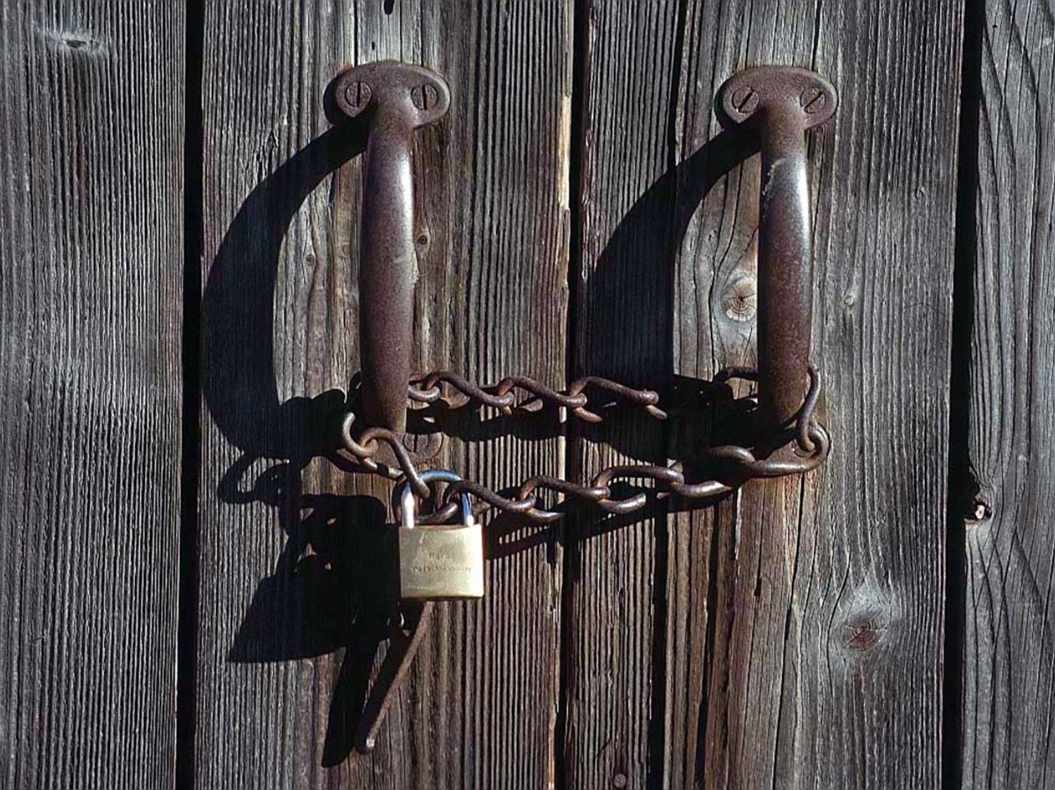
Hiding Behind Locked Doors
Their Motivating Factor…
…Fear – Phobia
Fear is Actually a Reaction…
…to What?
Confusion-
…Misunderstood His Words
Depression-
…Unmet Expectations
Desperation-
…Needed Answers

Slide 7
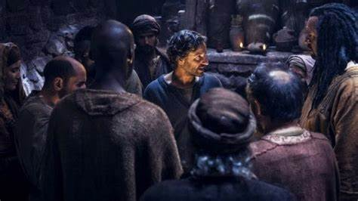
Hiding Behind Locked Doors
Faith Has to Be Active
in Order to Be Effective
They Moved from Faith…
…Attacking the Situation
…to the Situation
…Attacking Their Faith
Jesus Was About to Teach
“Valuable Lesson”

Slide 8
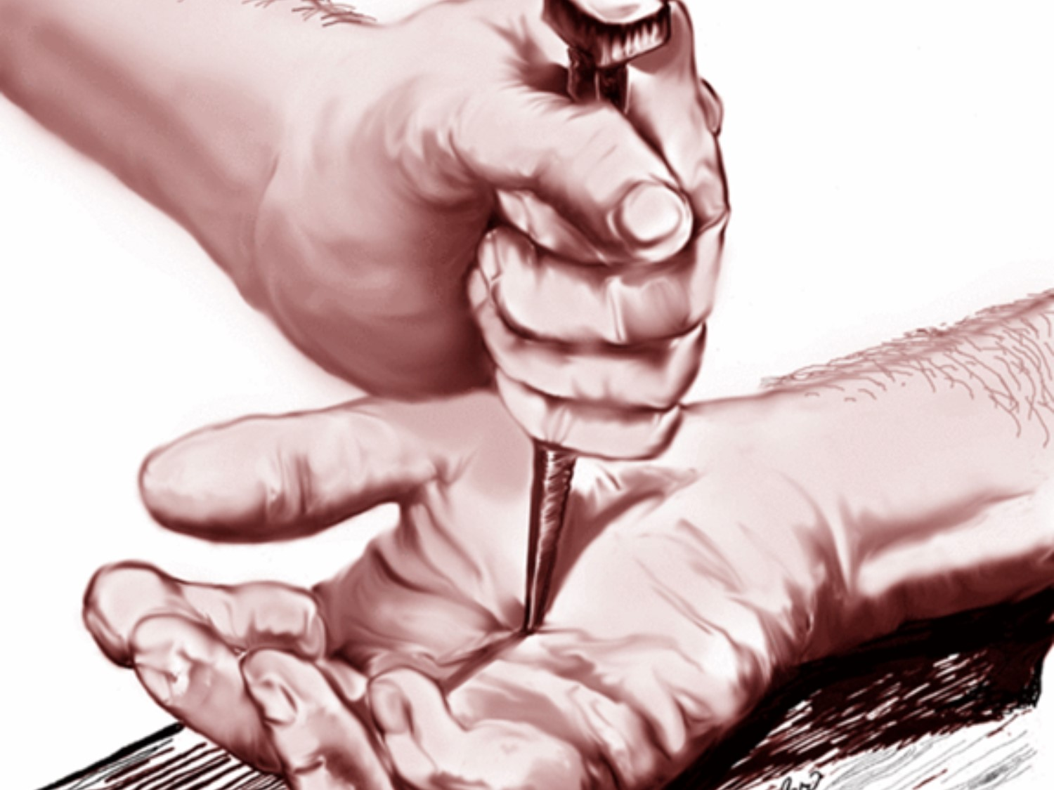
Our Wounds are Very Powerful
We Can Let Them Consume Us
And Be of Help to No One
Or
We Can Overcome…
Through the Power of God
And Help Many

Slide 9
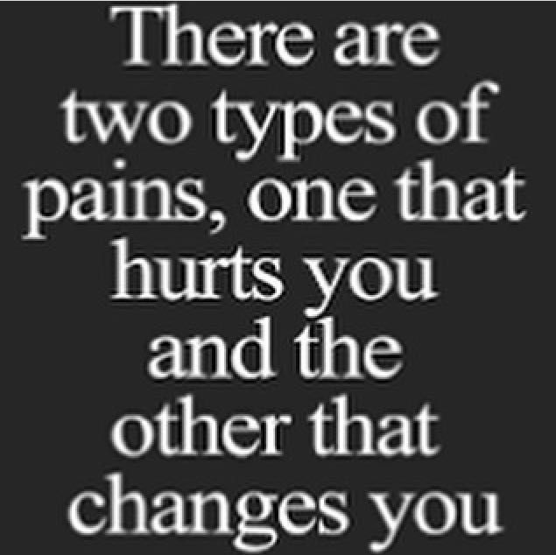
P= Powerful
A= All Experience it
I= Identify with Others
N= Never Wasted by God

Slide 10

Our Wounds Propel Our Message (19)
Power
#1- Moved Beyond Barriers
“locked doors”
Plan –let no one in
Power –not able to stop
#2- Moved Beyond Confusion
“stood in midst”
Stood(establish covenant)
Clear Message

Slide 11
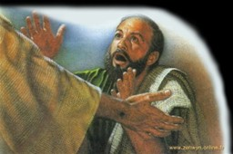
Our Wounds Propel Our Message (19)
Power
#3- Moved Beyond Fear
“…Peace..”
They Needed Calming
Peace (bind together,
set a break)
Positive Impact

Slide 12
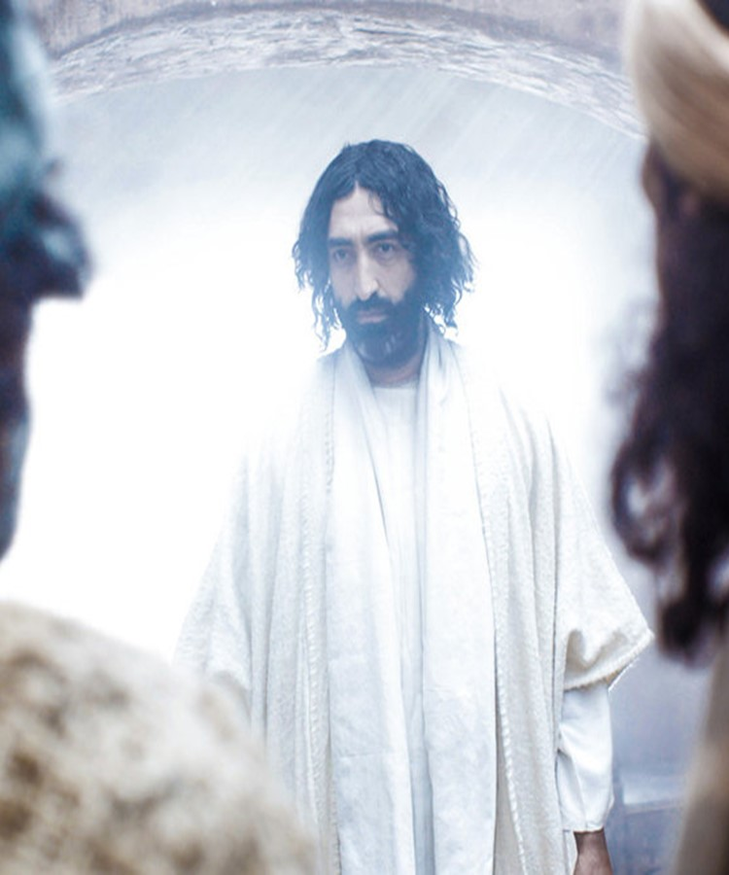
…Potential to Bless Others (20)
Communicate
Rev 12:11, “they overcame by the Blood, testimony...”
Illuminate
Wounds Left Scars
Validates Message

Slide 13
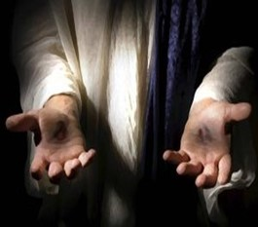
…Potential to Bless Others (20)
Accumulate
“When they saw, glad…”
They Caught it!
John Compares to =
Childbirth” John 16:20-22
Childbirth = Travail (Process)
Child = Joy (Product)

Slide 14
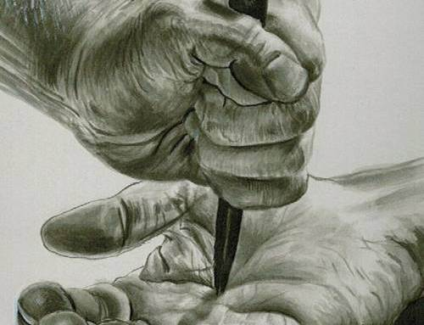
…Potential to Bless Others (20)
Blessing
1st - He Spoke
2nd - They Saw/ Heard
3rd - They Were Glad
Birth
Point of Pain
Healing Begins
Productive Pain
Bounty
Possibility

Slide 15
Shows the Power of God to… …Turn Around Any Situation (21-22)
Peace
Repeat
Confirmation
Push
As My Father hath sent me, so I send You!!
Go –be a witness

Slide 16
Shows the Power of God to… …Turn Around Any Situation (21-22)
Personal Impact
Breathed on Them… …receive Holy Ghost
God is Raising Up Generation Able to Breathe Fresh Annt

Slide 17
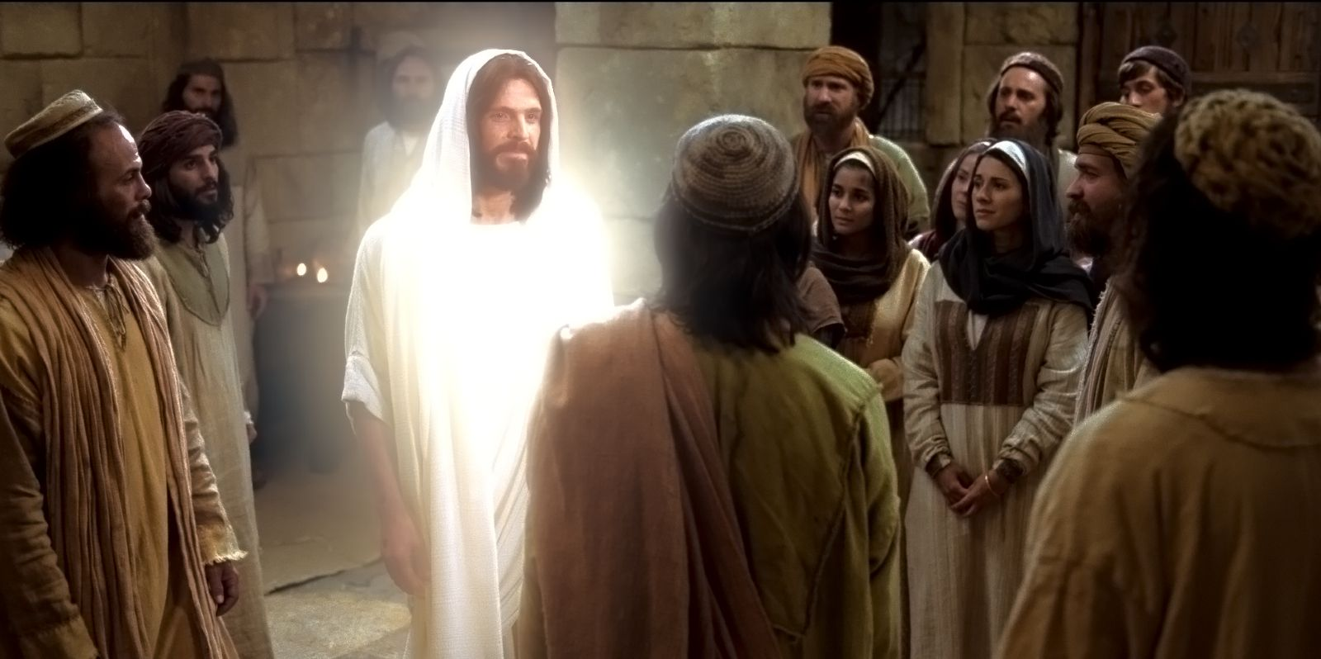
All the Walls We Build…
…All the Doors We Lock
…Can’t Lock Out the Pain
CANNOT KEEP JESUS OUT!

Slide 18

He Sympathized…
He Came Down From Heaven
He Emphasized…
He Carried a Cross
But He Gave Greatest Hope
He Arose

Slide 19
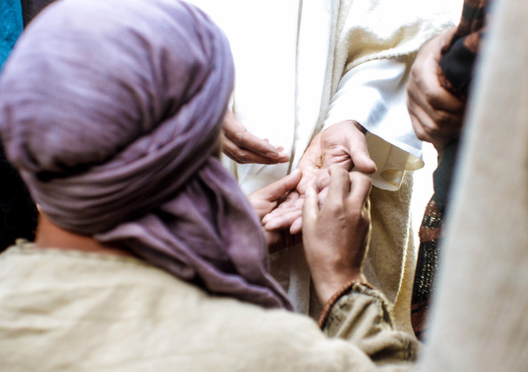
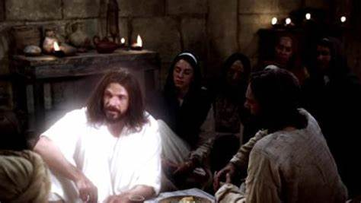


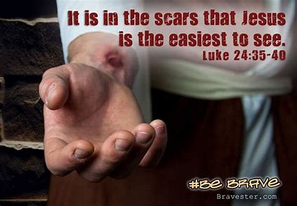
If He Can Defeat the Grave…
He Can Help You Defeat the Gravestones in Your Life…

Slide 21
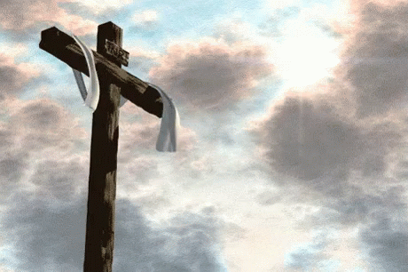

Repeat
These are the 2 Most Important Hours of My Week – Help Me to Cherish Them
I Am Here Today to Worship
Not to Be Entertained
I Am Singing to An Audience of One
Accept My Worship Oh Lord!

Slide 22
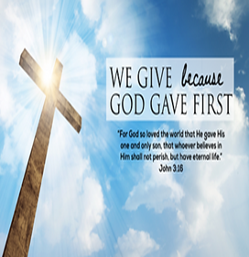
Repeat
I Lift My Offering to You
Let It Please You Oh Lord
This is My Seed
Although It Leaves My Hand
It will Never Leave My Life
You Will Multiply It!
Accept My Seed Oh Lord!

Slide 24
One Easter Sunday morning as the pastor was preaching a children's sermon, he reached into his bag of props and pulled out an egg. He pointed at the egg and asked the children, "What's in here?" "I know, I know!" a little boy exclaimed, "pantyhose!" What do you call three rabbits in a row, hopping backwards simultaneously? A receding hareline.

