Slide 1


Slide 2
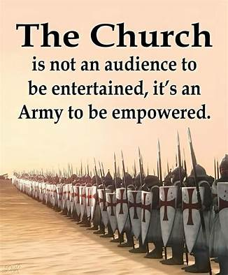
Repeat
These Are the 2 Most Significant Hours
of My Week
– Assist Me in Treasuring Them
I Am Present Today to Praise
Not for Entertainment
I Am Singing to an Audience of One
Receive My Worship, Oh Lord!

Slide 3

Repeat
I Lift My Offering to You
Let It Please You Oh Lord
This is My Seed
Although It Leaves My Hand
It will Never Leave My Life
You Will Multiply It!
Accept My Seed Oh Lord!

Slide 5
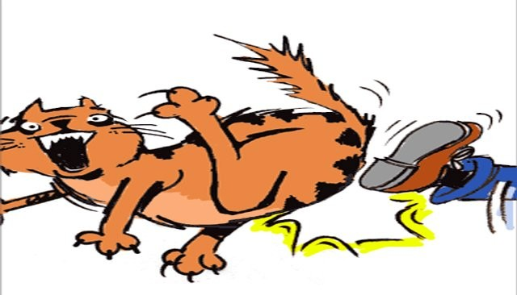
Anger
Edward Church
Ephesians 4:26-27
Kicking the Cat
April 27, 2025

Slide 6

Anger’s Nature
Anger is a God Given Powerful Emotion…
…Response to an Injustice or Pain or Threat…
...a Person Makes the Conscious Choice
…to Take Action to Immediately Stop the
…Threatening Behavior of
…Another Outside Force.
Moses Got Angry
David Got Angry
God Got Angry
Jesus Got Angry

Slide 7
What Are the Four Sources of Anger?
Hurt
Your Heart Is Wounded
³ Jacob^{[a]} loved Joseph more than any of his other children because Joseph had been born to him in his old age. So one day Jacob had a special gift made for Joseph—a beautiful robe.^{[b]} ⁴ But his brothers hated Joseph because their father loved him more than the rest of them. They couldn’t say a kind word to him. Genesis 37:3-4 NLT
Injustice
Your Rights Is Violated
³² “But why should he be put to death?” Jonathan asked his father. “What has he done?” ³³ Then Saul hurled his spear at Jonathan, intending to kill him. So at last Jonathan realized that his father was really determined to kill David.
³⁴ Jonathan left the table in fierce anger and refused to eat on that second day of the festival, for he was crushed by his father’s shameful behavior toward David. 1 Sam 20:32-34 NLT

Slide 8
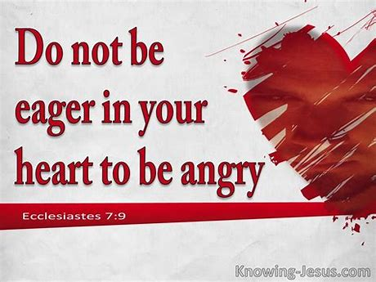
What Are the Four Sources of Anger?
Fear
Your Future Is Threatened
⁸ This made Saul very angry. “What’s this?” he said. “They credit David with ten thousands and me with only thousands. Next they’ll be making him their king!” 1 Samuel 18:8 NLT
Frustration
Your Effort Is Unsuccessful
⁶ “Why are you so angry?” the Lord asked Cain. “Why do you look so dejected?
Genesis 4:6 NLT

Slide 9

Anger’s Nurture
Anger is Fed by Feelings of…
Disappointment
Rejection
Embarrassment
Anger Pits You Against Whatever Sparked the Emotion.
It Is The Opposite of the Feeling of Love.
Love Draws You Toward the Person…
…Anger Sets You Against the Person.

Slide 10
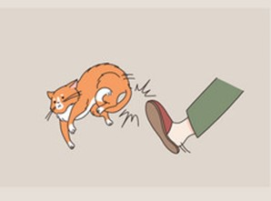
Anger Is Never Neutral
It Always has Consequences…
Challenge
(healthy)
Compound
(unhealthy)
Collapse
(unhealthy)
Contagious
(unhealthy)
Contaminates
(unhealthy)
...Confrontation
...Explode
…Implode
…Rubs Off
…Changes Atmosphere

Slide 11

Anger’s Negatives
Psalms 37:8 Refrain from anger, and forsake wrath! Fret not yourself; it tends only to evil.
Psa 37:8 HCSB Refrain from anger and give up your rage; do not be agitated—it can only bring harm
Proverbs 29:22 A man of wrath stirs up strife, and one given to anger causes much transgression.
Prov 29:22 Message Angry people stir up a lot of discord; the intemperate stir up trouble.
Loss of…
Confidence:
Energy
Faith
Freedom
Identity
Perspective
Sensitivity
Vision

Slide 12
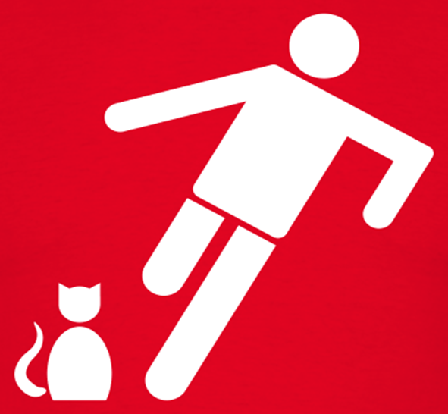
Just a Thought
Your Temper is Like a Fire. It Gets Very Destructive When It Gets Out of Control
A Shut Mouth Gathers No Foot
He Who Throws Dirt Loses Ground
Swallowing Angry Words Before You Say Them is Better Than Having to Eat Them Afterwards
Anger is a Stone Thrown at a Wasp's Nest
People Who Fly Into Rage…
…ALWAYS Make a Bad Landing

Slide 13
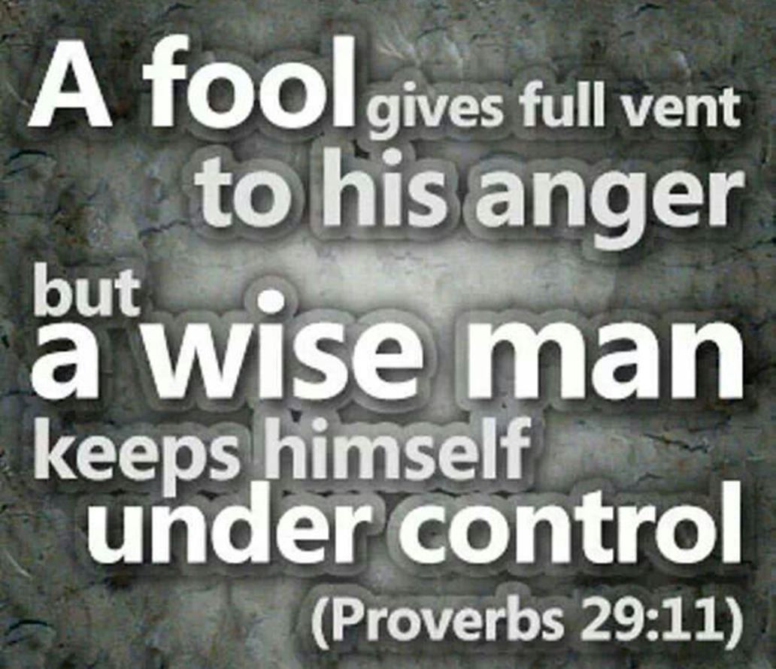

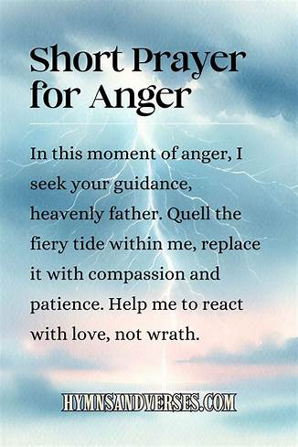

Slide 16
The hit-and-run victim was just getting to his feet when a policeman ran up to help.
"My mother-in-law just tried to run me over!" the shaken man told the cop.
"The car hit you from behind," the officer said. "How could you tell it was your mother-in-law?"
"I recognized the laugh!" he replied.

