Slide 1
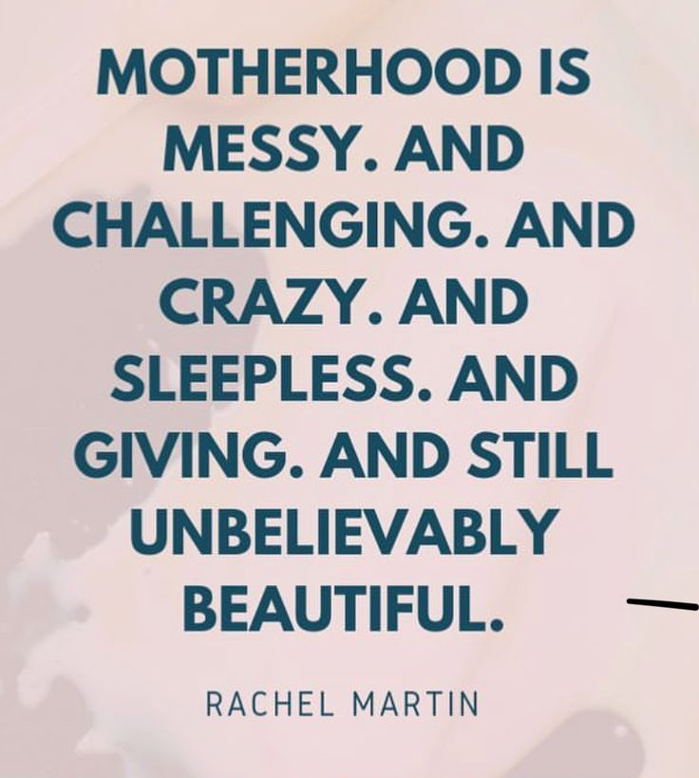
Happy Mother’s Day 2025

Slide 2

Repeat
These are the 2 Most Important Hours of My Week – Help Me to Cherish Them
I Am Here Today to Worship
Not to Be Entertained
I Am Singing to An Audience of One
Accept My Worship Oh Lord!

Slide 3

Repeat
I Lift My Offering to You
Let It Please You Oh Lord
This is My Seed
Although It Leaves My Hand
It will Never Leave My Life
You Will Multiply It!
Accept My Seed Oh Lord!

Slide 5
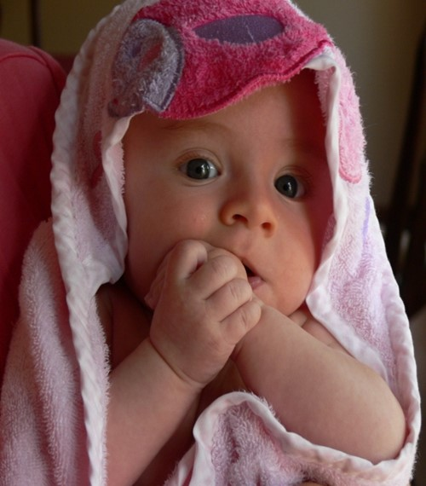
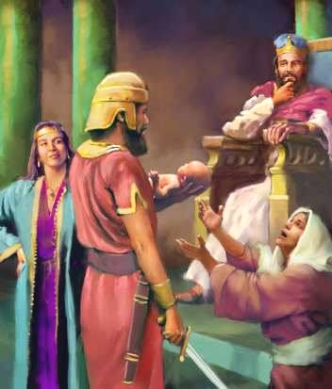
Will the Real Mother Please Stand Up!
1 Kings 3:16

Slide 6
Facts on Real Mothers
Real Mothers know right where their kitchen utensils are…out in the sandbox!
Real Mothers don’t eat quiche; they don’t have time to make it.
Real Mothers sometimes have sticky floors, filthy ovens, but happy kids.

Slide 7
Facts on Real Mothers
Real Mothers know and accept that dried play dough doesn’t come out of shag carpets.
Real Mothers don’t want to know what the vacuum just sucked up.
Real Mothers know that a child’s growth is not measured by height or years or grade...It is marked by the progression from “Mama” to “Mommy” to “Mom”.

Slide 8
Facts on Real Mothers
Diaper
Repaid

Slide 9
Top 7 Words Women Use
#7 “Fine”
This is the word women use to end an argument when they are right…
… and you need to shut up.
#6 “Five Minutes”
If she is getting dressed, this is half an hour.
Five minutes is only five minutes if you have just been given 5 more minutes to watch the game before helping around the house.

Slide 10
Top 7 Words Women Use
#5 “Nothing”
This is the calm before the storm.
This means "something" and you should be on your toes. Arguments that begin with "nothing" usually end in "fine"

Slide 11
Top 7 Words Women Use
#4 “Loud Sigh”
Although not actually a word, the loud sigh is often misunderstood by men.
A "Loud Sigh" means she thinks you are an idiot and wonders why she is wasting her time standing here and arguing with you over "Nothing".

Slide 12
Top 7 Words Women Use
#3 “Go Ahead”
This is a dare, not permission,
DON'T DO IT!
#2 “That's Okay”
This is one of the most dangerous statements that woman can make to a man.
"That's Okay" means that she wants to think long and hard before deciding how and when you will pay for your mistake.

Slide 13
Top 7 Words Women Use
#1 “Thanks”
This is the least used of all words in the female vocabulary.
If a woman is thanking you. Do not question it
… just say you're welcome and
… slowly back out of the room.

Slide 14
History Shows That All Great Leaders
…had Mothers
PAUL REVERE’S MOTHER:
"I don’t care where you think you have to go, young man. Midnight is past your curfew!"
MONA LISA’S MOTHER:
"After all that money your father and I spent on braces, Mona, that’s the biggest smile you can give us?"

Slide 15
History Shows That All Great Leaders
…had Mothers
HUMPTY DUMPTY’S MOTHER:
"Humpty, If I’ve told you once, I’ve told you a hundred times not to sit on that wall. But would you listen to me? Noooo!"
COLUMBUS’ MOTHER:
"I don’t care what you’ve discovered, Christopher. You still could have written!"

Slide 16
History Shows That All Great Leaders
…had Mothers
MICHELANGELO’S MOTHER:
"Mike, can’t you paint on walls like other
children? Do you have any idea how hard it is
to get that stuff off the ceiling?"
ABRAHAM LINCOLN’S MOTHER:
"Again with the stovepipe hat, Abe? Can’t you
just wear a baseball cap like the other kids?"

Slide 17
History Shows That All Great Leaders
…had Mothers
BATMAN’S MOTHER:
"It’s a nice car, Bruce, but do you realize how
much the insurance is going to be?"
GOLDILOCKS’ MOTHER:
"I’ve got a bill here for a busted chair from the
Bear family. You know anything about this, Goldie?"

Slide 18
There are 3 Types of Mothers
#1 –Physical (birth) Mother
They are responsible for bringing the child into the world
But they don’t necessarily take any further responsibility in the child’s life
There may or may not be bonding

Slide 19
There are 3 Types of Mothers
#2 –Emotional Mother
They are not necessarily responsible
for bringing the child into the world
But they do take further responsibility
in the child’s life
There will be a strong bonding

Slide 20
There are 3 Types of Mothers
#3 –Spiritual Mothers
They are not necessarily responsible
for bringing the child into the Kingdom
But they do take further responsibility
in the child of God’s life
There will be a strong bonding

Slide 21

The Trial (16-22)
Their Character
Harlot (hostess)
Obviously…
“well known”
#1: Real Mothers Are Not Perfect

Slide 22
The Trial (16-22)
Their Complaint
Unexpected Birth(17,18)
Both had children about the same time
Unexpected Death(19)
One rolls over and suffocates her baby

Slide 23
The Trial (16-22)
Unexpected Reaction (20)
Instead of accepting it, she trades it
#2: Real Mothers…
…Have Problems

Slide 24
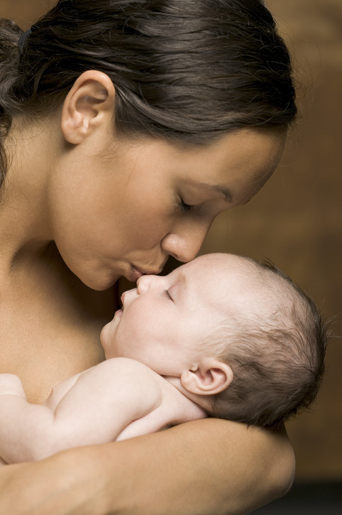
The Trial (16-22)
Her Composition
Her Perception (21)
#3: Real Mothers…
…Know Their Children
Her Pursuit (22)
#4: Real Mothers…
…Refuse to Give Up
On Their Children

Slide 25
The Test (23)
The Review
They couldn’t settle it
Lower courts No Go
Took It to Jerusalem Supreme Court
Judgment Final

Slide 26
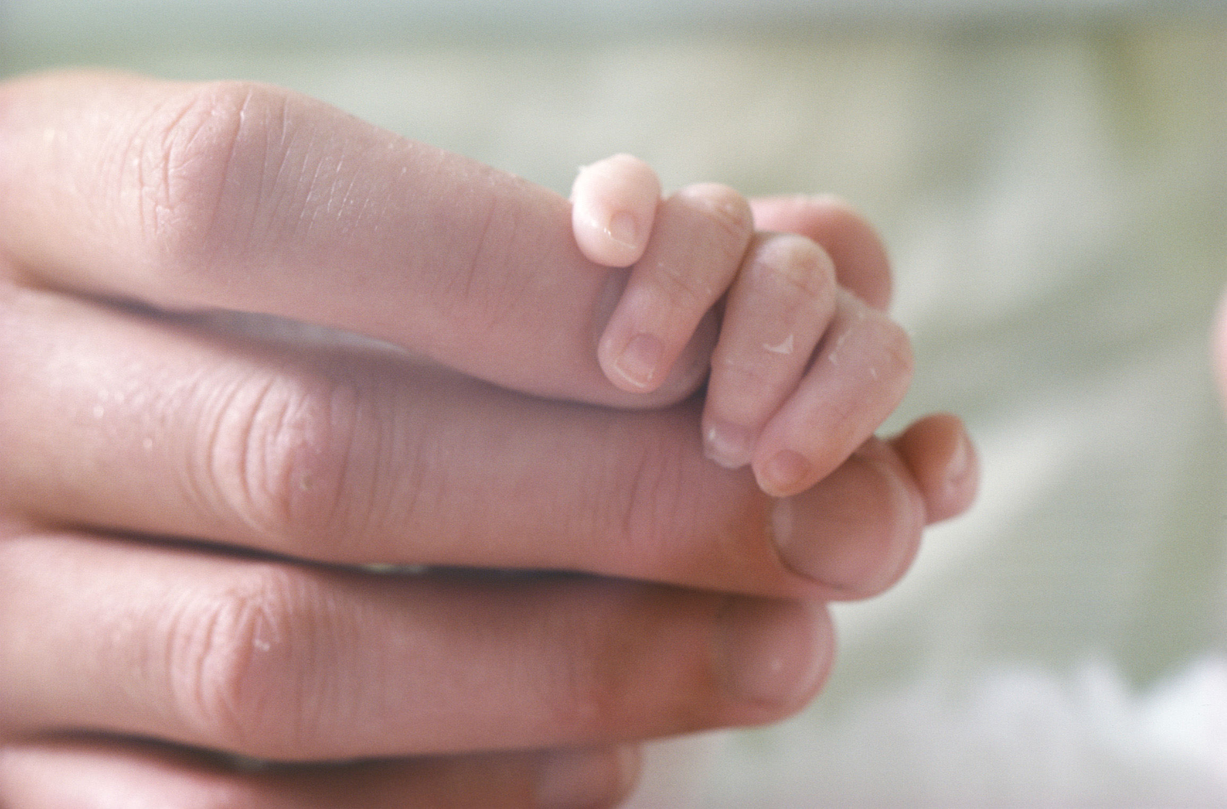
The Test (23)
The Revelation
The Check
He wasn’t going to divide the child
The Balance
He was seeing who actually had the heart of a mother
#5: Real Mothers Defend Their Child, Especially When The Heat Is On

Slide 27
The Testimony (26)
She Submitted to a Supreme Judge
She trusted his…
Judgment
wisdom
#6: Real Mothers Look to a Higher Power to Find What Is Needed

Slide 28
The Testimony (26)
She Sacrificed (26)
She was willing to do so to see the child live
#7: A Real Mother Will Sacrifice Her Desires To Benefit Her Child

Slide 29

The Testimony (26)
She was Supported ( 27)
The King saw her sacrifice
The King gave her child back to her
#8: Real Mothers Will… …Receive a Reward
One Day

Slide 30
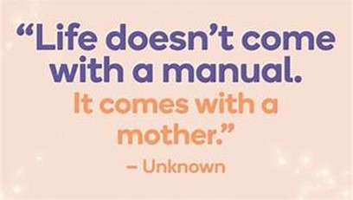
This Crazy World Has..
Demeaned
Diluted
The Power and Place
Of Motherhood
But GOD…
Elevates
Empowers
Encourages
Every Day!!!!!

