Slide 2
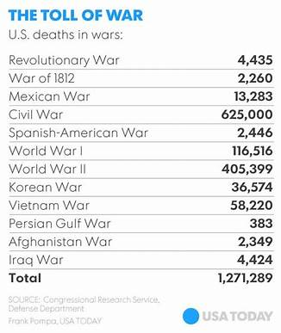


Slide 3

It is the soldier, not the reporter,
Who has given us freedom of the press.
It is the soldier, not the poet,
Who has given us freedom of speech.
It is the soldier, not the campus organizer,
Who has given us the freedom to demonstrate.
It is the soldier, Who salutes the flag,
Who serves beneath the flag,
and whose coffin is draped by the flag,
Who allows the protester to burn the flag.

Slide 4
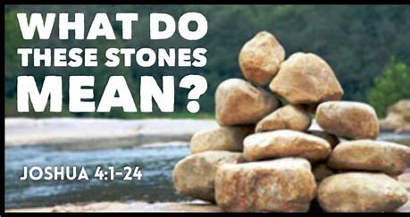
Edward Christian Church
May 28, 2023
Memorial Day 2025

Slide 5
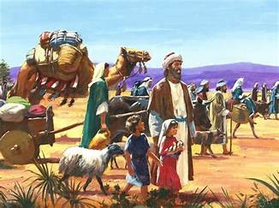
New Day Dawning
Behind Them was 40 yrs of :
  Wandering
  What If’s
  Could Have Beens
  The Known
  This Day …
They Would Leave it all Behind!

Slide 6
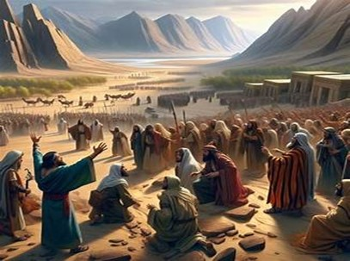
New Day Dawning
In Front of Them Continuous:
  Unknown
  Challenges
  Battles
  Victories
They Would Need a Forward Look!

Slide 7
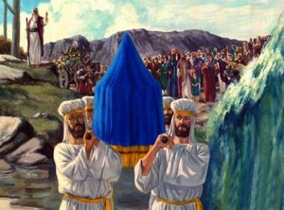
New Day Dawning
There was the…
Promise
Path of the Promise (swollen)
Power of the Promise (20 miles)
Picture of the Promise (12 stones)

Slide 8
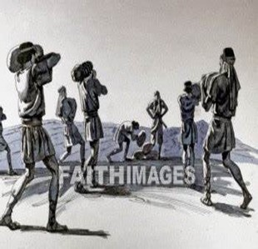
Picture of the Promise
“Memorial”
Twelve Men Took 12 Stones:
From Jordan’s Floor
Piled Them Together
In the Promised Land
Unmistakable Marker
At Place where God Demonstrated
His Power to Overcome Any Obstacle

Slide 9
Crossing of the Jordan
Not Just A Physical River…
…But a Spiritual One As Well
Leaving Behind a Past…
…Filled With Trials And Tribulations
…Stepping Into an Unknown Future
Yet Filled with Promise.
The stones were reminders
God Can Bring You
            Through
            Out
            Up

Slide 12

Spiritual Warfare
10% Satan’s Tactics
90% How We Respond
Remember… With God We Are Not
Helpless
Hopeless
We Are Powerful!!

Slide 13

Repeat
These are the 2 Most Important Hours of My Week – Help Me to Cherish Them
I Am Here Today to Worship
Not to Be Entertained
I Am Singing to An Audience of One
Accept My Worship Oh Lord!

Slide 14

Repeat
I Lift My Offering to You
Let It Please You Oh Lord
This is My Seed
Although It Leaves My Hand
It will Never Leave My Life
You Will Multiply It!
Accept My Seed Oh Lord!

Slide 16
A man selling vacuum cleaners knocked on the door of a remote farmhouse. When the lady of the house opened the door, he walked in and dumped a bag of dirt on the floor. “Now,” boasted the salesman, “I want to make a bargain with you. If this super-duper, new vacuum cleaner doesn't pick up every bit of this dirt, I’ll eat what’s left.” “Here’s a spoon,” said the farmer’s wife, “we don’t have any electricity.”
That man thought he knew what he was doing but obviously did not. - Mem Day is Not Start of Summer

