Slide 2
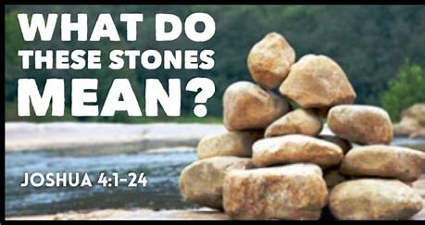
Edward Christian Church
June 1, 2025
Part 2

Slide 3
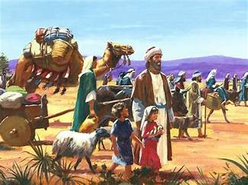
New Day Dawning
Behind Them was 40 yrs of :
Wandering
What If’s
Could Have Beens
The Known
This Day …
They Would Leave it all Behind!

Slide 4
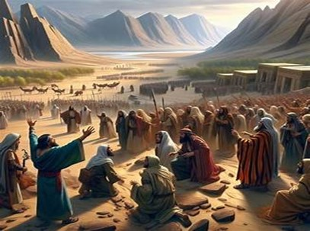
New Day Dawning
In Front of Them Continuous:
Unknown
Challenges
Battles
Victories
They Would Need a Forward Look!

Slide 5
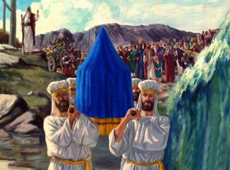
New Day Dawning
There was the…
Promise
Path of the Promise (swollen)
Power of the Promise (20 miles)
Picture of the Promise (12 stones)

Slide 6
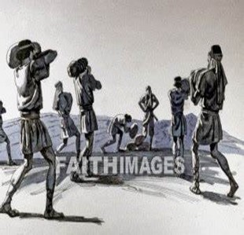
Picture of the Promise “Memorial”
Twelve Men Took 12 Stones:
From Jordan’s Floor
Piled Them Together
In the Promised Land
Unmistakable Marker
At Place where God Demonstrated
His Power to Overcome Any Obstacle

Slide 7
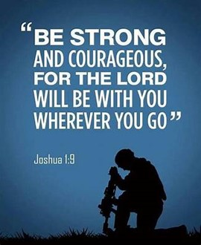
What Do These Stones Mean?
There Was…
There Will Be…
Struggle
Strength
Success
Struggle
Strength
Success
Spiritual Success Always Comes...
Through...
...Struggle

Slide 8
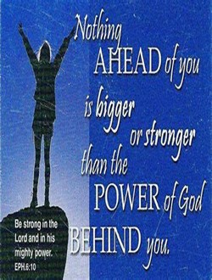
What Do These Stones Mean?
Behind There Was
Ahead Will Be…
Protection
Provision
Presence
Protection
Provision
Presence
God Always Helps Us...
Through...
...the Struggle

Slide 9
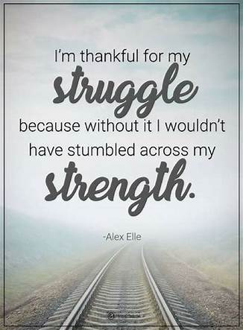
God Left Giants in Promised Land On Purpose..to Produce Struggle
God Knows a Lack of Struggle Produces:
Spiritual Weakness
Loss of Spiritual Edge
Thanklessness
Spiritual Laziness

Slide 10

Struggle is a Sign…
#1- There is Still Life in You! - Potential
#2- Satan Does Not Have You Yet - Problem
#3- God Still Has Need of You - Purpose
#4- God is Defending You - Power
#5- Break Thru is On the Way - Promise
Psalms 34:19 (KJV) Many are the afflictions of the righteous: but the LORD delivereth him out of them all.

Slide 11
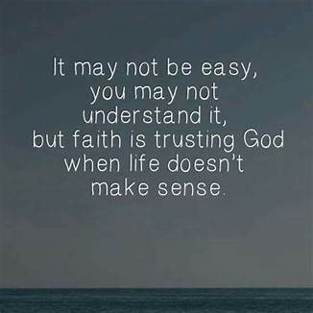
What Do These Stones Mean?
What About the Monument in the River?
Unseen by All -
….would it make a difference?

Slide 12
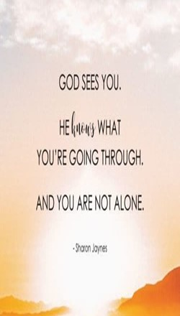
What Do These Stones Mean?
God and the Ones that Went Through
After the Trial -Test -Battle -Struggle
There’s Something Inside..
Nobody Knows but You and God
Nobody Understands but You and God
Nobody Not Even Satan…
…Can Take It Away

Slide 13
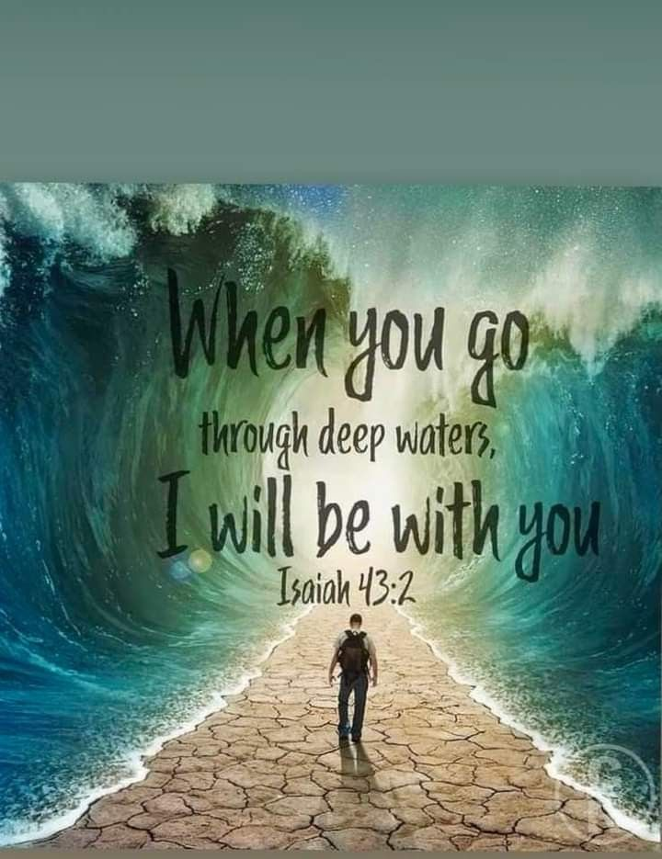
When you’re in over your head,
I’ll be there with you. When you’re in rough waters,
you will not go down. When you’re between a rock and a hard place, it won’t be a dead end— Because I am God,
your personal God
Isa 43:2 –the Message

Slide 15
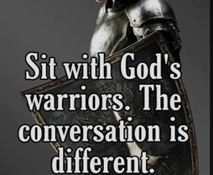
Spiritual Warfare
10% Satan’s Tactics
90% How We Respond
Remember… With God We Are Not
Helpless
Hopeless
We Are Powerful!!

Slide 16
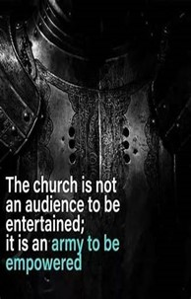
Repeat
These are the 2 Most Important Hours of My Week – Help Me to Cherish Them
I Am Here Today to Worship
Not to Be Entertained
I Am Singing to An Audience of One
Accept My Worship Oh Lord!

Slide 17
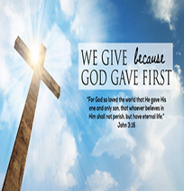
Repeat
I Lift My Offering to You
Let It Please You Oh Lord
This is My Seed
Although It Leaves My Hand
It will Never Leave My Life
You Will Multiply It!
Accept My Seed Oh Lord!

Slide 18
As the crowded airliner is about to push away from the gate , the peace is shattered by a five-year-old boy who picks that moment to throw a wild temper tantrum. No matter what his frustrated, embarrassed mother does to try to calm him down, the boy continues to scream furiously and kick the seats around him. Suddenly, from the rear of the plane, an elderly man in a Marine uniform is seen slowly walking forward up the aisle. Stopping the flustered mother with an upraised hand, the white-haired, courtly, soft-spoken Marine leans down and, motioning toward his chest, whispers something into the boy's ear.
Instantly, the boy calms down, gently takes his mother's hand, and quietly fastens his seat belt. All the other passengers burst into spontaneous applause.
As the Marine slowly makes his way back to his seat, one of the cabin attendants touches his sleeve. "Excuse me, sir," she asks quietly, "but could I ask you what magic words you used on that little boy?" The Marine smiles serenely and gently confides, "I showed him my pilot's wings, service stars, and battle ribbons, and explained that they entitle me to throw one passenger out the plane door on any flight I choose.

Slide 19
As the crowded airliner is about to push away from the gate , the peace is shattered by a five-year-old boy who picks that moment to throw a wild temper tantrum. No matter what his frustrated, embarrassed mother does to try to calm him down, the boy continues to scream furiously and kick the seats around him. Suddenly, from the rear of the plane, an elderly man in a Marine uniform is seen slowly walking forward up the aisle. Stopping the flustered mother with an upraised hand, the white-haired, courtly, soft-spoken Marine leans down and, motioning toward his chest, whispers something into the boy's ear.
Instantly, the boy calms down, gently takes his mother's hand, and quietly fastens his seat belt. All the other passengers burst into spontaneous applause.
As the Marine slowly makes his way back to his seat, one of the cabin attendants touches his sleeve. "Excuse me, sir," she asks quietly, "but could I ask you what magic words you used on that little boy?" The Marine smiles serenely and gently confides, "I showed him my pilot's wings, service stars, and battle ribbons, and explained that they entitle me to throw one passenger out the plane door on any flight I choose.

