Slide 1
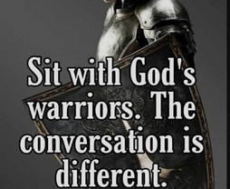
Spiritual Warfare
10% Satan’s Tactics
90% How We Respond
Remember… With God We Are Not
Helpless
Hopeless
We Are Powerful!!

Slide 2
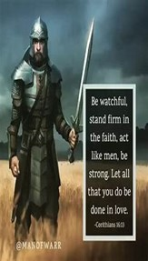
Repeat
These are the 2 Most Important Hours of My Week – Help Me to Cherish Them
I Am Here Today to Worship
Not to Be Entertained
I Am Singing to An Audience of One
Accept My Worship Oh Lord!

Slide 3
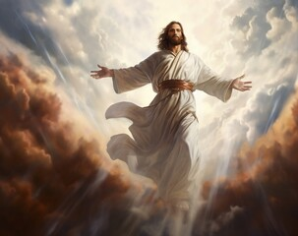
Edward Christian Church
6/8/2025

Slide 4
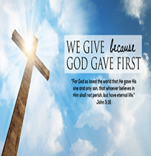
Repeat
I Lift My Offering to You
Let It Please You Oh Lord
This is My Seed
Although It Leaves My Hand
It will Never Leave My Life
You Will Multiply It!
Accept My Seed Oh Lord!

Slide 5
Fresh out of business school, the young man answered a want ad for an accountant. Now he was being interviewed by a very nervous man who ran a small business that he had started himself.
"I need someone with an accounting degree," the man said. "But mainly, I'm looking for someone to do my worrying for me.“
"Excuse me?" the accountant said.
"I worry about a lot of things," the man said. "But I don't want to have to worry about money. Your job will be to take all the money worries off my back.“
"I see," accountant said. "And how much does the job pay?“
"I'll start you at eighty thousand."
"Eighty thousand dollars!" the accountant exclaimed. "How can such a small business afford a sum like that?“
"That," the owner said, "is your first worry."

Slide 7
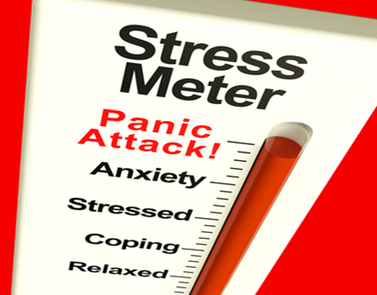
Attacking Panic
June 8, 2025
Joshua 1
Before It Attacks You!
Edward Church

Slide 8
Anxiety Test
I am ready to throw in the…………….
I am at the end of my…………………..
I am just a bundle of……………………
I am at my wits…………………………..
I feel like resigning from the human…
I am in over my…………………………..
If you answered yes to ANY/ All…
…Stress is Poised to Attack
(towel).
(rope).
(nerves).
(end).
(race).
(head).

Slide 9
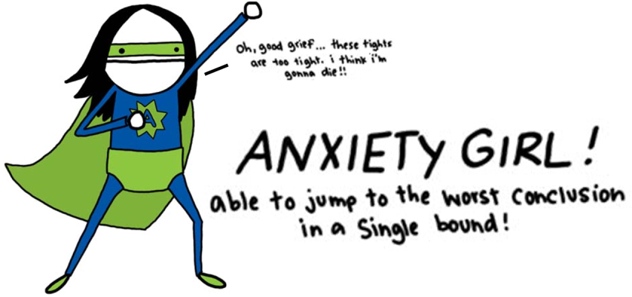
Anxiety = an unpleasant state of inner turmoil, often accompanied by nervous behavior, such as pacing back / forth
It is the subjectively unpleasant feelings of dread over anticipated events, such as the feeling of imminent death.
Anxiety is not the same as fear, which is a response to a real or perceived immediate threat, whereas anxiety is the expectation of future threat.
Anxiety Creates Panic…
…Panic Attacks

Slide 10

Joshua
If Ever a Person was in Position for Panic Attacks
He was Called to…
  Take Mose’s Place
  …Big Shoes to Fill
  Take the Land
  …Big Job to Complete
  Both Seemed Impossible
  …Without God

Slide 11
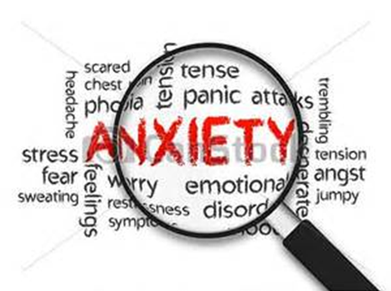
Anxiety is Triggered Many Ways
When Your Past Triggers Negative Feelings
Sometimes a reminder of a difficult past triggers anxious emotions.
You can’t change your past, but you can change how you respond to it!
  Josh 1:2- Moses my servant is dead; now therefore arise,….
When You Feel Unprepared
  Josh 1:2- …arise, go over this Jordan, thou, and all this people…
When You Feel Out of Control
Your future is unknown, and change is scary, you feel out of control.
  Josh 1:2- …thou, and all this people, unto the land…
When You Feel You Have No Explanation
Sometimes there is no warning or explanation to your anxiety.
Anxiety speaks false beliefs to us that leave us paralyzed.

Slide 12
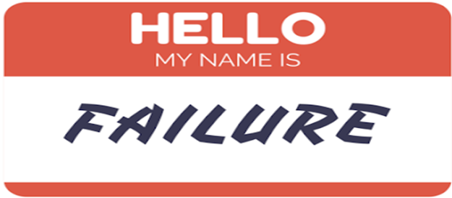
Anxiety Attacks
Danger of Looking Back (1:2)
“Moses My servant is dead. Now therefore, arise, go over this
Jordan, you and all this people, to the land….”
  Moses is Mentioned (6x) in vs 1-9 (57x) Rest of Book
  It is Very Easy to Look at What God Has Done in Past/ Think...
…I Cannot Move Forward
Danger of Standing Still (1:3)
“Every place that the sole of your foot will tread I have given..”
  Fulfilling the Promises of God Requires…
…that we Walk by Faith.

Slide 13

Dangers of Anxiety
The Danger of Giving Up (1:5)
“No man shall be able to stand before you all days of your life; as I was with Moses..will be with you. I will not leave you nor forsake …”
  Seems They May Have Given Up, But God Reassured Them.
The Danger of Falling Short (1:6)
“Be strong /good courage, for to this people you shall divide as an inheritance the land which I swore to their fathers to give them”
  The Inheritance Is the Land that God Promised.

Slide 14
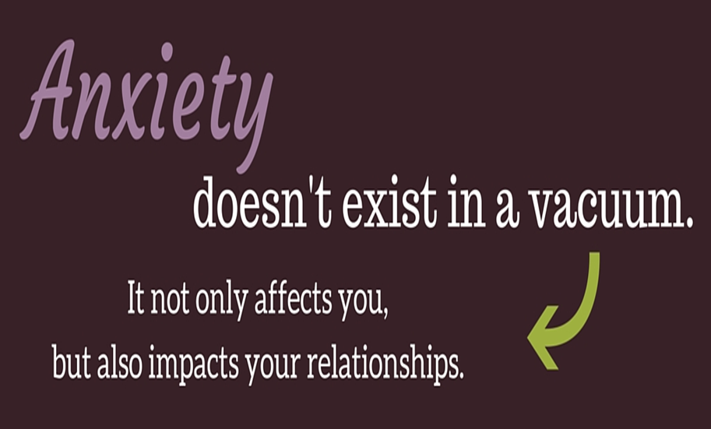
Attack Panic
Joshua 1:8 (KJV)
This book of the law shall not depart out of thy mouth; but thou shalt meditate therein day and night, that thou mayest observe to do according to all that is written therein: for then thou shalt make thy way prosperous, and then thou shalt have good success.
The Power of …
Meditation = to mutter under breath- talk to self
  Healthy Self-Talk (builds faith)
Reverse Meditation = Worry
  Unhealthy Self-Talk (deteriorates faith)

Slide 15
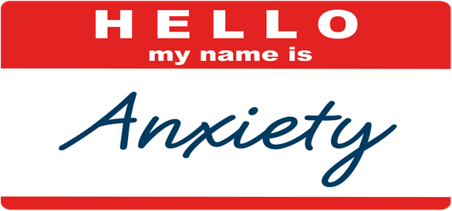


Slide 16
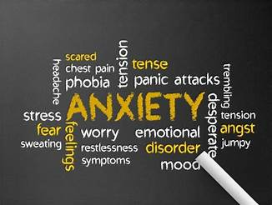
As We Conclude Today,
Reflect On Areas Of Your Life Where Anxiety has Taken Hold.
Remember, God Is Not Only Aware Of Your Struggles
But , Actively Working to Bring Peace Into Your Life.
Jesus Said, "In This World, You Will Have Trouble. But Take Heart! I Have Overcome The World” (John 16:33, NIV).
Let Us Choose To Focus On Him
Knowing He Cares For Us Deeply.

