Slide 1

Edward Christian Church
Fathers Day ‘25

Slide 2
There are times ...when men ....do not always say what we mean, So, allow me to translate ......for your future benefit:
When a Man Says,
IT WOULD TAKE TOO LONG TO EXPLAIN
He Means: ... I have no idea ... how it works
TAKE A BREAK HONEY YOU ARE WORKING TOO HARD
He Means: .... "I can't hear the Television
... over the vacuum cleaner"

Slide 3
When a Man Says, "I HEARD YOU."
He Means: .... "I haven't the foggiest clue to…
what you just said and I am hoping desperately
...that I can fake it well enough
...so that you will not tell me again
When a Man Says, "THAT'S NOT WHAT I MEANT."
He Means:
"If something I said can be interpreted two ways,
..and one of the ways makes you sad or angry,
......I meant the other one.
Am I speaking the truth here ladies? Is there an Amen!!

Slide 5
12 Top Reasons It’s Good to Be a Man.
1: Phone conversations are over in 30 seconds flat.
2: A 5-day holiday requires only one suitcase.
3: When clicking through the channels…
…you don’t have to stall at every shot of somebody crying.
4: Guys in hockey masks don’t attack you ...
….unless you’re playing hockey.
5: You only need 2 or 3 pairs of shoes.
6: Car mechanics tell you the truth.

Slide 6
12 Top Reasons It’s Good to Be a Man.
7: You can admire Clint Eastwood without...
…starving yourself to look like him.
8: Gray hair and wrinkles only add character to men.
9. We can do our nails during 1 traffic light.
10: If another guy shows up at the party in the same outfit…
…you just might become lifelong buddies.
11: The occasional well-rendered belch is practically expected.
12. We get to be Dads!

Slide 7

Never Underestimate the Power of a Father
Father’s Day 2025

Slide 8
You Are Called to Be…
a Man
a Leader
a Difference Maker
It’s Not a Mistake…
…That You’re a Dad

Slide 9
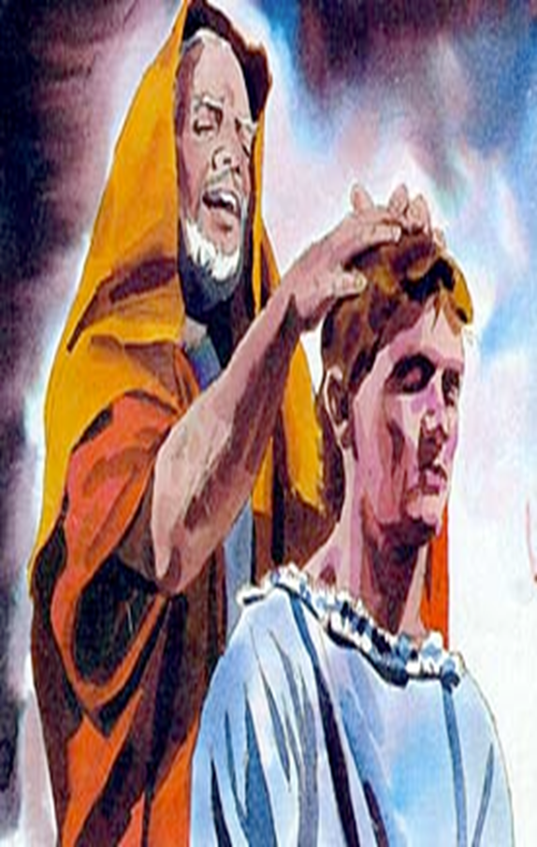
Never Underestimate the Power of a Father
“Your Children are Your Divine Assignment”
To Provide Genuine Fatherly…
Spiritual
Emotional
Physical
…Encouragement
It is Time to Check Ourselves and….
…Are We Living Up to Our Divine Potential?

Slide 10

Unasked Questions to a Father
Acceptance - Can I be myself around you?
Affection - Do you love me?
Affirmation - Are you proud of me?
Attention - Are you watching me?
Approval - Did I do a good job? Am I a smart kid?

Slide 11

Descriptions of Our Heavenly Father…
…and His Care For His Children
…Are a Path for Our Earthly Fathers

Slide 12


It’s Time…
Deuteronomy 20:4
“For the Lord your God is He who goes with you, to fight for you against your enemies, to save you.” – Deuteronomy 20:4 (Amp)
F -
A -
T -
H -
E -
R -
-fighter
Presence
Power
Protection

Slide 13

It’s Time…
“Are not five sparrows sold for two small coins? Yet not one of them has escaped the notice of God. Even the hairs of your head have all been counted. Do not be afraid. You are worth more than many sparrows.” Luke 12:6-7
-fighter
-attentive
F -
A -
T -
H -
E -
R -
Worth
Watch

Slide 14

It’s Time…
Hebrews 13:5 (NIV)
⁵ Keep your lives free from the love of money and be content with what you have, because God has said,
“Never will I leave you; never will I forsake you.”
F -
A -
T -
H -
E -
R -
-fighter
-attentive
-time
Leave= Physically
Forsake= Emotionally

Slide 15

It’s Time…
“Be strong and courageous, do not be afraid or tremble in dread before them, for it is the Lord your God who goes with you. He will not fail you or abandon you.” – Deuteronomy 31:6 (Amp)
-fighter
-attentive
-time
-help
F -
A -
T -
H -
E -
R -
Psalm 46 (KJV)
God is our refuge and strength, a very present help in trouble.

Slide 16

It’s Time…
-fighter
-attentive
-time
-help
-example
F -
A -
T -
H -
E -
R -
"You call Me Teacher / Lord; / you are right, for so I am. "If I then, the Lord /the Teacher, washed your feet, you also ought to wash one another's feet. "For I gave you an example that you also should do as I did to you” John 13:13
Never Forget…
Where You Came From
Treat Others as You Would Be Treated

Slide 17

It’s Time…
-fighter
-attentive
-time
-help
-example
-restore
F -
A -
T -
H -
E -
R -
He restoreth my soul: he leadeth me in the paths of righteousness for his name's sake. Psalm 23:3
You are Called to…
…Help Brings Things Upright
Again!!!

Slide 18


Slide 20
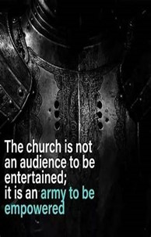
Repeat
These are the 2 Most Important Hours of My Week – Help Me to Cherish Them
I Am Here Today to Worship
Not to Be Entertained
I Am Singing to An Audience of One
Accept My Worship Oh Lord!

Slide 21

Repeat
I Lift My Offering to You
Let It Please You Oh Lord
This is My Seed
Although It Leaves My Hand
It will Never Leave My Life
You Will Multiply It!
Accept My Seed Oh Lord!

