Slide 1
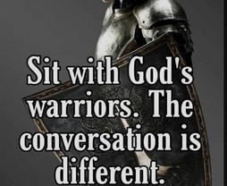
Spiritual Warfare
10% Satan’s Tactics
90% How We Respond
Remember… With God We Are Not
Helpless
Hopeless
We Are Powerful!!

Slide 2
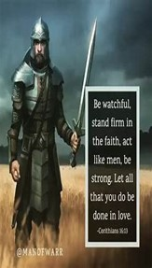
Repeat
These are the 2 Most Important Hours of My Week – Help Me to Cherish Them
I Am Here Today to Worship
Not to Be Entertained
I Am Singing to An Audience of One
Accept My Worship Oh Lord!

Slide 3
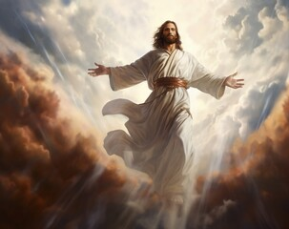
Edward Christian Church
6/8/2025

Slide 4
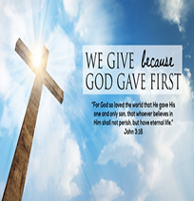
Repeat
I Lift My Offering to You
Let It Please You Oh Lord
This is My Seed
Although It Leaves My Hand
It will Never Leave My Life
You Will Multiply It!
Accept My Seed Oh Lord!

Slide 6
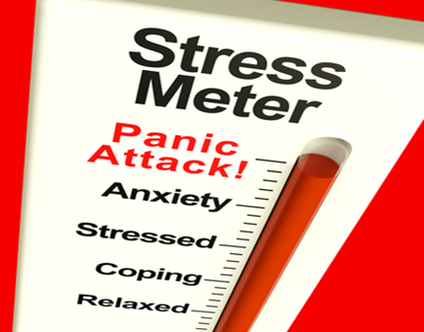
Attacking Panic
June 22, 2025
Joshua 1
Before It Attacks You! –pt2
Edward Church

Slide 7
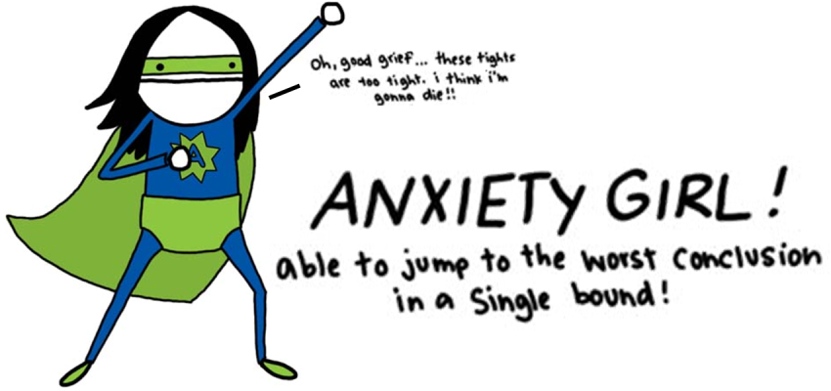
Anxiety = an unpleasant state of inner turmoil, often accompanied by nervous behavior, such as pacing back / forth
It is the subjectively unpleasant feelings of dread over anticipated events, such as the feeling of imminent death.
Anxiety is not the same as fear, which is a response to a real or perceived immediate threat, whereas anxiety is the expectation of future threat.
Anxiety Creates Panic…
…Panic Attacks

Slide 8
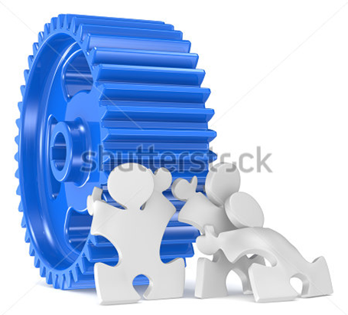
Joshua
If Ever a Person was in Position for Panic Attacks
He was Called to…
  Take Mose’s Place
  …Big Shoes to Fill
  Take the Land
  …Big Job to Complete
  Both Seemed Impossible
  …Without God

Slide 9
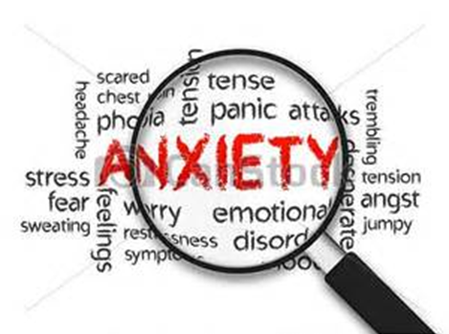
Anxiety is Triggered Many Ways
When Your Past Triggers Negative Feelings
Sometimes a reminder of a difficult past triggers anxious emotions.
You can’t change your past, but you can change how you respond to it!
  Josh 1:2- Moses my servant is dead; now therefore arise,….
When You Feel Unprepared
  Josh 1:2- …arise, go over this Jordan, thou, and all this people…
When You Feel Out of Control
Your future is unknown, and change is scary, you feel out of control.
  Josh 1:2- …thou, and all this people, unto the land…
When You Feel You Have No Explanation
Sometimes there is no warning or explanation to your anxiety.
Anxiety speaks false beliefs to us that leave us paralyzed.

Slide 10
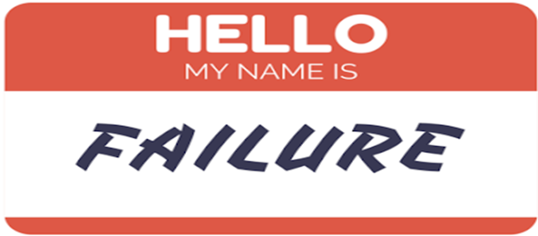
Anxiety Attacks
Danger of Looking Back (1:2)
“Moses My servant is dead. Now therefore, arise, go over this
Jordan, you and all this people, to the land….”
  Moses is Mentioned (6x) in vs 1-9 (57x) Rest of Book
  It is Very Easy to Look at What God Has Done in Past/ Think...
…I Cannot Move Forward
Danger of Standing Still (1:3)
“Every place that the sole of your foot will tread I have given..”
  Fulfilling the Promises of God Requires…
…that we Walk by Faith.

Slide 11
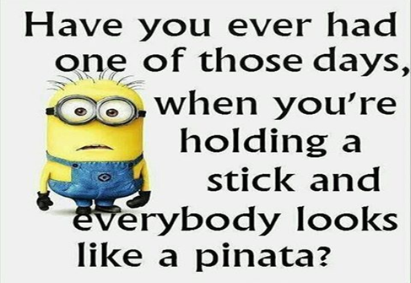
Dangers of Anxiety
The Danger of Giving Up (1:5)
“No man shall be able to stand before you all days of your life; as I was with Moses..will be with you. I will not leave you nor forsake …”
  Seems They May Have Given Up, But God Reassured Them.
The Danger of Falling Short (1:6)
“Be strong /good courage, for to this people you shall divide as an inheritance the land which I swore to their fathers to give them”
  The Inheritance Is the Land that God Promised.

Slide 12
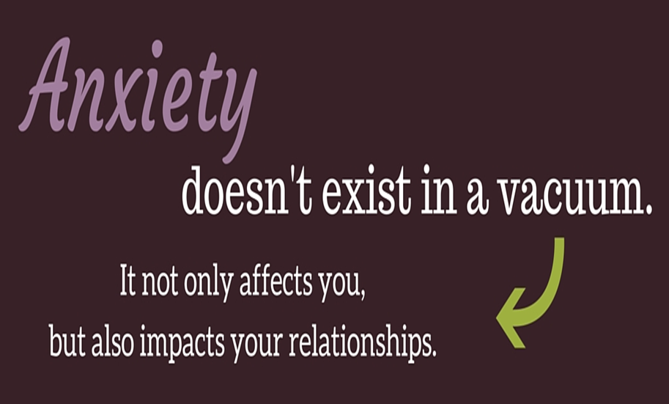
Attack Panic
Joshua 1:8 (KJV)
This book of the law shall not depart out of thy mouth; but thou shalt meditate therein day and night, that thou mayest observe to do according to all that is written therein: for then thou shalt make thy way prosperous, and then thou shalt have good success.
The Power of …
Meditation = to mutter under breath- talk to self
  Healthy Self-Talk (builds faith)
Reverse Meditation = Worry
  Unhealthy Self-Talk (deteriorates faith)

Slide 13
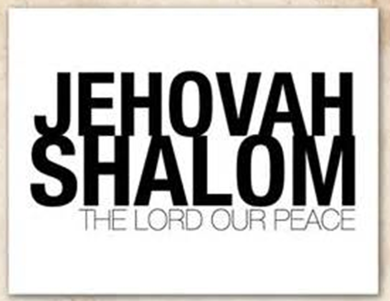
Gives You Power to “Put Your Mind At Ease”
Philippians 4:6-7-⁶ Be careful for nothing; but in every thing by prayer and supplication with thanksgiving let your requests be made known unto God. ^{7:} And the peace of God, which passeth all understanding, shall keep your hearts and minds through Christ Jesus.
Matthew 11:28- ²⁸ Come unto me, all ye that labour and are heavy laden, and I will give you rest. ²⁹ Take my yoke upon you, and learn of me; for I am meek and lowly in heart: and ye shall find rest unto your souls. ³⁰ For my yoke is easy, and my burden is light.
    Jehovah-Shalom= "the Lord is Peace"

Slide 14
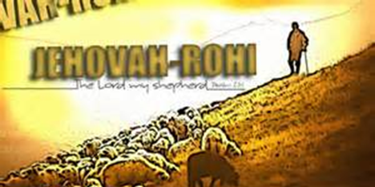
Gives You Power to “Put Your Trust In Him”
Psalm 62:8- “Trust in him at all times; ye people, pour out your heart before him: God is a refuge for us. Selah”
Trust= Him in Every Situation
Talk= to Him about Every Situation
  Jehovah Rohi = “the Lord is Our Shepherd”

Slide 15
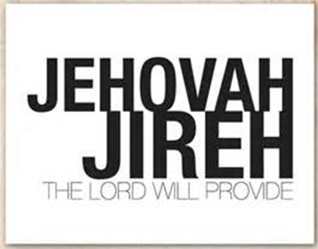
Gives Power to “Transfer All Your Burdens To Him”
Psalm 62:8- Trust in him at all times; ye people, pour out your heart before him: God is a refuge for us. Selah. -
Psalm 55:22- Cast thy burden upon the LORD, and he shall sustain thee: he shall never suffer the righteous to be moved.
I Peter 5:7- Casting all your care upon him; for he careth for you
  Jehovah-Jireh= "the Lord, my Provider"

Slide 16
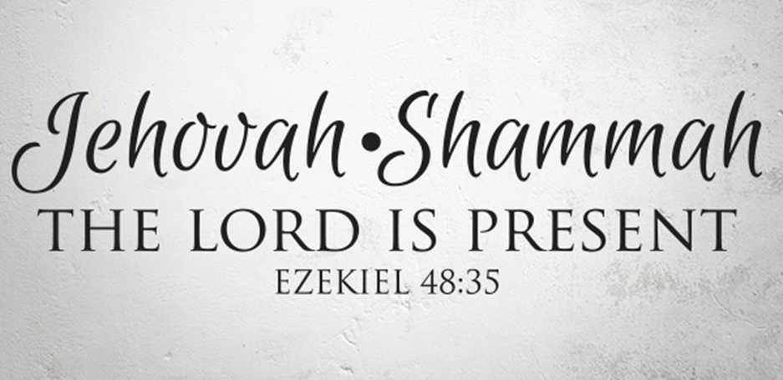
Gives You Power to “Practice His Presence”
Psalm 61:1-2- “Hear my cry, O God; attend unto my prayer.
² From the end of the earth will I cry unto thee, when my heart is
overwhelmed: lead me to the rock that is higher than I.”
    Jehovah Shammah = “the Lord is There”

Slide 17

Gives You Power to “Stand”
Joshua 1:9- Have not I commanded thee? Be strong and of a good courage; be not afraid, neither be thou dismayed: for the LORD thy God is with thee whithersoever thou goest.
Hebrews 13:6 - So that we may boldly say, The Lord is my helper, and I will not fear what man shall do unto me
  Jehovah Nissi = “The Lord Is Our Banner”

Slide 18
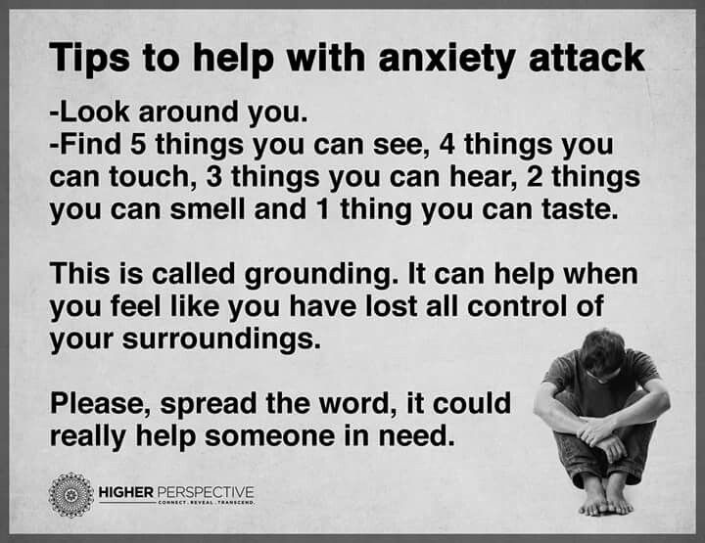

Slide 19
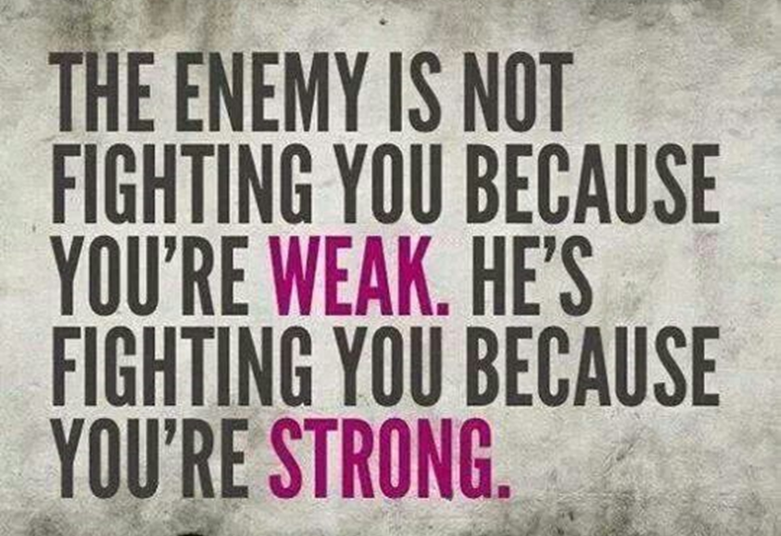
Joshua 1:8 (KJV)
This book of the law shall not depart out of thy mouth; but thou
shalt meditate therein day and night, that thou mayest observe to
do according to all that is written therein: for then thou shalt make
thy way prosperous, and then thou shalt have good success.

Slide 20
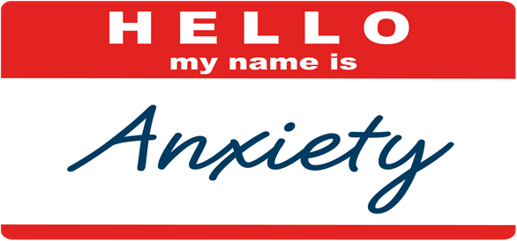


Slide 21
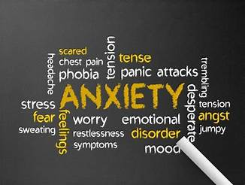
As We Conclude Today,
Reflect On Areas Of Your Life Where Anxiety has Taken Hold.
Remember, God Is Not Only Aware Of Your Struggles
But , Actively Working to Bring Peace Into Your Life.
Jesus Said, "In This World, You Will Have Trouble. But Take Heart! I Have Overcome The World” (John 16:33, NIV).
Let Us Choose To Focus On Him
Knowing He Cares For Us Deeply.

Slide 23
A woman isn't feeling well and goes into Urgent Care:
Nurse: "have you experienced a sudden loss of taste?"
Patient: "No, I've always dressed this way.“
>>>Today's Thot
Children are like pancakes. The first one always comes out a little weird.

